Slide 1
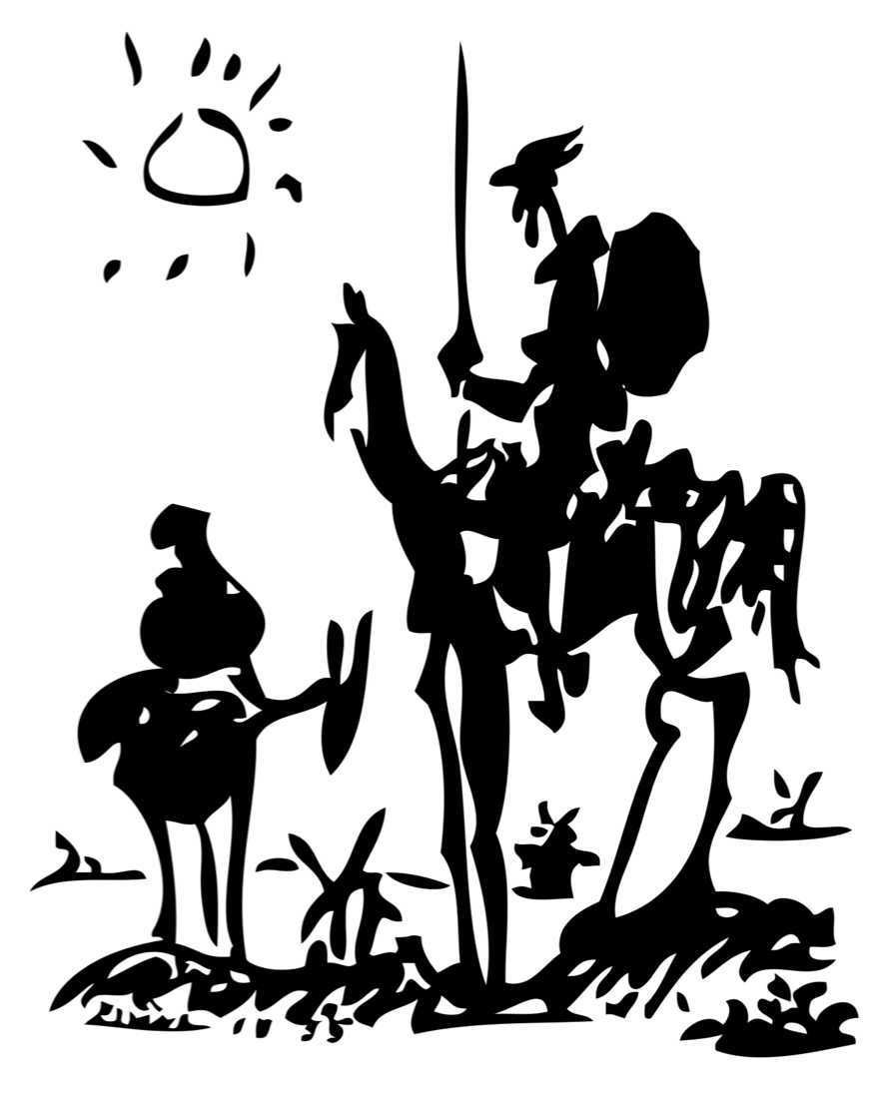
Don Quixote
Great VC?
Notes:
So this is the 1955 sketch by Picasso of…
Don Quixote…
You all know the protagonist in the 1605 novel The Indigenous Gentleman Don Quixote of La Mancha – from whom the saying “tilting at windmills” came from. Hidalgo (spanish cowboy) Alonso Quijano sets out to revive chivalry on a skinny horse with a lance...and antics pursue…in one of the most famous incidents, he mistake the windmills he passes on his equally aging horse for ferocious giants – and so came about the saying to describe people who react overly to something…
Another, perhaps contrarian, way to look at it is that: he saw things most others did not. And therefore he might have been…
Successful VC’s are this same way – and the difference between crazy and creative is a very thin line as well as generally only determinable afterwards…
In fact, everything you look for in most areas of life – calm, predictable, non-impulsive - is a negative indicator for a venture capitalists success.
While I have almost certainly overly pressed this metaphor …it has a ring of truth – most investments we make, when we make them, should seem at minimum curious to you all – if not downright odd…because we are trying to partner with entrepreneurs who are seeking to accomplish things that the world, at that time, thinks can not be done…
The trick is whether, several years thereafter, we will have solved the problem and the world will give a hoot. If both of those come true, we will have created a very valuable company.

Slide 2
Healthcare Focus Evolution
1998 - 2002
2008 - Today
20
26
Investments
57
60%
96%
Early Stage
20
Early
Late
Biotech/Devices
Health IT
Late
Early
20%
65%
Therapeutics
65

