Slide 1

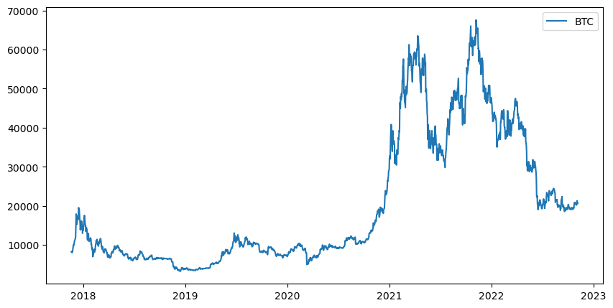
Journey on Price Correlation of Bitcoin

Slide 2
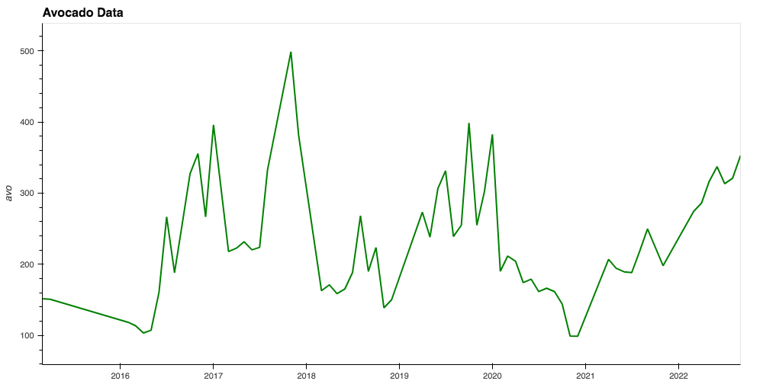
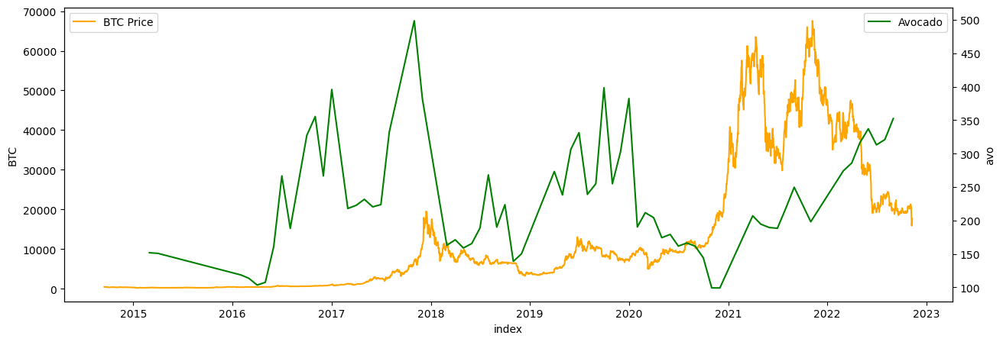
Price Correlates
Avocados
iShares US Technology ETF (IYW)
West Texas Intermediate (WTI Oil)
S&P 500 ETF (SPY)
Gold
Google Search Trends

Slide 3
The Data Collection Process
Data collecting via Google Sheet with "Yhfinance" add-on, and Pytrends API
Reading data and cleaning was done inside a Juypter Notebook using Pandas, Numpy, Python, Hvplot, matplotlib, and plotly.express.

Slide 4
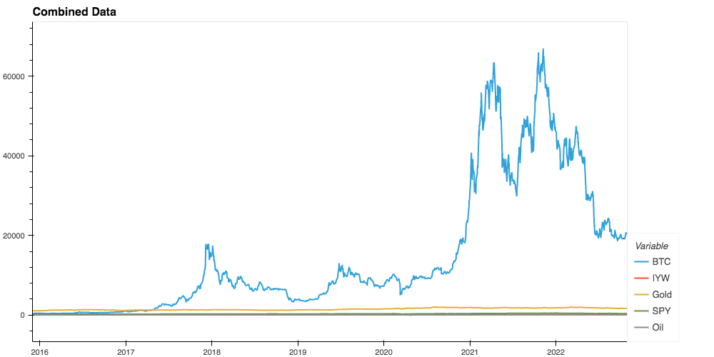
Data Cleaning
Concated all dataframes into a single dataframe

Slide 5
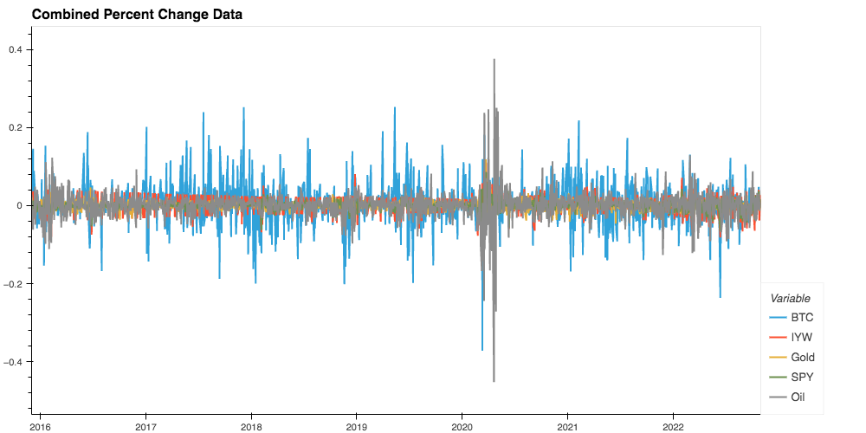
Calculated Percentage Change

Slide 6
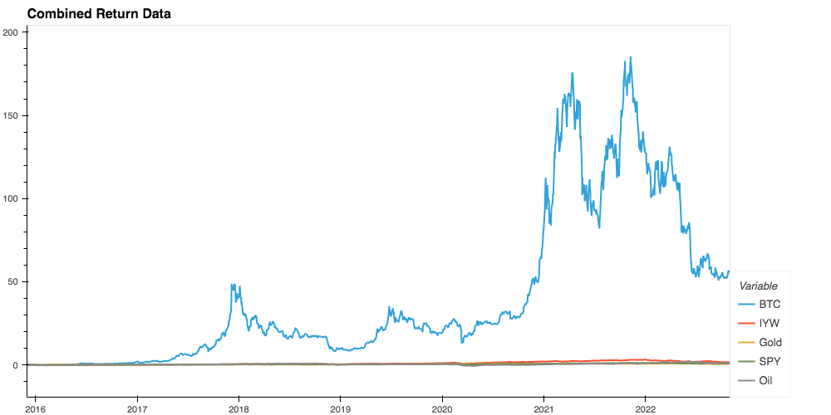
Calculated Cumulative Returns

Slide 7
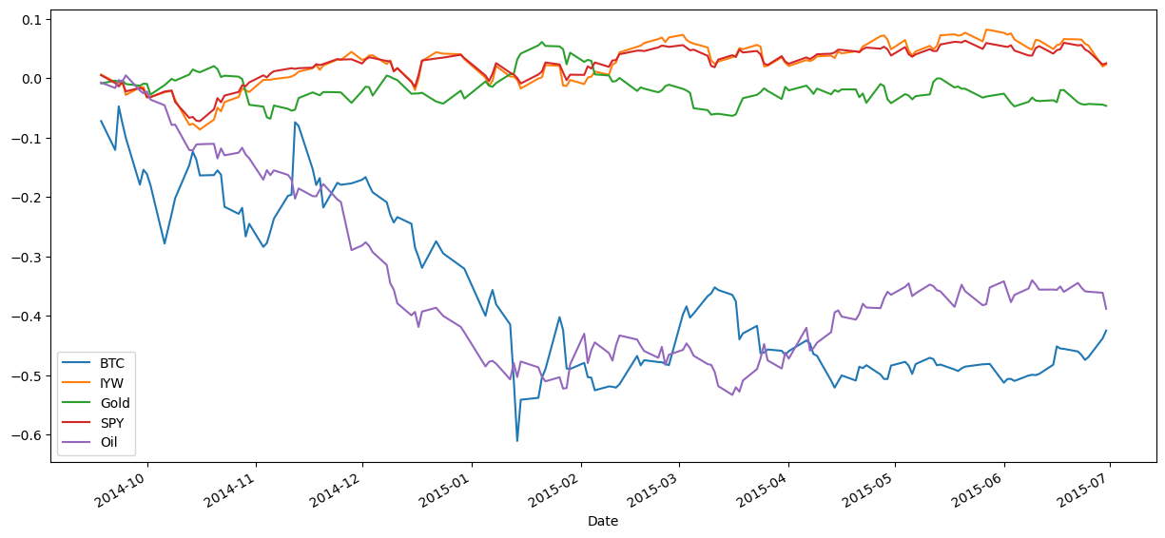
Narrowed Timeframe for Oil

Slide 8
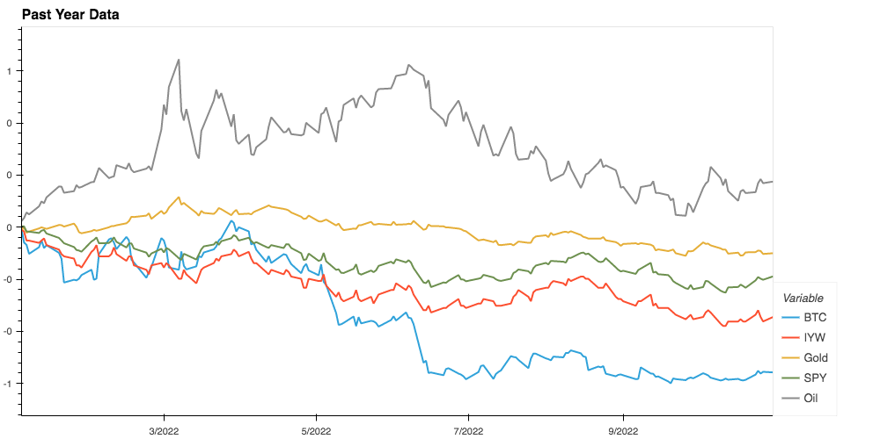
Narrowed Timeframe For Tech Stock

Slide 9
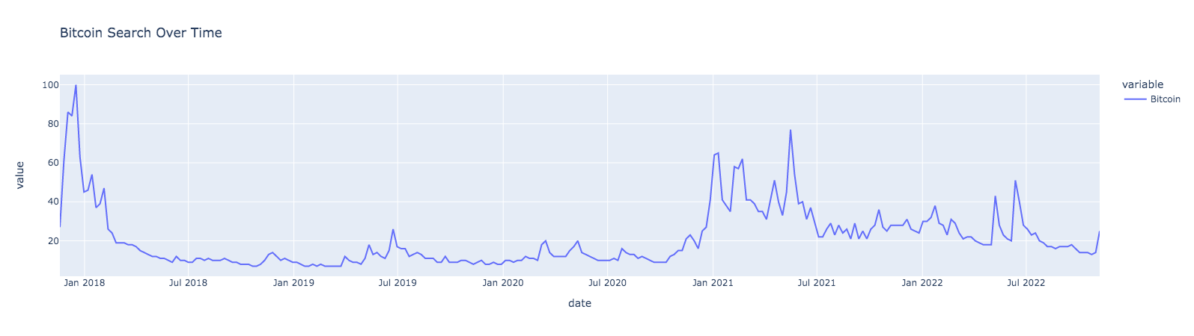
Google Search Trends

Slide 10
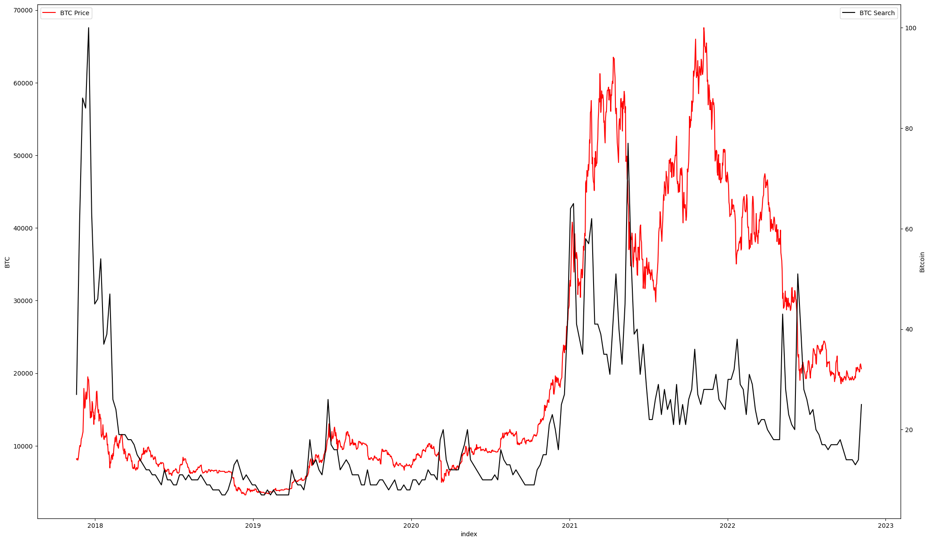
Google Search Trends Overlayed Bitcoin Price

Slide 11
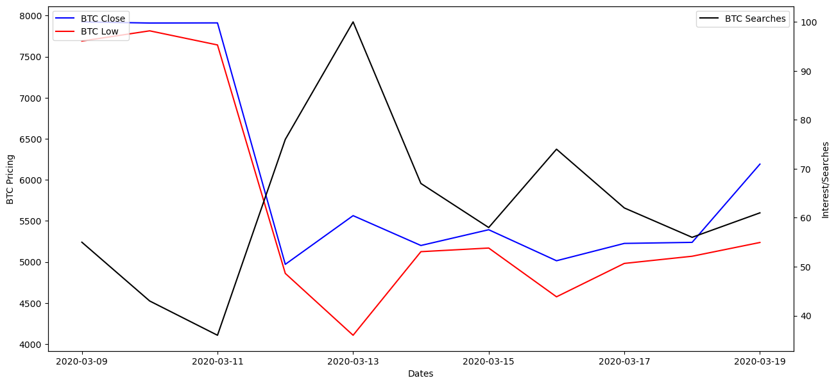
Google Search 2020-03-09 To 2020-03-19

Slide 12
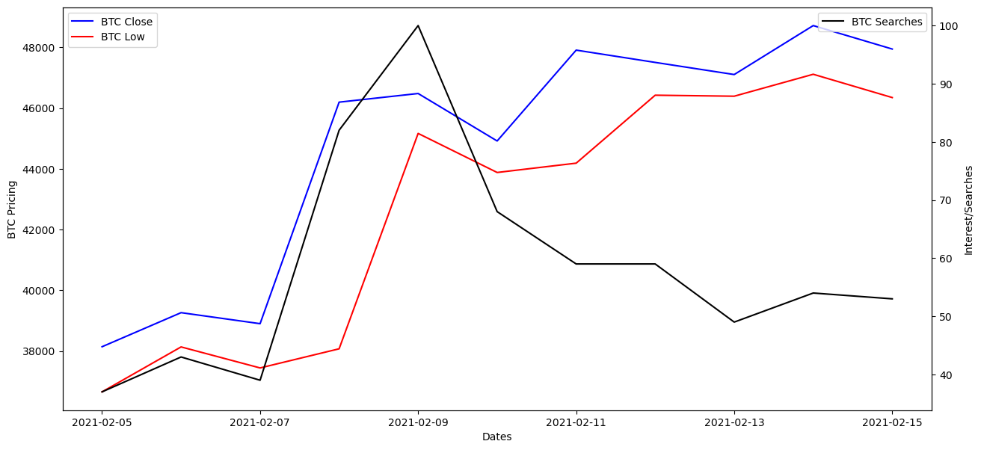
Google Search 2021-02-05 To 2021-02-15

Slide 13
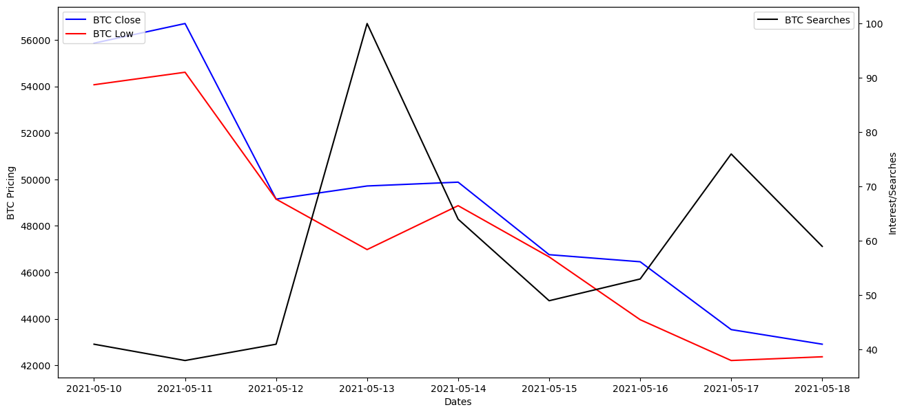
Google Search 2021-05-10 To 2021-05-18

Slide 14
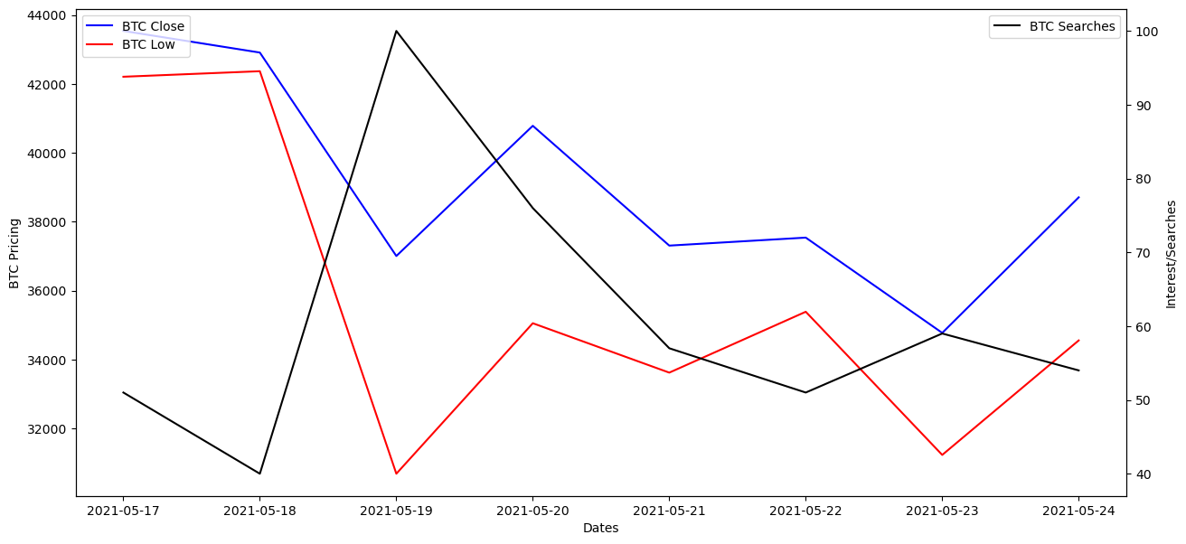
Google Search 2021-05-17 To 2021-05-24

Slide 15
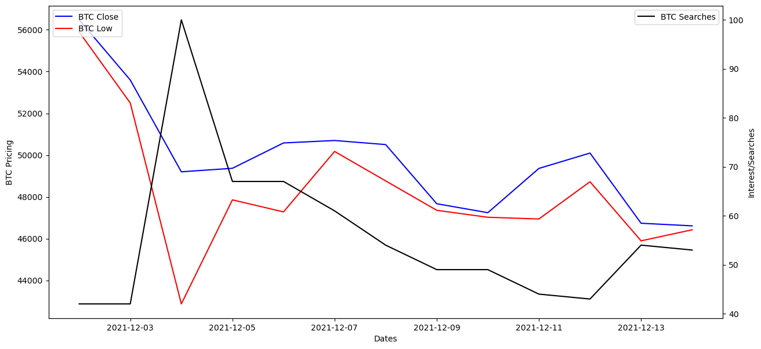
Google Search 2021-12-02 To 2021-12-14

Slide 16
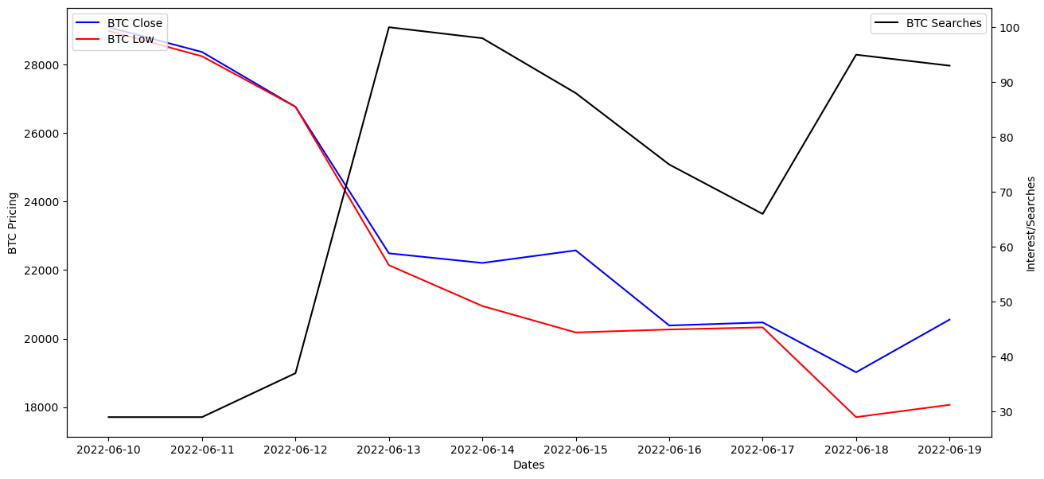
Google Search 2022-06-10 To 2022-06-19

Slide 17
Conclusion
Only with in the past couple years has a correlation between stocks and Bitcoin begun to be seen
2021 brought an increase in institutional investment and VC firm investment could be the cause.
In Oct 2014 there was some correlation with oil but diverged by Jun 2015
Bitcoin’s correlations tend to move to different industries over time.
Using the Pytrends Api we where able to see price movement around searches for Bitcoin.
The price movements and search trends can normally be traced back to major events.
Github repository https://github.com/Olegreg762/group_project_1

