Slide 1

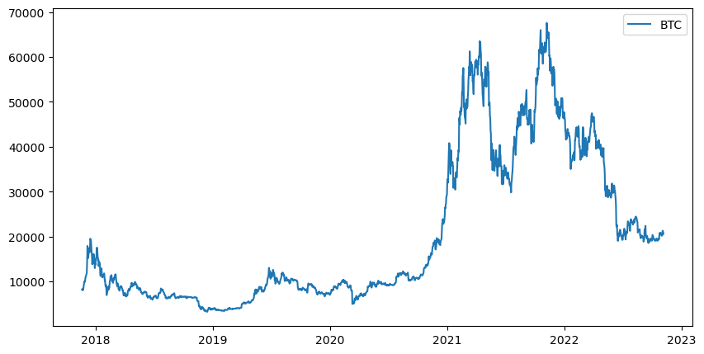
Journey on Price Correlation of Bitcoin

Slide 2
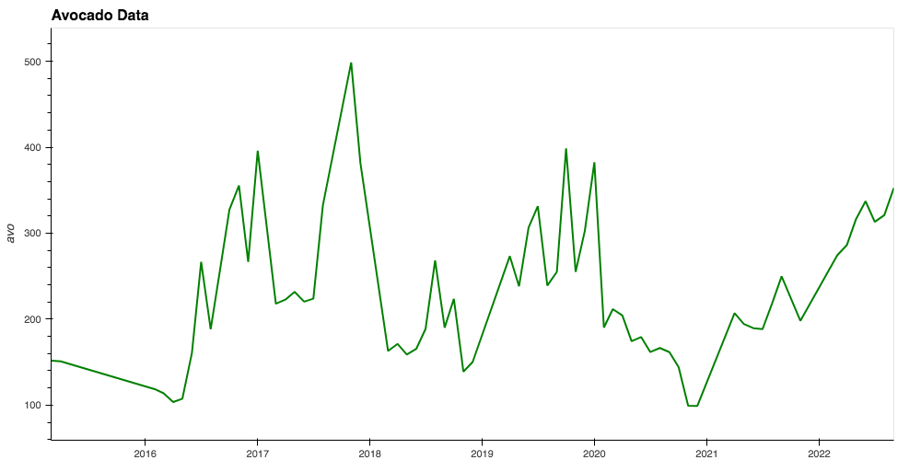
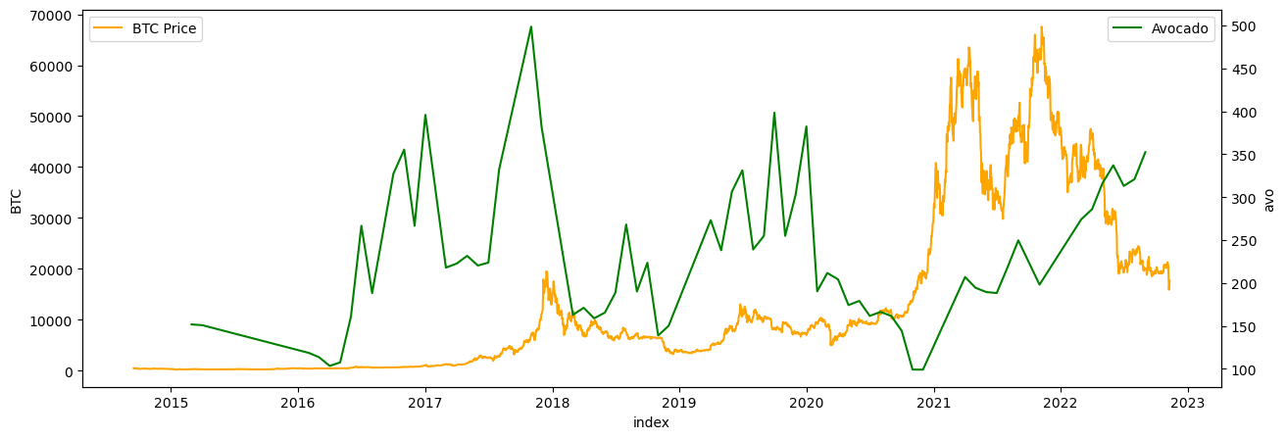
Price Correlates
Avocados
iShares US Technology ETF (IYW)
West Texas Intermediate (WTI Oil)
S&P 500 ETF (SPY)
Gold
Google Search Trends

Slide 3
The Data Collection Process
Data collecting via Google Sheet with "Yhfinance" add-on, Pytrends API, and Alpaca API
Reading data and cleaning was done inside a Juypter Notebook using Pandas, Numpy, Python, Hvplot, matplotlib, and plotly.express.

Slide 4
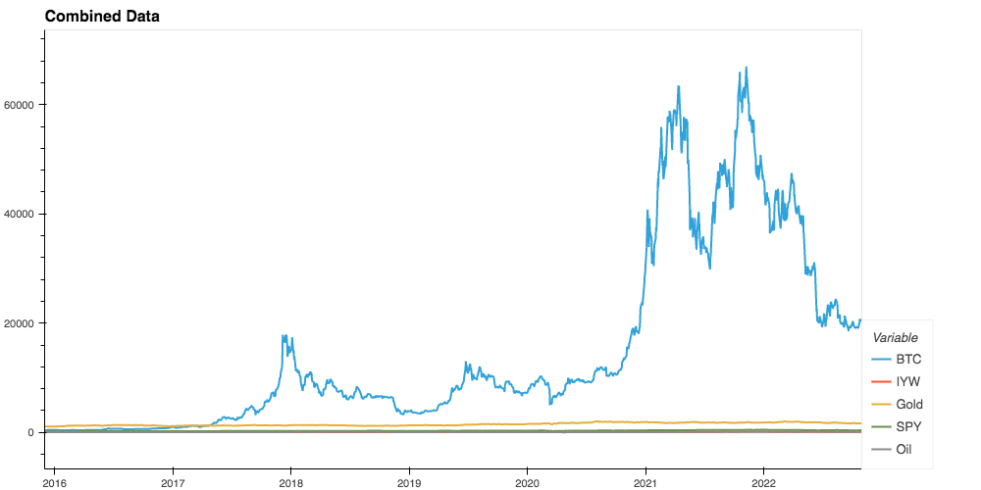
Data Cleaning
Concated all dataframes into a single dataframe

Slide 5
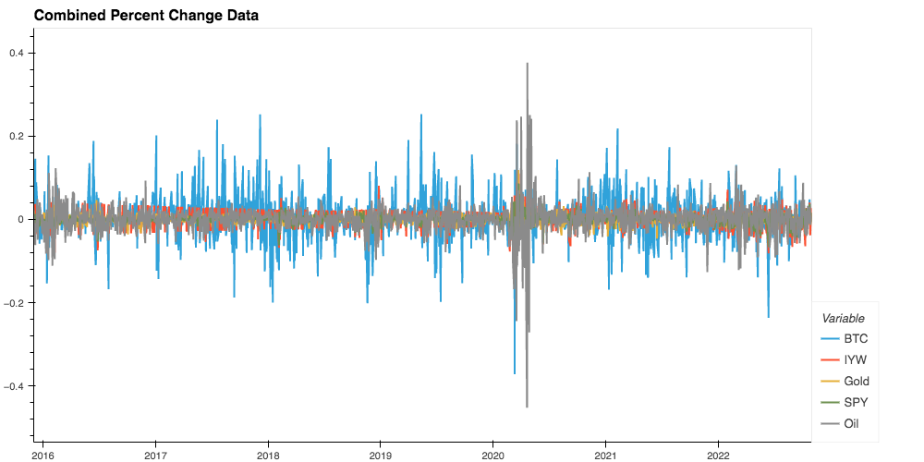
Calculated Percentage Change

Slide 6
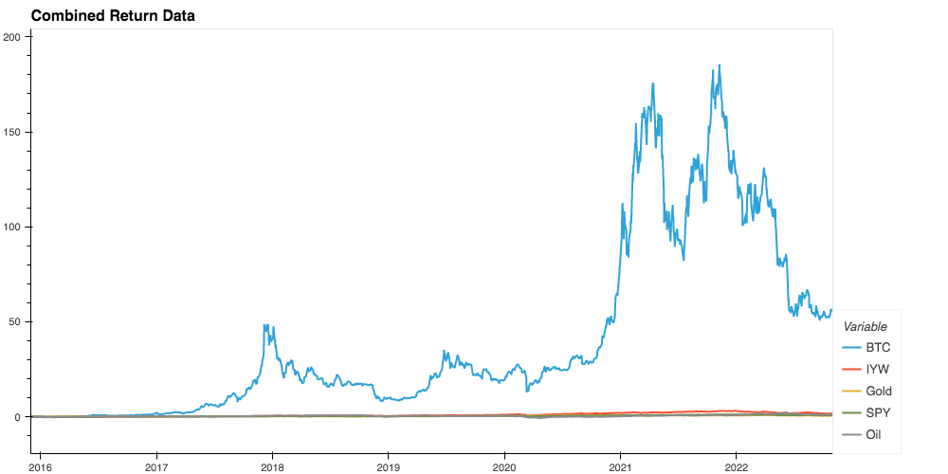
Calculated Cumulative Returns

Slide 7
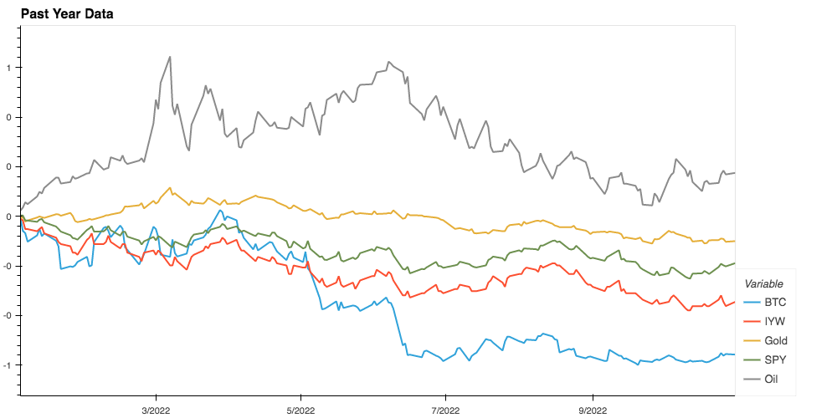
Narrowed Timeframe

Slide 8
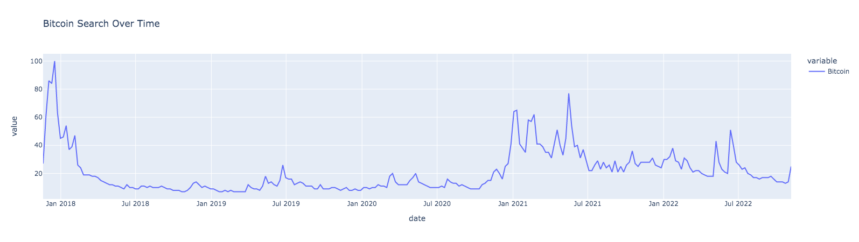
Google Search Trends

Slide 9
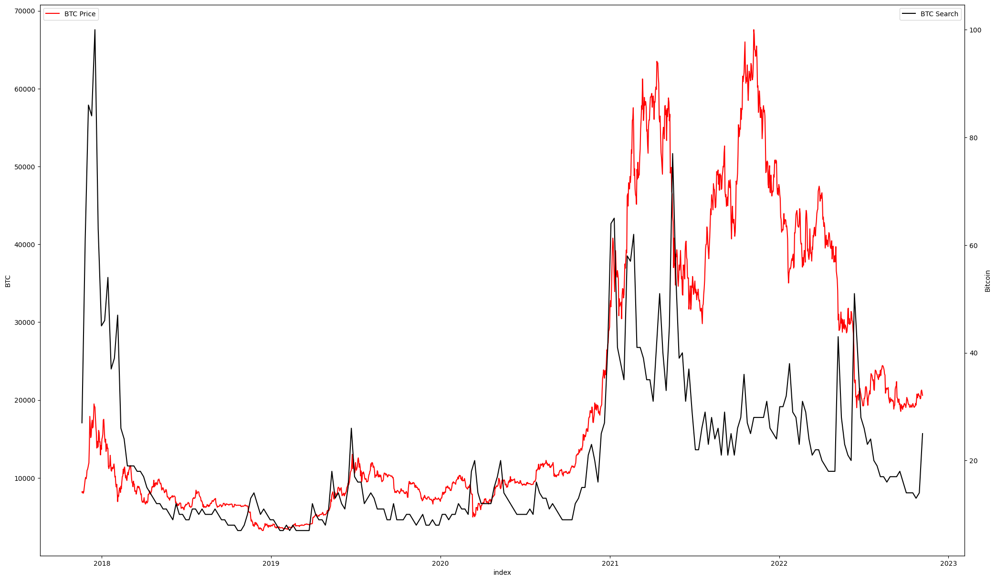
Google Search Trends Overlayed Bitcoin Price

Slide 10
Conclusion
Only with in the past couple years has a correlation between stocks and Bitcoin begun to be seen
In 2021 the increase in institutional investment and VC firm investment could be the cause.
Using the Pytrends Api we where able to see price movement around searches for Bitcoin.
The price movements and search trends can normally be traced back to major events in the cryptocurrency world.

