Slide 1
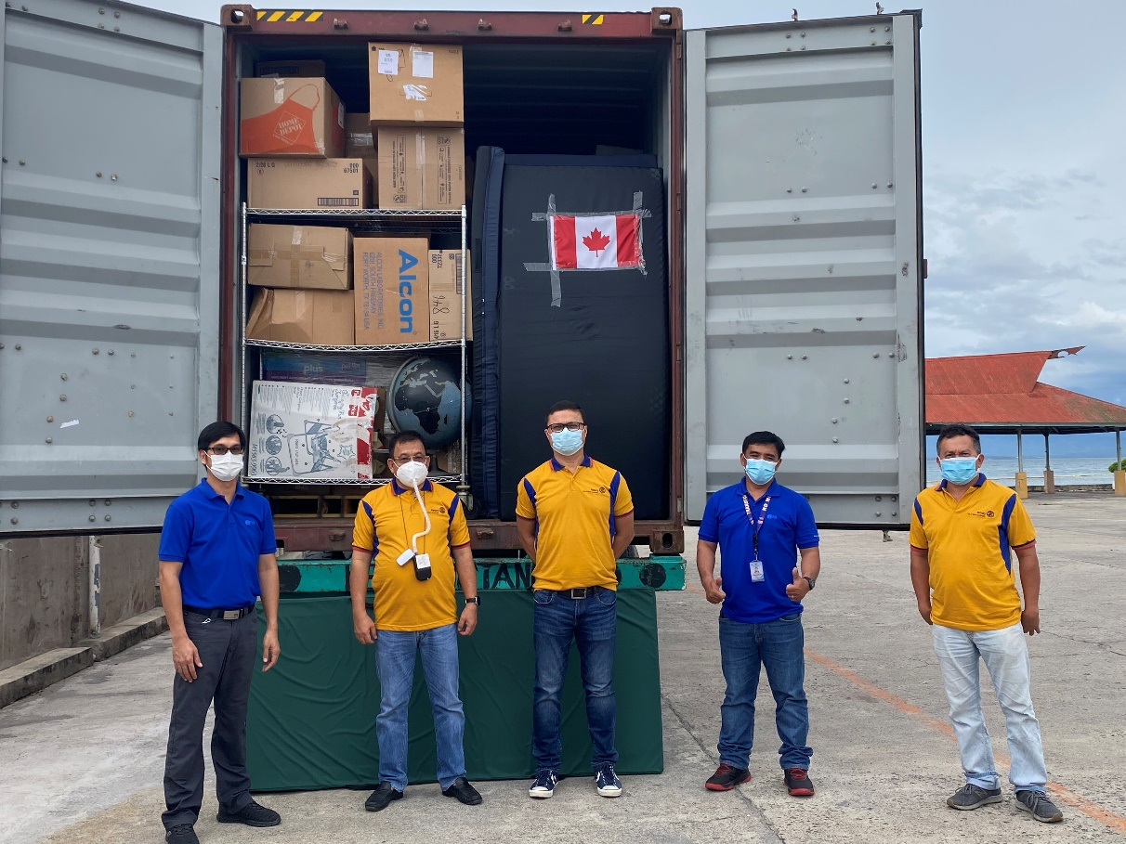
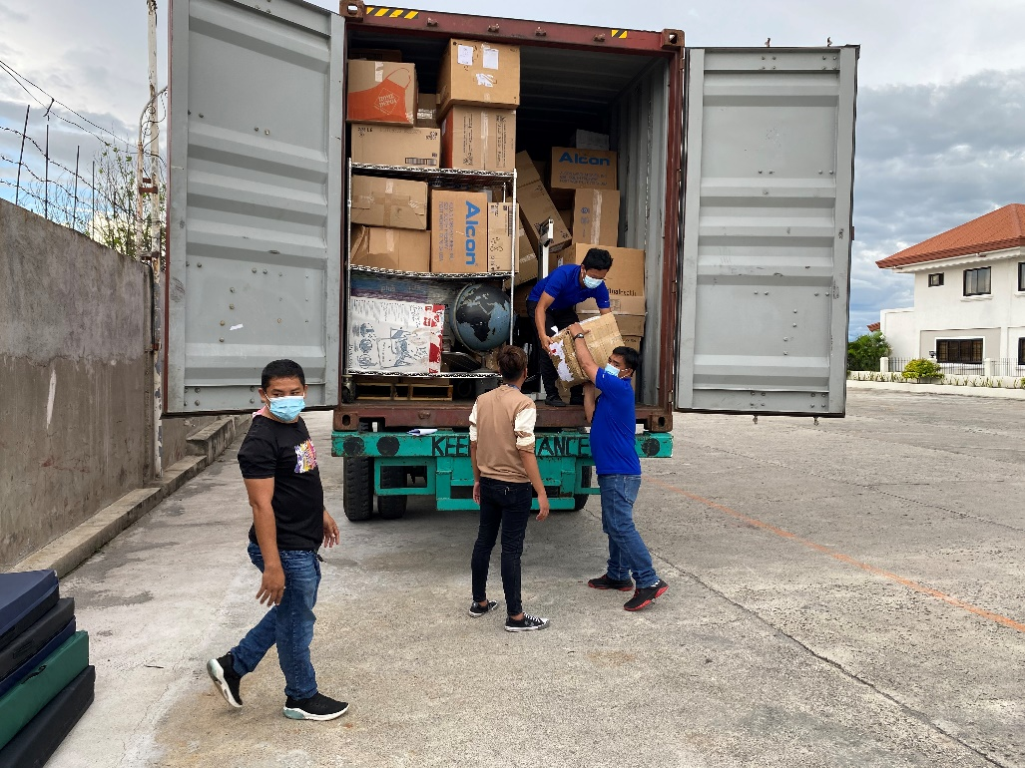
ROTARY WORLD HELP
Container Project 20-06
- Received 1 container last January

Slide 2
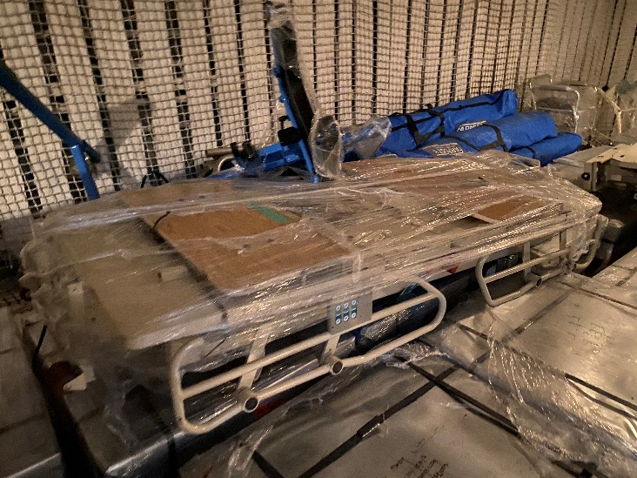
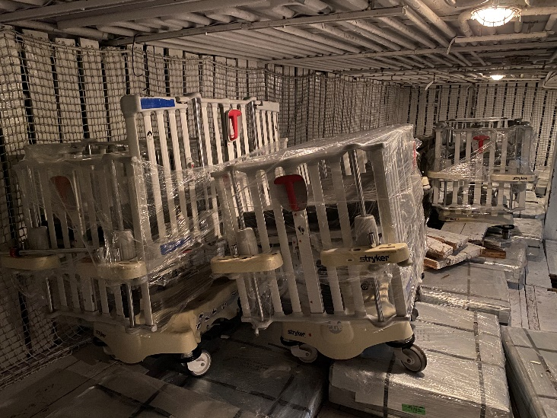
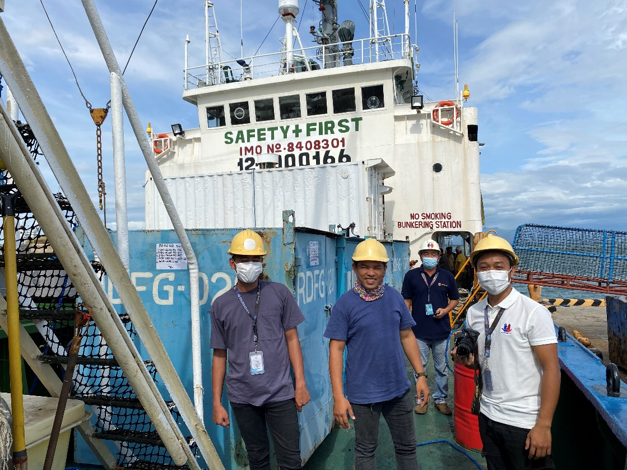
Special Projects
ROTARY WORLD HELP
Most of the items were shipped to PNG for donation

Slide 3
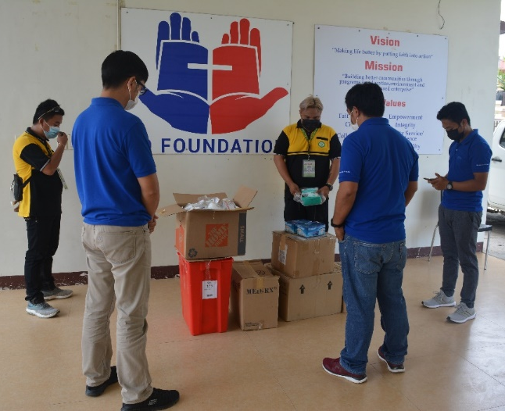
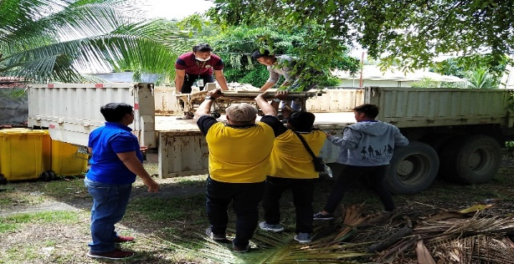
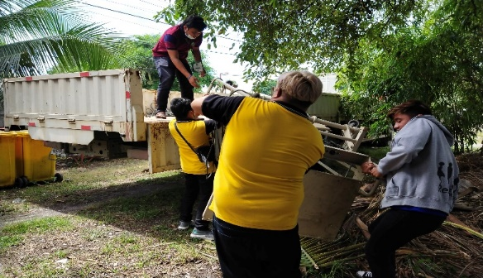
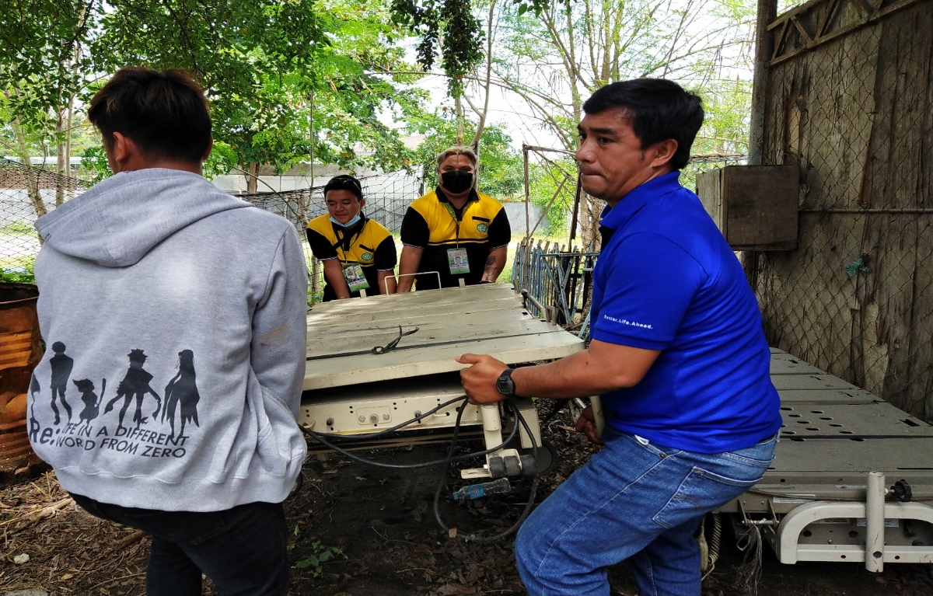
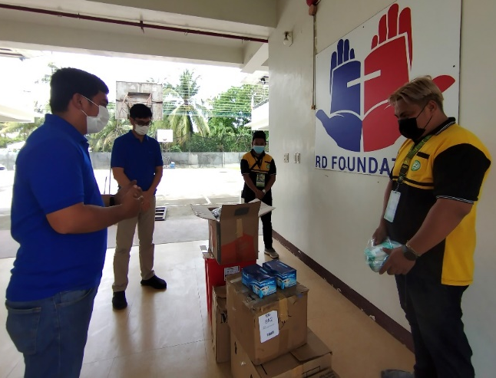
Turn over Hospital Equipment & Supplies to Davao Occidental Provincial Hospital
Surgical Face Mask-800 pcs
KN95- 800 pcs
Surgical Hoods- 200 pcs
Exam & Cleaning Gloves- 3,700 pairs
Bed Pans- 90 pcs
Face Shield- 80 pcs
Foot Cover- 50 pcs
Beds & Mattresses- 4pcs
Drug Cart

Slide 4
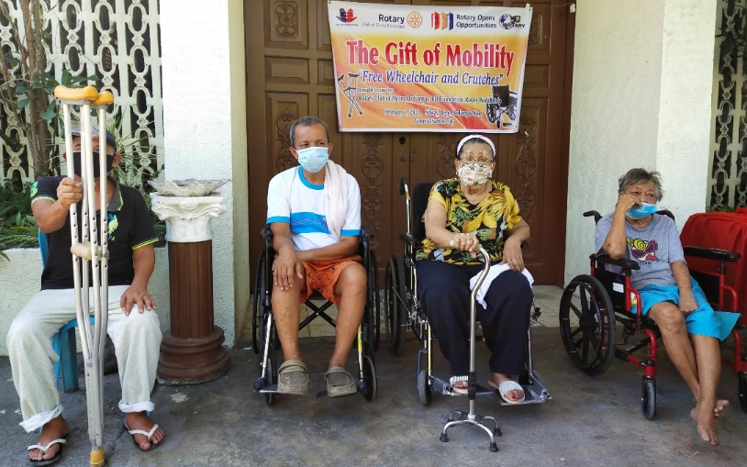
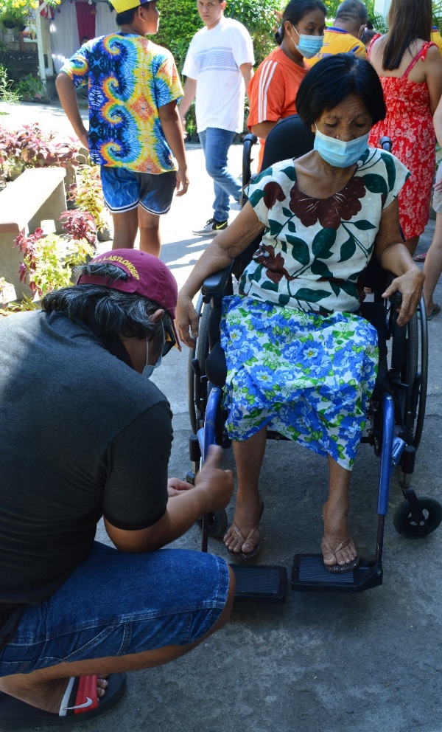
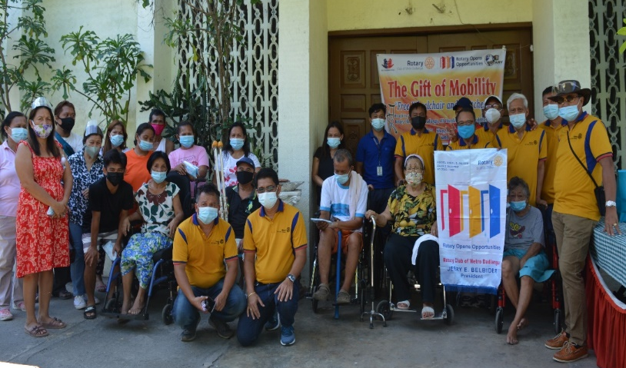
Surgical Face Mask- 400 pcs
KN95- 100 pcs
Surgical Hoods- 44 pcs
Exam & Cleaning Gloves- 1,689 pairs
Bed Pans- 90 pcs
Face Shield- 20 pcs
Foot Cover- 32 pcs
Beds- 4pcs
Bed Pans 170 pcs
Mattresses- 10 pcs
Wheel Chairs- 6 pcs
Examination Tables- 3 pcs
Bundles of Linens- 12 pcs
Bedside Tables- 4 pcs
Elem. Books- 50 Boxes
Turn over Hospital Equipment & Supplies by Rotary Club of Metro Dadiangas

Slide 5
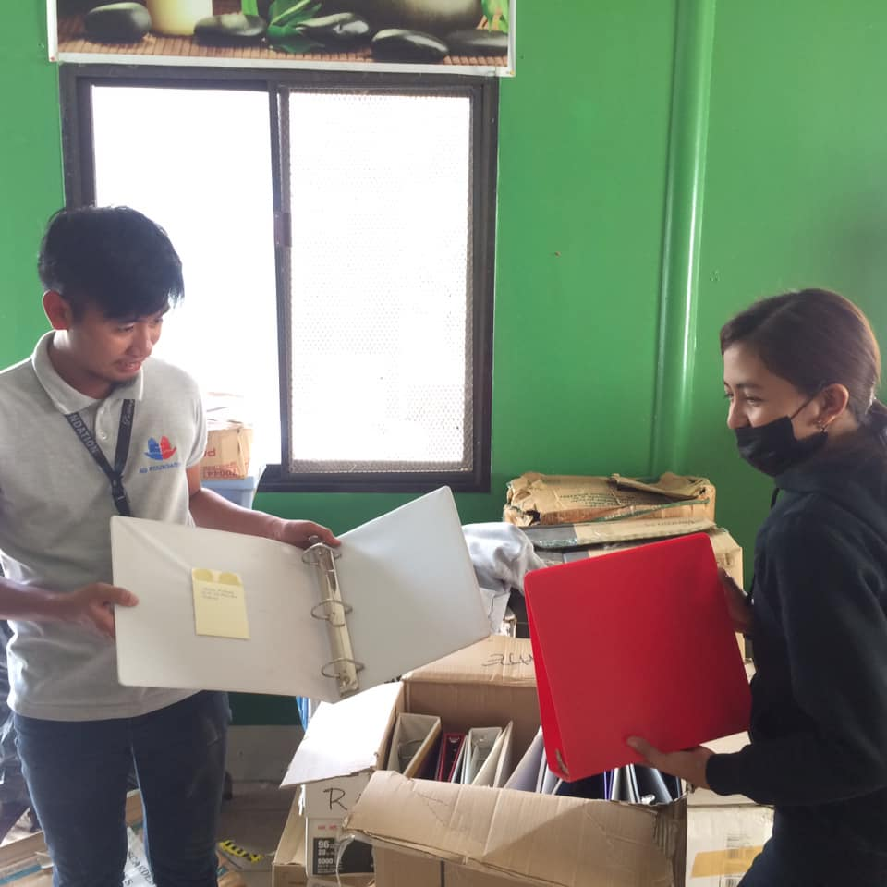
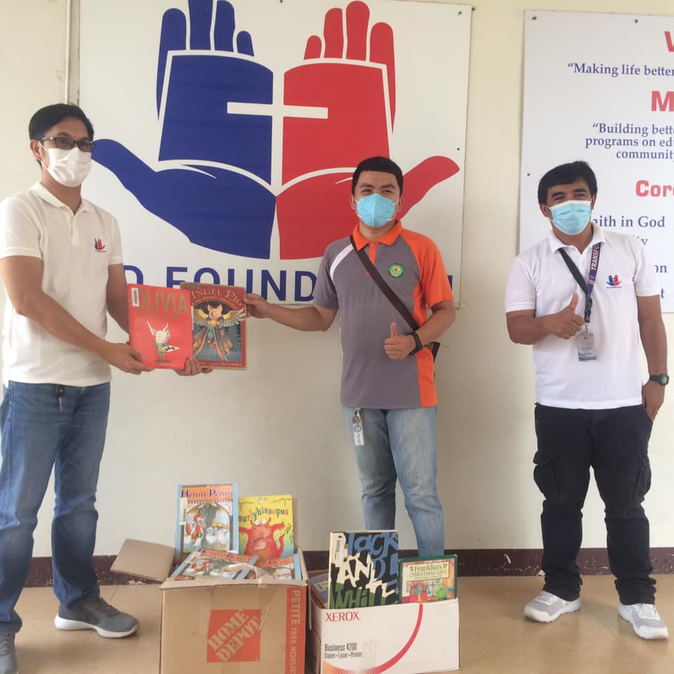
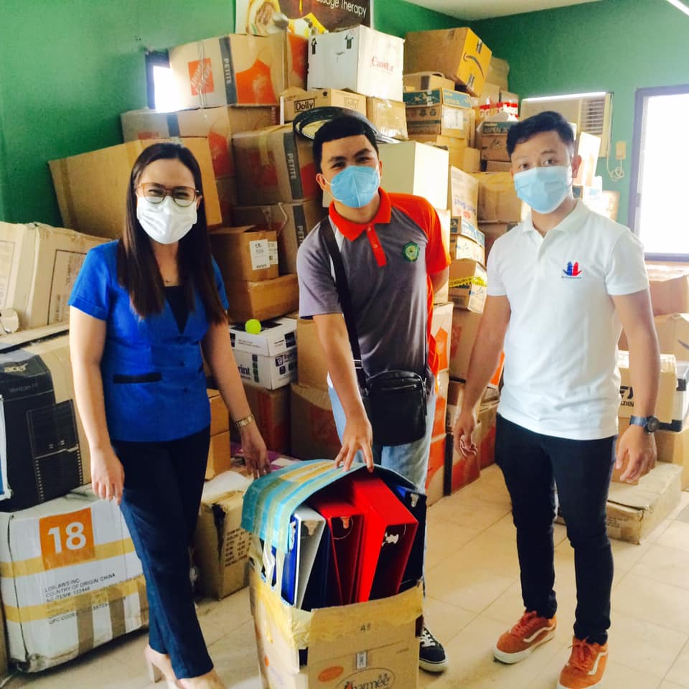
Turn over around 9,000 pieces of books to partner school beneficiaries
Silway 8 Elementary School

Slide 6
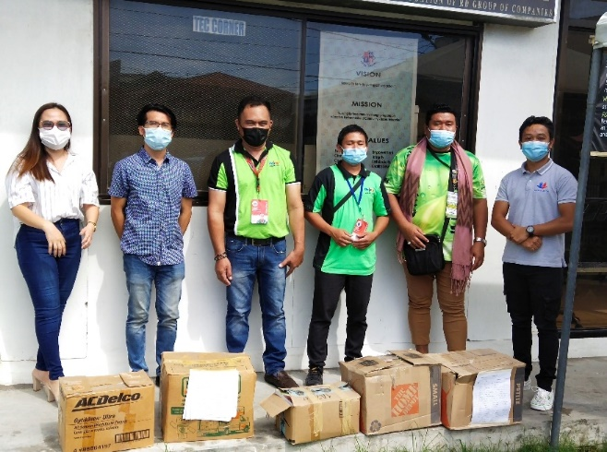
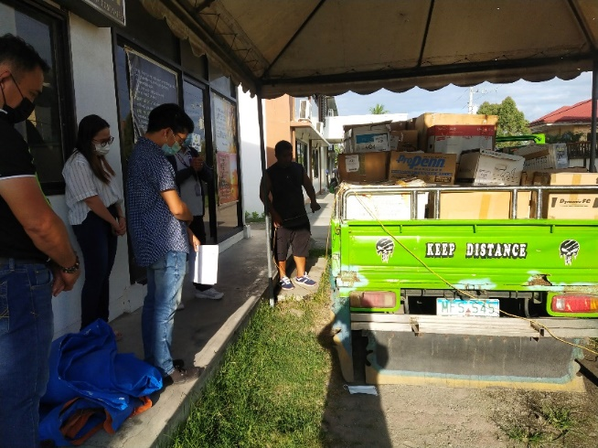
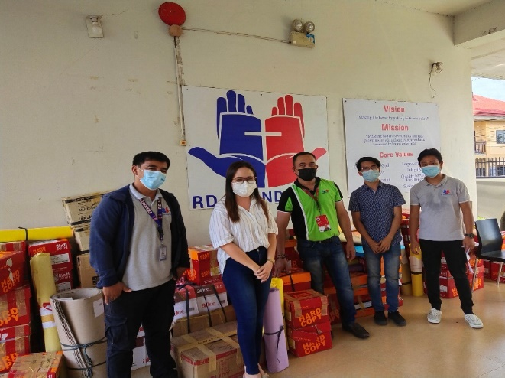
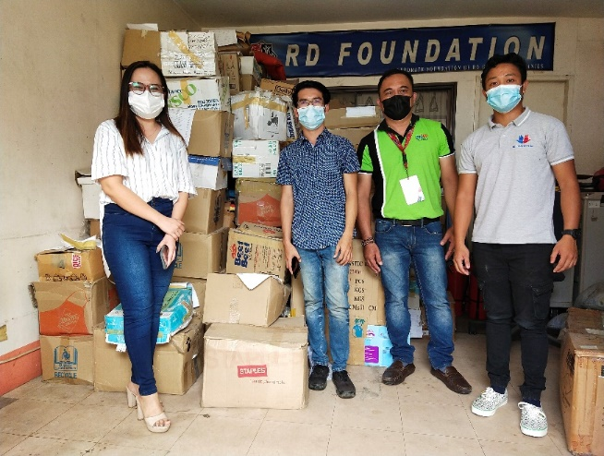
Malapatan Central Elem. School

Slide 7
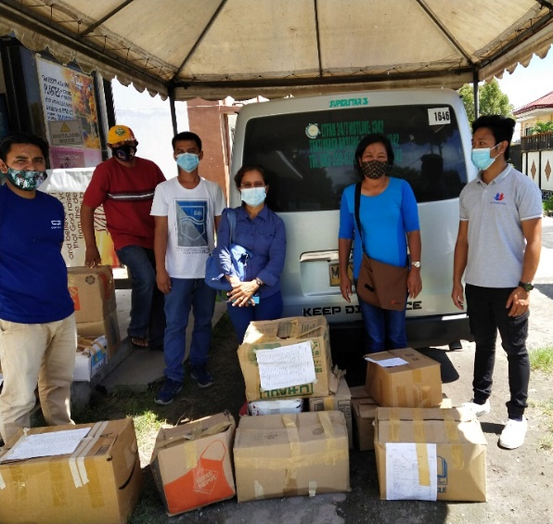
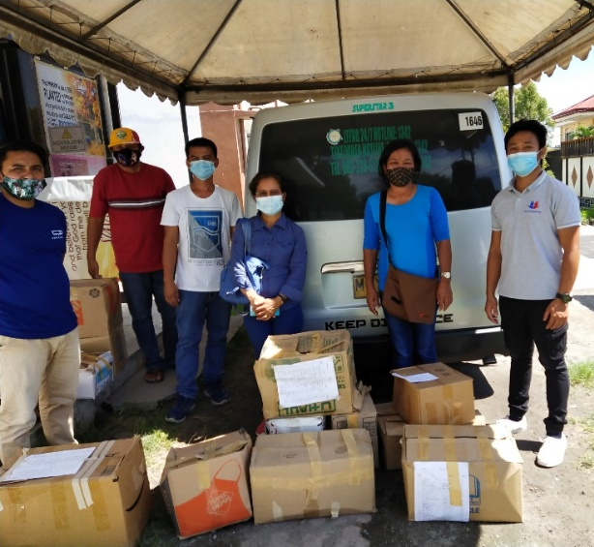
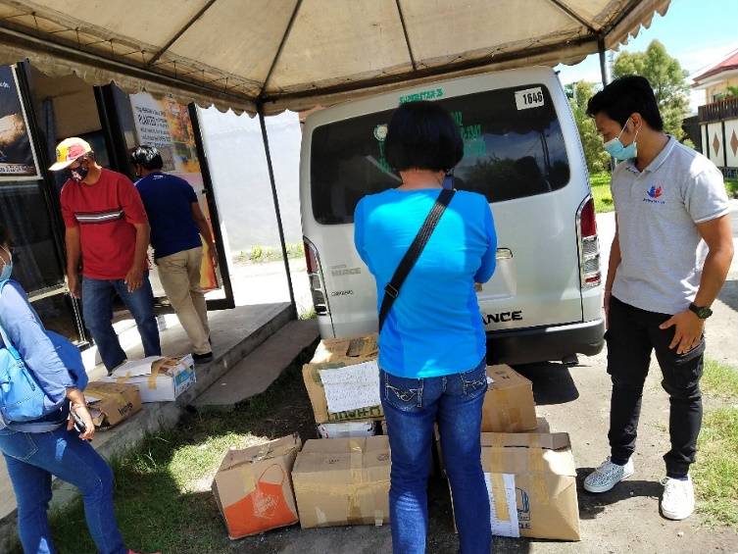
Kiamba Central School SPED Center

Slide 8
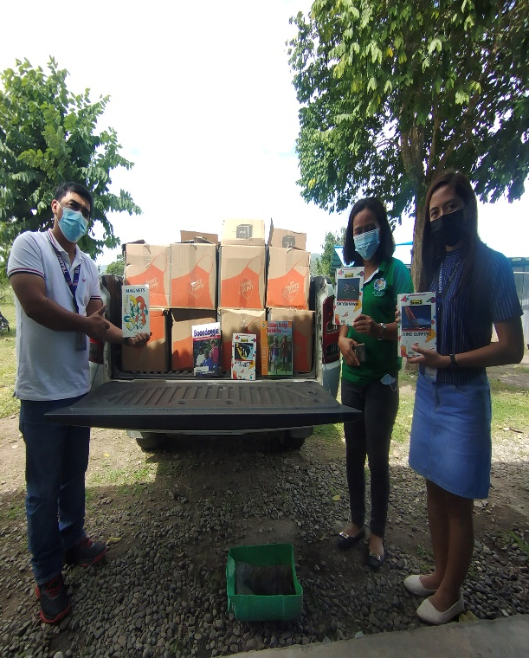
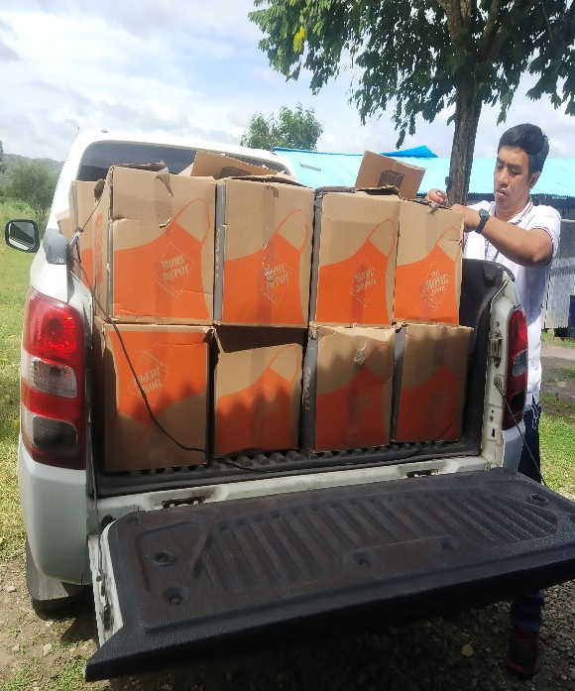
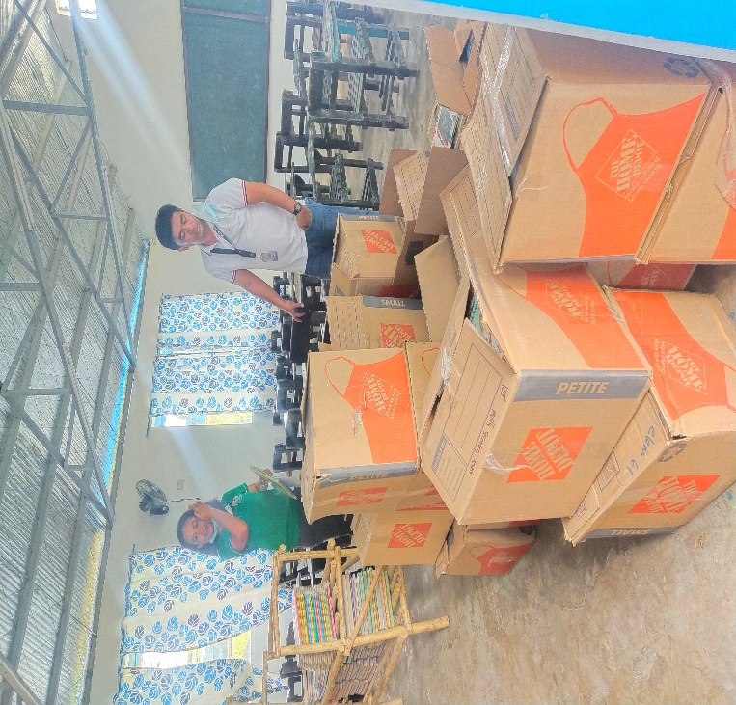
Colot Aligado IP School

Slide 9
Thank you and God bless!
“And whatever you do, whether in word or deed, do it all in the name the Lord Jesus, giving thanks to God the Father through Him” Collosians 3:17

