Slide 1
.NET Lab #9 Lecture Kopylets Mykhailo, RD, Lviv
Entity
Framework Core
vs Dapper
May, 2019

Slide 2
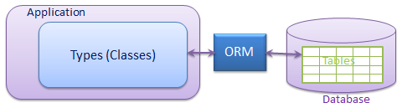
Object Relational Mapping
ORM is a programming technique for converting data between incompatible type systems in object-oriented programming languages
Generates code for you to map your Relational data model into object-oriented classes (entities) that are strongly typed (concrete).

Slide 3
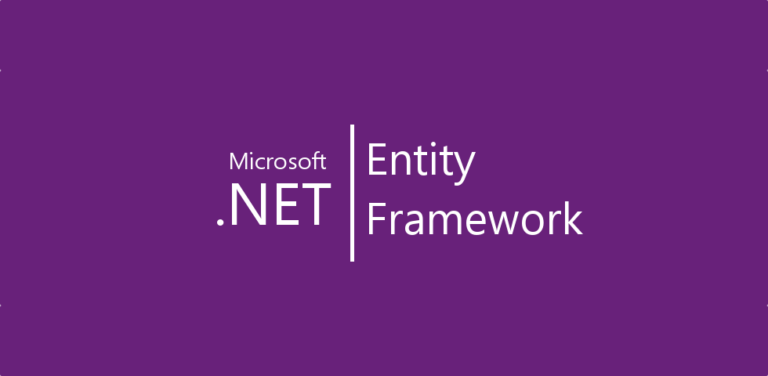
Entity Framework Core
Entity Framework is an Object/Relational Mapping (O/RM) framework. It is an enhancement to ADO.NET that gives developers an automated mechanism for accessing & storing the data in the database.
generates strongly-typed entity objects that can be customized beyond 1-1 mapping
generates mapping/plumbing code
translates LINQ queries to database queries
materializes objects from data store calls
tracks changes, generating updates/inserts

Slide 4
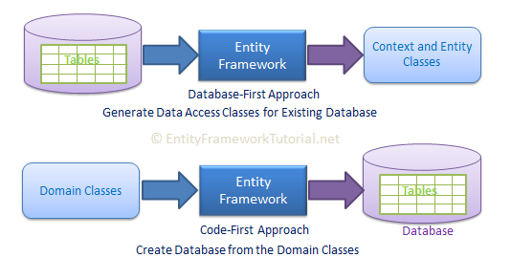
Entity Framework approaches
Entity Framework Core supports two different development approaches to use entity framework in your application.
Code first
Database first(Scaffold-DbContext)

Slide 5
Conventions
EF was able to create a DB based on the model because it uses conventions!
Convention is a set of default rules to automatically configure a conceptual model based on domain class definitions when working with Code-First.
Primary Key Convention
If a property on a class is named “ID” or ID:
public int DepartmentID { get; set; }
Type Discovery
Code-First includes types defined as a DbSet property in context class.
Code-First includes reference types included in entity types even if they are defined in different assembly.
Code-First includes derived classes even if only the base class is defined as DbSet property.

Slide 6
DataAnnotations
If your classes do not follow any kind of EF conventions, you can use attributes called DataAnnotations.
DataAnnotation is a simple attribute based configuration, which you can apply to your domain classes and its properties.
One of the coolest thing about DataAnnotations is that it’s shared between other frameworks like ASP .Net MVC!
If you set as property as required:
[Required]
public string Title { get; set; }
The DB column will be set as “not null” and the MVC application will perform client side validation, even dynamically building a message using the property and annotation names

Slide 7
DataAnnotations
Here’s the list of the most common DataAnnotations:
Key: Primary key
Required: Not null
MaxLength and MinLength: Obvious ;-)
NotMapped: Not need to be stored
ComplexType: Entity without primary key
ConcurrencyCheck: If someone has modified the data in the meantime, it will fail and throw a DbUpdateConcurrencyException
TimeStamp: Concurrency based on Timestamp
Table and Column: change the name of the tables and columns
DatabaseGenerated: computed properties

Slide 8
Fluent API
Fluent API is another way to configure your domain classes. Fluent API provides more functionality for configuration than DataAnnotations.
Fluent API supports the following types of mappings:
Mappings | To Database
Model-wide Mapping | Set default Schema Set Custom Conversion
Entity Mapping | To Single or Multiple Tables and Schema To Complex type Inheritance Hierarchies
Property Mapping | To Column, Column Name, Column Type, Nullable or Not Null Column, Column size, Columns Order To Foreign key column To configure relationships

Slide 9
Fluent API
All configuration code using Fluent API should be in OnModelCreating method. DbModelBuilder is a main class on which you can configure all your domain classes because at this point, all your domain classes would have initialized.
public class SchoolContext: DbContext { public SchoolDBContext(): base() { } public DbSet<Student> Students { get; set; } public DbSet<Standard> Standards { get; set; } protected override void OnModelCreating(DbModelBuilder modelBuilder) { //Configure domain classes using modelBuilder here base.OnModelCreating(modelBuilder); } }

Slide 10
Fluent API
Map entity to table
Code-First will create the database tables with the name of DbSet properties in the context class - Students and Standards in this case. You can override this convention and can give a different table name than the DbSet properties
public class SchoolContext: DbContext { public SchoolDBContext(): base() { } public DbSet<Student> Students { get; set; } public DbSet<Standard> Standards { get; set; } protected override void OnModelCreating(DbModelBuilder modelBuilder) { //Configure default schema modelBuilder.HasDefaultSchema("Admin"); //Map entity to table modelBuilder.Entity<Student>().ToTable("StudentInfo"); modelBuilder.Entity<Standard>().ToTable("StandardInfo","dbo"); } }

Slide 11
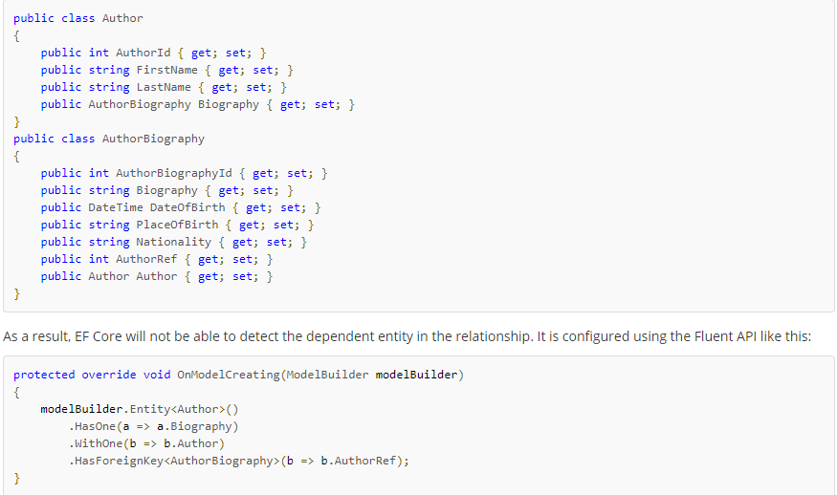
Relationship One To One

Slide 12
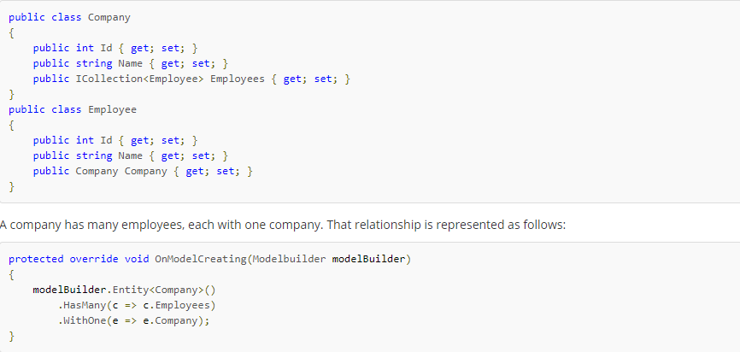
Relationship One To Many

Slide 13
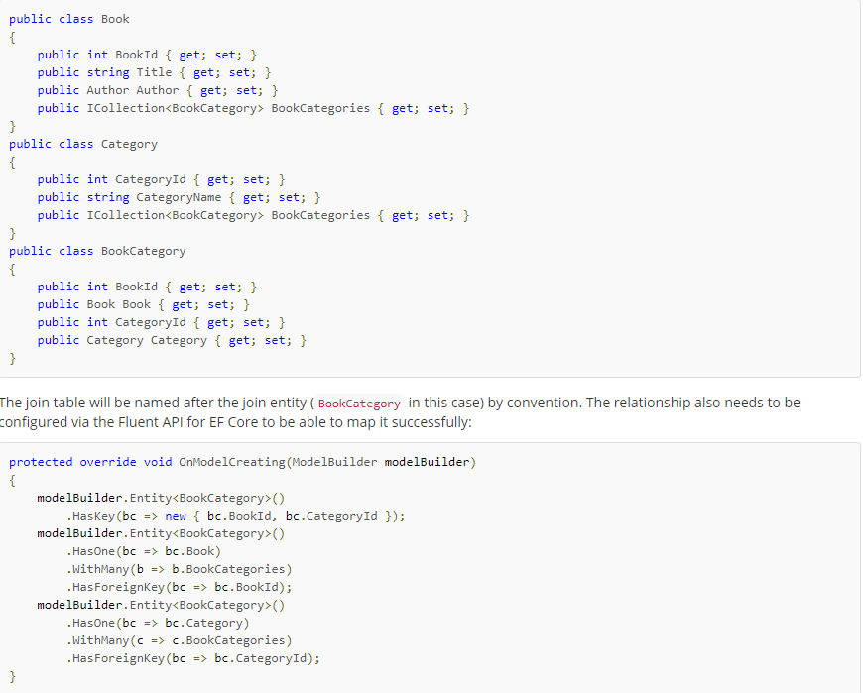
Relationship Many To Many

Slide 14
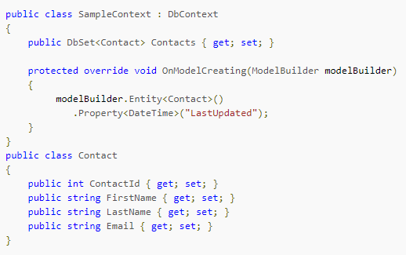
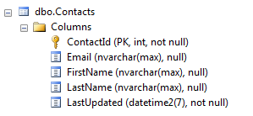
Shadow Properties

Slide 15
Migrations
add-migration <name of migration>
remove-migration
update-database
update-database <name of migration>
script-migration

Slide 16
Eager Loading
Eager loading is the process whereby a query for one type of entity also loads related entities as part of the query. Eager loading is achieved using the Include() method.
using (var ctx = new SchoolDBEntities()) { var stud1 = ctx.Students.Include(s => s.Standard) .Where(s => s.StudentName == "Student1") .FirstOrDefault<Student>(); }

Slide 17
Lazy Loading
Lazy loading means delaying the loading of related data, until you specifically request for it.
using (var ctx = new SchoolDBEntities()) { //Loading students only IList<Student> studList = ctx.Students.ToList<Student>(); Student std = studList[0]; //Loads Student address for particular Student only (seperate SQL query) StudentAddress add = std.StudentAddress; }

Slide 18
Explicit Loading
Even with lazy loading disabled, it is still possible to lazily load related entities, but it must be done with an explicit call. Use the Load method of DBEntityEntry object to accomplish this.
using (var context = new SchoolDBEntities()) { context.Configuration.LazyLoadingEnabled = false; var student = (from s in context.Students where s.StudentName == "Bill" select s).FirstOrDefault<Student>(); context.Entry(student).Collection(s => s.Courses).Load(); }

Slide 19
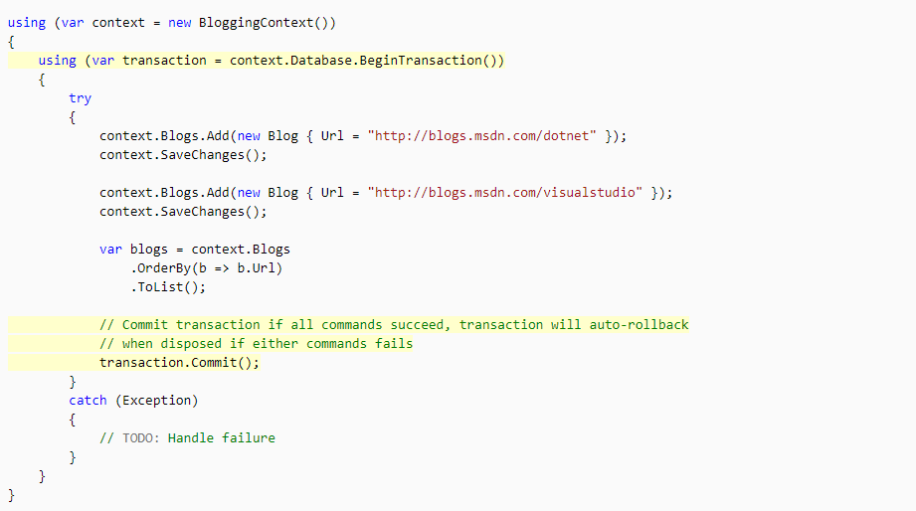
Transactions

Slide 20
Stored Procedure
using (var context = new SchoolDBEntities()) { var sql = "exec spTestSp @ParamIn1, @ParamIn2, @ParamOut1 OUT, @ParamOut2 OUT"; var result = db.Database.ExecuteSqlCommand(sql, in1, in2, out1, out2); var out1Value = (long) out1.Value; var out2Value = (string) out2.Value; }

Slide 21

Dapper
Dapper is a simple object mapper for .NET and own the title of King of Micro ORM in terms of speed and is virtually as fast as using a raw ADO.NET data reader. An ORM is an Object Relational Mapper, which is responsible for mapping between database and programming language.
Dapper extend the IDbConnection by providing useful extension methods to query your database.

Slide 22
Data Annotations
Possible attributes: Key, ExplicitKey, Table, Write, Computed
[Table("Invoice")] public class InvoiceContrib { [Key] public int InvoiceID { get; set; } public string Code { get; set; } public InvoiceKind Kind { get; set; } [Write(false)] [Computed] public string FakeProperty { get; set; } } using (var connection = My.ConnectionFactory()) { connection.Open(); var identity = connection.Insert(new InvoiceContrib {Kind = InvoiceKind.WebInvoice, Code = "Insert_Single_1"}); }

Slide 23
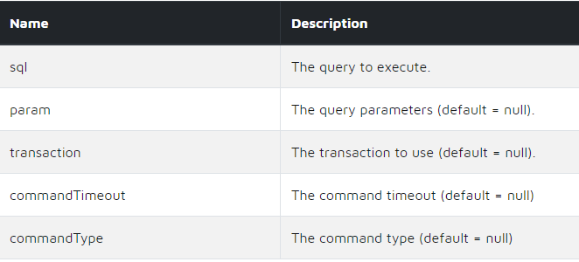
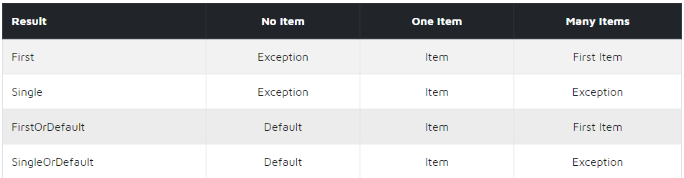
Methods
Execute
Query
QueryFirst
QueryFirstOrDefault
QuerySingle
QuerySingleOrDefault
QueryMultiple

Slide 24
Query Multi-Mapping (One to One)
string sql = "SELECT * FROM Invoice AS A INNER JOIN InvoiceDetail AS B ON A.InvoiceID = B.InvoiceID;"; using (var connection = My.ConnectionFactory()) { connection.Open(); var invoices = connection.Query<Invoice, InvoiceDetail, Invoice>( sql, (invoice, invoiceDetail) => { invoice.InvoiceDetail = invoiceDetail; return invoice; }, splitOn: "InvoiceID") .Distinct() .ToList(); }

Slide 25
Query Multi-Mapping (One to Many)
string sql = "SELECT TOP 10 * FROM Orders AS A INNER JOIN OrderDetails AS B ON A.OrderID = B.OrderID;"; using (var connection = new SqlConnection(FiddleHelper.GetConnectionStringSqlServerW3Schools())) { var orderDictionary = new Dictionary<int, Order>(); var list = connection.Query<Order, OrderDetail, Order>( sql, (order, orderDetail) => { Order orderEntry; if (!orderDictionary.TryGetValue(order.OrderID, out orderEntry)) { orderEntry = order; orderEntry.OrderDetails = new List<OrderDetail>(); orderDictionary.Add(orderEntry.OrderID, orderEntry); } orderEntry.OrderDetails.Add(orderDetail); return orderEntry; }, splitOn: "OrderID") .Distinct() .ToList(); Console.WriteLine(list.Count); FiddleHelper.WriteTable(list); FiddleHelper.WriteTable(list.First().OrderDetails); }

Slide 26
Query Multi-Type
string sql = "SELECT * FROM Invoice;"; using (var connection = My.ConnectionFactory()) { connection.Open(); var invoices = new List<Invoice>(); using (var reader = connection.ExecuteReader(sql)) { var storeInvoiceParser = reader.GetRowParser<StoreInvoice>(); var webInvoiceParser = reader.GetRowParser<WebInvoice>(); while (reader.Read()) { Invoice invoice; }
switch ((InvoiceKind) reader.GetInt32(reader.GetOrdinal("Kind"))) { case InvoiceKind.StoreInvoice: invoice = storeInvoiceParser(reader); break; case InvoiceKind.WebInvoice: invoice = webInvoiceParser(reader); break; default: throw new Exception(ExceptionMessage.GeneralException); } invoices.Add(invoice); } } My.Result.Show(invoices); }

Slide 27
QueryMultiple
string sql = "SELECT * FROM Invoice WHERE InvoiceID = @InvoiceID; SELECT * FROM InvoiceItem WHERE InvoiceID = @InvoiceID;"; using (var connection = My.ConnectionFactory()) { connection.Open(); using (var multi = connection.QueryMultiple(sql, new {InvoiceID = 1})) { var invoice = multi.Read<Invoice>().First(); var invoiceItems = multi.Read<InvoiceItem>().ToList(); } }

Slide 28
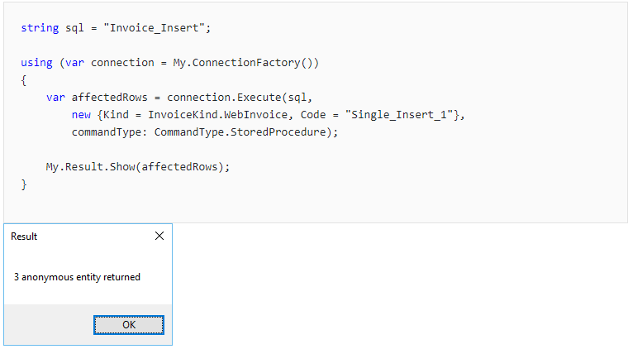
Execute Stored Procedure

Slide 29
Execute INSERT
string sql = "INSERT INTO Customers (CustomerName) Values (@CustomerName);"; using (var connection = new SqlConnection(FiddleHelper.GetConnectionStringSqlServerW3Schools())) { connection.Open(); var affectedRows = connection.Execute(sql, new[] { new {CustomerName = "John"}, new {CustomerName = "Andy"}, new {CustomerName = "Allan"} } ); Console.WriteLine(affectedRows);

Slide 30
Execute UPDATE
string sql = "UPDATE Categories SET Description = @Description WHERE CategoryID = @CategoryID;"; using (var connection = new SqlConnection(FiddleHelper.GetConnectionStringSqlServerW3Schools())) { var affectedRows = connection.Execute(sql, new[] { new {CategoryID = 1, Description = "Soft drinks, coffees, teas, beers, mixed drinks, and ales"}, new {CategoryID = 4, Description = "Cheeses and butters etc."} } ); Console.WriteLine(affectedRows);

Slide 31
Execute DELETE
string sql = "DELETE FROM OrderDetails WHERE OrderDetailID = @OrderDetailID"; using (var connection = new SqlConnection(FiddleHelper.GetConnectionStringSqlServerW3Schools())) { var affectedRows = connection.Execute(sql, new[] { new {OrderDetailID = 1}, new {OrderDetailID = 2}, new {OrderDetailID = 3} } ); Console.WriteLine(affectedRows);

Slide 32
Transaction
string sql = "INSERT INTO Customers (CustomerName) Values (@CustomerName);"; using (var connection = new SqlConnection(FiddleHelper.GetConnectionStringSqlServerW3Schools())) { connection.Open(); using (var transaction = connection.BeginTransaction()) { var affectedRows = connection.Execute(sql, new {CustomerName = "Mark"}, transaction: transaction); transaction.Commit(); Console.WriteLine(affectedRows); } }

Slide 33
TransactionScope
// using System.Transactions; using (var transaction = new TransactionScope()) { var sql = "Invoice_Insert"; using (var connection = My.ConnectionFactory()) { connection.Open(); var affectedRows = connection.Execute(sql, new {Kind = InvoiceKind.WebInvoice, Code = "Single_Insert_1"}, commandType: CommandType.StoredProcedure); } transaction.Complete(); }

Slide 34
Alternative methods: Get, GetAll, Insert, Update, Delete, DeleteAll
using (var connection = My.ConnectionFactory()) { connection.Open(); var invoice = connection.Get<Invoice>(1); //by ID var invoices = connection.GetAll<Invoice>().ToList(); var identity = connection.Insert(new InvoiceContrib { Kind = InvoiceKind.WebInvoice, Code = "Insert_Single_1"}); var isSuccess = connection.Update(new Invoice { InvoiceID = 1, Code = "Update_Single_1"}); var isSuccessRemoved = connection.Delete(new Invoice {InvoiceID = 1}); var isSuccessAllRemoved = connection.DeleteAll<Invoice>(); }
Scaffold-DbContext

Slide 35
Tasks
Налаштувати моделі використовуючи DataAnnotations або Fluent API відповідно до малюнка схеми.
Обовязкові поправки:
Таблиця Customers колонка Location повинна мати довжине максимальну 20 символів
Таблиця Customers колонка LicenseId є не обвязковою
Таблиця Orders колонка Status є Enum і повинна бути string в базі даних
Таблиця Orders колонка LastChanged є прихованою(Shadow property)
Таблиця Orders колонка CreatedDate повинна мати значення за замовчунням – сьогоднішня дата
Створити міграцію і оновити базу даних. Запустити TestDataScript.sql з тестовими даними
Створити методи які вирішують наступні проблеми:
Створити сторед процедуру як перерахує Total Prices для заданого CustomerID. Імплементувати таким чином, щоб перепахунок відбувався тільки замовлень в яких статус Created.
Створити вхідну модель (CustomerId, LicenseId, LicenseCreatedBy, List of product ids and count ). Реалізувати метод який створить нову ліцензію, додасть її до кастомера, створить замовлення. Всі дії потрібно зроибити в транзакції.
Вивести список продуктів які замовляв кожен замовник.
Вивести замовників в яких є ліцензії, та де ця ліцензія була видана
Підрахувати скільки замовлень здійснено для кожної локації. (Вивести навіть якщо не було замовлень в даній локації)
Повторити попередній крок З використанням Dapper
Переглянути тестовий поект і додати свої методи для тестування.

Slide 36
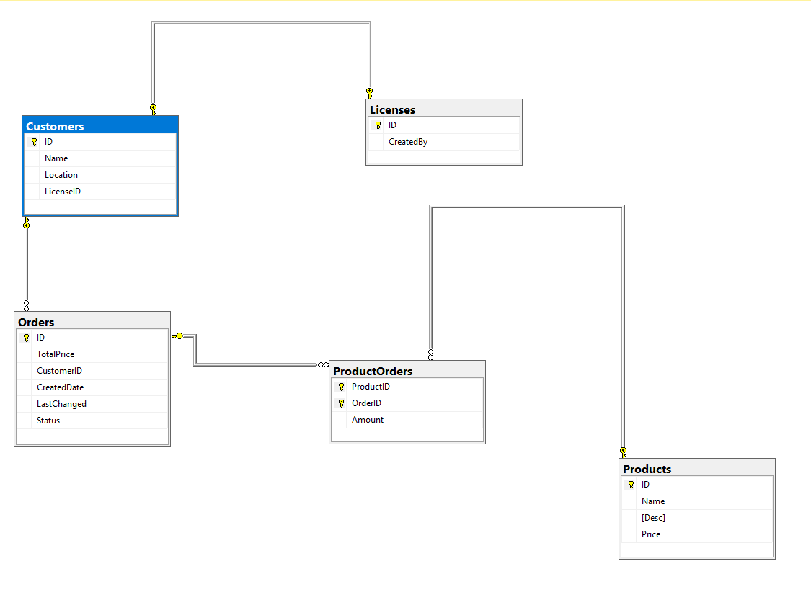
Schema

Slide 37
Links EF Core
https://www.learnentityframeworkcore.com/
https://www.entityframeworktutorial.net/efcore/entity-framework-core.aspx
https://metanit.com/sharp/entityframeworkcore/
https://docs.microsoft.com/en-us/ef/core/saving/transactions
Links Dapper
https://exceptionnotfound.net/using-dapper-asynchronously-in-asp-net-core-2-1/
https://metanit.com/sharp/aspnet5/26.1.php
https://dapper-tutorial.net/dapper

Slide 38

script-migration

