Slide 1
Research Showcase Portal
Software Engineering 1
University of Luxembourg
Group 10

Slide 2
Our Vision
Simple, functional website
Easy research sharing and discovery
Endorse discussions
Voice for everyone
Semi-formal “vibe”

Slide 3
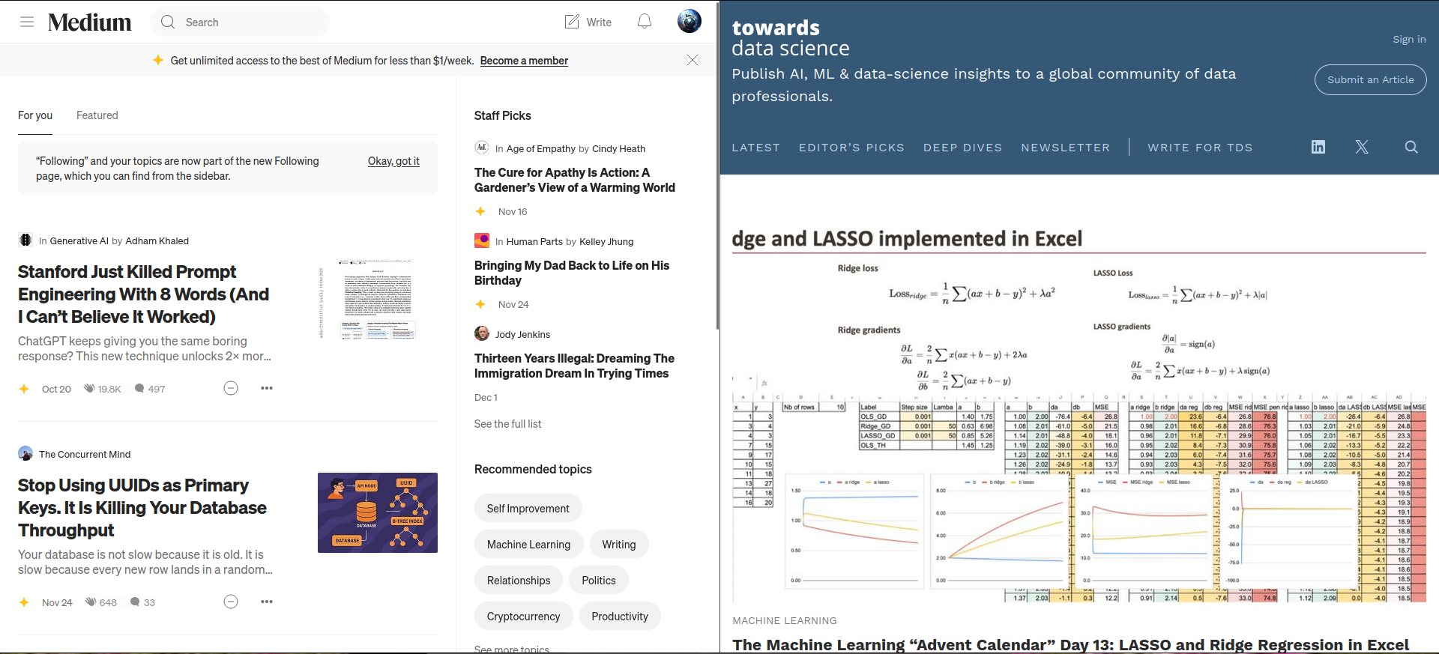
Inspirations

Slide 4
Stakeholder Roles
Anonymous User: search, read, share/cite published research
Registered User: all of the above + comment, publish research, vote, report T&C violations
Researcher: all of the above + review other users’ research, have a special plaque when posting
Moderator: handles T&C reports; can approve initial researchers (cold-start problem)

Slide 5
Requirements
Functional | Non-functional
Accounts: register, login, reset password | Performance: search ≤ 1s, page render ≤ 2s
Profiles: editable profile and post history; optional social links | Scalability: API supports horizontal scaling
Create Research Post: allow text and attachment files | Reliability: durable storage for posts/comments
Comments: comments and replies for posts | Security: secure credentials storage, rate limits
Voting: up/down votes on posts and comments | Usability: intuitive UI and clear error messages
Reviews: researchers review published posts (3 positive reviews to become a researcher) | Maintainability: clean module boundaries, automated and manual testing, target 80% line coverage
Moderation: users report T&C violations; moderators delete/allow

Slide 6
Use Cases (Core)
UC-01 Search + Filtering
UC-02 Registration + Authentication
UC-03 Login
UC-07 Publish Research Post
UC-08 Comment
UC-09 Vote
UC-11 Review Research Post
UC-12/13 T&C + Moderation

Slide 7
DEMO TIME!

Slide 8




Tech Stack
Backend
Frontend
Database

Slide 9
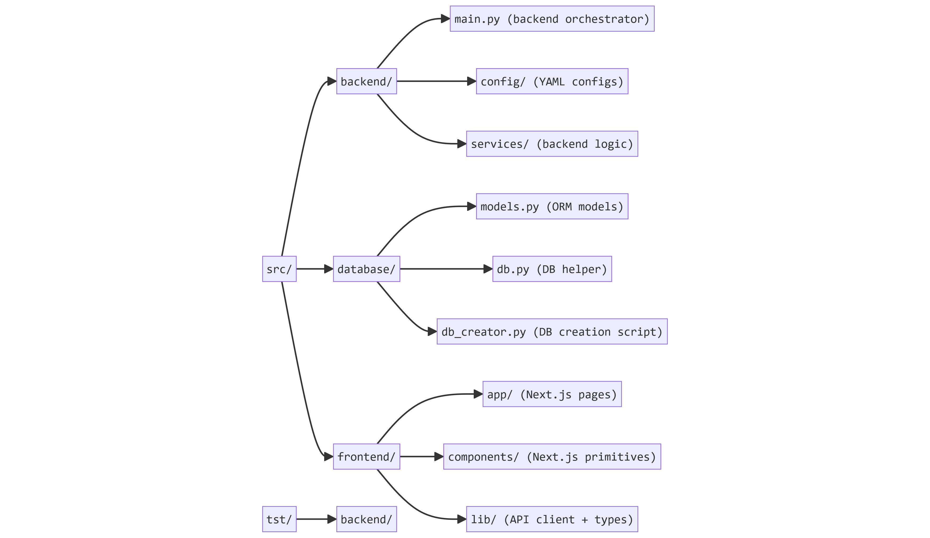
Project Structure

Slide 10
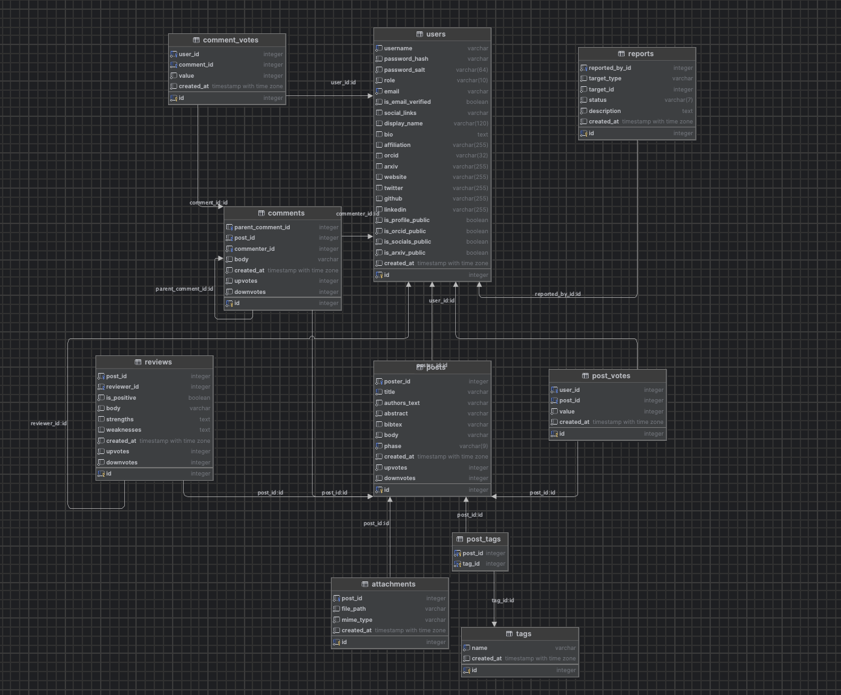
DB Schema

Slide 11
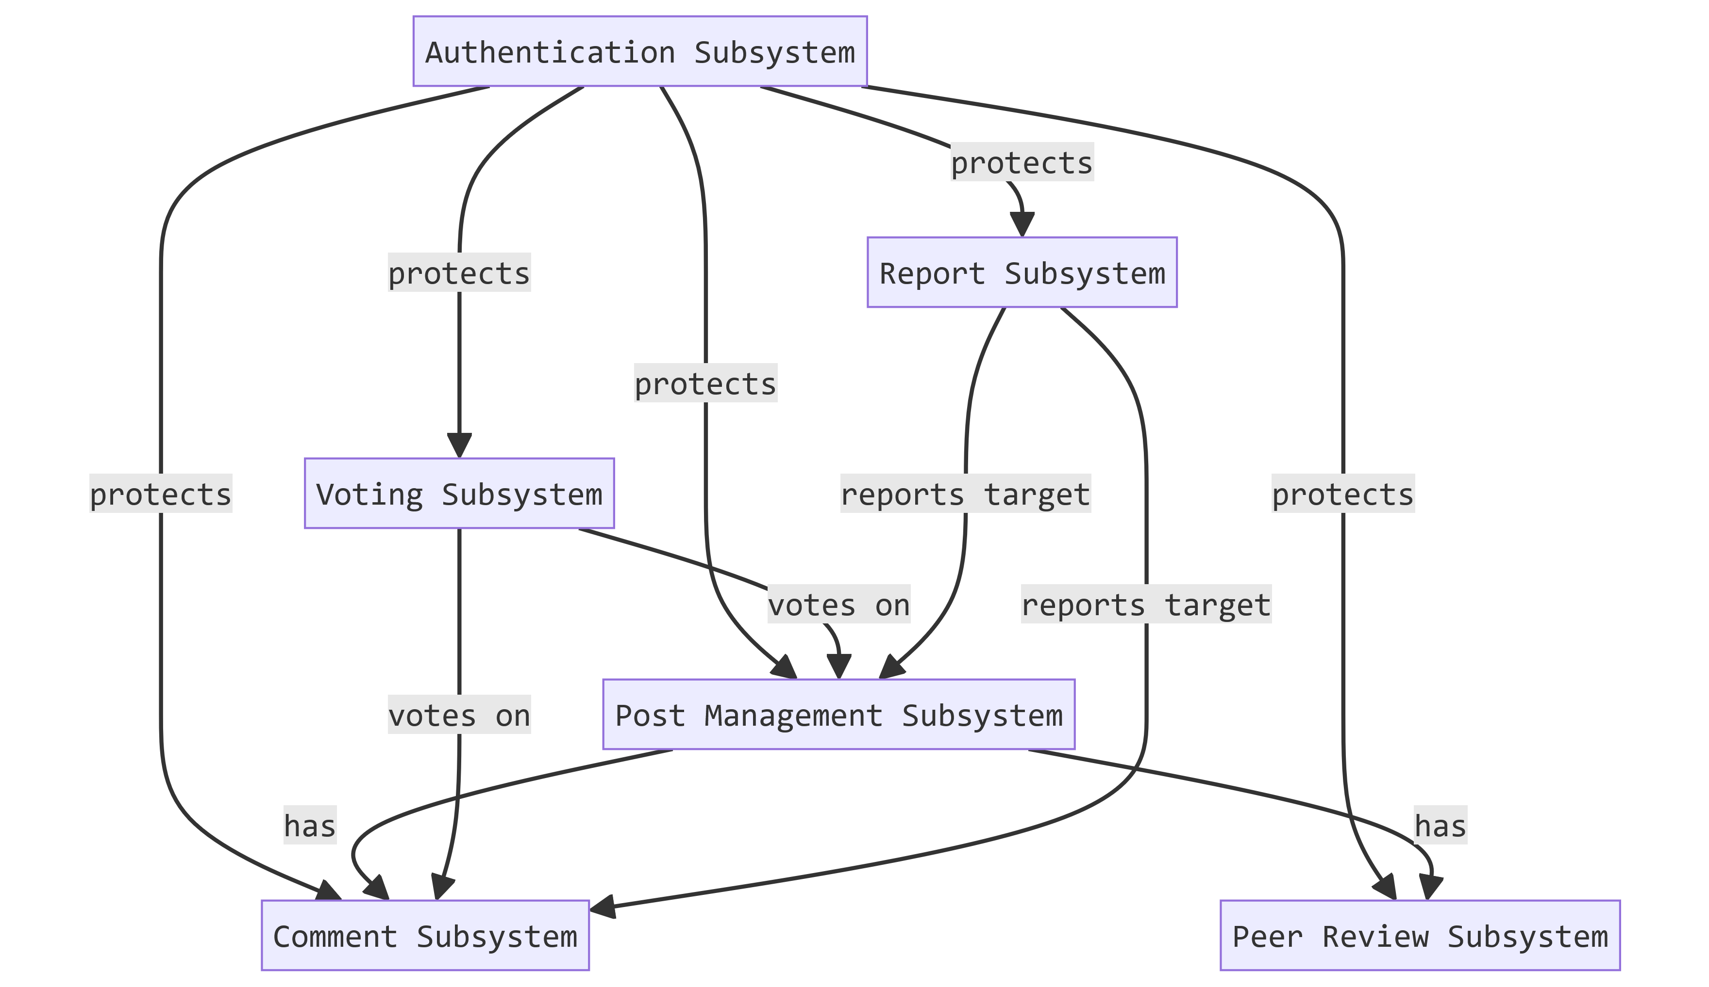
Subsystem Interactions

Slide 12
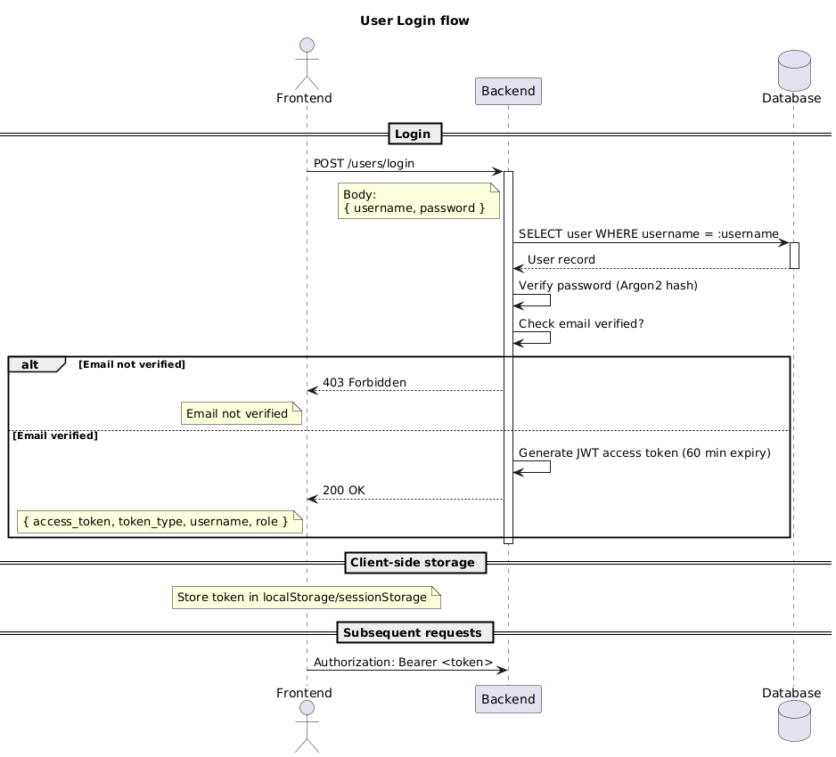

Slide 13
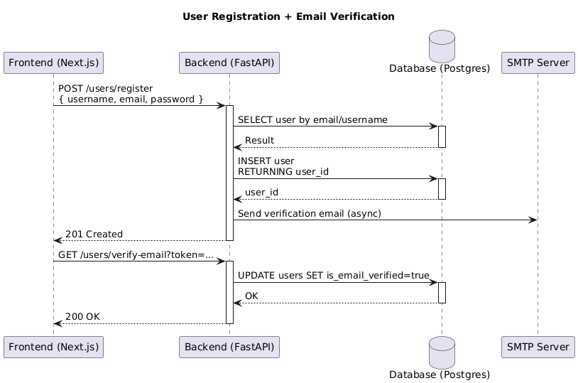

Slide 14
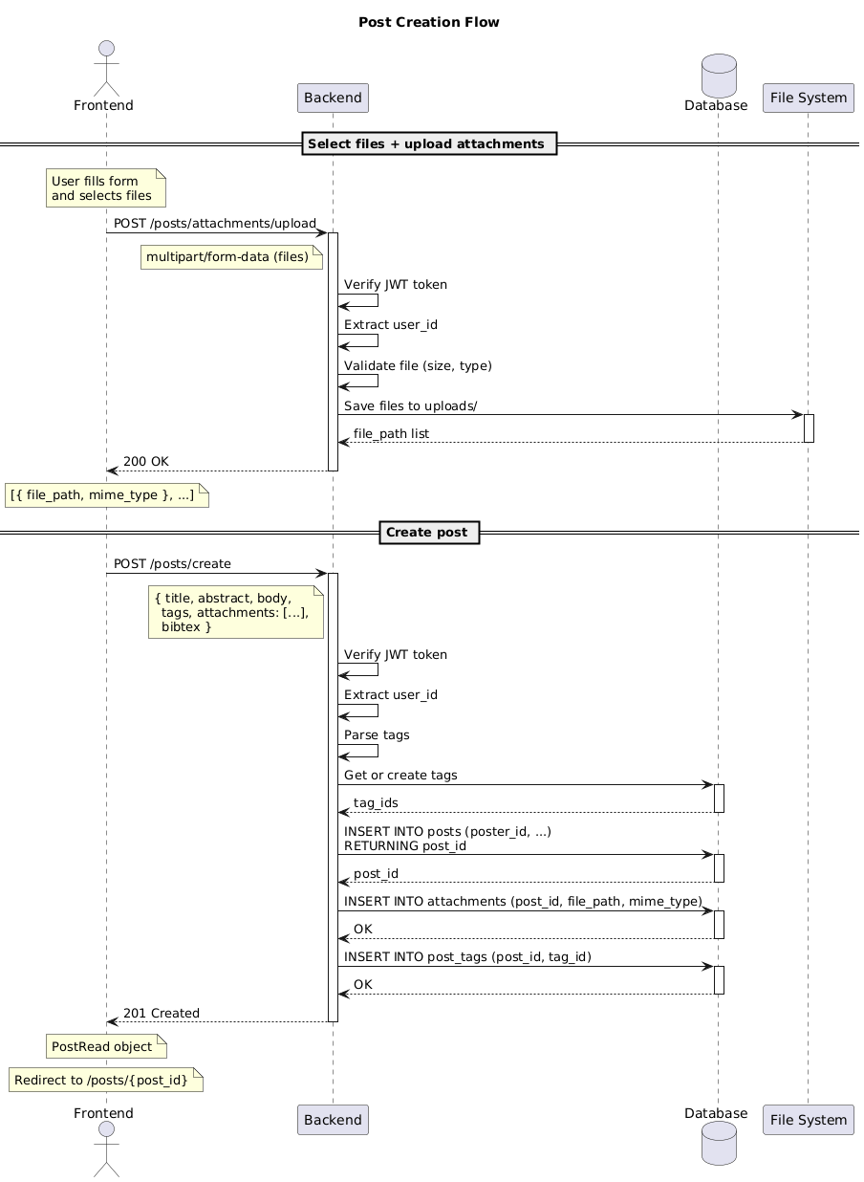

Slide 15
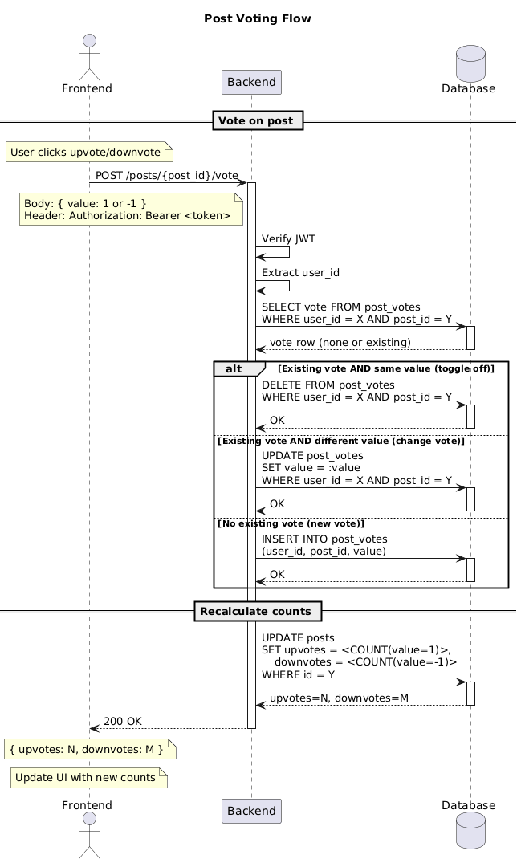

Slide 16
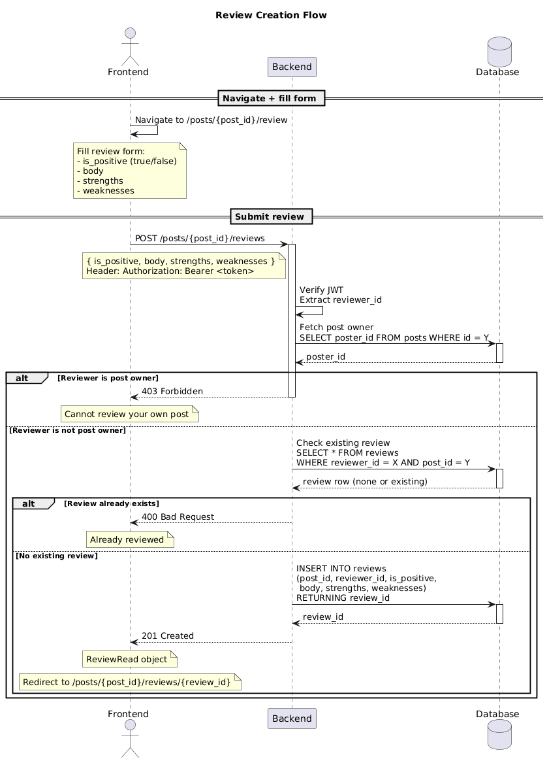

Slide 17
Contributions
Yaraslaw Akhramenka: profile page, report feature
Adelaide Danilov: DB modelling, registration feature
Demyan Faguer: review feature, report
Oleksandr Marchenko Breneur: search, post, comment and vote features
Oleksandr Yeroftieiev: personal page, report feature

Slide 18
ANY QUESTIONS?

