Slide 1
Domain adaptation for classifying disaster-related Twitter data
Department of Computer Science
College of Engineering
Presenter: Oleksandra Sopova
Major Professor: Doina Caragea
GRAD Forum
March 30, 2017

Slide 2
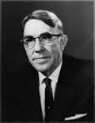
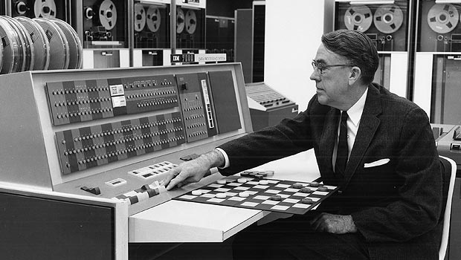
What is Machine Learning?
Arthur Samuel
(1901-1990)
– a pioneer of artificial intelligence research
Arthur Samuel’s Checkers program is considered a milestone for artificial intelligence, and offered the public in the early 1960s an example of the capabilities of an electronic computer.

Slide 3

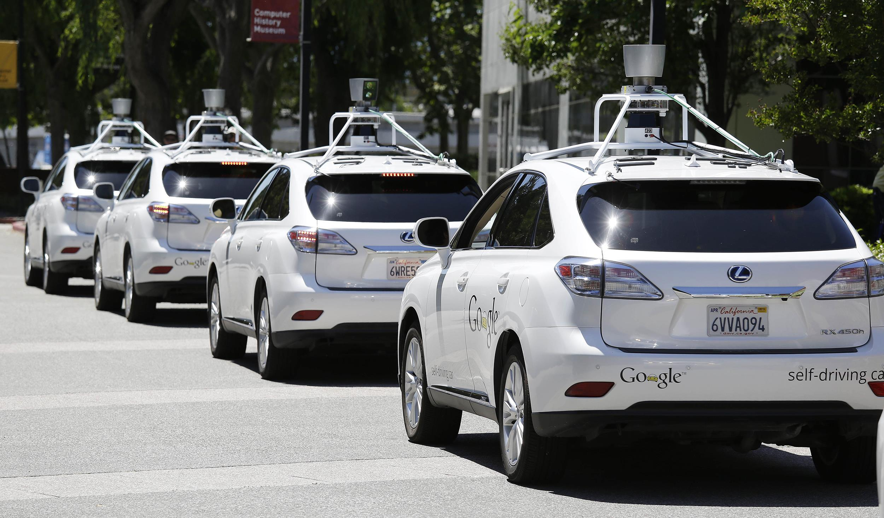

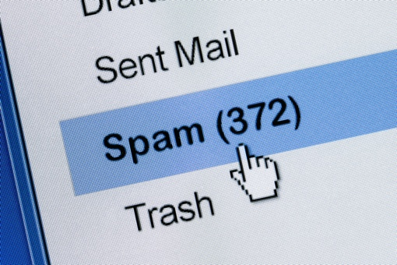

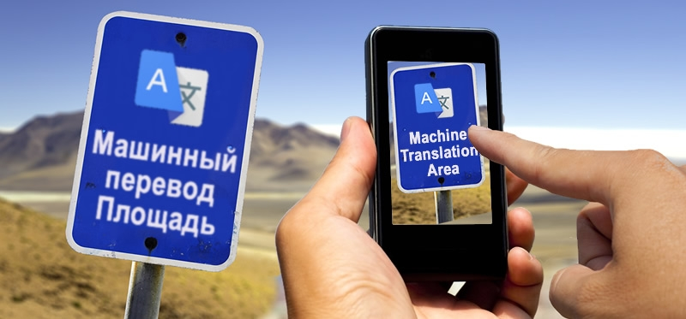
What is Machine Learning?
Examples of machine learning tasks may include:
Recommender systems
Self-driving cars
Image search
[Link]
[Link]
Machine Translation
Spam Filtering
Text Recognition
[Link]
[Link]
[Link]

Slide 4
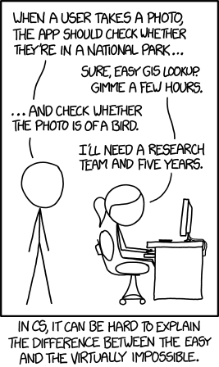
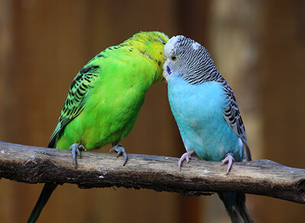
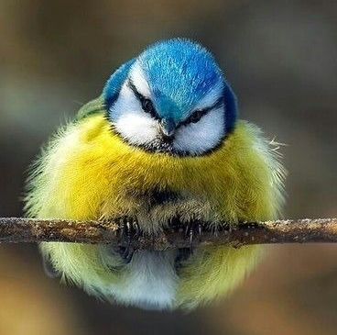
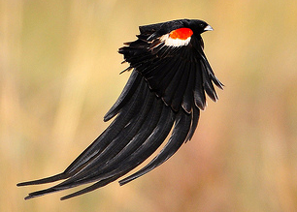
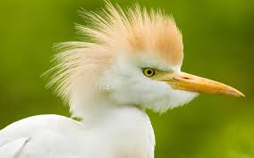
Motivation for Machine Learning
Some tasks are difficult to define algorithmically
Example: is there a bird in a given picture?

Slide 5
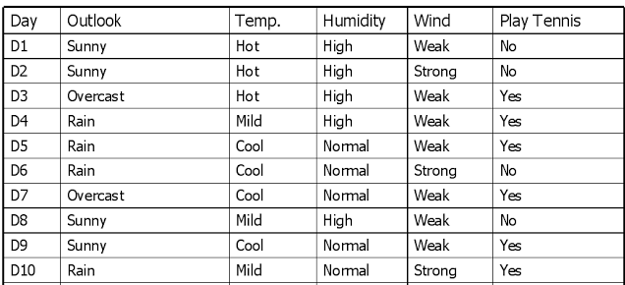

Terminology
Instances (examples, observations)
[Link]
Could you predict the values of “Plat Tennis”?
?
?
?
[Link]

Slide 6
Terminology
Label (class)
Instances (examples, observations)
[Link]
Could you predict the values of “Plat Tennis”?
?
?
?
[Link]

Slide 7
Terminology
Features (attributes)
Label (class)
Instances (examples, observations)
[Link]
Could you predict the values of “Plat Tennis”?
?
?
?
[Link]

Slide 8
Terminology
Features (attributes)
Label (class)
Instances (examples, observations)
Training data
[Link]
Could you predict the values of “Plat Tennis”?
?
?
?
[Link]

Slide 9
Terminology
Features (attributes)
Label (class)
Instances (examples, observations)
Training data
[Link]
Could you predict the values of “Plat Tennis”?
?
?
Testing data
?
[Link]

Slide 10
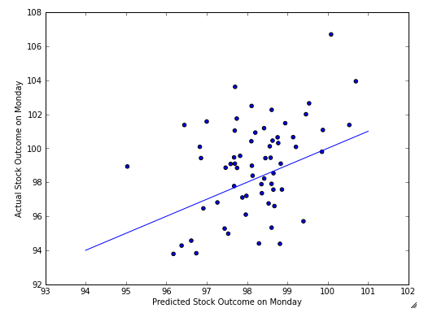
Terminology
Supervised Machine Learning
– learning from labeled data
Unsupervised Machine Learning
– learning from unlabeled data
What is being learned?
– a hypothesis, i.e. parameters of a model that can make accurate predictions (e.g., stock prices)
[Link]

Slide 11
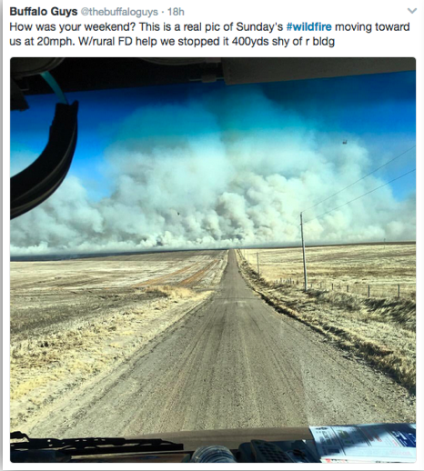
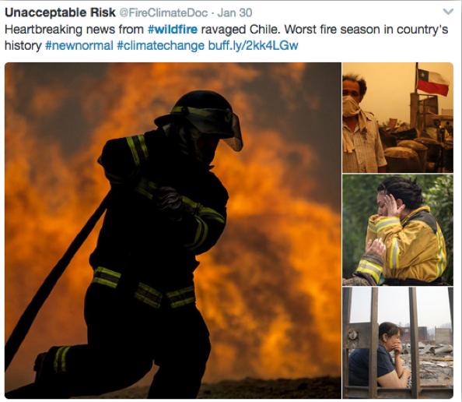
Why Twitter for Disaster Management?

Slide 12



Motivation for Machine Learning
Human language is ambiguous
Could you come up with a general rule to identify tweets about natural disasters?

Slide 13
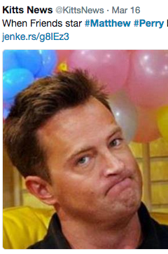
Motivation for Machine Learning
Human language is ambiguous
Could you come up with a general rule identify tweets about natural disasters?
..maybe use hashtags?
– not too reliable

Slide 14
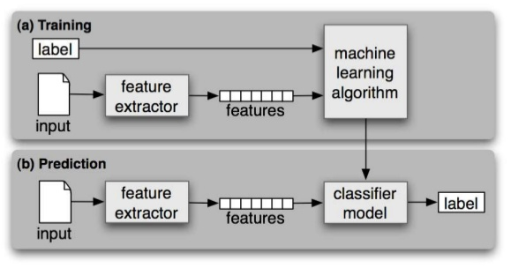
Supervised Learning Model Workflow
[Link]

Slide 15
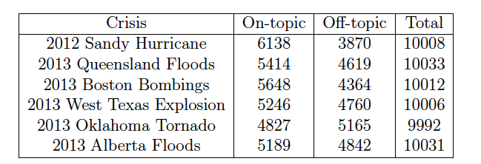
Data Description
Original dataset:
60,000 tweets posted during 6 crisis events in 2012 and 2013

Slide 16
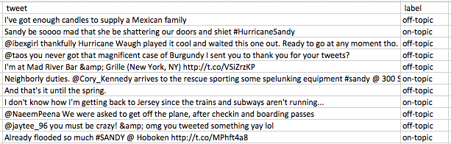
Data Description
Original tweets:

Slide 17
Data Preprocessing
Original tweets:
“@ibexgirl thankfully Hurricane Waugh played it cool”
“I'm at Mad River Bar &amp; Grille (New York, NY) http://t.co/VSzKP”
Preprocessed tweets:
“USERNAME thankfully Hurricane Waugh played it cool”
“I'm at Mad River Bar & Grille (New York, NY) URL”

Slide 18
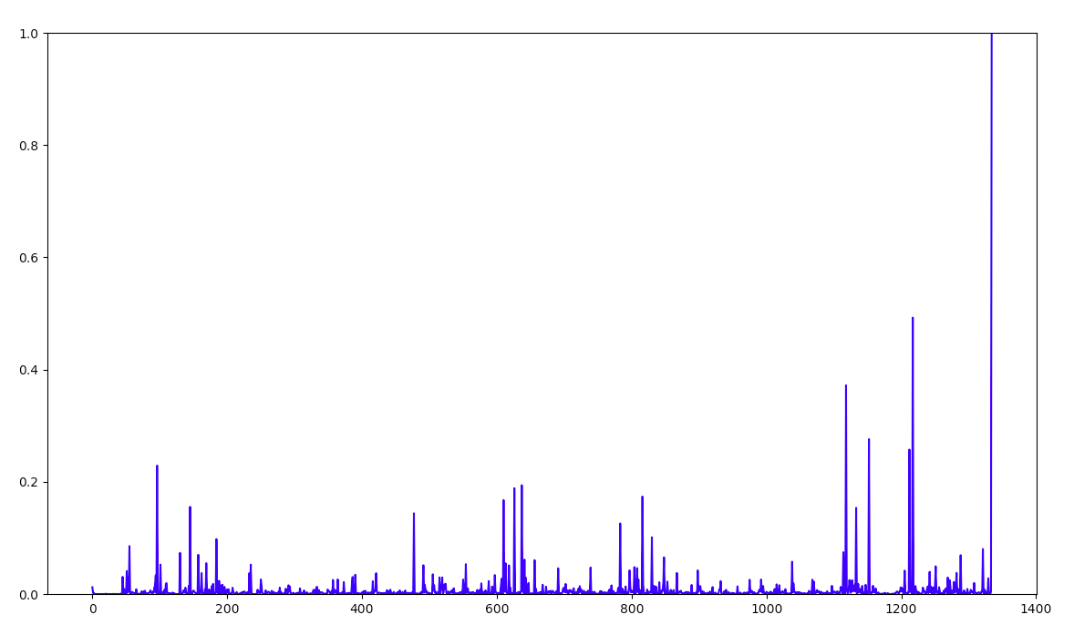
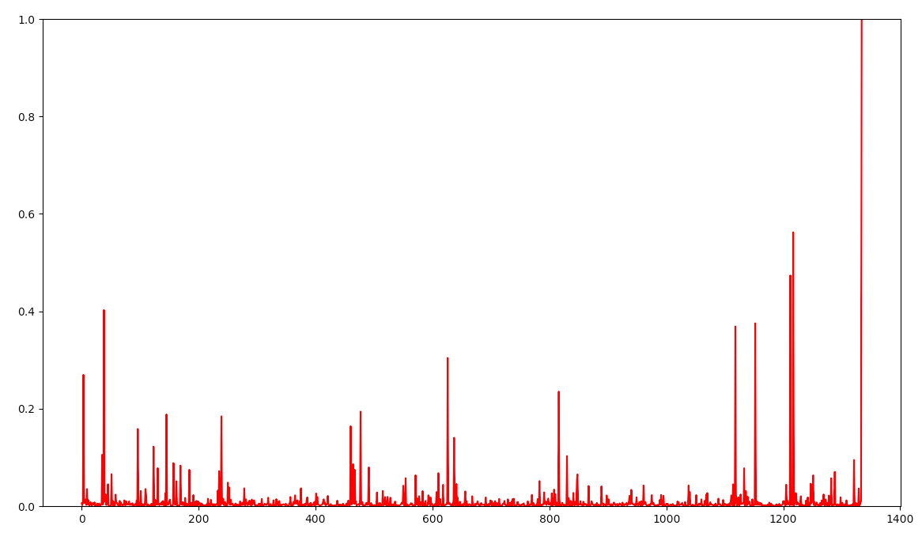
Supervised Machine Learning
assumes that training and testing data come from the same distribution
→ in real life scenarios, this does not always hold true
Source (Sandy Hurricane)
Target (Alberta Floods)

Slide 19
Domain Adaptation (DA) Terminology
Previous disaster – “Source”
Current disaster – “Target”
Make predictions
Train the model
Machine Learning Model
Labels are available
No labels are available

Slide 20
Problem Definition
learn a model from labeled source data and unlabeled target data:
Labeled Source Data
Unlabeled Target Data
Machine Learning Model

Slide 21
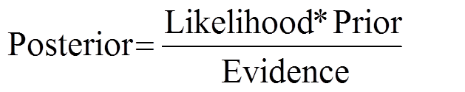
Naive Bayes Classifier
based on Bayes Theorem

Slide 22
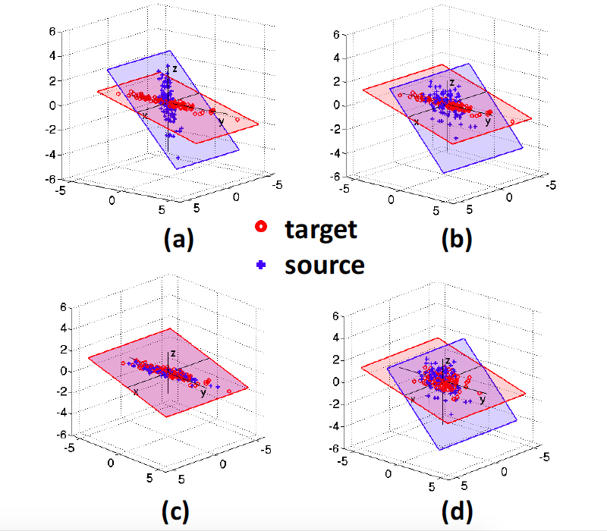
Correlation Alignment Algorithm
before DA:
after DA:
Baochen Sun, Jiashi Feng, and Kate Saenko. Return of frustratingly easy domain adaptation. In Proceedings of the Thirtieth AAAI Conference on Artificial Intelligence (AAAI-16), pages 2058-2065, 2016.

Slide 23
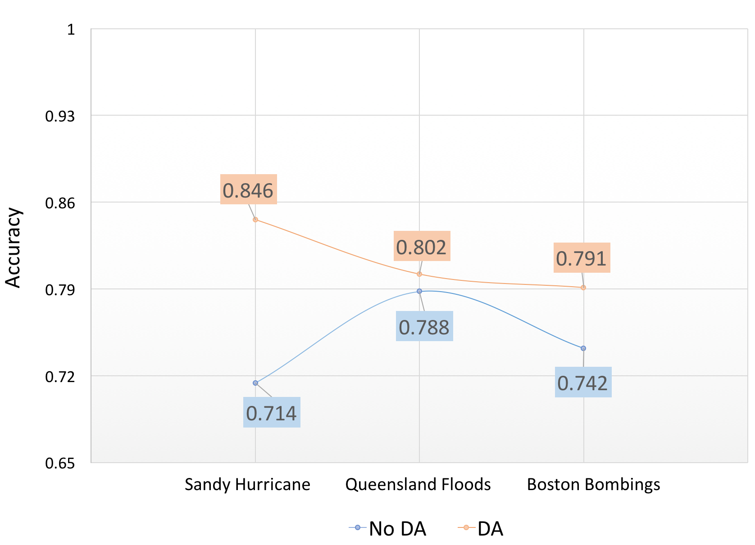
Single-source Domain Adaptation
Here the target disaster – Alberta Floods

Slide 24
Feature Selection

Slide 25
Multi-source Domain Adaptation

Slide 26
Thank you for your attention! Questions?

