Slide 1
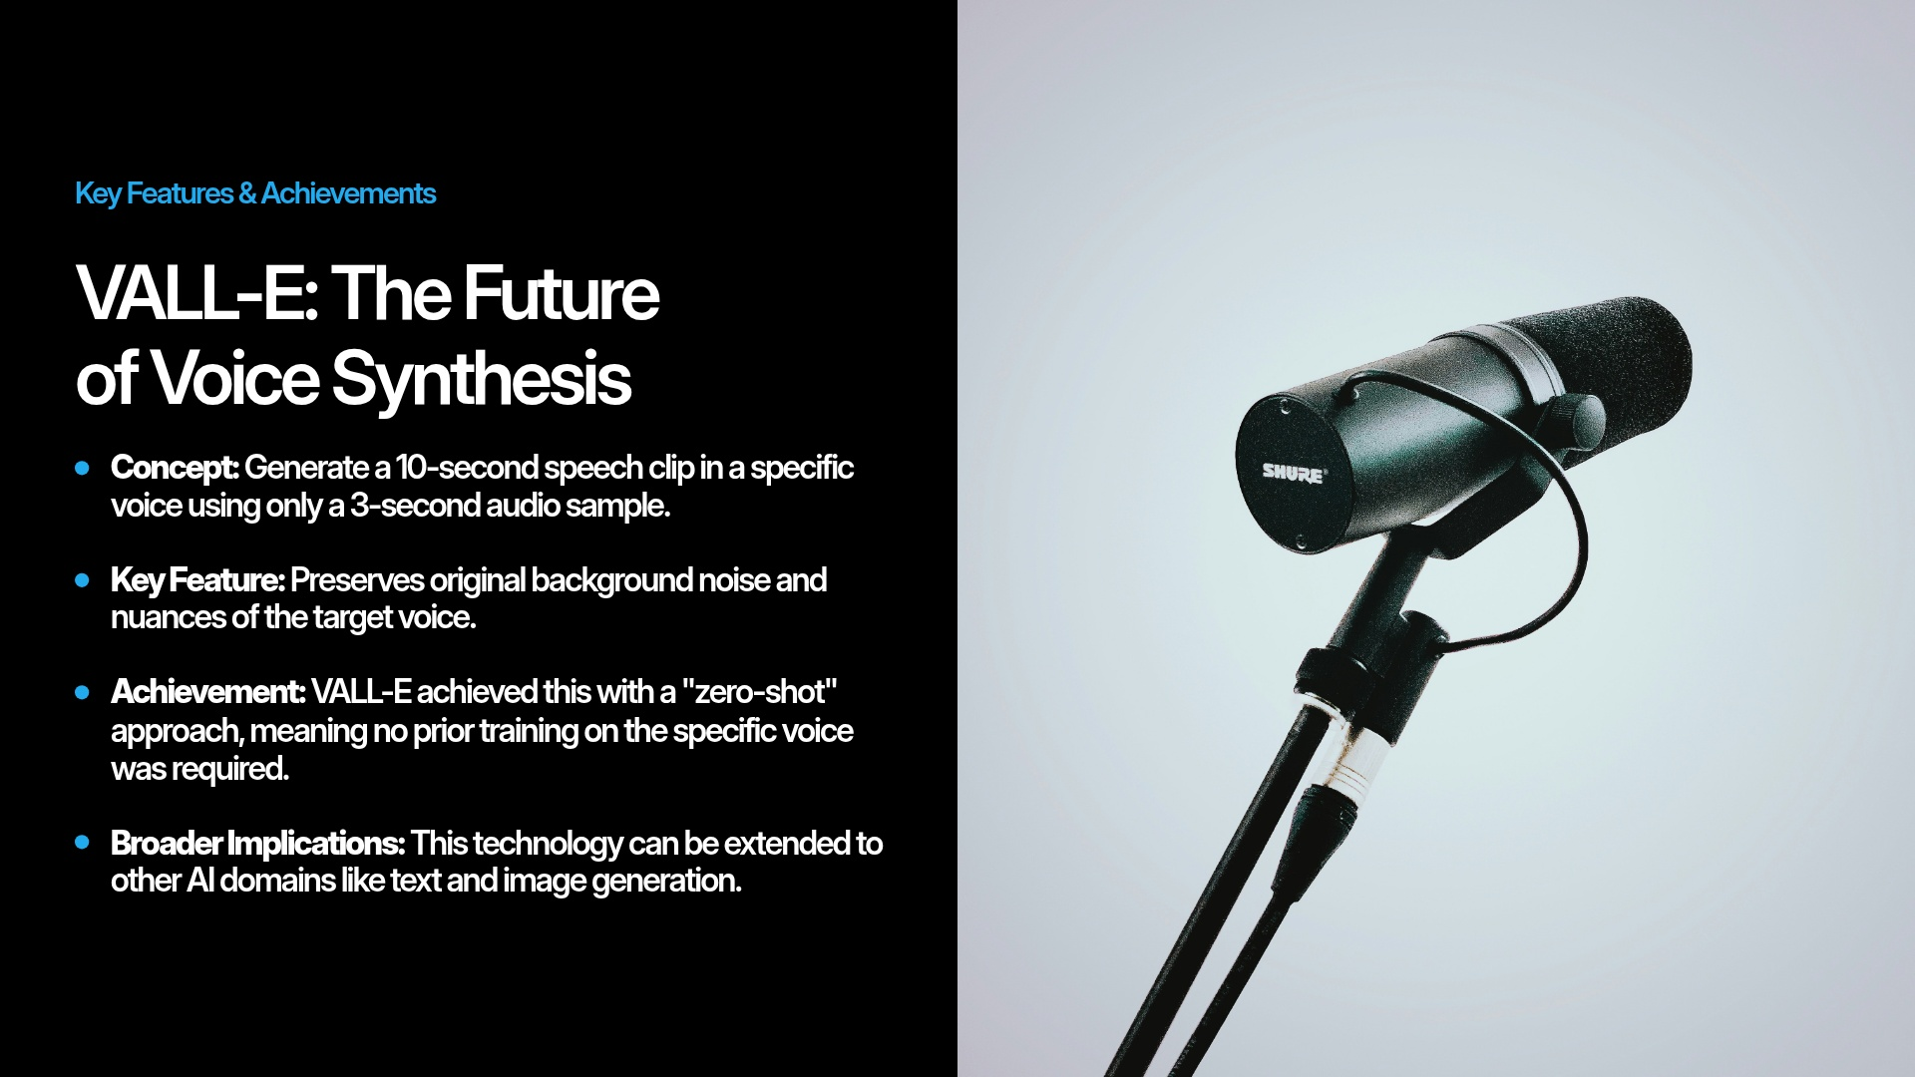
Notes:
Welcome, everyone. Today we are reviewing a massive paradigm shift in generative audio: Microsoft's VALL-E paper. Before VALL-E, cloning a voice required hours of clean, studio-quality data from a single speaker. VALL-E achieved 'zero-shot' text-to-speech. This means it only needs a 3-second unseen audio prompt to perfectly clone a voice. Not only does it capture the speaker's timbre and emotion, but it perfectly replicates the acoustic environment—if the 3-second prompt has telephone static, the generated audio will have that exact same static.

Slide 2
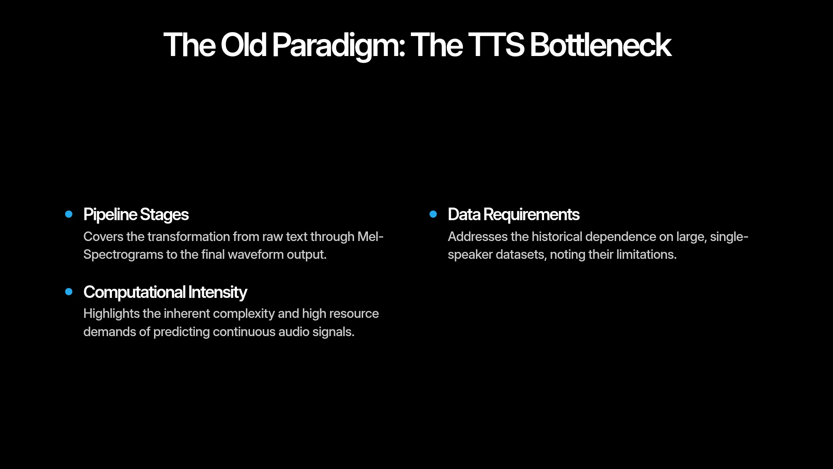
Notes:
To understand why VALL-E is special, we have to look at the old pipeline. Traditionally, Text-to-Speech (TTS) models converted text into a mel-spectrogram, and then a vocoder converted that spectrogram into a continuous waveform. Predicting continuous, high-dimensional audio signals is incredibly computationally heavy. Furthermore, because these older models required massive, single-speaker datasets, they were highly 'brittle'—they couldn't easily generalize to new voices or noisy environments.

Slide 3
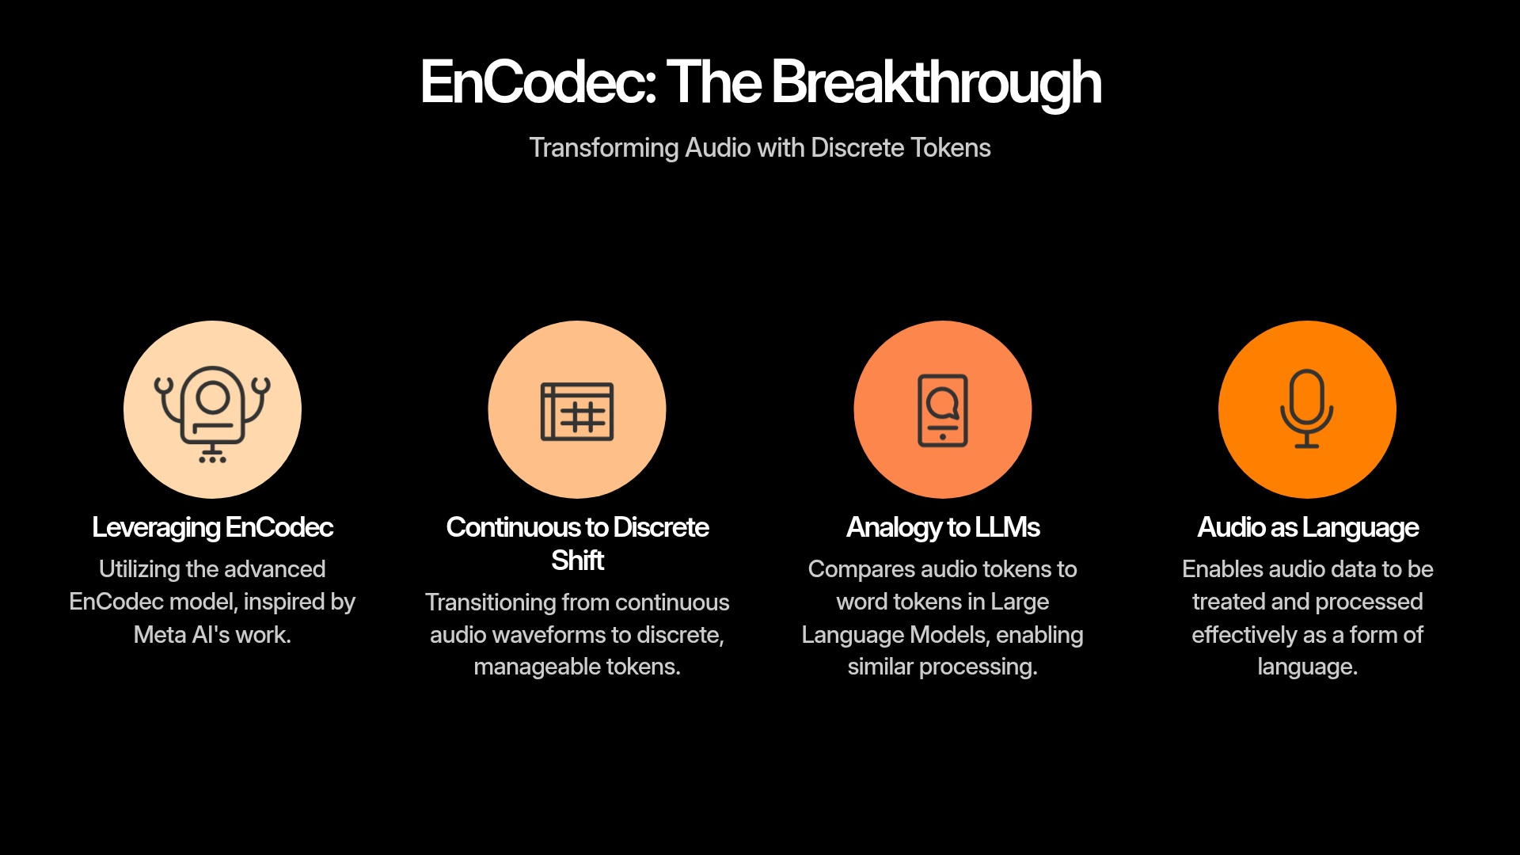
Notes:
The genius of VALL-E was throwing out the mel-spectrogram entirely. Instead, the researchers borrowed an audio codec from Meta called EnCodec. EnCodec takes continuous audio waveforms and compresses them into discrete, quantized 'tokens.' Once audio is converted into discrete tokens, it looks exactly like text to a neural network. This allowed the researchers to treat voice cloning not as a signal processing problem, but as a Language Modeling problem. They essentially built an LLM, but for sound.

Slide 4
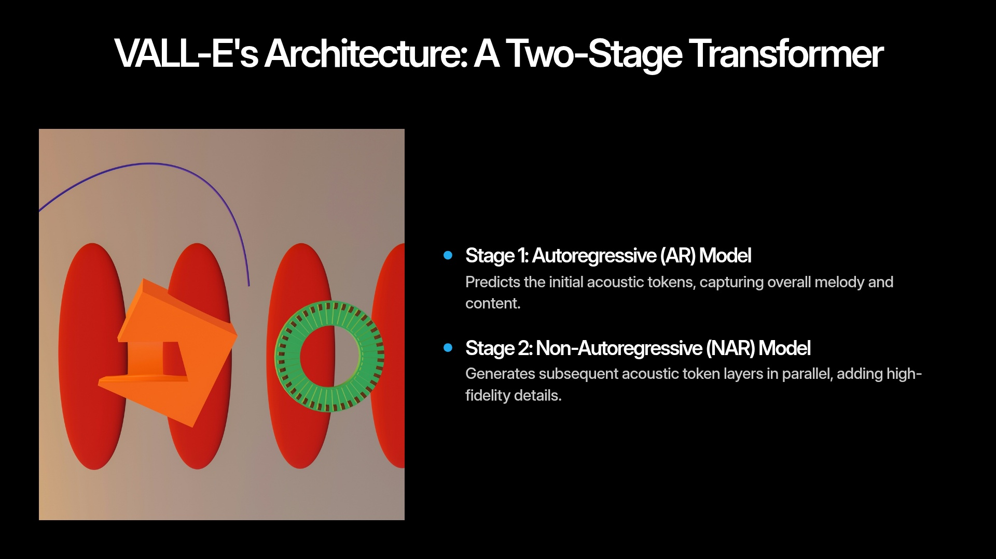
Notes:
Because they are using discrete tokens, VALL-E uses a two-stage Transformer architecture.
First is the Autoregressive (AR) Model: It predicts the very first layer of acoustic tokens sequentially. You can think of this stage as capturing the 'melody'—the prosody, the emotion, and the phonetic content.
Second is the Non-Autoregressive (NAR) Model: Once the melody is set, this model generates the remaining layers of acoustic tokens all at once, in parallel. This stage fills in the high-fidelity acoustic details, giving the voice its rich timbre and depth. Splitting it this way balances acoustic quality with processing speed.

Slide 5
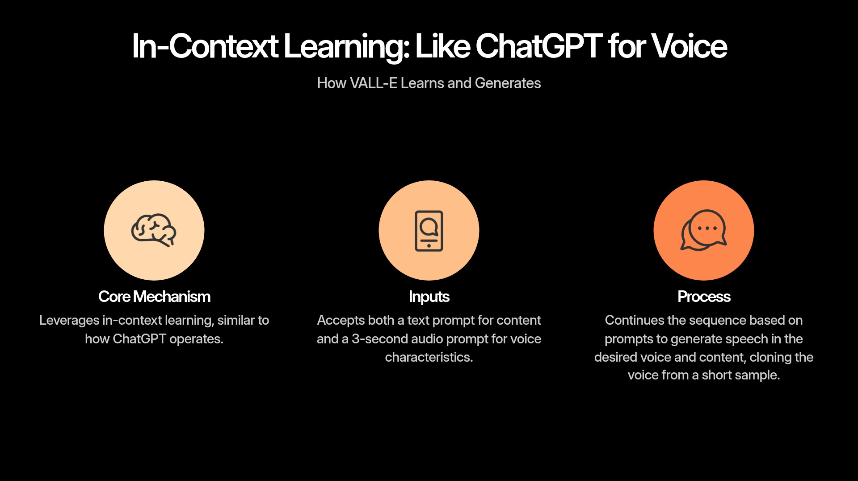
Notes:
Because VALL-E is essentially an audio language model, it learns in-context, exactly like ChatGPT. When you prompt ChatGPT, you give it a few words and it predicts the next words. With VALL-E, you give it a text prompt of what you want it to say, plus a 3-second audio token sequence of the target voice. The transformer looks at the text, looks at the voice tokens, and simply 'continues the sequence,' generating the new speech in the exact same acoustic style.

Slide 6
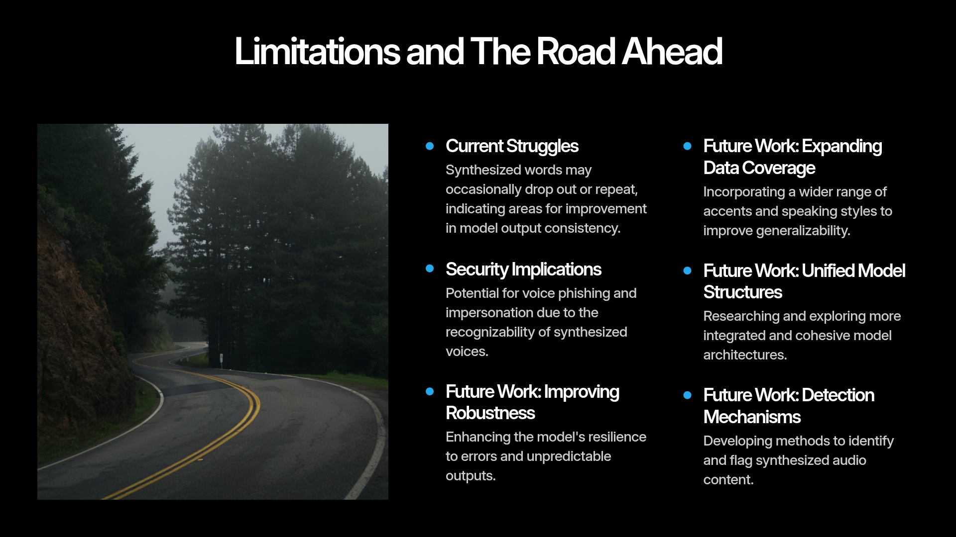
Notes:
Of course, because it functions like a language model, it suffers from language model problems. The most prominent issue is that it sometimes drops words, hallucinates, or repeats tokens, leading to unnatural stutters in the output. Furthermore, the security implications are massive. Because it can clone a voice perfectly from a 3-second clip scraped from social media, it opens the door wide to voice phishing and biometric bypass. The paper itself acknowledges that robust detection mechanisms must be developed in tandem with this technology.

Slide 7

Notes:
Ultimately, VALL-E proved that scaling up discrete audio tokens with massive data (60,000 hours of English speech) yields emergent zero-shot capabilities. I'd love to open the floor to any questions about the architecture, the EnCodec quantization process, or the security implications. Thank you!

