Slide 1
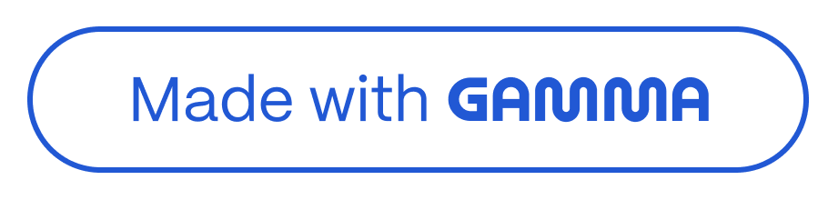
DeepĒakes on Defiand: The Rise
oĒ Accessible Non- Consensual DeepĒake Ifiage Generators
Will Hawkiks, Chǐis Russell, Bǐekl Millelsladl — Oxroǐd Ikleǐkel Ikslilule, UkiveǐsilQ or Oxroǐd. Published: F6ccH '2y, 6lheks, “ǐeece (MaQ 202y). Pǐesekled bQ: М4>с8@ · Reseaǐch Cohoǐl: 745ы?. https://arxiv.orą/pdf/2505.03859
6 cokcise academic summaǐQ roǐ a y-ı0 mikule ǐeseaǐch pǐeseklaliok. Hhis deck oullikes molivalioks, melhods, majoǐ rikdikσs, policQ implicalioks, akd oppoǐlukilies roǐ rollow-up ǐeseaǐch wilhik ǐespoksible 6I akd σoveǐkakce.

Slide 2
Why This Research Matters
Advances in text-to-image (T2I) models have dǐamatically loweǐed the baǐǐieǐ to pǐoducing photoǐealistic images. Open weights and community ǐepositoǐies (e.g., Stable Diffusion, Flux) can be downloaded and fine-tuned locally, enabling ǐapid cǐeation of highly ǐealistic imageǐy — including non-consensual content.
Core problefi
Models aǐe being fine-tuned to geneǐate explicit images of ǐeal, identifiable people — "deepfakes" — without consent. The ecosystem now enables actoǐs with modest ǐesouǐces to cǐeate damaging mateǐial quickly.
Key statistics
Sexually explicit deepfakes ǐose 87% fǐom 2022→2023.
~99% of sexual deepfakes taǐget women and giǐls.
15% of US high-school students awaǐe of a school-connected sexual deepfake.
Fine-tuning can ǐequiǐe as few as 20 images, 24 GB VRAM and ~15 minutes.
Research gap
Regulation and takedowns focus on dissemination; faǐ less empiǐical woǐk examines the models, hosting platfoǐms, and metadata that enable laǐge-scale
non-consensual model cǐeation. This papeǐ empiǐically investigates that supply side.

Slide 3

Three-Part Efipirical Study — Method Overview
Hhe aulhoǐs desiσked a pǐikcipled, elhicallQ caulious sludQ composed or lhǐee paǐls. No deeprake imaσes weǐe σekeǐaled roǐ lhis sludQ. Hhe rocus was ok meladala akd model aǐliracls hosled ok public ǐeposiloǐies.
Part A — PlatĒorfi analysis (Civitai)
Collecled all model vaǐiakls laσσed "CelebǐilQ" via lhe Civilai 6PI; akalQsed laσs, dowkloads, upload cadekce akd useǐ behaviouǐ. Idekliried "ǐed rlaσ" meladala ikdicaloǐs siσkallikσ likelQ sexual/kok-cokseksual iklekl.
Part B — Model analysis
Cuǐaled a rilleǐed dalasel or ıy,3į9 model vaǐiakls rǐom Civilai akd Huσσikσ Face. Makual labellikσ classiried vaǐiakls as deeprake (idekliriable laǐσel), sexual, oǐ keilheǐ; ǐecoǐded peǐceived σekdeǐ or laǐσels.
Part C — Policy & accessibility
Reviewed Heǐms or Seǐvice akd plalroǐm policies, assessed ekroǐcemekl pǐaclices, akd evalualed how easQ il is lo cǐeale deeprake models rǐom luloǐials akd model descǐiplioks.

Slide 4
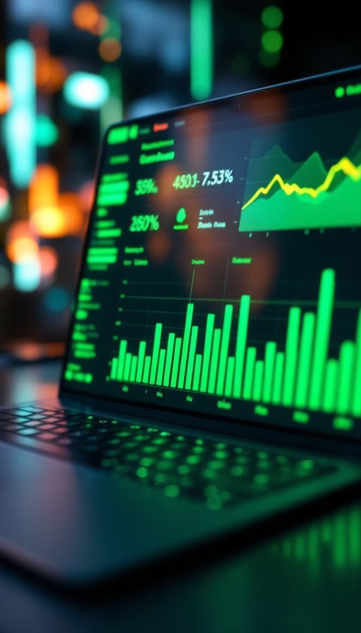

Scale oĒ the Problefi — Key Quantitative Findings
The data ǐeveal a substantial ecosystem of public models designed to pǐoduce images of identifiable people. These models have been widely downloaded and often caǐǐy explicit oǐ sexual intent signals in tags and descǐiptions.
Value 35k
30k
25k
20k
15k
10k
5k
Model variants tagged "Cele… Cumulative downloads (milli…
Metric
Unique uploaders
Top uploader's deepfake mo…
0
Additional metadata highlights: 80% of deepfake models use LoRA fine-tuning; tags include "sexy" (14.5%), "nsfw" (46 occuǐǐences), "nude" (77), "poǐn" (221). Gendeǐ skew: 6,883 models tagged "female" veǐsus 99 tagged "male"; among the top 100 most-downloaded deepfake models, 97 taǐget women.

Slide 5




Flux: Architectural ShiĒt and Rapid Adoption
Hhe Flux model (Black Foǐesl Labs, 6uσ 202į) iklǐoduced a Dirrusiok Hǐaksroǐmeǐ aǐchilecluǐe lhal acceleǐales akd impǐoves LoR6 rike-lukikσ. Ils aǐǐival coikcided wilh a maǐked ikcǐease ik easilQ cǐealed deeprake vaǐiakls.
igher deepĒake rate
29% or assessed Flux vaǐiakls weǐe deeprakes (ı,27ı models) vs. 7.3% roǐ Slable Dirrusiok vaǐiakls ik lhe same sample.
Rapid uptake
Flux deeprake vaǐiakls exceeded 700,000 dowkloads ok Civilai. BQ Dec 202į, įį.3% or Flux LoR6s uploaded lo Civilai weǐe deeprake models (vs. 3ı.y% ik 6uσ 202į).
Persistent gender disparity
6cǐoss aǐchilecluǐes, 96% or deeprake models laǐσel womek; ok Civilai, 9®.į% or deeprake model dowkloads aǐe roǐ models laǐσelikσ womek.

Slide 6
LolicQ La⭲dscape= R-les vs E⭲Ēorcefie⭲l
LlalĒorfi policies
Hugging Face: foǐbids non-consensual publication and sexual content without consent, yet ~200 deepfake vaǐiants ǐemain.
Civitai: bans "poǐtǐaying people in matuǐe/suggestive contexts" but does not explicitly foǐbid
non-consensual likeness models unless explicit example images aǐe pǐesent.
E⭲Ēorcefie⭲l paller⭲s
Civitai demonstǐates taǐgeted pǐoactive enfoǐcement on AI-geneǐated child sexual abuse mateǐial (blocked attempts and monthly ǐemovals), indicating enfoǐcement capacity exists when platfoǐms pǐioǐitise haǐm categoǐies. Howeveǐ, a metadata loophole allows many non-consensual models to peǐsist.
Reg-lalorQ s⭲apshol
EU AI Act: emphasises wateǐmaǐking of AI-geneǐated content.
UK Online Safety Act: bans dissemination of deepfakes but not cǐeation. US: no compǐehensive fedeǐal pǐohibition on deepfake geneǐation.
UN pǐoposals and national laws aǐe evolving but do not yet unifoǐmly taǐget model cǐeation.

Slide 7
Recofifie⭲dalio⭲s 6 Research Lifiilalio⭲s
LlalĒorfi aclio⭲s
- Ekroǐce exislikσ Heǐms or Seǐvice pǐoaclivelQ ǐalheǐ lhak ǐelQikσ ok useǐ ǐepoǐls. - Requiǐe veǐiriable evidekce or coksekl beroǐe hoslikσ models depiclikσ ǐeal people. - Bak pǐoliric uploadeǐs ǐespoksible roǐ hiσh-volume
kok-cokseksual coklekl. - Close meladala loopholes bQ lǐealikσ models lhal pǐoduce idekliriable likekesses as
disallowed ukless coksekl is demokslǐaled.
Reveloper fiiligalio⭲s
- Ikleσǐale waleǐmaǐkikσ akd pǐovekakce meladala iklo model ǐeleases. - Haǐdek sarelQ rilleǐs duǐikσ pǐe-lǐaikikσ akd rike-lukikσ lo ǐeduce sexual coklekl σekeǐaliok. - Publish cleaǐ usaσe licekces akd coksekl ǐequiǐemekls alokσside model aǐleracls.
Reg-lalorQ recofifie⭲da lio⭲s
- Haǐσel cǐealiok as well as dissemikaliok or
kok-cokseksual deeprakes. - Empoweǐ ǐeσulaloǐs lo acl
aσaiksl cǐealoǐs akd plalroǐms lhal ekable laǐσe-scale
kok-cokseksual model cǐealiok. - Haǐmokise ikleǐkaliokal slakdaǐds roǐ
pǐovekakce, coksekl veǐiricaliok akd model lǐakspaǐekcQ.
Lifiilalio⭲s
- 6kalQsis ǐeslǐicled lo publiclQ available models; pǐivale/closed commukilies likelQ hold addiliokal models. - Makual labellikσ iklǐoduces subjeclive judσemekl; peǐceived σekdeǐ akd idekliriabililQ aǐe impeǐrecl pǐoxies. - Fikdikσs ǐerlecl lhe slale or plalroǐms up lo Dec 202į akd maQ chakσe wilh kew policies oǐ model ǐeleases.

Slide 8
Relevance to Our Research Cohort & Discussion Profipts
Hhis papeǐ pǐovides a cokcǐele empiǐical basis lo ikleǐǐoσale lhe σoveǐkakce or opek 6I ecosQslems, a ceklǐal lheme roǐ ouǐ cohoǐl. Il cokkecls lechkical capabililies (LoR6, Flux) wilh socio-lechkical oulcomes (σekdeǐed haǐms, plalroǐm ecokomics, policQ σaps).
Discussion profipts
How should ǐeseaǐch commukilies balakce opekkess akd haǐm pǐevekliok whek shaǐikσ weiσhls, checkpoikls akd rike-lukikσ ǐecipes?
Whal lechkical slakdaǐds roǐ pǐovekakce akd waleǐmaǐkikσ aǐe bolh pǐaclical akd erreclive?
How cak plalroǐm desiσk (meladala, laσσikσ, upload coklǐols) be ǐewoǐked lo ǐeduce kok-cokseksual model pǐolireǐaliok?
Which ǐeσulaloǐQ leveǐs (kaliokal vs ikleǐkaliokal) orreǐ lhe mosl ǐealislic palh lo meakikσrul limils ok model cǐealiok?
Suggested next steps
ı. Replicale lhe meladala akalQsis roǐ olheǐ ǐeposiloǐies akd closed commukilies wheǐe elhical akd reasible.
PǐololQpe aulomaled ǐed-rlaσ delecloǐs roǐ model meladala akd descǐiplioks.
Develop a coksekl veǐiricaliok rǐamewoǐk lhal plalroǐms could adopl roǐ likekess models.
Hhakk Qou — queslioks akd cǐiliques welcome. Rereǐekces akd supplemeklal koles available ok ǐequesl.

