Slide 1


Bat algorithm
Oleksii Roiko, Volodymyr Kolesnikov, Vladyslav Tsimbota, Bohdan Orydoroha

Slide 2


What is Bat Algorithm
The Bat algorithm is a metaheuristic algorithm for global optimization.
It was inspired by the echolocation behaviour of microbats, with varying pulse rates of emission and loudness.
Developed by Xin-She Yang in 2010.

Slide 3
What is Metaheuristic
Metaheuristic is a higher-level procedure or heuristic designed to find, generate, or select a heuristic (partial search algorithm) that may provide a sufficiently good solution to an optimization problem, especially with incomplete or imperfect information or limited computation capacity.

Slide 4
Global Optimization
Global optimization is a branch of applied mathematics and numerical analysis that attempts to find the global minima or maxima of a function or a set of functions on a given set.

Slide 5
Why We Chose The Bat Algorithm

Slide 6

About Xin-She Yang
Xin-She Yang is a Senior Research Scientist at National Physical Laboratory, best known as a developer of various heuristic algorithms for engineering optimization. He obtained a DPhil in applied mathematics from Oxford University.

Slide 7

Microbats
Microbats typically use a type of sonar, called, echolocation, to detect prey, avoid obstacles, and locate their roosting crevices in the dark. They can emit a very loud sound pulse and listen for the echo that bounces back from the surrounding objects (Richardson, 2008).

Slide 8
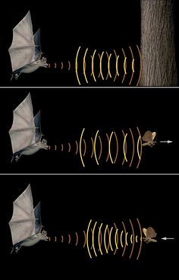
Echolocation
Echolocation is a technique used by bats, dolphins and other animals to determine the location of objects using reflected sound. This allows the animals to move around in pitch darkness, so they can navigate, hunt, identify friends and enemies, and avoid obstacles.

Slide 9
Algorithm Functions
Help to solve NP-completeness.
Image Processing
Fuzzy Logic and Other Applications
Classifications, Clustering and Data Mining
Inverse Problems and Parameter Estimation

Slide 10
Image Processing
Abdel-Rahman presented a study for full body human pose estimation using bat algorithm, and they concluded that BA performs better than (PSO), (PF) and (APF).
Du and Liu presented a variant of bat algorithm with mutation for image matching, and they indicated that their bat-based model is more effective and feasible in imagine matching than other models.

Slide 11
Inverse Problems and Parameter Estimation
Lin et al. (2012) presented a chaotic L´evy flight bat algorithm to estimate parameters in nonlinear dynamic biological systems, which proved the effectiveness of the proposed algorithm.
Yang et al. (2012b) use the bat algorithm to study topological shape optimization in microelectronic applications so that materials of different thermal properties can be placed in such a way that the heat transfer is most efficient under stringent constraints.

Slide 12
Fuzzy Logic and Other Applications
Furthermore, Lemma et al. (2011) used fuzzy systems and bat algorithm for exergy modelling, and later Tamiru and Hashim (2013) applied bat algorithm to study fuzzy systems and to model exergy changes in a gas turbine

Slide 13
Classifications, Clustering and Data Mining
Komarasamy and Wahi (2012) studied K-means clustering using bat algorithm and they concluded that the combination of both K-means and BA can achieve higher efficiency and thus performs better than other algorithms.
Damodaram and Valarmathi (2012) studied phishing website detection using modified bat algorithm and achieved very good results. 5

Slide 14
Help to solve NP-completeness.

Slide 15
How Does It Work

Slide 16
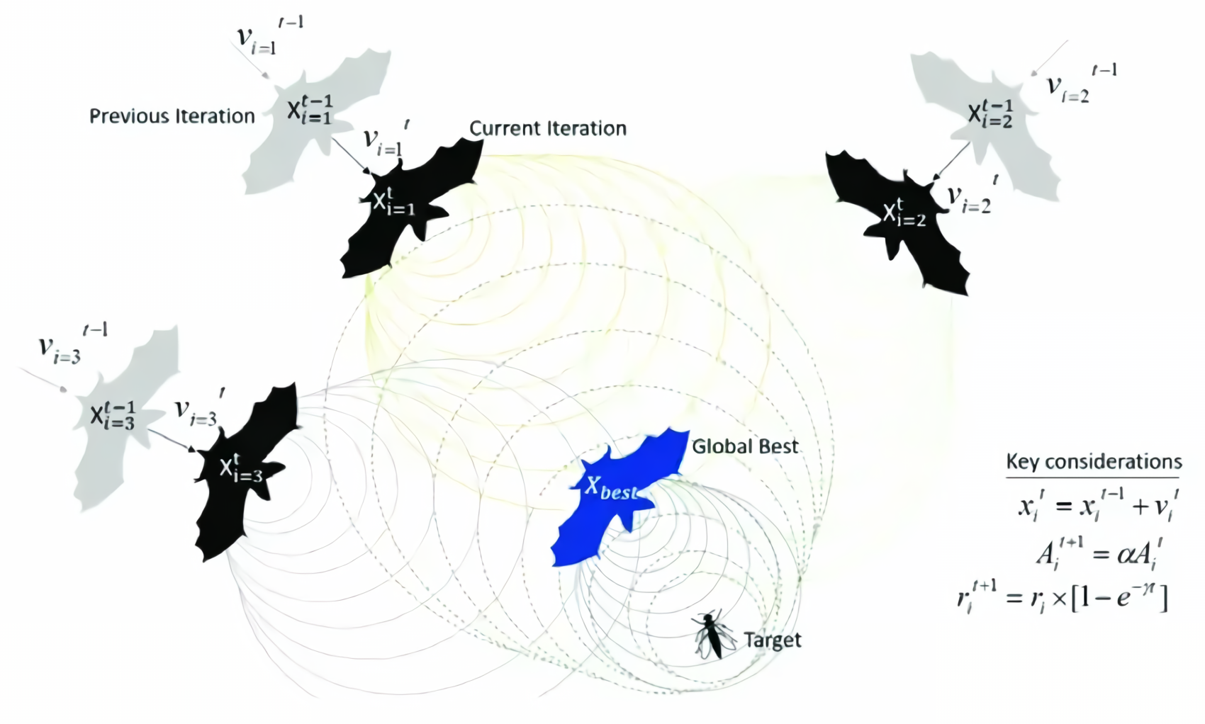
How bats locate each other

Slide 17
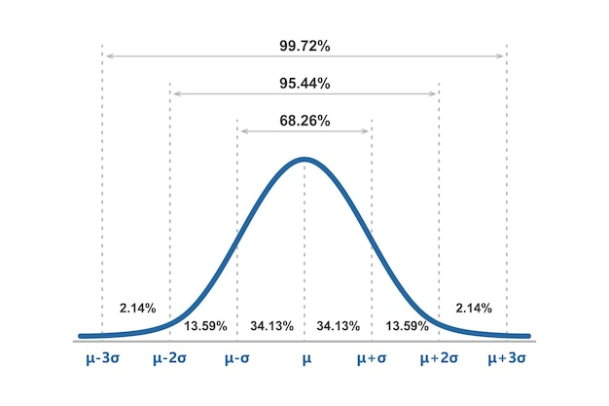
Gaussian distribution

Slide 18
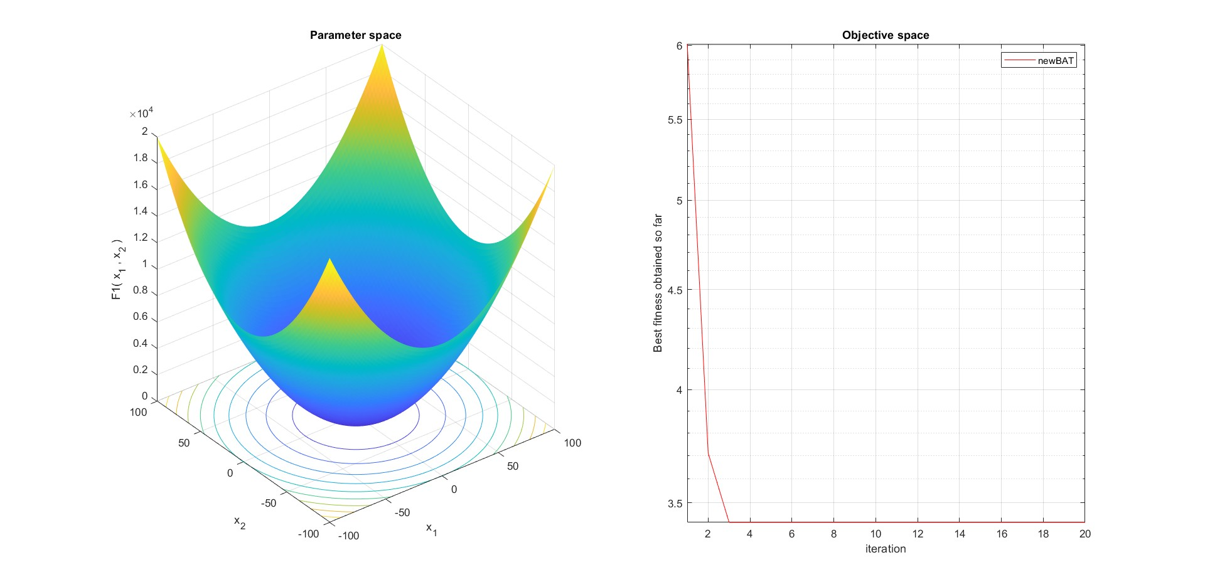
Visualization Bat Algorithm

Slide 19
Thanks for Your Attention

