Slide 1

COVID-19 in Chicago
The Impact of the Pandemic on Financial Well-Being and Mobility
Chicago | June 21, 2020

Slide 2

Agenda
Hypotheses and Research Questions
Recommendations
Introduction
Analysis and Prediction

Slide 3
Executive Summary
Chicago and its communities is facing unprecedented challenges due to the economic fallout from COVID-19. Social distancing has necessitated a dramatically reduced taxi ridership compared to previous years. This has left the taxi companies, drivers, and their families far below their expected revenue, a trend which is expected to continue in coming months
We have conducted a research, analyzing taxi rides data, which allowed us to understand the big picture of the crisis and a dramatic decrease of revenues in the industry, and developed recommendations to interested parties ​
We expect that this analysis allow the different stakeholders to develop mitigation mechanisms and allocate financial resources, while considering both policy objectives and the shareholder expectations ​
For our research we used data from Chicago Open Data Portal and conducted the exploratory data analysis together with building simple predictive models for further recommendations

Slide 4



Business Case
Client: Working group of Chicago Mayor’s Office, Chicago Taxi Union, taxi companies, Chicago CDO
Problem: estimate the effect of COVID-19 on Chicago taxi drivers, taxi companies, and taxi clients
Deliverable: Research about the effect of COVID-19
on Chicago financial well-being and mobility

Slide 5



Data & Source
Time period: Taxi trips in Chicago (12/2019 – 06/2020)
Size: 4137294 rows * 23 columns (50 taxi companies)
Source: Chicago Open Data Portal

Slide 6
Hypotheses and Research Questions
Recommendations
Introduction
Analysis and Prediction

Slide 7

Research Hypotheses
Hypothesis 1: COVID-19 negatively affected the financial well-being of Chicago cab drivers and their families, as well as revenues of taxi companies
Hypothesis 2: COVID-19 changed the behavior of Chicago taxi clients

Slide 8

Research questions
Changes in rides frequency
Total
by Company
Changes in clients payments
Payment amount (average check & total revenue)
Changes in tipping behavior
Changes in mobility
Duration
Mileage
Hours of use
Changes in hotspots

Slide 9
Hypotheses and Research Questions
Recommendations
Introduction
Analysis and Prediction

Slide 10



Hypothesis 1
COVID-19 negatively affected the financial well-being of Chicago cab drivers and their families, as well as revenues of taxi companies
In Chicago, cab drivers are licensed as chauffeurs (~12,700 licenses)
Average salary is $38,001, but the range typically falls between $31,564 and $46,379. Some lease cabs for $500 per week

Slide 11
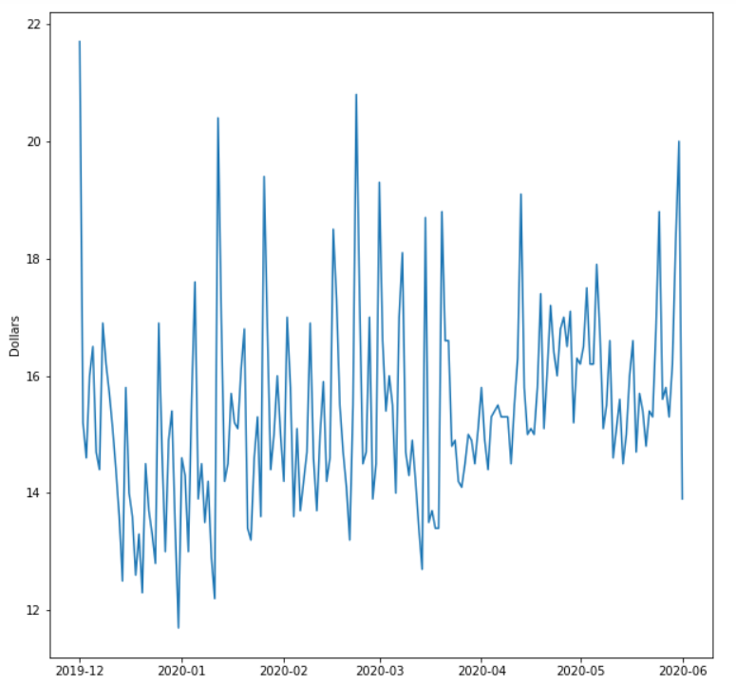
Average amount is the same ($16-17)
Notes:
https://www.wbez.org/stories/chicago-cab-drivers-face-impossible-situation-during-pandemic/bcc7ea0f-a14a-4e68-a662-b170cf89e544

Slide 12
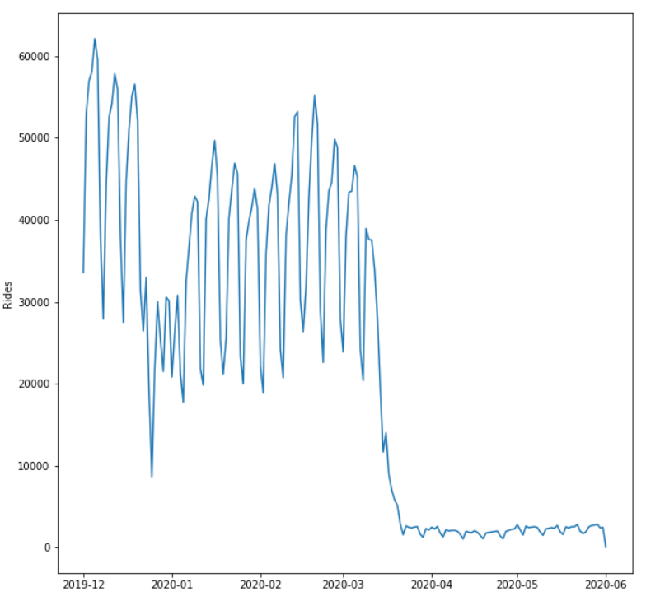
Daily taxi traffic dropped by ~95%

Slide 13
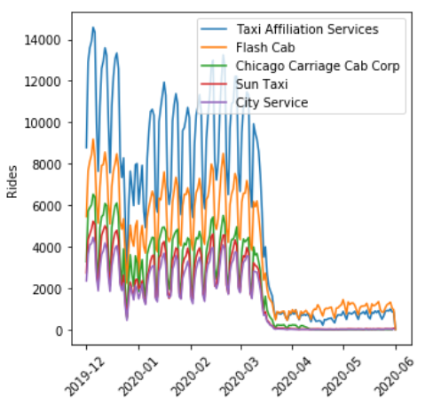
Major companies have the same trend

Slide 14
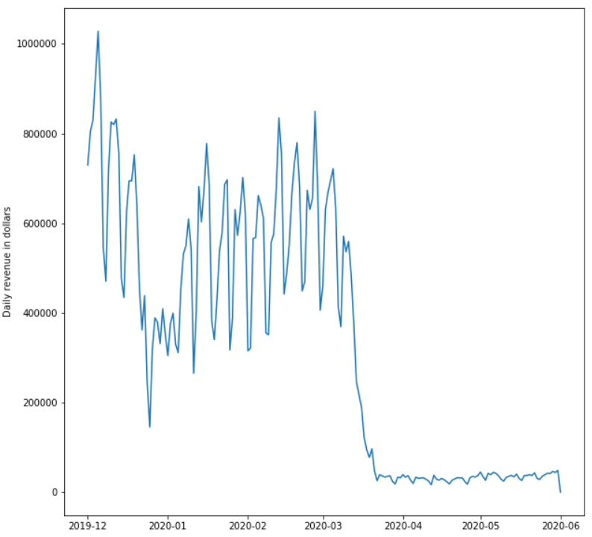
Total daily revenue down by ~95%

Slide 15

Hypothesis 2
COVID-19 changed the behavior of taxi clients
Average tipping amount went down
Pick up and drop off locations changed

Slide 16
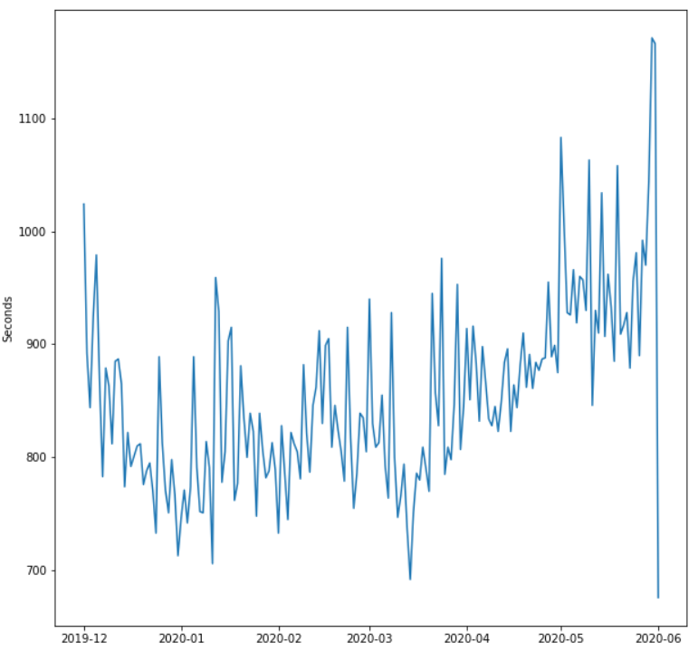
Average duration went up by 3 min

Slide 17
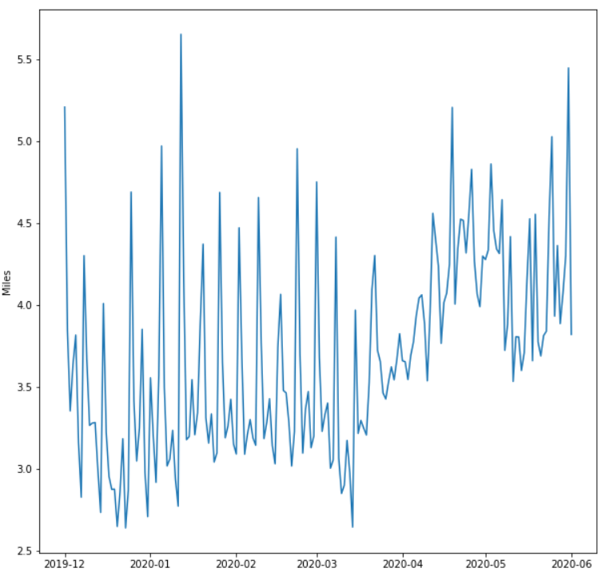
Average mileage went up by 1 mile

Slide 18
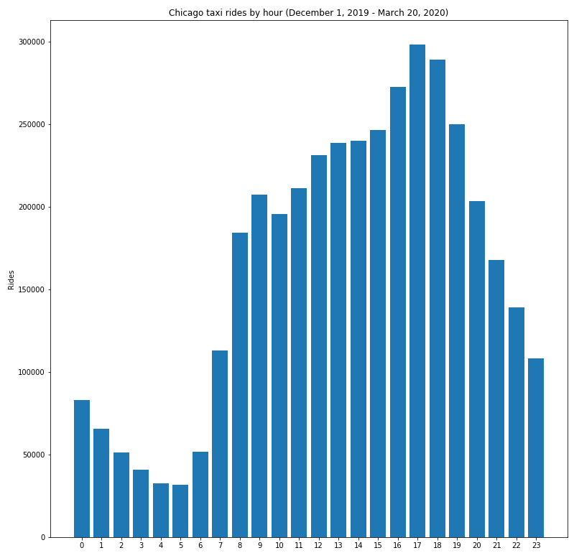
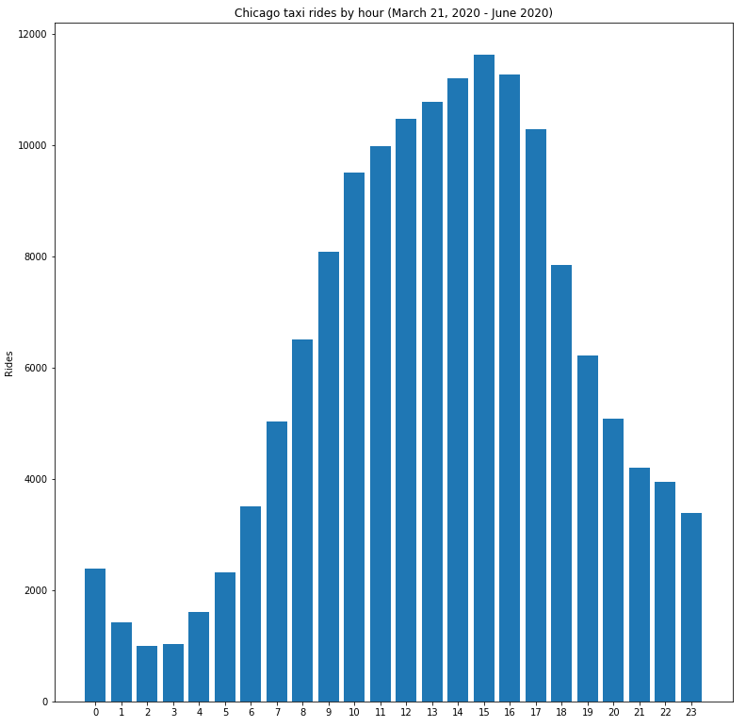
Clients change their hour preferences

Slide 19

Predictive Analytics: Ideas and Challenges
Prophet is an open source science tool developed by the Data science team at Facebook for time series forecasting
Uses Generalized additive models which can be represented by ​
y(t) = g(t) + s(t) + h(t) + ϵ
Where​​
g(t)= models trend​​
s(t) = models seasonality​​
h(t)= models the effects of holidays​​
ϵ = error term​

Slide 20
Hypotheses and Research Questions
Recommendations
Introduction
Analysis and Prediction

Slide 21



Policy Recommendations
Chicago authorities should reconsider the tax and fees burden on taxi drivers
Drivers should be reimbursed for purchasing protective equipment
Companies should develop more flexible pricing and operations policies
Banks should develop flexible payment mechanisms for car loan payments

Slide 22




MScA Advisors
Devanshi Verma
Co-Founder
Oleksiy Anokhin​
Co-Founder

Slide 23
References
GitHub Repository
https://github.com/OleksiyAnokhin/UChicago-COVID-Hackathon
Chicago Open Data Portal
https://data.cityofchicago.org/Transportation/Taxi-Trips/wrvz-psew

Slide 24

Thank you for your time

