Slide 1
Stat 405
Introduction to git
Garrett Grolemund

Slide 2
Why git?
Setting up git
Using git
More reasons for git

Slide 3
Why git?

Slide 4
Download git-project.r and git-template.tex
Download baby-names.csv
What does git-project.r do?

Slide 5
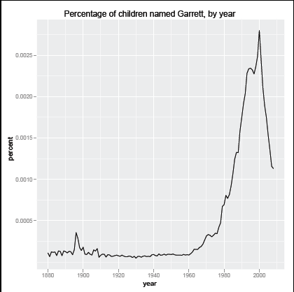

Slide 6
Your turn
Use the git-project.r. code to make a graph that shows the percentage of children with your name by year. Make the graph, but don’t save the changes to git-project.r.
Hint: you only need to change two words, three if you are female.

Slide 7
Group projects
Working on our own is simple. But what if we wish to pool our efforts?
Pair up with a partner
Our goal: to create a one page report about your two names. Include a graph that compares the popularity of each name over time.

Slide 8
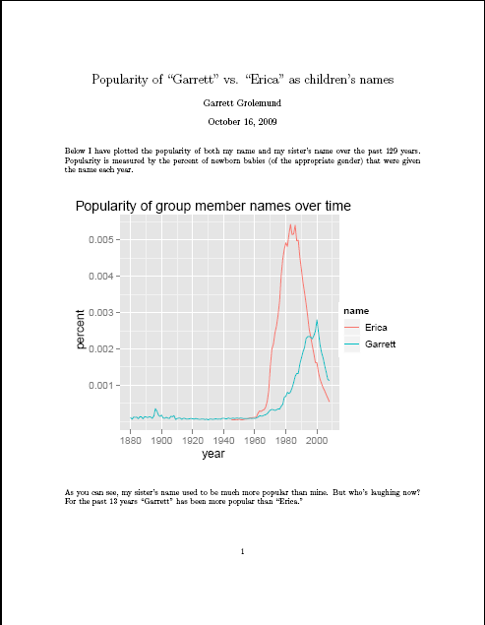

Slide 9
Caveat: you must each work from your own computer.
Brainstorm
How would you exchange information? How many people could work on the code at once? How would you back up your work? What difficulties might you encounter?
Pair up and brainstorm for 2 minutes

Slide 10

Git
Git is a program that makes project management easier. Github is a website that makes using git easier.

Slide 11
What does git do?
Git backs up the entire project and the entire history of the project. You can undo mistakes very easily.
Git allows multiple people to work on the same code at once without overwriting each other’s work.
Github allows you to keep all of your files in one central, publicly accessible location.

Slide 12

Think of git as a library where your files live. The library stores the most up to date version of the files as well as all previous versions. Multiple users can check out the same file at the same time. Whenever you return the file, the library writes a new most up to date version that incorporates your changes.

Slide 13
Github
Github provides an online location for this “library.” It is a website that hosts project files for git users. It also offers its own project management tools, and it can be used to share your project with the public.
www.github.com
A sample repository on github:
www.github.com/hadley/data-housing-crisis

Slide 14
Setting up Git

Slide 15
Configuring git
After you install git, open the terminal window and run the following commands. These will make working with git easier.
git config --global user.name 'John Doe' git config --global user.email jd@example.com git config --global color.ui auto git config --global color.branch auto git config --global color.status auto git config --global color.interactive auto git config --global branch.autosetupmerge true

Slide 16
Creating ssh key
To register for a github account, you will need to provide an ssh key. This is how github will recognize the messages your computer sends.
Instructions for generating an ssh key for Macs, Linux, and Windows are each on the handout.

Slide 17
Your turn
Register for a free github account at www.github.com. You will need to create a ssh key to use. Run
ssh git@github.com
at the command prompt to ensure the ssh key is working. You should get the message:
Hi username! You’ve successfully authenticated, but GitHub does not provide shell access

Slide 18
You have now:
Installed git (before class)
Created a repository
Now we want to put our work into the repository and begin collaborating.

Slide 19
Git init
Git does not automatically track every file on your computer. You must tell it which files to monitor.
To do this, open a terminal window and navigate to the folder you wish git to track.
cd <filepath>

Slide 20
Git init
From within this folder run the command:
git init
This “inititalizes” the folder. Git will now pay attention to the folder and its contents. You only have to run git init once per the lifetime of a folder.

Slide 21
Linking to github
To link the folder to your github repository, run the command:
git remote add origin git@github.com:<username>/
<repositoryname>.git
(All one line) Your username and repository name are in the address bar of the github webpage for your repository. Like git init, this command only needs to be run once. Note: don’t include the <> symbols.

Slide 22
Your turn
Go to your dashboard page on github. Click “create your first repository” and follow the directions. Github will give you a short script to run. You’ll recognize git init and git remote in the script.
Create a new folder on your computer named “name-project”.
Navigate to that folder and then run the script github gave you.

Slide 23
Adding to the repository
Now that we have a repository, we’d like to put some files into it.
Sending files to a repository is a three step process:
First we tell git which files we want to send
We package these files up with a message
We send the package to the repository

Slide 24
Git add
We tell git which files to send with git add. To add files one by one, use
git add <filename>
Or, to add all of the files in the folder at once, run:
git add .

Slide 25
Git commit –m""
Once we’ve selected all of the files to update, we need to combine them into a package to send to github.
These “packages” are called commits and contain two parts:
The files to add to the repository
A short message describing the files

Slide 26
Git commit –m""
To build a new package out of the files that have been added, run
git commit –m"your message here"
The message will appear on github and will help you navigate back through points in the project’s history.
It will also help you and your coworkers understand what you included in the package.

Slide 27
Git push
Now we just need to send our neatly packaged files to the github repository.
Doing this is very simple. Just run:
git push

Slide 28
Your turn
Move the original git-project.r and git-template.tex files into the folder linked to the git repository.
Use git add, git commit –m"", and git push to send the files to your github repository.

Slide 29
Git clone
At some point you may want to collaborate with a researcher who already has files in a github repository.
With one command you can 1.) copy these files to your computer, 2.) link the files to the github repository, and 3.) tell git to start monitoring them. To do so, create a folder and from within it run:

Slide 30
Git clone
git clone git@github.com:<username>/<repository>.git
(All one line). The address that you’ll need after “clone” is the same address that appears on the researcher’s github repository page in the first box down. Like init and remote, this command only needs to be run once per folder.

Slide 31
Your turn
Decide with your partner which repository to use for today’s project (theirs or yours).
Repository owner: click the Admin tab on your github repository webpage. Add your partner as a Collaborator.
Collaborator: clone the repository into a folder on your computer.

Slide 32
Using Git

Slide 33
Now that everything is set up, using git is easy. With git, you will always follow the same process:
Checkout the most current version of the project from the repository (git pull)
Work on the files and save your changes
Review what changes you have made (git status and git diff)

Slide 34
4. Tell git which changed files to update the repository with (git add)
5. Package those files up (git commit –m"")
6. Send those files to github (git push)
Github will automatically update the project with the changes you made.

Slide 35
Git pull
Git pull does the opposite of git push. It brings updated files from the repository to your computer.
In both cases, out of date files are automatically replaced with their updated versions.

Slide 36
Git pull
When working with a group, always pull the most up to date version of the project before beginning work.
If someone has worked on the project recently, the files on your computer may be obsolete.
To pull, navigate to the folder you want to work on and run:
git pull

Slide 37
Git pull
git pull won’t work if you have “uncommitted” changes
You must first save your changes with git add and git commit or remove them.
Why? Git doesn’t want to overwrite any important changes that you’ve made

Slide 38
Your turn
Use git pull to update your folder with the files in the repository that your group has chosen to use.
Open the new version of git-project.r and change the code so that it graphs your name. This time save the changes.

Slide 39
Git status and git diff
It’s a good idea to keep track of what you’ve been changing.
git status shows you which files in your folder have been changed. It also shows you which files have been “added” for the next commit and which haven’t been added.
git diff shows you the exact changes that you’ve made within each file

Slide 40
Git checkout
Sometimes you don’t want to save your changes. You can remove changed files with
git checkout <filename>
Or
git checkout .
To remove all uncommitted changed files.
This replaces the changed files with their old versions stored on github.

Slide 41
Git rm
Sometimes the change you wish to make involves deleting a file. You can delete a file with
git rm <filename>

Slide 42
If you manually delete a file, you manually add and then commit this change to the repository. Otherwise git will continue to look for a file that no longer exists. You can add the "removal" with the command:
git add -u
In general its easier to use git rm to delete files that git is tracking.

Slide 43
Your turn
Look at the changes you’ve made to git-project.r. Add those changes with git add and use git commit-m"" to package them with an appropriate message. Then push them to github with git push.

Slide 44
Uh oh. What happened?
The repository changed while you were away. We’ll have to retrieve the new files with git pull and then fix any conflicts that have arisen.

Slide 45
Merging conflicts
If two people check out the same version of code and then both alter the same line of code, git won’t know which version to keep.
Git will ask you to show it how to blend the two changes.

Slide 46
Merging conflicts
To resolve a conflict:
Run git diff Git will show you exactly which lines are conflicting.
Open the file and rewrite those lines however you prefer. You’ll notice that git has put markers in the file to help you find the lines.
Use git add and git commit –m"fixed conflict" to repackage the file
Run git push again

Slide 47
Your turn
Fix your merge conflict. Rewrite the code to include both names. You can also now use the bottom portion of the code to create a graph that compares both names.

Slide 48
Dealing with mistakes – git reset
If you ever make a mistake and want to back up to a previously saved commit, you can use git reset –-hard
But be careful: once you reset and then push, your project will return to where it was at the specified commit. ALL changes since then will be gone.

Slide 49
Git reset --hard
To return to the previous commit, run
git reset --hard
To go back exactly two commits, run
git reset --hard HEAD^
To go back to some ancient commit, look up the name of the commit on the commits tab on github, and run:
git reset --hard <commit name>
*Please ask Professor Wickham or me before doing this last one. There’s probably a better way to achieve your goals.

Slide 50
.gitignore
.gitignore is a file that you can save inside of any git tracked folder. Git will ignore any file whose name you put into the .gitignore file.
This is useful is you don’t want to send large datasets or extra latex files to the repository.
Each subfolder can have its own .gitignore file

Slide 51
Git ignore
To make a .gitignore file, open a text editor, write the file, and then save it as ".gitignore" in the desired folder.
Note: Files whose names begin with "." are considered system files. As such they remain hidden when you look at a folder's contents. To see all of a folder's contents, including hidden files, type:
ls -a

Slide 52
A basic .gitignore file could contain the following items. This will prevent git from updating all of the excess latex files.
.DS_Store ..Rcheck *.old *.bbl *.pdfsync *.aux *.bak *.blg *.mtc *.log *.mtc1

Slide 53
*.out *.toc *.maf *.fdb_latexmk *.lof *.lot *Autosaved* *.dvdproj *.synctex.gz *.adx *.and *.idx *.ilg *.ind

Slide 54
Your turn
Work together to fill in the git-template.tex latex template. One person fill out the template, one person make the graph. Create a .gitignore file before you start filling your repository with excess latex files. Use git to send material to each other. Push your final product to the github repository.

Slide 55
Other benefits of git and github
Reproducibility
Organization
Tip: divide work and create a to do list with github issues tab
See who is contributing and who is not with the github impact graph
Online backup
Will be helpful (and required) for a future project

Slide 56
Thank you.
I hope you find git useful.

Slide 57
Git resources
Large collection of help files
http://github.com/guides/home
Git cheat sheet
http://zrusin.blogspot.com/2007/09/git-cheat-sheet.html
Git User's manual
http://www.kernel.org/pub/software/scm/git/docs/user-manual.html

