Slide 1

Data Science Camp
Evaluation

Slide 2
This Lesson
Evaluation metrics for binary classification
Evaluation metrics for multi-class classification
Error analysis

Slide 3
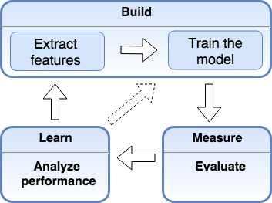
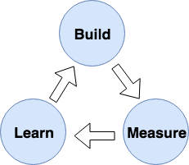
Evaluation In
Model Development Cycle

Slide 4
Evaluation Metrics
Accuracy - is the most popular metric
Business may induce different metrics e.g.:
Users satisfaction (web search)
Revenue (e-commerce)
Patient survival rates (medical)
Some domains may require shifted threshold of classification e.g. check for cancer requires high accuracy on positive (cover all for sure) though with low accuracy of negative (some false negative prediction)

Slide 5

Imbalanced Classes
E.g. Fraudulent transaction detection
Out of 1,000 random;uy selected:
1 is fraudulent (relevant)
999 are normal (irrelevant)
Dummy classifier that always predicts the majority class
Accuracy: 99.9%
Accuracy is not good measure for this case
*
Notes:
Show the notebook

Slide 6
Dummy Classifier
Completely ignores input data (X)
Use it as sanity check of your classifier performance
Consider it as null-metric (baseline)
Don’t use for real problem
from sklearn.dummy import DummyClassifier
clf= DummyClassifier(strategy='most_frequent').fit(X_train, y_train)
clf.predict(X_test)
print("train accuracy= {:.3%}".format(clf.score (X_train, y_train)))
print("test accuracy= {:.3%}".format(clf.score (X_test, y_test)))
*

Slide 7
Dummy Classifier Parameters
Parameters:
strategy : str, default=”stratified”
“most_frequent”: always predicts the most frequent label in the training set.
“stratified”: generates predictions by respecting the training set’s class distribution.
“uniform”: generates predictions uniformly at random.
“constant”: always predicts a constant label that is provided by the user.
(useful for metrics that evaluate a non-majority class)
random_state : int, default=None
constant : int or str or array of shape = [n_outputs]

Slide 8
Null-Metic Cases
Reasons of your classifier accuracy is close to dummy classifier accuracy:
wrong/missed relevant features
wrong parameters (e.g. kernel)
Imbalanced data
If imbalanced data use another evaluation metric

Slide 9
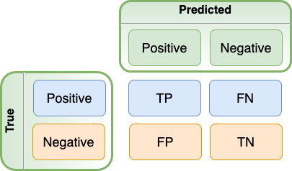
Confusion Matrix

Slide 10
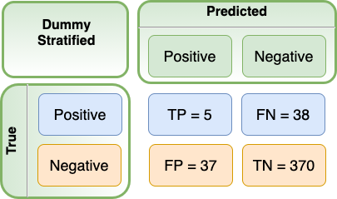
Confusion Matrix For Dummy Classifier
Let’s have training set that consists of 1347 samples:
1208 negative and 139 positive.
Thus stratified dummy classifier predicts with distribution ratio = 0.115. Prediction may vary on random state. Let’s consider one of them.

Slide 11

Accuracy
What is the share of correct predicted from total ?

Slide 12

Classification Error
What is the share of incorrect predicted from total ?

Slide 13
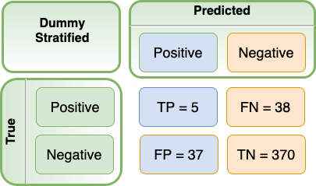

Precision
What is the share of
correct predicted positive
from all predicted positive ?

Slide 14

Recall
What is the share of
correct predicted positive
from all true positive?
= True Positive Rate (TPR)
= Sensitivity
= Probability Of Detection

Slide 15

False Positive Rate
= Specificity

Slide 16
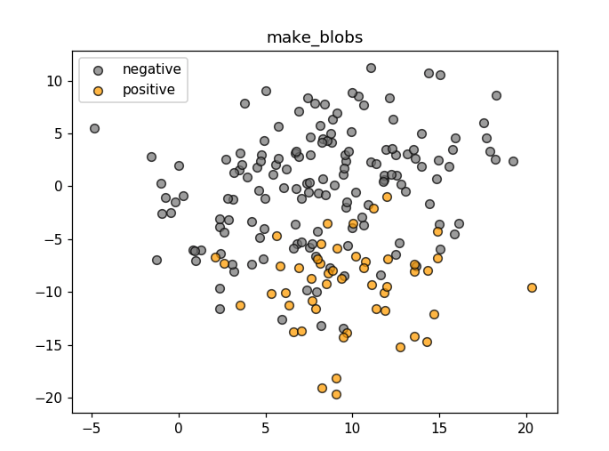
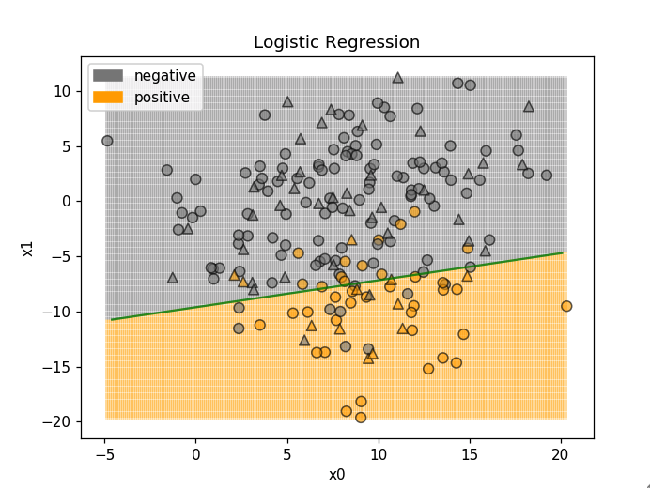
Logistic Regression for Synthetic Data Set
Logistic Regression

Slide 17
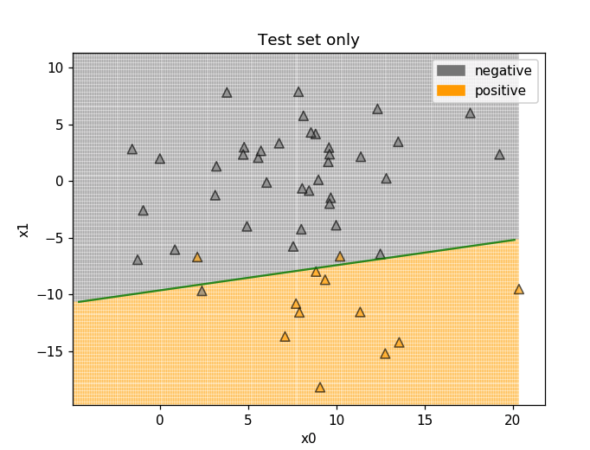
Performance On Test Set
 | Predicted Negative | Predicted Positive
True Negative | TN = 37 | FP = 1
True Positive | FN = 2 | TP = 10
Recall = 0.91
Precision = 0.83

Slide 18
Probability Of Prediction
index | true_value | predicted | probability of 0 | probability of 1
46 | True | True | 0.215176 | 0.784824
47 | True | False | 0.554316 | 0.445684
44 | False | False | 0.982009 | 0.017991
22 | True | True | 0.042861 | 0.957139
10 | True | True | 0.077809 | 0.922191
45 | False | False | 0.948227 | 0.051773
31 | False | False | 0.956127 | 0.043873
42 | True | True | 0.213881 | 0.786119
3 | False | False | 0.532526 | 0.467474
33 | True | True | 0.252123 | 0.747877
clf.predict_proba(X_test)
Threshold = 0.5

Slide 19
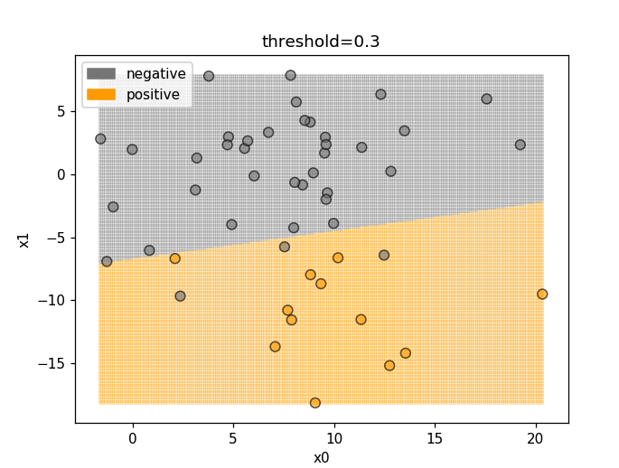
Recall Oriented Classifier
 | Predicted Negative | Predicted Positive
True Negative | TN = 35 | FP = 3
True Positive | FN = 0 | TP = 12
Recall = 1.00
Precision = 0.80
Avoid False Negative (e.g. make sure every positive diagnose is in account)

Slide 20
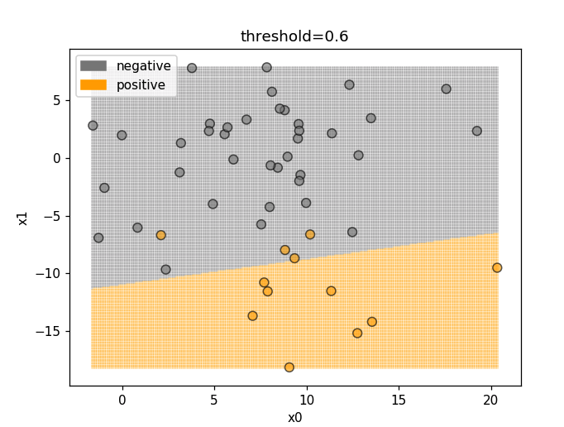
Precision Focused Classifier
 | Predicted Negative | Predicted Positive
True Negative | TN = 38 | FP = 0
True Positive | FN = 4 | TP = 8
Recall = 0.67
Precision = 1.00
Avoid False Positive (e.g. recommend only matched movies and no partially matched)

Slide 21
Decision Function
index | true_value | predicted | score
37 | True | False | 0.334655
23 | False | False | -3.080418
44 | False | False | -3.999724
42 | True | True | 1.301689
47 | True | False | -0.218125
20 | False | False | -2.039472
3 | False | False | -0.130288
30 | False | False | -2.122499
7 | False | False | -4.643650
6 | False | False | -4.890379
y_score = clf.decision_function(X_test)

Slide 22


Aggregated Score

Slide 23
Sklearn Metrics
from sklearn.metrics import accuracy_score, precision_score, recall_score, f1_score
y_predicted = clf.predict(X_test)
print ('accuracy = {:.2}'.format(accuracy_score(y_test, y_predicted)))
print ('recall = {:.2}'.format(recall_score(y_test, y_predicted)))
print ('precision = {:.2}'.format(precision_score(y_test, y_predicted)))
print ('f1_score = {:.2}'.format(f1_score(y_test, y_predicted)))
Out:
accuracy = 0.94
recall = 0.83
precision = 0.91
f1_score = 0.87 * Decision function

Slide 24
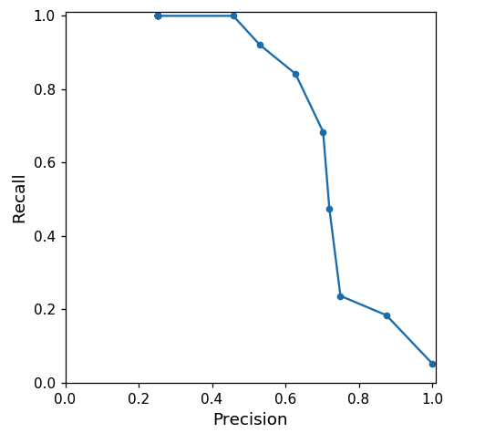
Precision-Recall Curve
threshold | recall | precision
-0.017282 | 1.000000 | 0.253333
0.104312 | 1.000000 | 0.457831
0.225905 | 0.921053 | 0.530303
0.347498 | 0.842105 | 0.627451
0.469091 | 0.684211 | 0.702703
0.590685 | 0.473684 | 0.720000
0.712278 | 0.236842 | 0.750000
0.833871 | 0.184211 | 0.875000
0.955465 | 0.052632 | 1.000000

Slide 25
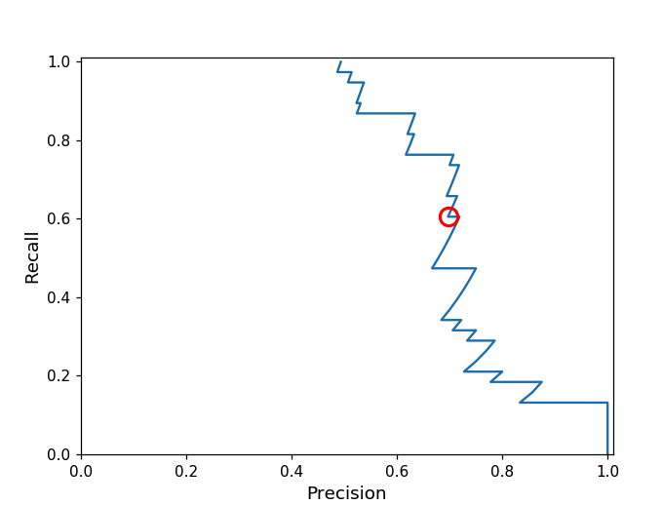
Precision-Recall Curve
Train set (150 samples) of synthetic data set (make_blobs) after training Logistic Regression classifier
from sklearn.metrics import precision_recall_curve
y_score = clf.decision_function(X_test)
precision, recall, thresholds = precision_recall_curve(y_test, y_score)
* Precision Recall Curve

Slide 26
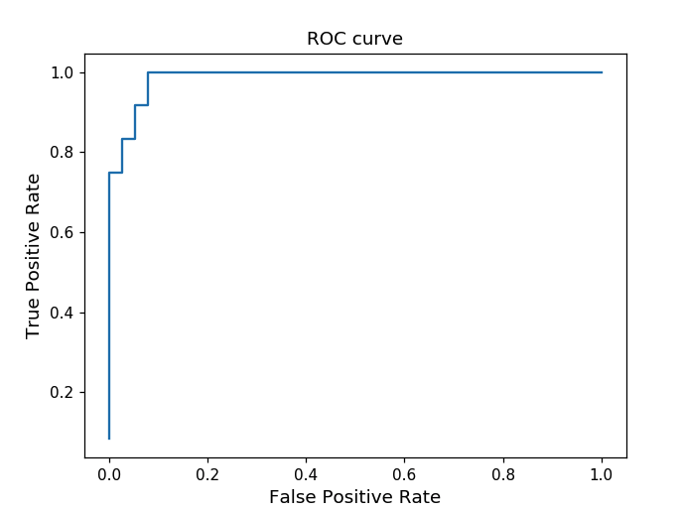
Receiver Operating Characteristic (ROC) Curve
Test set (50 samples) of synthetic data set (make_blobs) after training Logistic Regression classifier
from sklearn.metrics import roc_curve
precision, recall, thresholds = roc_curve(y_test, y_score)
*ROC curve

Slide 27
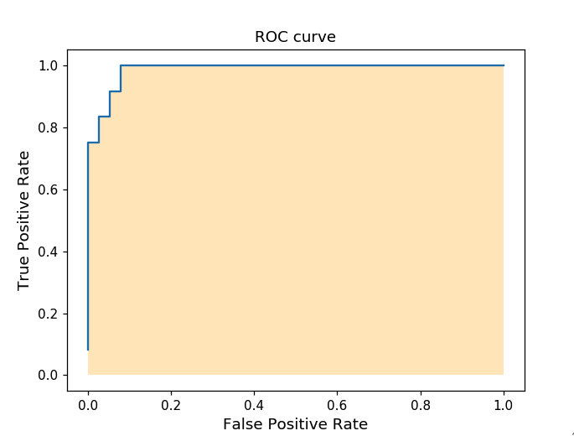
AUC Score
Test set (50 samples) of synthetic data set (make_blobs) after training Logistic Regression classifier
from sklearn.metrics import auc
precision, recall, thresholds = roc_curve(y_test, y_score)
roc_auc = auc(fpr, tpr)
Out:
roc_auc = 0.99
*AUC score

Slide 28
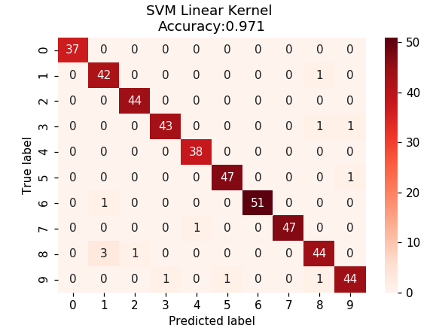
Multi-Class Confusion Matrix
from sklearn.datasets import load_digits
from sklearn.svm import SVC
Linear kernel import seaborn as sns

Slide 29
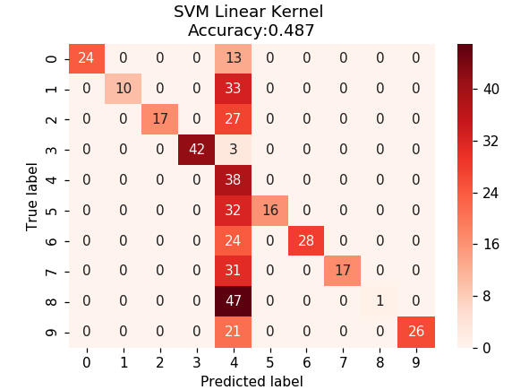
Multi-Class Confusion Matrix
from sklearn.datasets import load_digits
from sklearn.svm import SVC
RBF kernel import seaborn as sns
*Multi-class confusion matrix

Slide 30
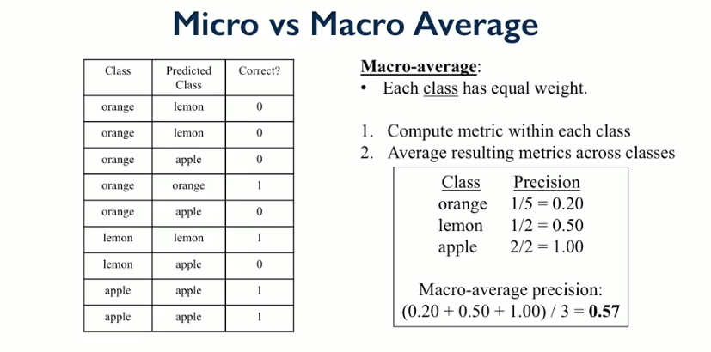
Macro-Average Precision

Slide 31
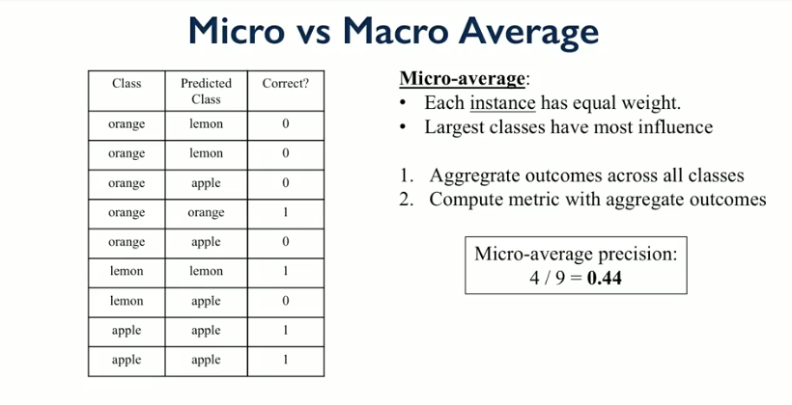
Micro-Average Precision

Slide 32
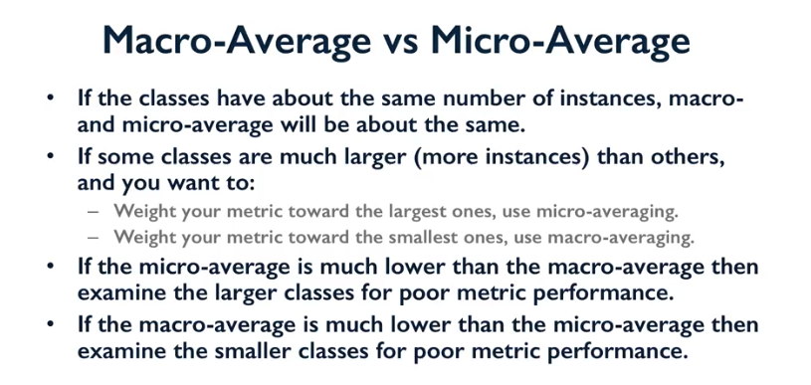
Macro vs Micro Average Precision
*Average

Slide 33
Train/Validation/Test Sets
outlook | humidity | wind | play
sunny | high | weak | no
sunny | high | strong | no
overcast | high | weak | yes
rainy | high | weak | yes
rainy | normal | weak | yes
rainy | normal | strong | no
overcast | normal | strong | yes
sunny | high | weak | no
sunny | normal | weak | yes
rainy | normal | weak | yes
sunny | normal | strong | yes
overcast | high | strong | yes
overcast | normal | weak | yes
rainy | high | strong | no
Using test set to tune the model parameters (e.g. degree of polynomial features ) tends to provide the most optimistic evaluation
Train
Validation
Test

Slide 34
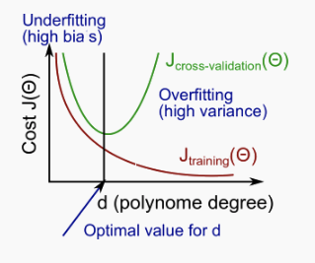
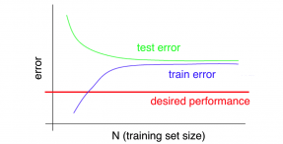
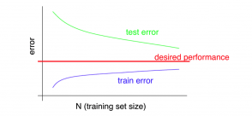
Error Analysis : Bias vs Variance
Comparing classification error of Train and Validation sets depending on parameter value
Comparing classification error of Train and Test sets depending on number of training samples
Underfitting (high bias)
Overfitting (high variance)

Slide 35
Cross Validation Score
Evaluating model on the several splits (folds)
Splits the data to K folds
-> Fits the data on (K-1) folds
-> evaluates on remaining fold
from sklearn.model_selection import cross_val_score
print('Cross-validation (accuracy)', cross_val_score(clf, X, y, cv=5))
print('Cross-validation (AUC)', cross_val_score(clf, X, y, cv=5, scoring = 'roc_auc'))
print('Cross-validation (recall)', cross_val_score(clf, X, y, cv=5, scoring = 'recall'))
Out:
Cross-validation (accuracy) [0.91944444 0.98611111 0.97214485 0.97493036 0.96935933]
Cross-validation (AUC) [0.9641871 0.9976571 0.99372205 0.99699002 0.98675611]
Cross-validation (recall) [0.81081081 0.89189189 0.83333333 0.83333333 0.83333333]
* Cross validation score

Slide 36
Home Task
Get practice with various metrics
for various datasets for various models

Slide 37
Next Lesson
Grid search
Blight Fines Classification

Slide 38
Learn more
Applied Machine Learning in Python
https://www.coursera.org/learn/python-machine-learning
Sklearn.datasets.load_digits
https://scikit-learn.org/stable/modules/generated/sklearn.datasets.load_digits.html
Optical Recognition of Handwritten Digits Data Set
http://archive.ics.uci.edu/ml/datasets/Optical+Recognition+of+Handwritten+Digits
sklearn.dummy.DummyClassifier
https://scikit-learn.org/stable/modules/generated/sklearn.dummy.DummyClassifier.html
sklearn.metrics.roc_auc_score
https://scikit-learn.org/stable/modules/generated/sklearn.metrics.roc_auc_score.html
sklearn.model_selection.cross_val_score
https://scikit-learn.org/stable/modules/generated/sklearn.model_selection.cross_val_score.html#sklearn.model_selection.cross_val_score
Notes:
All home task text is provided in handouts

Slide 39
THANKS!
Any questions?

