Slide 1
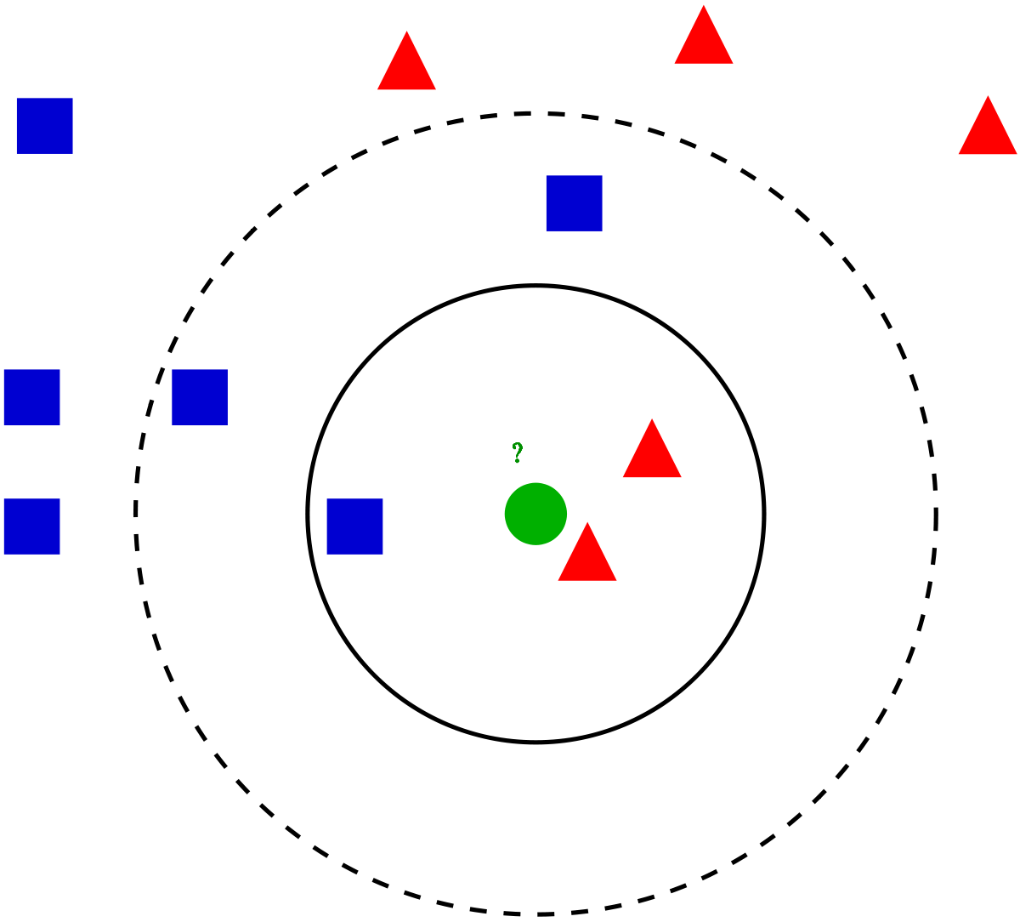
Data Science Camp 2021
K N N

Slide 2
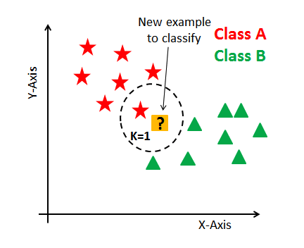
K-Nearest Neighbor (KNN)
KNN classification
KNN regression

Slide 3
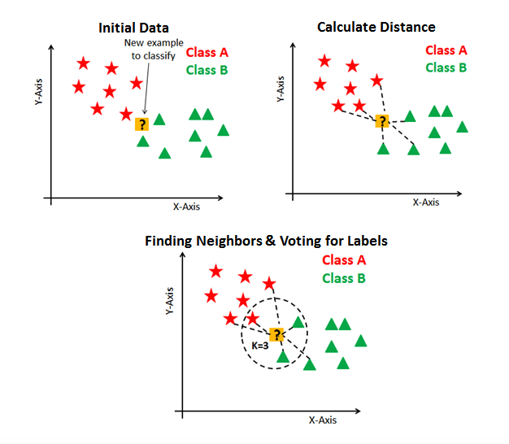
KNN: Classification
KNN executes the
following basic steps:
Compute distance to every point
Find closest neighbors
Vote for labels ( simple majority )

Slide 4
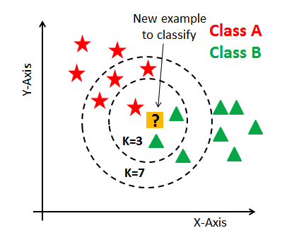
KNN Notes
It calculates distances to ALL samples
K is the only parameter to learn
All training data used for prediction
If K = n (number of training samples), prediction is always constant and resolved to majority label within training samples

Slide 5
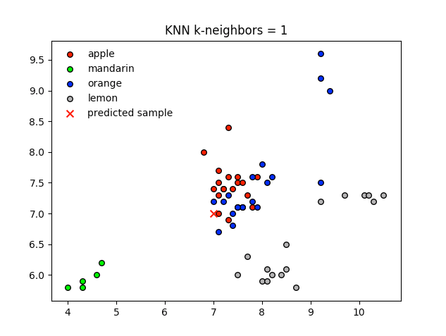
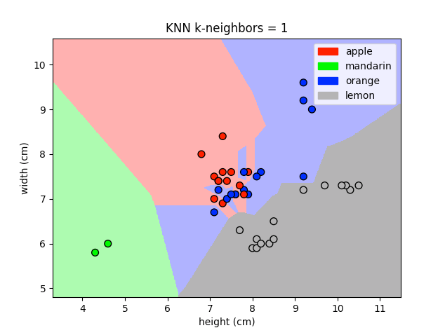
KNN results visualization

Slide 6
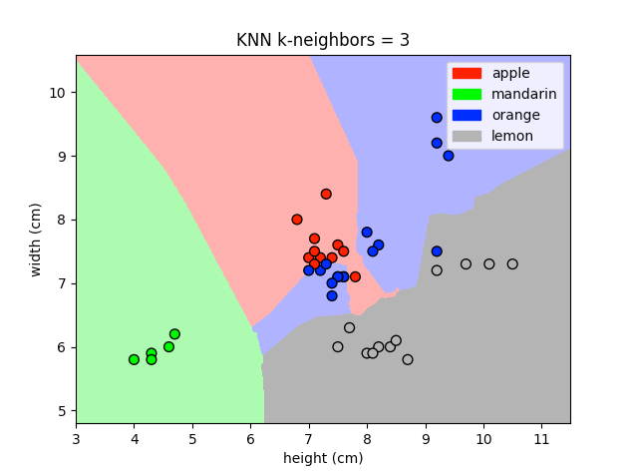
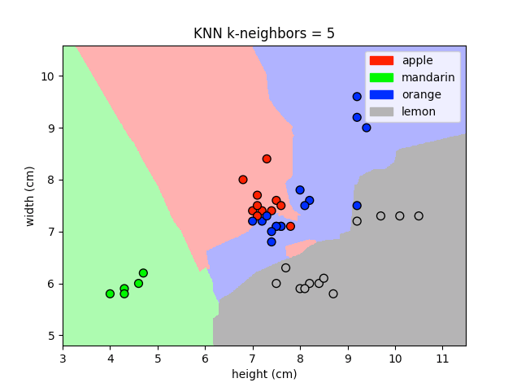
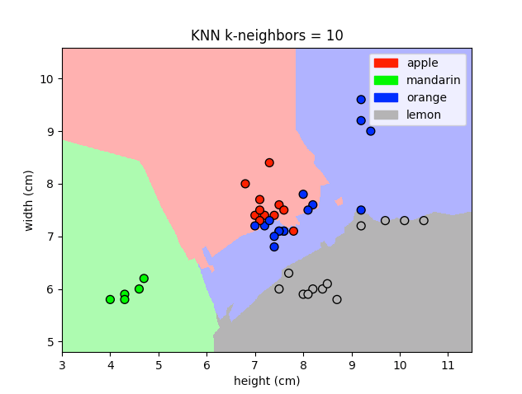
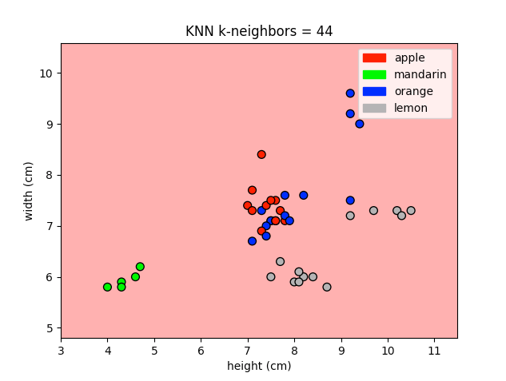

KNN results visualization
fruit_name count
apple 19
orange 19
lemon 16
mandarin 5

Slide 7

Normalization
Algorithm works better if features are similar ranges.
StandardScaler
z = (x - mean(x)) / std(x)
MinMaxScaler
z = (x - min) / (max - min)
from sklearn.preprocessing import StandardScaler
scaler = StandardScaler()
X_train_scaled= scaler.fit_transform(X_train)
X_test_scaled= scaler.transform(X_train)
from sklearn.preprocessing import MinMaxScaler
...

Slide 8
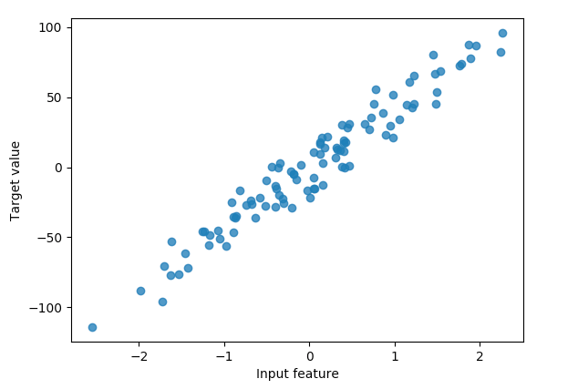
Regression
from sklearn.datasets import make_regression
X_R1, y_R1 = make_regression(
n_samples = 100,
n_features=1,
n_informative=1,
bias = 0,
noise = 10)

Slide 9
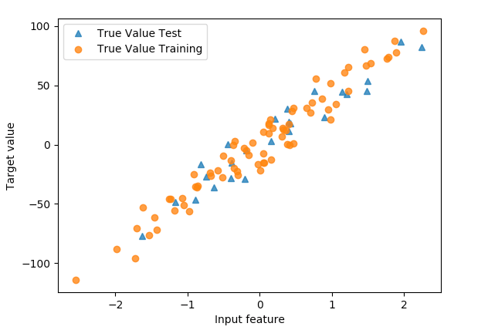
Train and Test sets
from sklearn.model_selection import train_test_split
X_train, X_test, y_train, y_test = train_test_split(X_R1, y_R1)

Slide 10
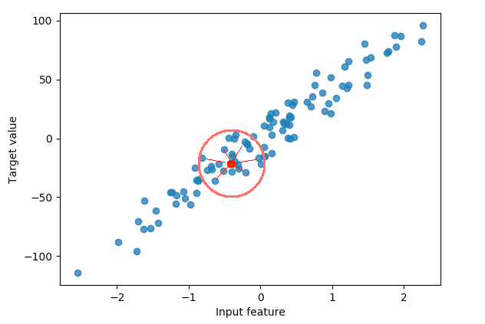
KNN Regression
KNN regression executes the following basic steps:
Calculate distance
Find closest neighbors
Vote for labels ( simple majority )
Calculate average

Slide 11
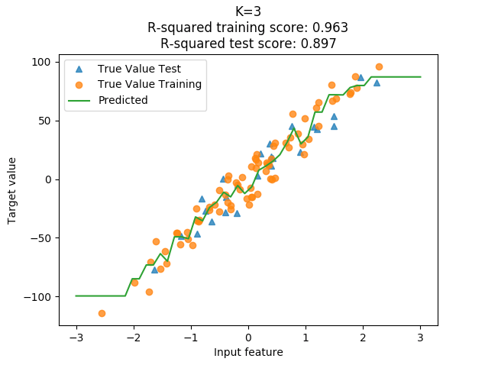
KNN Results Visualization

Slide 12
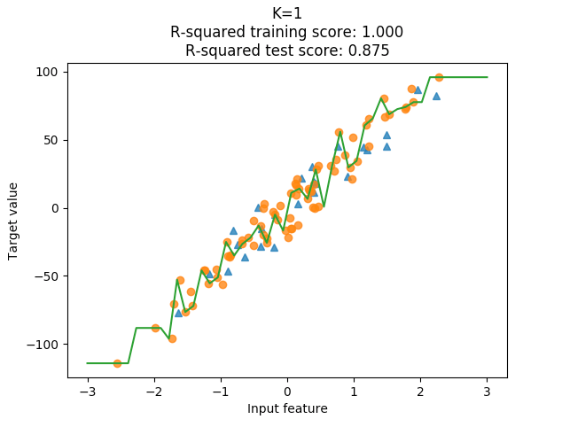
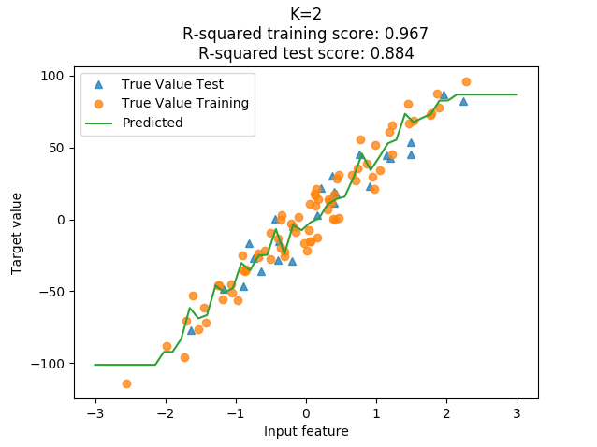
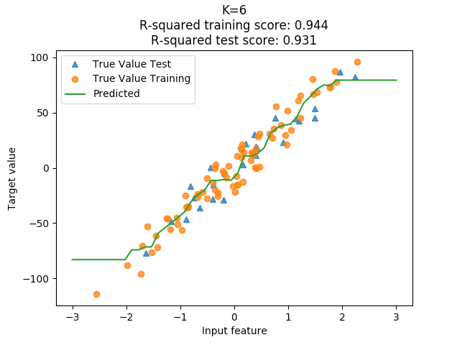
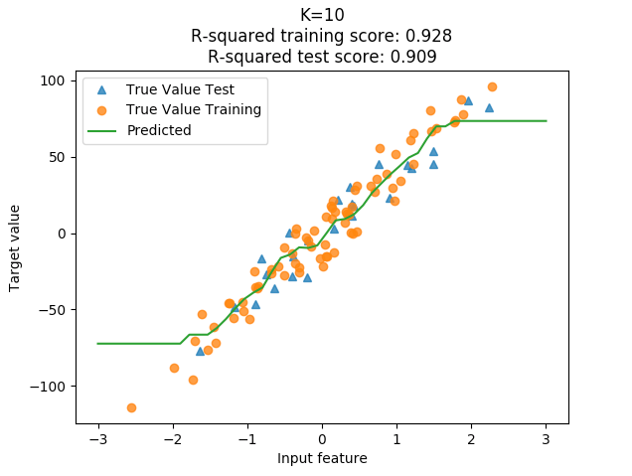
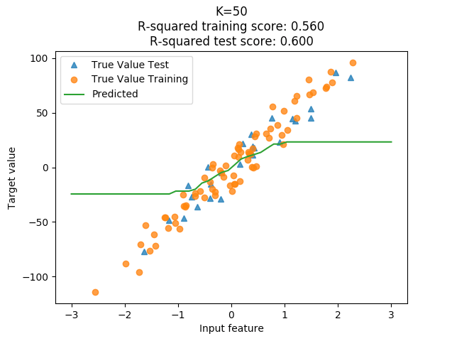
Select the best K

Slide 13
Sklearn KNN Regression
from sklearn.neighbors import KNeighborsRegressor
n_neighbors =5
knn_reg = KNeighborsRegressor(n_neighbors = n_neighbors).fit(X_train, y_train)
knn_reg.score(X_test, y_test) # R2 score
X_predict_input = np.linspace(-3, 3, 50).reshape(-1,1)
y_predict_output= knn_reg.predict(X_predict_input)
# R2 score from sklearn.metrics
z= knn_reg.predict(X_test)
from sklearn.metrics.scorer import r2_score
print (r2_score(y_test, z))

Slide 14
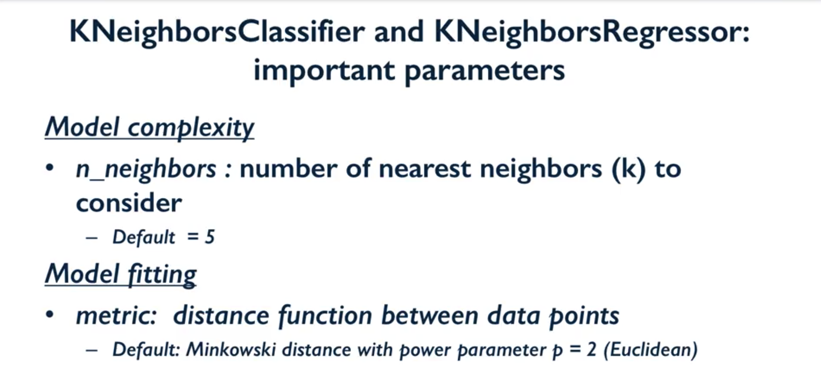
Sklearn KNN Regression parameters
Notes:
Just to remind

Slide 15
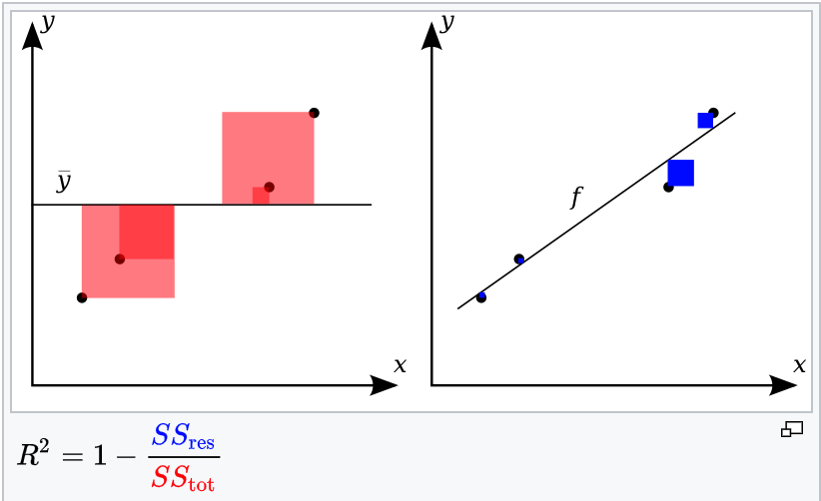

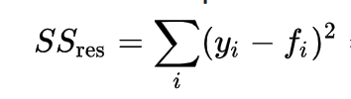
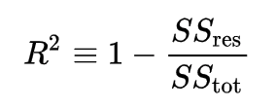
Coefficient of determination (R2 score)
R2 gives information about the goodness of fit of a model.
It is a statistical measure of how well the regression predictions approximate the real data points.
R2 equals 1 indicates the regression predictions perfectly fit the data.
The total sum of squares:
The sum of squares of residuals,
also called the residual sum of squares:

Slide 16
Coefficient of determination (R2 score)
Note: Constant prediction equals to mean gives R2 = 0
from sklearn.metrics.scorer import r2_score
m = np.mean(y_test)
const_pred= np.array([m]*len(y_test))
print (r2_score(y_test, const_pred))
Note: R2 score can be negative value if the prediction is worse that mean
neg_pred = [ m + len(y_test) - i for i in range (len(y_test))]
print (r2_score(y_test, neg_pred))

Slide 17
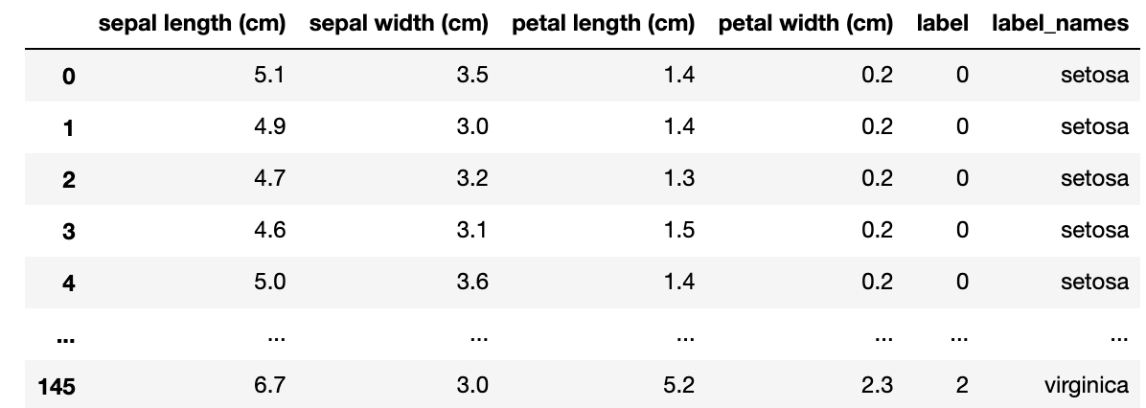

Home Task: 1. KNN classification for iris dataset
Notes:
All home task text is provided in handouts

Slide 18
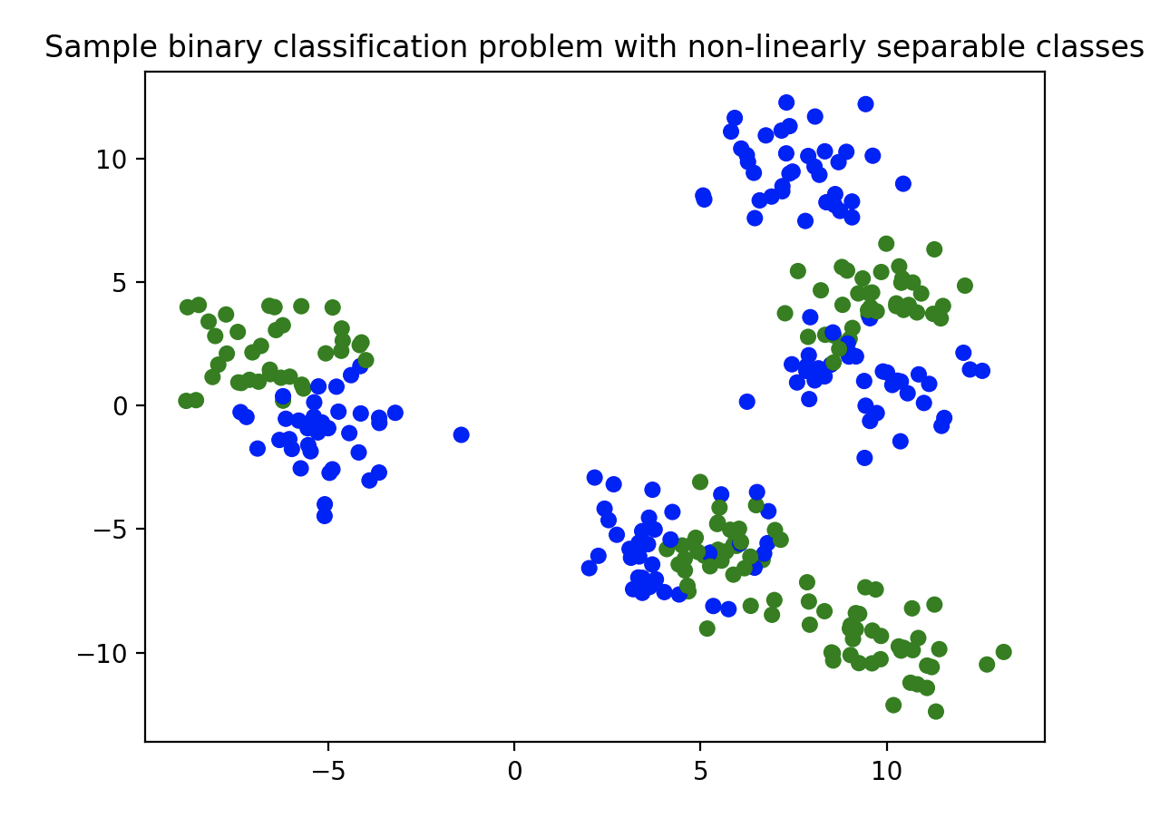

Home Task : 2. KNN classification for synthetic dataset
Notes:
All home task text is provided in handouts

Slide 19

Learn more
sklearn.model_selection.train_test_split
https://scikit-learn.org/stable/modules/generated/sklearn.model_selection.train_test_split.html
Sklearn.datasets.load_boston
https://scikit-learn.org/stable/modules/generated/sklearn.datasets.load_boston.html#sklearn.datasets.load_boston
Coefficient of determination
https://en.wikipedia.org/wiki/Coefficient_of_determination
Notes:
All home task text is provided in handouts

Slide 20

THANKS!
Any questions?

