Slide 1

Analysis of movies
Anirudh Pratap Singh
Olive Olemmyan
Umesh K Bugata

Slide 2
objectives
Perform OLS Regression
Perform T Hypothesis Test
Fit a Decision Tree Regressor

Slide 3
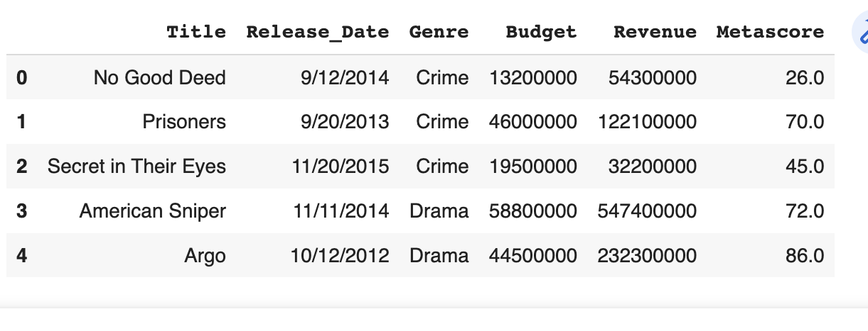
VARIABLES OF INTEREST

Slide 4

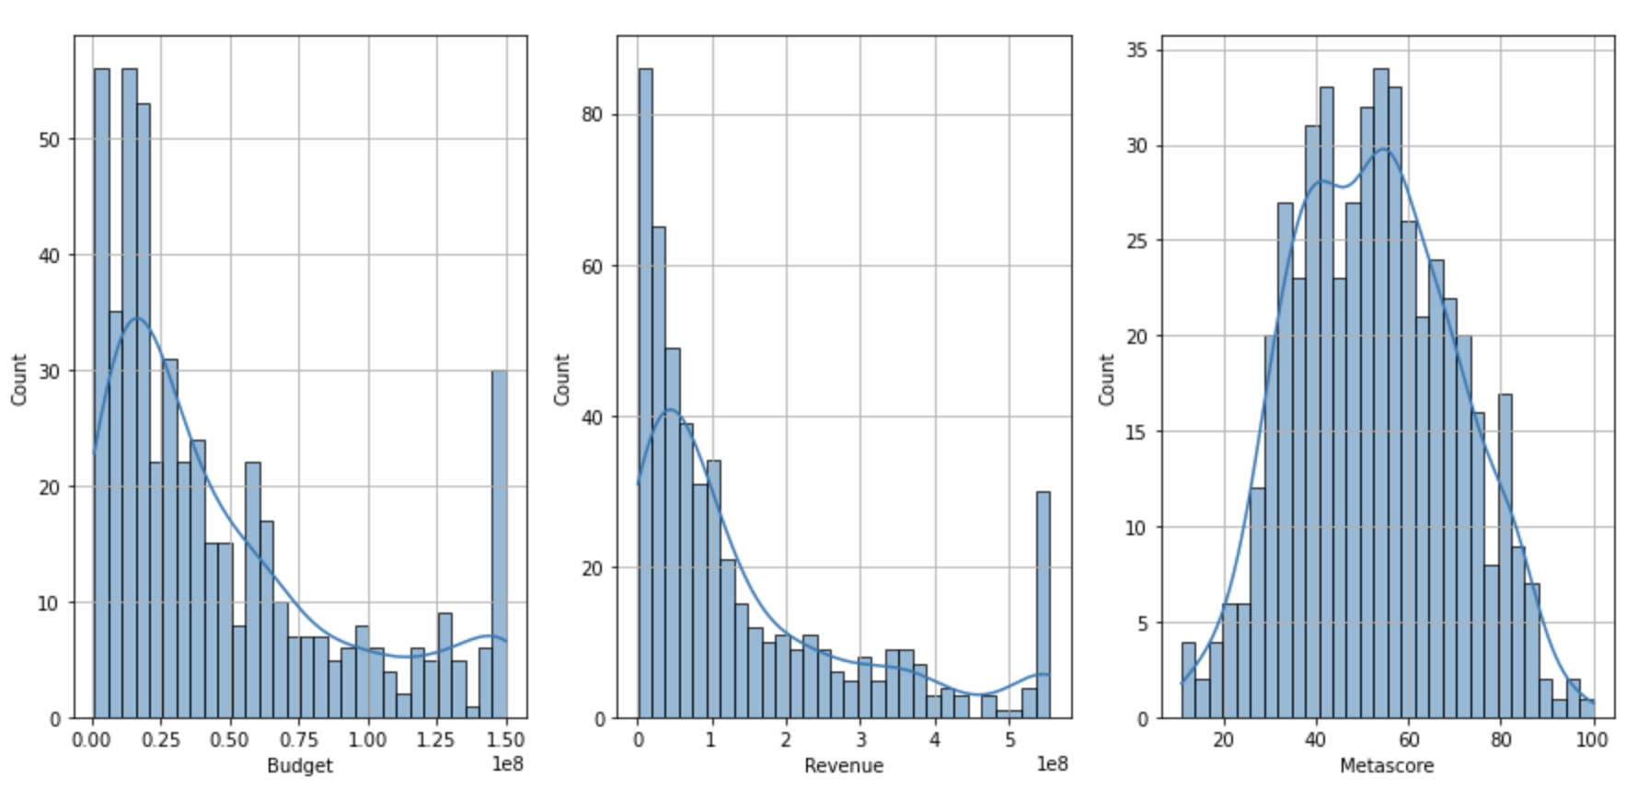

Statistical plots for numerical variables
Skewness of Budget: 1.102
Skewness of Revenue: 1.382
Skewness of Metascore: 0.136

Slide 5
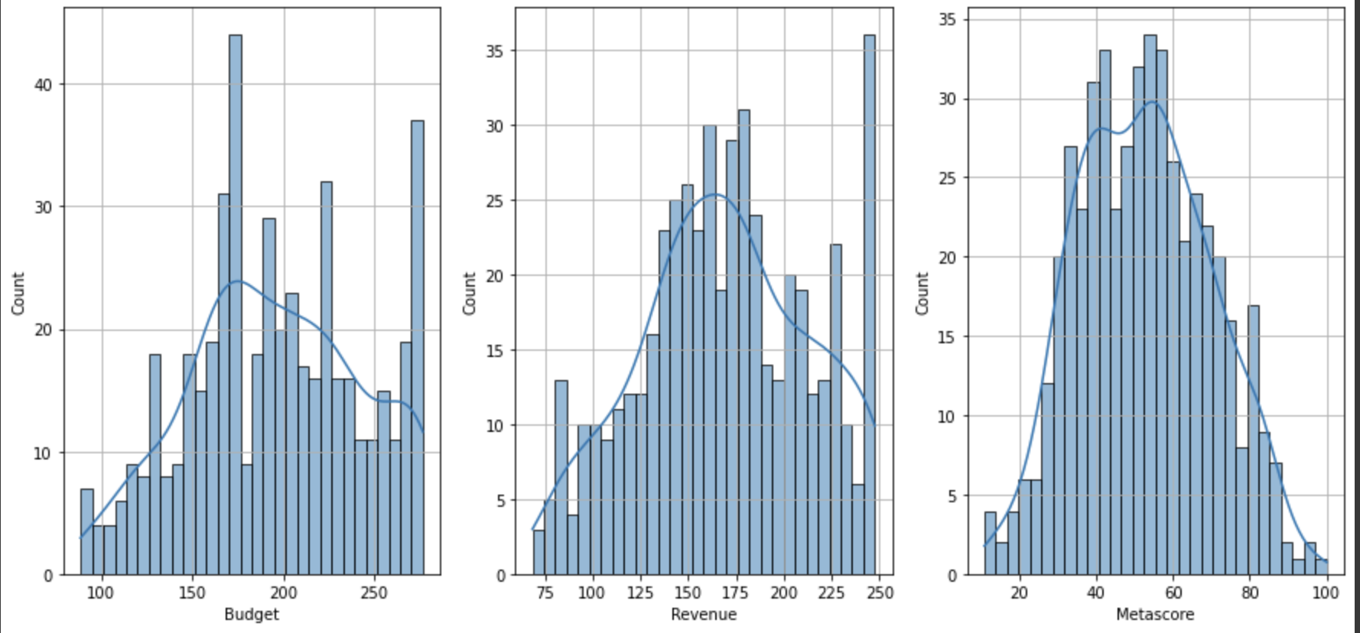
Box cox transformation
A statistical technique that transforms target variable so that the data closely resembles a normal distribution
Skewness of Budget: -0.064
Skewness of Revenue: -0.067
Skewness of Metascore: 0.136

Slide 6
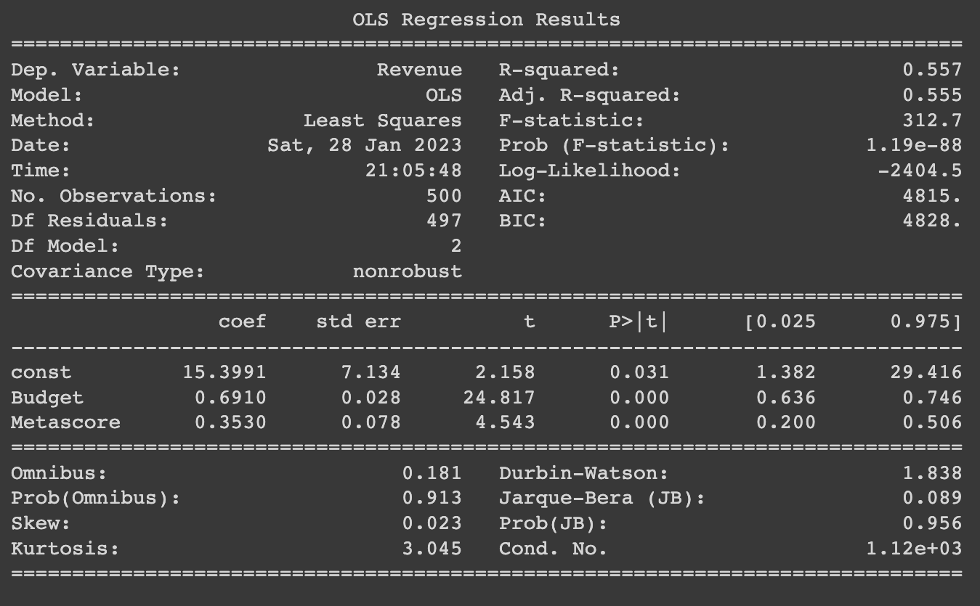
Regression analysis
The p-value of the regression model falls under null hypothesis rejection region.
That is the model is significant
The adjusted R squared value is 0.555
Thus, the Budget and Metascore explain 55.5% of the variability of the Revenue
Both the predictors are significant

Slide 7
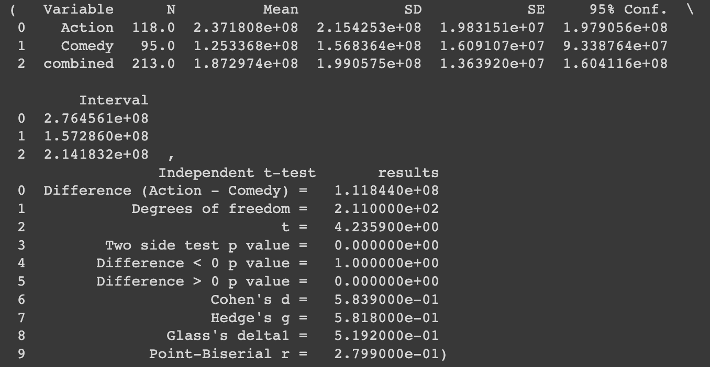
T test
Ho(null hypothesis): The mean Revenue generated for the Action and Comedy genre is same
H1(alternate hypothesis): The means are unequal
The p-value of the two-side t-test is close to 0
Thus, we reject the H0, i.e., the mean revenue of Action is not equal to the mean revenue of Comedy

Slide 8
Decision tree regressor
It observes features of an object and trains a model in the structure of a tree to predict data in the future to produce meaningful continuous output
The Decision tree a gave R squared value of 0.971, which is a very good score
It makes a nonlinear line

Slide 9
THANK YOU

