Slide 1

Scaling your data to the size of the Cosmos (DB)
Olena Borzenko
@borzenko_lena
Notes:
Welcome everyone. My name is Olena Borzenko. You can find me on twitter @borzenko_lena. If you have any questions or comments, feel free to text me.
A little introduction. I’m a senior backend engineer in a company called Durstexpress. It’s beverages delivery service based in Germany. And I started at this company as a part of the logistics team, where we were taking care of the order system but now I’m working with a warehouse team. I live in Berlin and you might have thought that I'm German as well, I know it's shocking but I'm not, I’m originally from Ukraine.
I got the idea for this talk after the latest event which happened in my company. When I had an opportunity to learn first of all how I shouldn’t work with CosmosDB and today I want to share this story.
I’ll start from a story behind all this. There were two companies on the same market and doing the same business and they were doing great. But one day decisions were taken and mistakes were made.

Slide 2
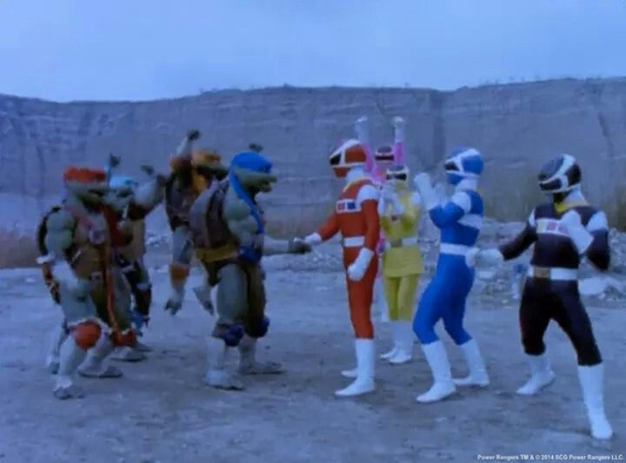
Notes:
Those two companies started a process of merging.
Of course, even if companies are doing exactly the same things in the end, it doesn't necessarily mean that software can be integrated together.
We ended up having a two completely different architectures, and merging a software, which would be extremely complicated process, was not an option.

Slide 3
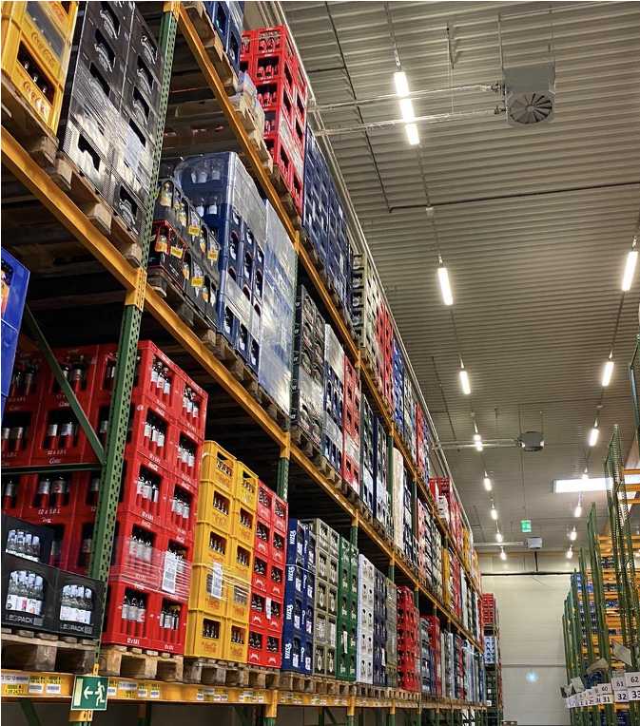
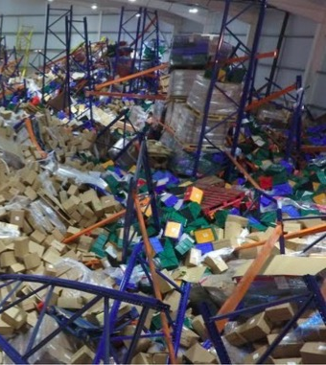
How it Started vs. How It’s going
*not a single bottle of beer was hurt for this picture
Notes:
So one company was integrated into another, and for this last and less fortunate it means that the load on the system, amount of users and hubs increased in a very short period of time.
As we all know sometimes software doesn’t scale well, especially when we really need it. That was clear that we should expect many new challenges. Who knew that one of them will be a new warehouse system from a scratch.

Slide 4

Notes:
A chance to rebuild a crusial part of the running system is not smth what is hapening every day, so of course they didn’t want to have a replica on a bigger scale, they wanted something better. When that kind of things happening and you need to build something new which will replace smth old and big and a little bit legacy, it’s usually not a case that someone will just handle you a bunch of requirements with all the necessary information you need to do this. We had no idea what’s going to happen next.
But it was also not a case that we can just relax and wait, no one had an idea how it should look like in the end.

Slide 5
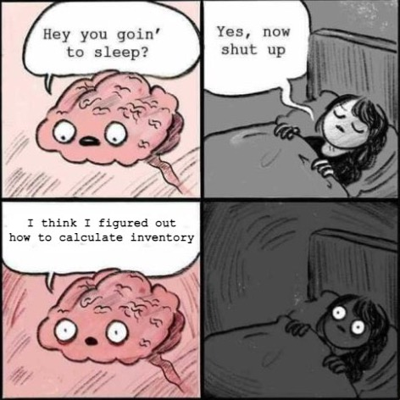
Notes:
So we started to think how the processes should look like, how to calculate inventory, track articles inside the warehouse and so on. Looking into our system, making some assumptions and taking into account problems which were coming up during a merger process we were trying to create a new design.
It took some time but in a couple of weeks we did came up with some ideas. So finally we can write some code! We can build PoC and validate our ideas to see if it's rly gonna work as expected. We briefly discussed technologies we were going to use. But we were working in the same team for a quite some time, so everyone were on the same page and not thinking of using something different.

Slide 6
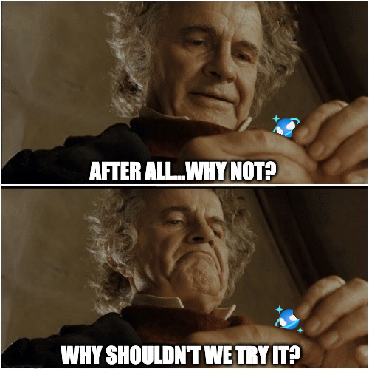
Notes:
Up to a moment when the idea of using nonSQL database was thrown on a table. Who shouldn’t we try CosmosDB? Really why not, it was fitting quite well. I thought it’s a great opportunity to try smth else and volunteered myself out of pure curiosity to investigate this option. We decided to give it a try, it was great to have a plan B or alternative solution, so we can later make a comparison and choose what works better for us. One day I was talking with head of engineering and he told me smth like: Remember that your queries shouldn’t consume more than 10RUs. And I having absolutely no idea what he’s actually talking about genuinely agreed with him. That was a moment when I realized that there is much more than just to make it work.
While we were building PoC using technologies we picked before I also kept looking into CosmosDB itself trying to understand it better and how to properly use it.

Slide 7



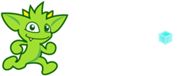

Azure Cosmos DB
MongoDB
Table API
Column-family
Document
Key-value
Graph
Guaranteed low latency
Elastic scale out
Five consistency levels
Global distribution
Comprehensive SLAs
Notes:
One hour won’t be enough to tell you about all the interesting features I’ve learned, but I’ll definitely mention those which were in my opinion most important for my case and this session.
First of all, as you can see that cosmosDB has different APIs such as………for me personally was important that I can use SQL api and start working right away, as I had no experience with other syntax before. For companies like mine it’s very important to be highly responsive and always online. It’s means that data should be as close as possible to users and such applications called globally distributed. Of course you also need to have a globally distributed database such as CosmosDB. Besides that it’s massively scalable and offers 5 different levels of consistency.

Slide 8
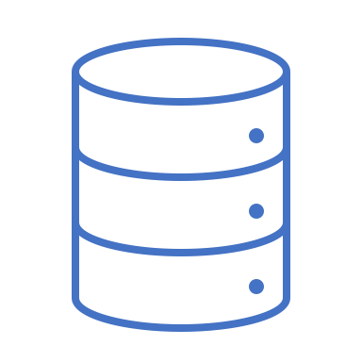


Request units
% Memory
% CPU
% IOPs
Notes:
Latency, Throughput currency Request units;
Measure of computation cost.

Slide 9
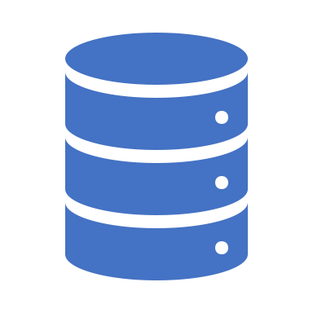


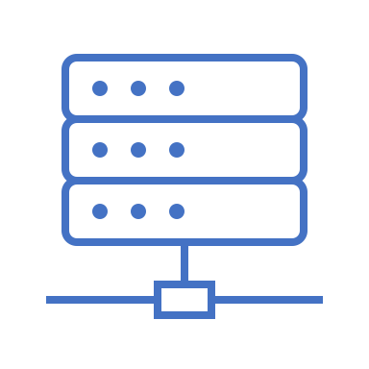
Database
pk: ”c”
id: 123
pk: ”c”
id: 456
pk: ”c”
id: 789
pk: ”c”
id: 036
Container
PartitionKeyPath: “age”
Container
PartitionKeyPath: “name”
PartitionKeyValue: “c”
Logical partitions
a
b
c
1
2
3
c
Physical partitions
Notes:
Explain difference between logical and physical partition. Your container will require more than a few physical partitions when either of the following are true:
Your container will have over 30,000 RU's provisioned
Your container will store over 100 GB of data
File 2MB, logical partition 20GB

Slide 10
Partition key:
Property that has a value which does not change;
Wide range of possible values; (high cardinality)
Spread RU consumption and data storage evenly;

Slide 11










Event-Computing and Notification
Stream Processing
New events (writes)
Change feed
Data movement
Notes:
Pull model;
Change feed processor CFP library, stateful and scalable;
Azure functions: Serverless wrapper around the CFP library;
Rerun your change feed to see if system will behave in the same way.
Trigger api call when a document is inserted or modified;
Perform real-time processing on updates;
Zero downtime migration;
Do I have to do those updates every time? Can I just make aggregation when I need it?

Slide 12
Strong
Bounded staleness
Session
Consistent prefix
Eventual
Notes:
Strong consistency is useful for applications that cannot tolerate any data loss in case of downtime. But it also means that every write must be replicated and committed to the new regions. So you have highest consistency, lower performance, and lowest availability. The latency is also high and this type of model is best suited for Financial transactions, Scheduling, or Forecasting workloads. The performance of bounded staleness is better than the strong consistency however the availability is still. This level is used for apps that don't need to fetch data in real-time, but order of writes is important. The session consistency is the default model. It ensures a strong consistency for an application session with the same session token. The availability of the data is relatively high with lower latency and higher throughput than the bounded staleness. Can be used for a typical e-commerce application, social media app, and other similar services with persistent user connection. The consistent prefix model is similar to bounded staleness. The replicas guarantee the consistency and order of the writes however the data is not always current. This model provides high availability and very low latency which is best for certain applications that can afford the lag and still function as expected.
Eventual consistency is the weakest consistency level of all. There is no guarantee on the order of the data and also no guarantee of how long the data can take to replicate. This model offers high availability and low latency along with the highest throughput of all. This model suits the application that does not require any ordering guarantee. The best usage of this type of model would be the count of retweets, likes, non-threaded comments where the count is more important than any other information.

Slide 13
Use cases:
Track articles in a warehouse;
Calculate the inventory of each article;
Status of each shelf (articles quantity);

Slide 14
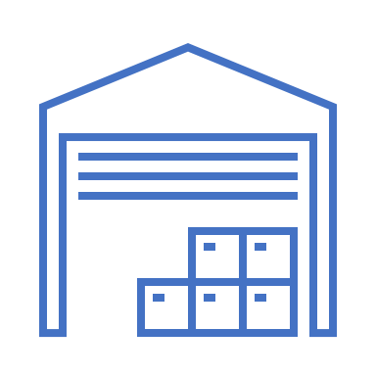
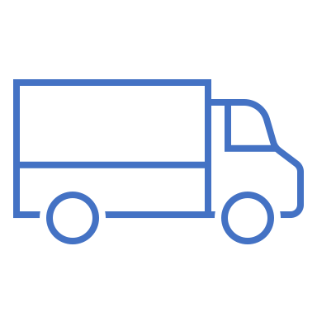

Inbound

Slide 15
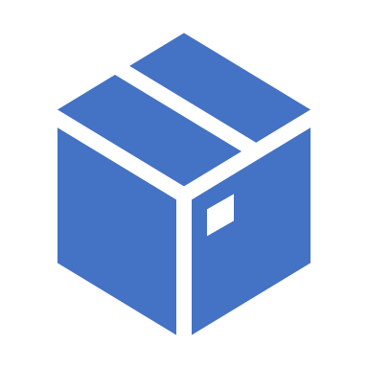
Refilling
Picking
Notes:
Refilling

Slide 16

Notes:
What I did I just assumed that I can easily swap databases. I mean that should work…right? Everything really worked out quite well, up to the moment when I remembered that my queries shouldn’t consume more than 10 RUs. And the numbers I was getting were a little bit different. Turned out that queries were too complicated, with a lot of filtering and aggregations, so or course they were too heavy.

Slide 17
DEMO
V1 – watch and never repeat;

Slide 18
DEMO
V1 – watch and never repeat;
V2 – Change Feed Processor example;
V3 - Azure Function example;

Slide 19
Summary:
SQL Api != SQL;
Create materialized views and duplicate your data;
Make sure that data is distributed evenly;

Slide 20


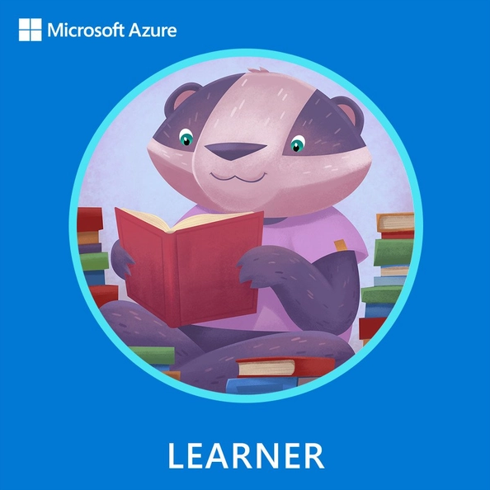
Swag and more
Claim your attendee Learner Badge here:
30 Days to learn it: aka.ms/global-azure/30D2L
Virtual background and ANOTHER Badge: blog.globalazure.net/Swag

Slide 21
Scaling your data to the size of the Cosmos (DB)
Olena Borzenko
@borzenko_lena
Notes:
Welcome everyone. My name is Olena Borzenko. You can find me on twitter @borzenko_lena. If you have any questions or comments, just write me a message I’ll be happy to chat.
Just a few words about me. I’m a senior backend engineer in a company called Durstexpress. It’s beverages delivery all over Germany. And I started at this company as a part of logistics team, where we were taking care of the order part and now I’m working with a warehouse system. I live in Berlin and you might have thought that I'm German as well, I know it's shocking but I'm not, I’m originally from Ukraine.
So this talk is a summary of the lessons I’ve learned after the latest event which happened in my company.
I’ll start from a story behind all this. There were two companies on the same market and doing the same business and they were doing great. But one day decisions were taken and mistakes were made.

