Slide 1
TDD misconceptions
Olena Borzenko
@borzenko_lena

Slide 2




Hello!
I’m Olena Borzenko and I’m a software developer

Slide 3
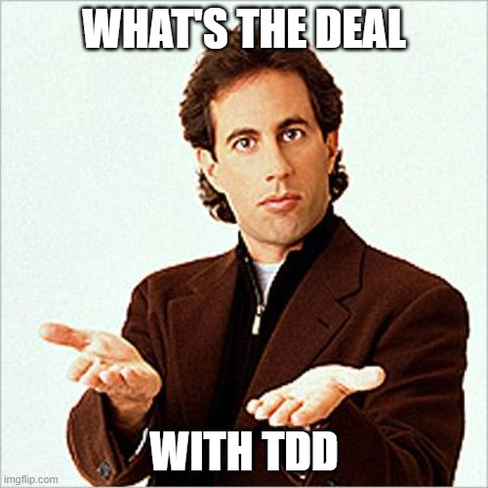
Notes:
From my experience, the most important thing I’ve learned: lack of knowledges is not that big of an issue. The real issue starts when you are convinced that you know something, but reality - is completely different. That was my case, what is more, now that’s one of the reasons why I want to share my story today. What made me reconsider my attitude regarding the TDD and what lessons I learned after that.

Slide 4
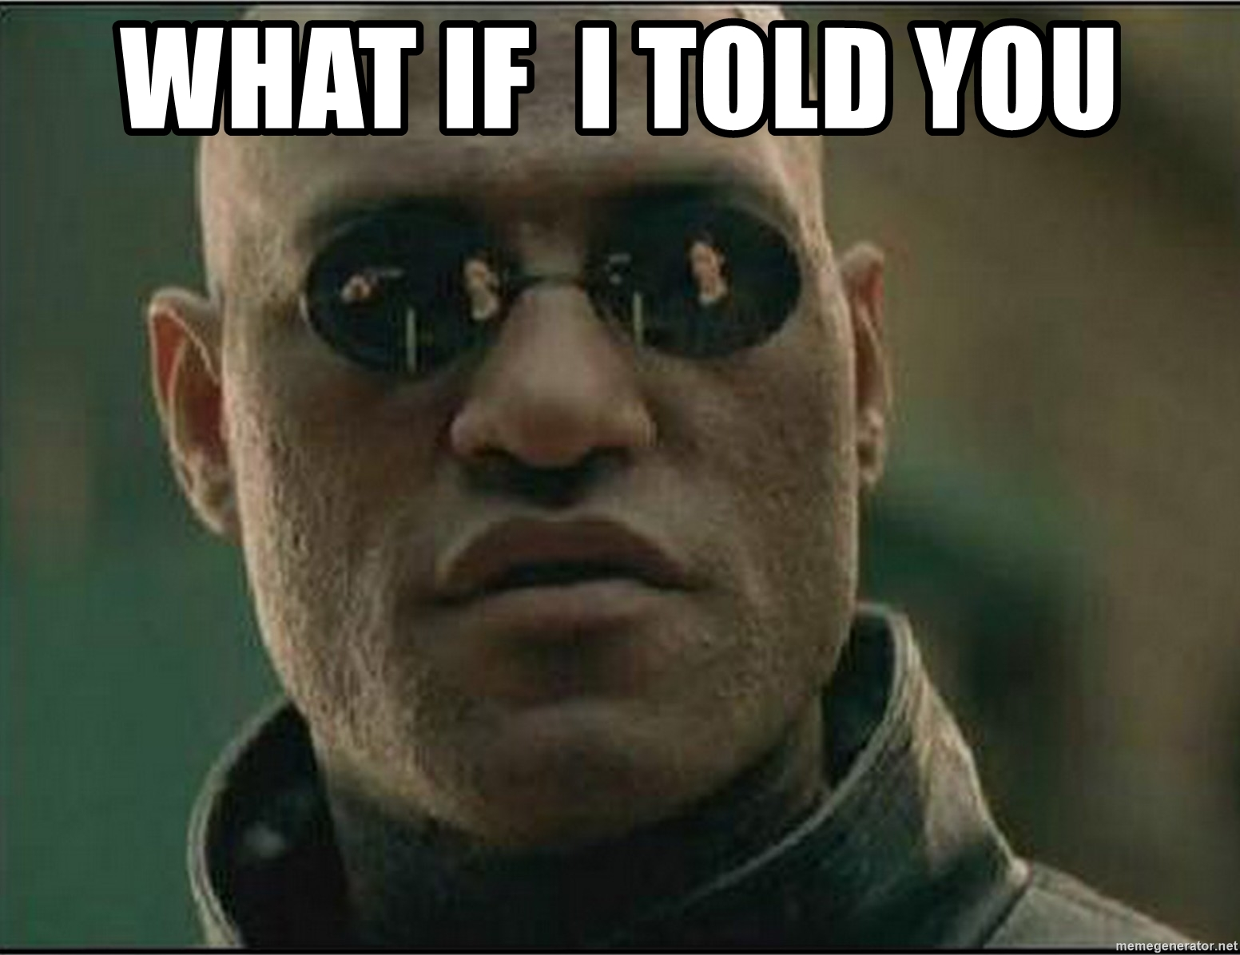

Slide 5
“TDD is when you write all tests before implementing the business logic…”

Slide 6


Slide 7
Why not?
Requirements were changing with the same speed as customer’s mood (if they were even defined)
Confusion in unexperienced team (including me)
Lack of understanding, what is the purpose of this kind of approach

Slide 8
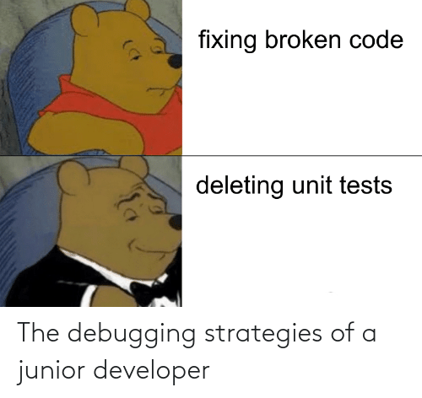

Slide 9
“Found a bug? Fix it. Write a test to prove it was fixed”

Slide 10


Slide 11
Did it work?
Code coverage was very inconsistent
Usually, tests were written to ensure code quality
Still, no guarantee that business logic won't get broken with new changes
Notes:
If implementation of feature was good enough, code coverage was very poor. As a result, we had a risk of breaking existing functionality implementing new features.
Besides that, tests itself were not testing the business logic or behavior but rather some parts of the code. As an example, If input is properly validated or formatted. Tests were created to ensure that code quality was on a certain level and not that code was doing what it suppose to do.

Slide 12


Slide 13
“100% code coverage”
Notes:
Or in this case it was also Everything Needs Unit Tests

Slide 14
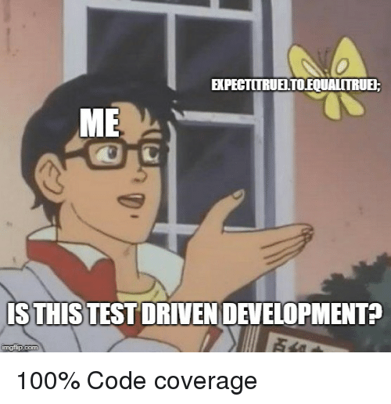

Slide 15
Something went wrong… again…
Critical defects were still there
Tests were about code quality
Development time significantly increased as a result of over-complications
Notes:
We had a lot of mocks and (mocking is a code smell) it became obvious that not everything needs unit tests only when we realized, how much time was wasted; I was genially surprised of the number of reported defects, mostly because most of them were critical or mid level. But in the end, there is nothing to be surprised about. Again, we were tasting implementation instead logic itself. Besides that, development process became insanely complicated. Most of the times features were related to each other, and as a result developing one feature, you also, must spend time fixing all the tests which failed because you introduced smth new.

Slide 16
Same company, but another project…

Slide 17
We were testing behavior…

Slide 18
What was the difference?
First; test that fails
Only useful code which is needed to pass that test
The minimum number of tests that is needed to cover all the use cases

Slide 19

Notes:
Dramatic effect

Slide 20
1. TDD is when you write a single test. Watch it fail, and only after that you implement the code

Slide 21
2. TDD assists in better software design
Notes:
To be able to write tests ahead you have to be able to break your code on small logical modules.

Slide 22
3. Easier to refactor and hand-over your code

Slide 23
A few more…

Slide 24
TDD is too Time Consuming

Slide 25
TDD is too Time Consuming
“Pre-release defect density of the four products decreased between 40% and 90%”
Notes:
The benefits of TDD have been tested on real projects by companies like Microsoft, IBM, and Springer, and they found that the TDD process is enormously beneficial. Quote from their finding:

Slide 26
Red, Green, and ALWAYS Refactor?

Slide 27
Red, Green, and ALWAYS Refactor?
“Perfect is the enemy of good.”

Slide 28
Simple code need no tests

Slide 29
Simple code need no tests
Tests are also the specification
Notes:
Tests are also the specification on what the code should do while the implementation is how the problem is solved

Slide 30
TDD misconceptions
Thank you!
Olena Borzenko
@borzenko_lena
in/olena-borzenko

