Slide 1
ACTIVITY CLIFFS
Chemoinformatics Seminar
Apurva Gopisetty
Semester- III

Slide 2
Overview
Introduction
Identification of activity cliffs
→ Tanimoto coefficient
→ MMP formalism
Application
Adverse effects
Conclusion

Slide 3

Introduction
Activity Cliffs :
Pairs of structurally similar molecules
Large difference in potency
Potency values measured in “pKi”
Usually ≥ 2 log units
Xiaoying Hu, Ye Hu, Martin Vogt, Dagmar Stumpfe, and Jü rgen Bajorath, MMP-Cliffs: Systematic Identification of Activity Cliffs on the Basis of Matched Molecular Pairs, J. Chem. Inf. Model., 2012, 52 (5), pp 1138–1145.
Notes:
pKi = (negative decadic logarithm)

Slide 4
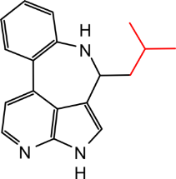
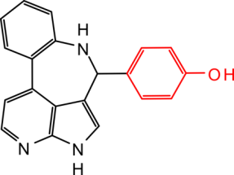
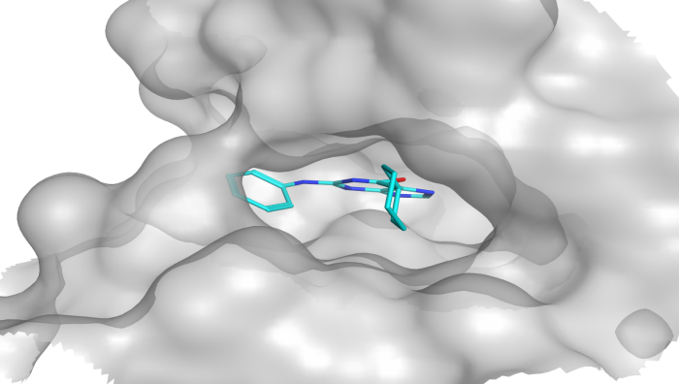
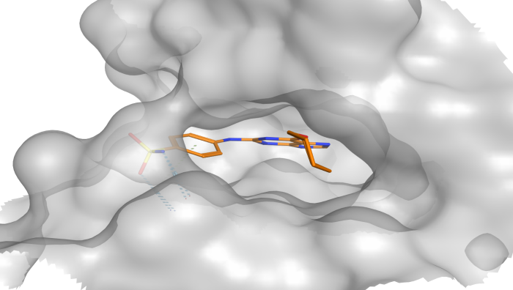
Types of activity cliffs
A
Tanimoto similarity-based cliffs
ECFP4 cliff
0.65
4.1
6.4
B
Substructure-based cliffs
MMP cliff
6.3
8.9
R-group cliff
5.0
8.8
C
Scaffold-based cliffs
Scaffold cliff
5.9
9.0
0.90
D
Binding mode-based cliffs
3D cliff
6.0
8.2

Slide 5
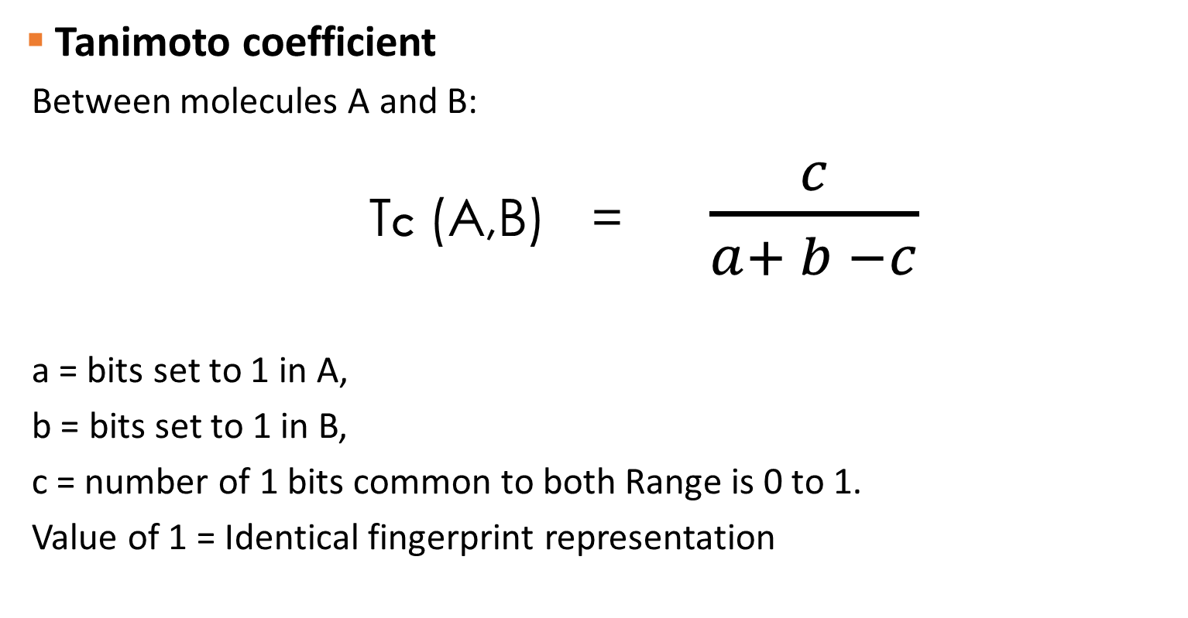
Identification
Tanimoto coefficient
Between molecules A and B:
TC (A,B) = $\frac{c}{a+ b −c}$
a = bits set to 1 in A,
b = bits set to 1 in B,
c = number of 1 bits common to both Range is 0 to 1.
Value of 1 = Identical fingerprint representation
Notes:
Tanimoto → gives a measure of the number of fragments in common between the two molecules
Limitations :
-> Ambiguous chemical interpretability
- > Whether compound pairs have different similarity values and are actually similar or not – difficult to rationalize from a chemical perspective

Slide 6
Alternate method
MMP formalism
Systematically exploring substructure transformations, leading to the introduction of MMP-cliffs
MMP-Cliffs
Data Selection
Algorithm
Notes:
Data Selction → ChEMBL and BindingDB

Slide 7
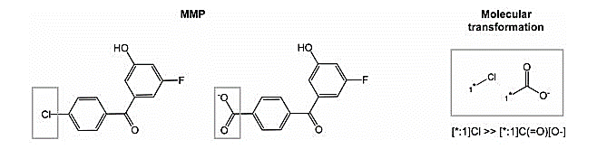
Matched Molecular Pairs (MMP):
- Pair of molecules
- Single point change
- Replacement of 1 functional group
Anne Mai Wassermann, Dilyana Dimova, Preeti Iyer, and Jürgen Bajorath Advances in Computational Medicinal :Matched Molecular Pair Analysis Chemistry, Drug Development Research(2012)
Notes:
molecular transformation can be defined as the replacement of a molecular fragment having one, two or three attachment points with another fragment.

Slide 8
Fragment – based algorithm
Single & Non ring bonds in molecule deleted
2 Fragments 1 single bond
Each fragment, Key and Value
Search for keys with more than 1 value
Key – common substructure
Value – Molecular transformations
Repeated with double or triple cuts
Notes:
1.)
2.) Single bond deletion == 2 fragments
3.) Each fragment inserted ONCE as Key and Value
4.) If two molecules forming an MMP differed only in a single group attached to a common core via a single bond, the two groups were associated with the same key (common core).
5.) MMPs can be identified searching for keys with more than one value.
-- MMP CLIFFS – Structural criteria Minimum = 8 non Hydrogen atoms
Maximum 13
Potency Criteria - Potency difference = 2 Orders of magnitude
Minimum = 10 μM

Slide 9
Applications
SAR studies
In activity landscape :
Smooth regions → continuous SAR
Rugged regions → discontinuous SAR
The extreme forms of SAR discontinuity are termed activity cliffs
Discontinuous SAR and activity cliffs → lead optimization
Continuous and smooth SAR regions → application of QSAR
Notes:
An activity landscape represents a hypersurface in a biologically relevant chemical space where compound potency is added as a third dimension to a 2D projection of the chemical space
Discontinuous SAR -> small chemical modifications drastically change the biological response
Continuous - - gradual changes in chemical structure induce moderate changes in biological activity.

Slide 10
Adverse Effects
Machine learning techniques fail to recognize activity cliffs.
A model that learns from a training dataset including a significant number of activity cliffs is prone to over- fitting.
Notes:
ML - Just capture major trends (‘rolling hills’) and …fail to recognize activity cliffs reducing the reliability of the prediction
SOLUTION --→ activity cliffs can be understood as special cases of ISMs. (Instances that should be misclassified)

Slide 11
Conclusion
Large influence on medicinal chemists to interpret SAR
New chemoinformatics approaches
Presence of activity cliffs affects the generalization ability of machine learning models
Activity cliffs → A boon and bane !
Notes:
1.)
2.) ………. have been developed to detect activity cliff
3.)
4.) Thus AC, although necessary, can be considered as a boon and a bane

Slide 12
References
Xiaoying Hu, Ye Hu, Martin Vogt, Dagmar Stumpfe, and Jürgen Bajorath, MMP-Cliffs: Systematic Identification of Activity Cliffs on the Basis of Matched Molecular Pairs, J. Chem. Inf. Model., 2012, 52 (5), pp 1138–1145.
Dagmar Stumpfe; Jürgen Bajorath, J. Exploring activity cliffs in medicinal chemistry, J. Med. Chem. 2012, 55, DOI: 10.1021/jm201706b.
Advances in Activity Cliff Research, Dilyana Dimova and Jürgen Bajorath.
Activity cliffs in drug discovery: Dr Jekyll or Mr Hyde? Maykel Cruz-Monteagudo , Jose´ L. Medina-Franco , Yunierkis Pe´rez-Castillo , Orazio Nicolotti , M. Nata´lia D.S. Cordeiro and Fernanda Borges.

Slide 13
Thank You!

