Slide 1
Cognitive vs Computational aspects of molecular similarity - Molecular Similarity in Medicinal Chemistry : Gerald Maggiora, Martin Vogt, Dagmar Stumpfe,and Jürgen Bajorath
-Presented By
Nanditha Mallesh

Slide 2
Outline
Background
Pattern recognition
Similarity assessment – cognitive and computational approach
Similarity coefficient
Computed vs Intuitive similarity

Slide 3
Background
Similarity perceived by medicinal chemists and computational methods not same
Still has comparable aspects:
Symbolic representation of structural information
Notes:
And the representation used : Must make molecular information comprehensible and help identify patterns

Slide 4
Pattern recognition
Essential requirement for decision making
Key patterns : simpler patterns that contain essential feature of the original pattern
Complex data
Pattern Recognition
Similarity assessment
Notes:
“The ability to detect recurrent themes, organization principles and rules in large data sets”
Key patterns : cognitive pattern recognition → done intuitively where as computational methods use mathematical functions
These patterns vary between individuals and also algorithms and thus for same data set → results with varying agreement

Slide 5
Similarity assessment
Computational
Computational methods - SVM
Cognitive
Chemical intuition and experience
Little consensus between experts
Perception is context dependent
Results obtained are not chemically interpretable – black box character
Needs training data
Decision based on few patterns/parameters
Context independent
Notes:
Machine learning methods – decision tree are preferred → results more interpretable although the methods are based on abstract molecular representation.
Cognitive aspects influence judgment of molecular similarity

Slide 6
Similarity coefficients
Mathematical functions to quantify the degree of similarity
Typically values are in the range of [0,1]
Different functions yield different values
Examples - Tanimoto and Tversky coefficient
Notes:
Are numerical readouts superior to subjective methods, do they increase consensus? → need to quantify the numerical results
These coefficients allow classification of similarity relationships in a consistent manner

Slide 7
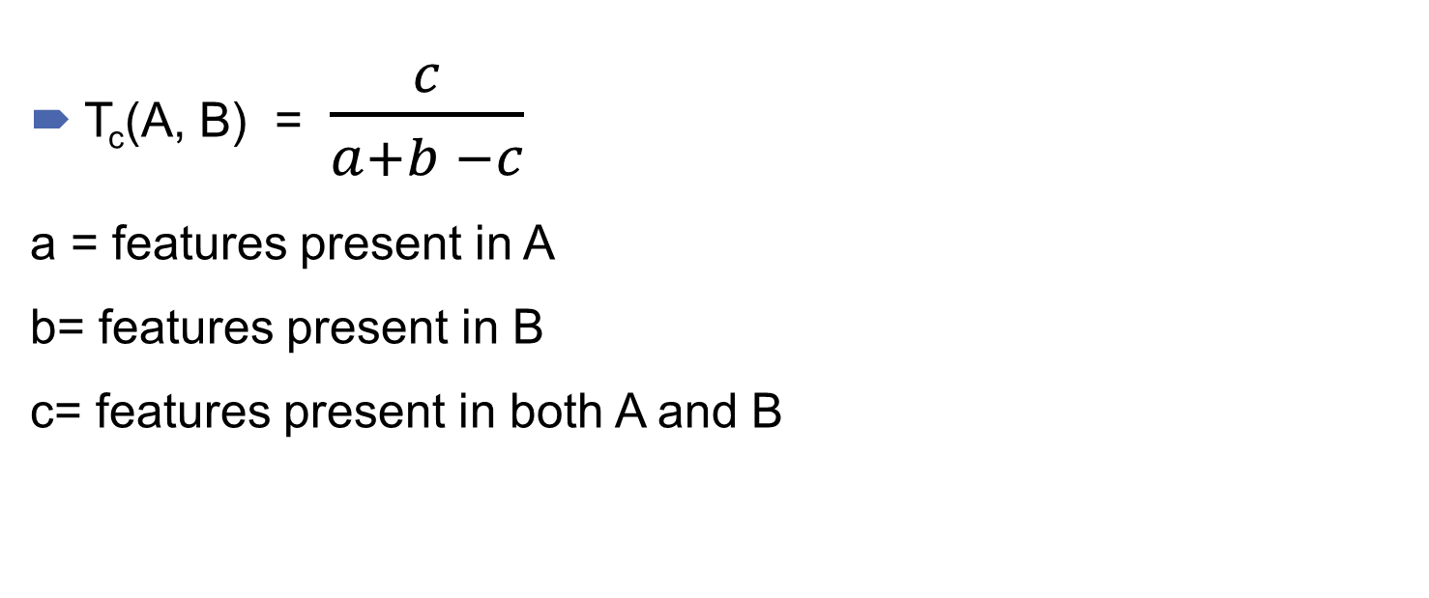
Tanimoto coefficient
T_{c}(A, B) = $\frac{c}{a+b −c}$
a = features present in A
b= features present in B
c= features present in both A and B
Notes:
1)Value ranges from 0,1
2)As A and B become more similar, the number of shared features approaches the number of features in A and B and the number of unique features in both compounds approaches zero, thus the ratio goes to infinity giving tc=1
3)Conversely, as A and B become less similar, the number of shared features approaches zero and consequently all of the features of A and B are unique, and thus, the ratio of these features also goes to zero
4) Tanimoto similarity is based on “molecular fingerprint” – very brief intro → most widely used descriptor for similarity searching

Slide 8
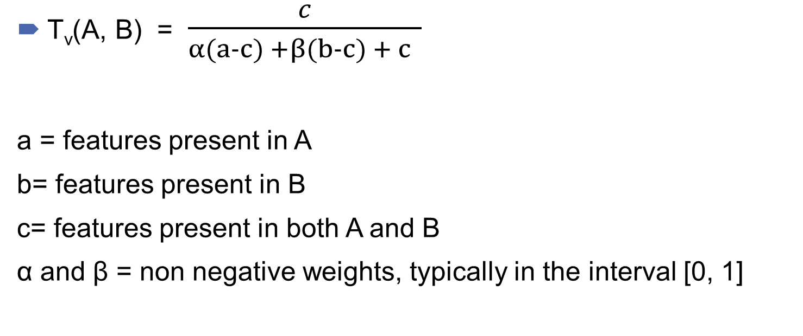
Tversky coefficient
T_{v}(A, B) = $\frac{c}{α(a−c) +β(b−c) + c }$
a = features present in A
b= features present in B
c= features present in both A and B
α and β = non negative weights, typically in the interval [0, 1]
Notes:
Larger the value of alpha, more is the weight of unique feature in A compared to B and vice versa
Tv lies b/w 0 and 1, and changes as the 2 weights vary
Use of weights → can be used to introduce asymmetry and makes it possible to study the relative importance of unique features and common features
When alpha = beta= 1, tv= tc and when it is 0.5, tv is identical to dice coefficient ( tc and dice are symmetric)

Slide 9
Computed vs Intuitive similarity
Similarity scale used not uniform
Computation – similarity and dissimilarity are complimentary:
Dissimilarity= 1 – similarity
High similarity value – intuitive meaning
Decreasing similarity value – less interpretable
Asymmetry needs to be considered
Notes:
Example for asymmetry → Korea considered more similar to china than the other way round
Size effect : If compound A ( ref compound) is small and is a substructure of larger comp, A is more similar to B
However if this reversed, B is ref and A is the DB compound, then similarity will be lower. → accounted in Tv

Slide 10
Summary
Cognitive aspects influence computational similarity calculations
Human perception - more complex
Subconscious decisions leads to reduction approach
Similarity calculations – very attractive
Notes:
Human perception → includes cognitive algorithm → subconscious complexity reduction
These decisions are included in similarity assessment by chemists→ leads to reduction
Similarity calculation -> reduce the complex molecular comparison to numerical readouts.

Slide 11
Thank you!!
All Equations and diagrams taken/adapted form the paper - Molecular Similarity in Medicinal Chemistry : Gerald Maggiora, Martin Vogt, Dagmar Stumpfe,and Jürgen Bajorath

