Slide 1
Polypharmacology: Combination Therapy vs Multi-target Drugs
Mohd Mujahidul Islam

Slide 2
Introduction
Combination therapy refers to using multiple therapies to treat a single disease
It includes:
• More than one medication
• Prescribing separate drugs
• Administering separate drugs

Slide 3
Uses for combination therapy
Includes the treatment of:
• Tuberculosis
• Leprosy
• Cancer
• Malaria
• HIV/AIDS

Slide 4
Testing of combination drugs
There are at least three ways to select an agent for testing in combination with another drug:
• Drug may act on the same target
• An additional target of the same pathway
• Different pathway or cellular process

Slide 5
Effectiveness of combination therapy
It helps:
• Significant savings
• Lower treatment failure rate
• Lower case-fatality ratios
• Fewer side-effects
• Less money needed

Slide 6
Drawbacks of combination therapy
Drug compounds may interfere with each other and result:
• Reduced efficacy
• Enhanced severity of the disease
• Increased toxicity

Slide 7
Multi-target drugs
Targeted drugs allow to hit in a more specific manner
Tyrosine Kinase Receptors (RTKs) are the best example of multi-target drugs
RTK targets two types of compounds:
1. Monoclonal antibodies
2. Tyrosine kinase inhibitors

Slide 8
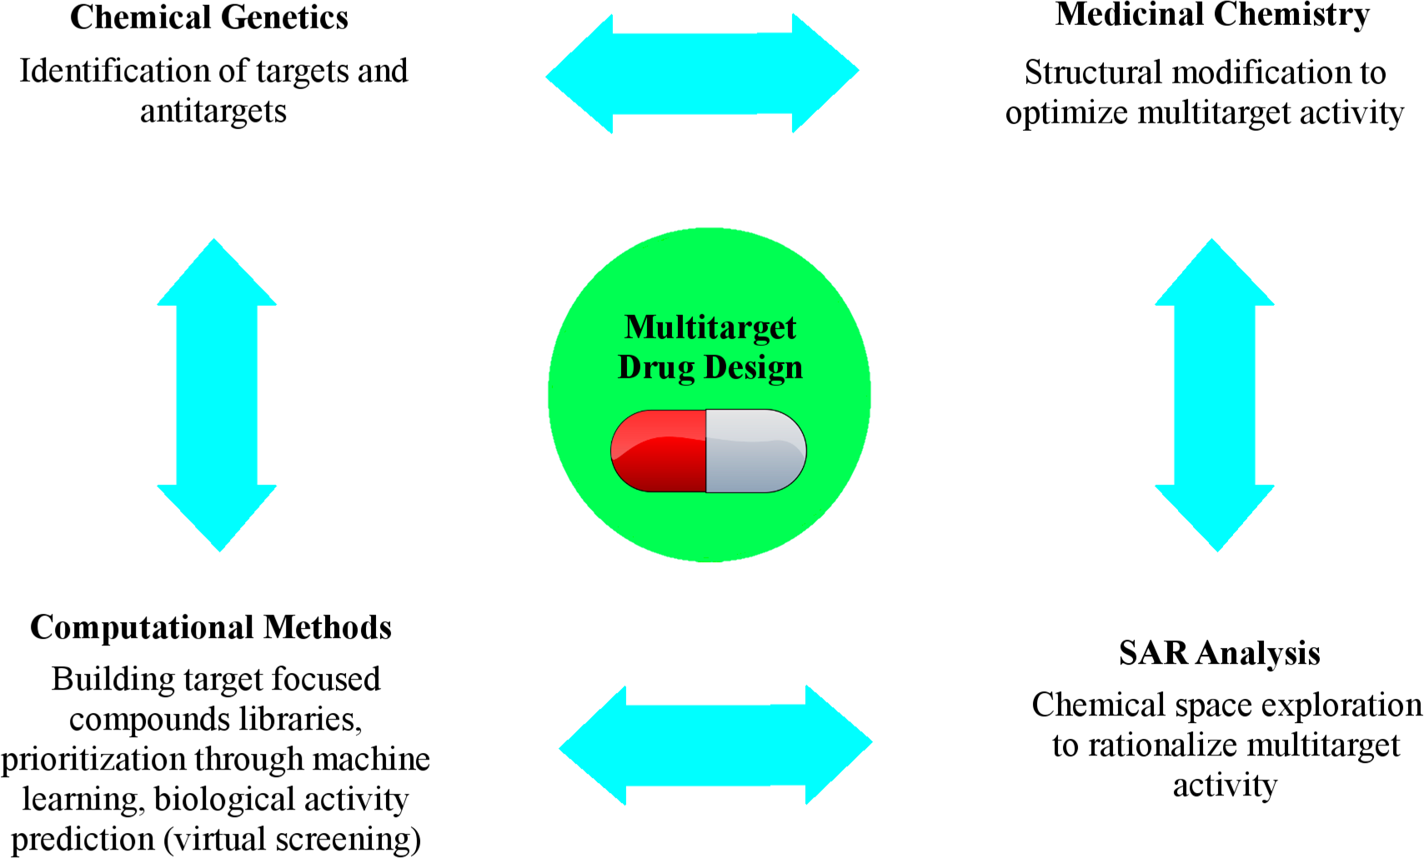
Approaches relevant to the generation of multi-target drugs

Slide 9
Combinational therapy and multi-target drugs comparison
Multi-target drugs have more predictable pharmacokinetic profile compared to the drug combination
These drugs often show much superiority than of combination therapy
But, currently combination therapy is more extensively explored in the clinic than the use of multi-target drugs

Slide 10
Take home message
In future, single-molecule drugs development with a desired multi-target profile may offer an appealing and cost-effective complement or alternative to drug combinations

Slide 11
References
Polypharmacology: Challenges and Opportunities in Drug Discovery by Andrew Anighoro,†Jürgen Bajorath and and Giulio Rastelli
https://en.wikipedia.org/wiki/Combination_therapy
https://www.ncbi.nlm.nih.gov/pubmed/18288997

Slide 12
Thank You

