Slide 1
Polypharmacology: Drug Discovery For The Future
Md. Nur Alam

Slide 2
Introduction
Drugs or xenobiotics affect the biological system, possessing bioactivity and toxicity.
- Pharmacodynamics (PD)
- Pharmacokinetics (PK)
The aim of drug development is to provide bioactive compound show beneficient PD and PK properties.
- Restrain human diseases
- Increase life expentency
- Elongate the life span

Slide 3
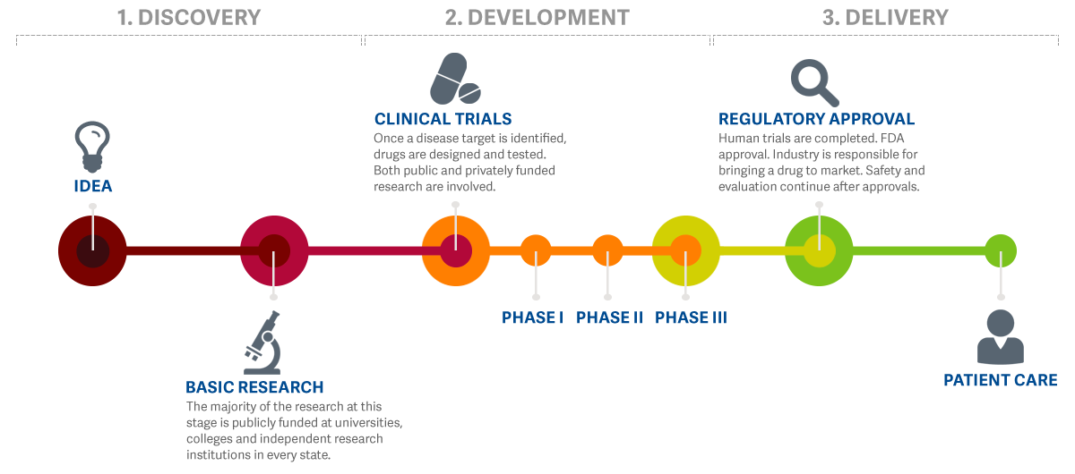
Drug Development Pipeline

Slide 4
Polypharmacology
Drug design philosophy has been transformed from “one drug one target“ to “ one drug multiple target“.
Acting on multiple disease pathway.
Aim to discover drug repurposing.
Example of some multi targeting drug:
- Aspirin
- Sildenafil (Viagra)

Slide 5
Current Technologies and Progresses
Post genomic era has significantly accelerated the polypharmacology research.
System Biology are being frequently used to identify off-targets.
Different databases can be used to predict the protein target.

Slide 6
In Silico Pharmacology
It uses biological or medical data from different sources to creat computational model for predictions in medicine.
It can be applied througt out the whole drug development pipeline.

Slide 7
Different Approaches of In-Silico Pharmacology
Quantitative Structure Activity Relationship (QSAR):
First initiatives in the field of In Silico pharmacology.
Linear mathematical model that sets up the corellation between structural properties and desired activity.
It uses a training set of several dozenes molecule.
Most widely used QSAR are descreptor based methodes.

Slide 8
Different Approaches of In-Silico Pharmacology
Virtual Ligand Screening (VLS):
- It is the In Silico adoption of High Throught Screening (HTS).
- To perform VLS, Structural information is needed for the ligand or terget.

Slide 9
Different Approaches of In-Silico Pharmacology
Virtual Affinity Profiling
- Newest branch of In Silico pharmacology.
- Assess the PD/PK profile of a compound.
- It adopt the theory of Polypharmacology.

Slide 10
Challanges for Polypharmacology
We partially understand the pathway or mechanism of many disease at the molecular level.
Without complete data its difficult to derive the full polypharmcological network.
Complexity in inverse docking approaches.

Slide 11
Take Home Message
High level data curation would be needed for accurate prediction of polypharmacology.
It is acknowledged that polypharmacology goes well beyond target families.
It would certainly have the potential to transform our next generation drug discovery and development.

Slide 12
References
Boran Adw, Iyengar R. Systems approaches to polypharmacology and drug discovery. Current Opinion in Drug Discovery & Development. 2010;13(3):297–309.
Simpson Mr, Simpson Nr, Masheter Hc. New drugs. 8. Flufenamic acid in rheumatoid arthritis. Comparison with aspirin and the results of extended treatment. Ann Phys Med. 1966;8(6):208–213.
Drug Discovery by Polypharmacology-based Interaction Profiling by, Zoltán Simon, Eötvös Loránd University.
http://www.researchamerica.org/sites/default/files/ResearchAmerica_BenchToBedside.png
http://www. ncbi.nlm.nih.gov/pmc/articles/PMC3809828/

Slide 13
Thank You!

