Slide 1


Polypharmacology: Multi-target Drugs
Chemoinformatics Seminar
Presented by: Lilit Antonyan
29.November.2016

Slide 2
Overview
Polypharmacology
Single-target Drug Design
Multi-target Drug Design
Single- vs Multi-target Drug Design
Challenges and Opportunities
Notes:
Polypharmacology: Challenges and opportunities
Single vs Multi-target drugs
Design of multitarget drugs

Slide 3
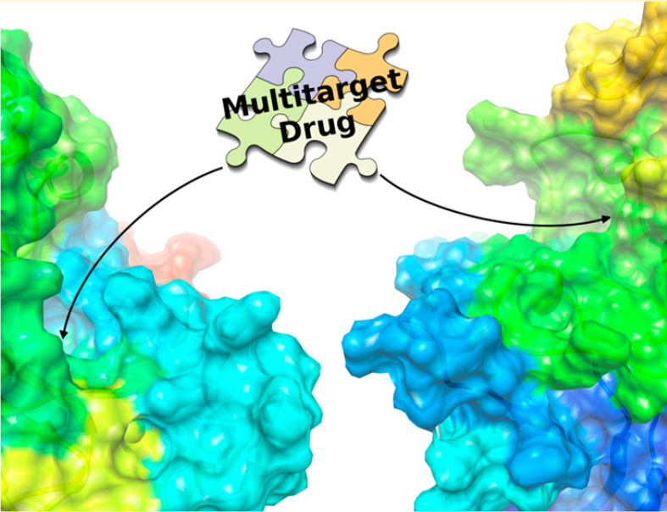
Introduction
What is polypharmacology?
Design of pharmaceutical agents acting on multiple targets
Study for multi-target drugs
Anighoro A, Bajorath J, Rastelli G. “Polypharmacology: Challenges and Opportunities in Drug Discovery: Miniperspective.” Journal of medicinal chemistry. 2014 Jun 25;57(19):7874-87.
Notes:
The desire to develop more effective treatment agents for complex disease are pushing drug design towards the multi-target approach. So what is Polypharmacology? Let’s give a MESH (Medical Subject Headings) defination first

Slide 4
Goal
Complex diseases - complex therapeutic approaches
Design of a single drug molecule able to simultaneously and specifically interact with multiple targets
Limitation of drawback arising from single-target therapy
Notes:
Modern DD has been focused on the development of drugs intended to act against a specific target with high potency and selectivity. , More effective drugs have multiple targets .In this respect, a drug that “hits” multiple sensitive nodes belonging to a network of interacting targets, limit drawbacks arising from the use of a single-target drug or a combination of multiple drugs.

Slide 5
Current Drug Design Strategies
In vitro
(chemical library)
In silico
Lab tests
Best target identification
Notes:
the goal is to find a target gene, protein …of suitable function; Identify the ‘best-binder’ by
in vitro- high-throughput screening
2.in silico- and/or by rational drug design based on the three-dimensional structure of the target
3.provide a set of lab tests to develop a technology platform that predicts potential clinical applications.

Slide 6
Single- vs Multi-target Drugs
Single-target drug design
Multi-target drug design
Drug Candidate
Drug Candidate
Target 1
Target 1
Target 2
Desired Action
Desired Action
Desired Action
2
Result
Result
Better
Notes:
In Single-target drug design the drug candidate molecule binds to its target
for better result, we need also action activated by target 2

Slide 7
Single- vs Multi-target Drugs (cont.)
Single-target | Multi-target
One drug - one receptor | One drug - multiple receptors
Reduced efficiency | Efficiency against advanced-stage diseases
Drug resistance | Reduced target based resistance
Decreased quality of life for patients | Probable valuable therapy for patients
Notes:
3.The probability of developing target-based resistance to multitarget drugs is statistically lower than is the probability of developing resistance against single-target drugs.
4) The use of drug cocktails often complicates dosing schedules and negatively impacts patient compliance.

Slide 8
Design of Multi-target Drugs
Chemical Genetics
Medical Chemistry
Multi-target Drug
Computational Methods
SAR Analysis
Notes:
Chemical Genetics - To Identify targets and antitargets
Medical Chemistry - to optimize multitarget activity for Structural modification
Computational Methods - To Build target focused compounds’ libraries, using Machine L.,VS to predict bio activity
SAR Analysis - To rationalize multitarget activity exploring chemical space

Slide 9
Challenges
Design multi-target ligands
Using of desired polypharmacology profile
Transforming them into drug candidates
Design multi-target ligands
If the targets are not phylogenetically related
If the targets are not structurally related
Notes:
Multitargeted drugs may represent a valuable complement or even alternative to therapeutic regimens based on drug combinations. A major challenge from a medicinal chemistry point of view is the ability to rationally design multitarget ligands, especially when the targets of interest are not phylogenetically or structurally related.

Slide 10
Conclusion
Polypharmacology is a novel approach in drug design
Molecules with multi-target activity improve
Efficiency
Safety of drugs
Notes:
Molecules with optimal multitarget activities have the potential of improving efficacy and safety of drugs in the therapy of complex diseases. It is conceivable that in the near future rational polypharmacology will play an increasingly important role in drug discovery.

Slide 11
References
Anighoro A, Bajorath J, Rastelli G. “Polypharmacology: Challenges and Opportunities in Drug Discovery: Miniperspective.” Journal of medicinal chemistry. 2014 Jun 25;57(19):7874-87.
“Polypharmacology”.PubMed. MeSH. Retrieved 2015. Access date: 20.11.2016
Csermely P, Agoston V, Pongor S. “The efficiency of multi-target drugs: the network approach might help drug design.” Trends in pharmacological sciences. 2005 Apr 30;26(4):178-82.
Sikazwe D. “The Multi-Target Drug Design Era is Here, Consider it.” Drug Designing: Open Access. 2012 Aug 16.
Reddy, A. Srinivas; Zhang, Shuxing ”Polypharmacology: drug discovery for the future.” Expert Rev Clin Pharmacol. 2013 6.1: 41–47.
Boran AD, Iyengar R. “Systems approaches to polypharmacology and drug discovery.” Current opinion in drug discovery & development. 2010 May;13(3):297.

Slide 12
Thank you

