Slide 1
POLYPHARMACOLOGY IN CANCER THERAPY
MONICA SUDARSANAM
2853542

Slide 2
Polypharmacology - Introduction
One drug multiple targets
Example : Aspirin
It might not always be desirable
Example : Lumiracoxib – It may cause liver failure

Slide 3
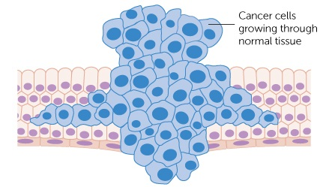
Polypharmacology in Cancer
Mostly relevant for wide target networks
and cellular pathways
Prime example : CANCER
Cancer cells are characterized by a transformed phenotype with excessive proliferation and survival
Abnormal cellular activity can be sustained by deregulation in the expression or activity of different proteins
Image was taken from http://www.cancerresearchuk.org

Slide 4
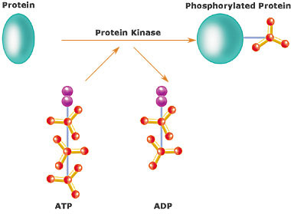
Protein Kinases
Modifies proteins by adding phosphate groups
Results in functional change
The human genome contains
about 500 protein kinase genes
2% of all human genes
Image was taken from wikipedia/kinase

Slide 5
Protein kinases – Anti cancer drug target
30% of all human proteins may be modified by kinase activity
Known to regulate the majority of cellular pathways
Involved in cancer growth, proliferation and survival, Example : EGFR
The deregulation of activity of single kinase is efficient (in some cancers)

Slide 6
Polypharmacology and Protein kinases
Mutations and redundancy in biological networks
Overactivation of another target or cellular pathway
Enables the tumor to escape
Makes single target approach ineffective
Simultaneous inhibition of multiple kinases is now established as a successful therapeutic strategy.
Examples: Sunitinib and Nelﬁnavir

Slide 7
Discovering new targets
RNA interference to discover new targets
What is RNA interference?
It is a biological process in which RNA molecules inhibit gene expression, typically by causing the destruction of specific mRNA molecules.

Slide 8
RNAi to discover new targets
The development of RNAi made it possible to screen the genes responsible for tumor proliferation
These screens have two advantages :
1) They can identify new drug targets - selectively blocks tumor growth when knocked down by RNAi
2) Provides an unbiased test of models of tumor signaling - because they directly examine which genes are most important to the tumor.

Slide 9
Conclusion
The selection of optimal target combinations is a key aspect in polypharmacology research
Polypharmacology might not always be desirable
RNAi screens can help to challenge our assumptions about the genes that are most important in cancer

Slide 10
Reference
Andrew Anighoro, Jürgen Bajorath and Giulio Rastelli. Polypharmacology: Challenges and Opportunities in Drug Discovery.
A.Srinivas Reddy and Shuxing Zhang. Polypharmacology: drug discovery for the future
Zachary A.Knight, Henry Lin and Kevan M.Shkat. Targeting the cancer kinome through polypharmocology

Slide 11
Thanks for your attention

