Slide 1
North West London Health Inequalities
Full analysis and borough prioritisation

Slide 2
Headline
Health inequalities vary significantly across NWL
Different boroughs show different drivers
Prevention and access are key levers
Targeted intervention required

Slide 3
Where inequality is highest
Hounslow, Hammersmith & Fulham, Brent
Moderate: Ealing, Westminster
Lower: Hillingdon, Harrow, Kensington & Chelsea

Slide 4
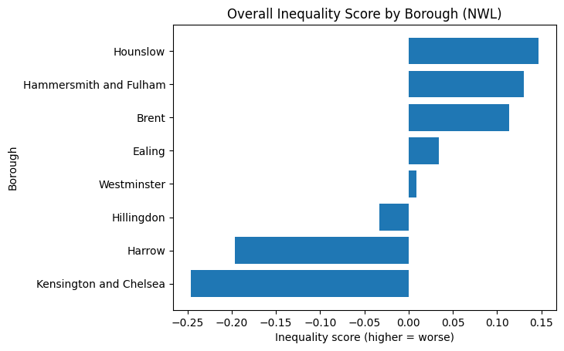
Health inequality score by Borough

Slide 5
What drives inequality
Prevention gaps
Access and service pathways
Structural determinants
Population exposure

Slide 6
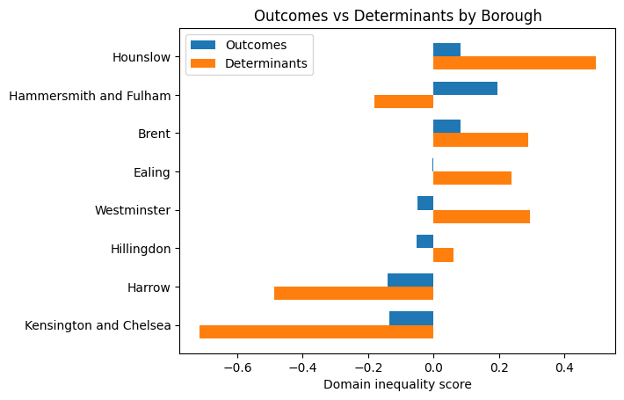
Health outcomes vs. social factors
Notes:
### The above results already answer part of our core project questions:
Are there differences across boroughs, and can we start to explain why?
1. Two distinct inequality patterns:
#### Determinant-driven inequality - structural conditions (housing, employment, environment) are worse:
- Hounslow
- Brent
- Ealing
- Westminster
This is important for:
- prevention
- VCSE upstream interventions
#### Outcome-driven inequality - suggests service-related factors (access, experience, outcome), population complexity, or unmet need
- Hammersmith and Fulham
This is important for:
- access
- service experience
- targeted care
#### Relatively lower inequality - comparatively better position (but still requires subgroup analysis)
- Kensington and Chelsea
- Harrow
2. Key insight for the project:
- Hounslow - structural disadvantage - requires prevention focus
- Brent - structural + emerging outcomes - high priority
- H&F - outcome pressure - service access/delivery
- Westminster - hidden structural risk
- Ealing - moderate structural pressure

Slide 7
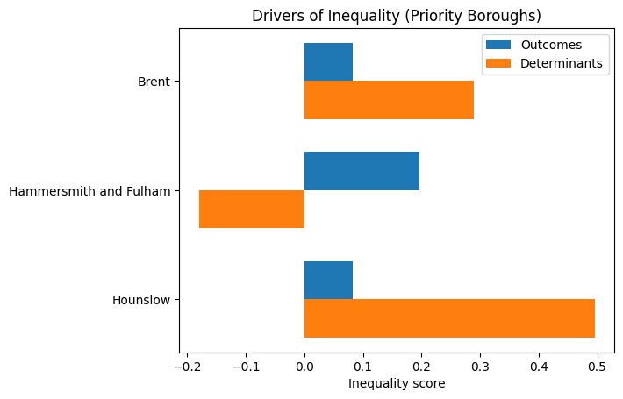
Drivers of inequality: top priority boroughs
Notes:
### A note:
The distinction between outcomes and determinants is based on dataset source (Fingertips vs GLA) and should be interpreted as a pragmatic analytical grouping rather than a strict causal classification.
### Priority borough deep-dive — drivers of inequality
1. Hounslow → Strong determinant-driven inequality
- Determinant score is substantially higher than outcomes
- Top drivers include:
- HIV late diagnosis
- Lower healthy life expectancy (male & female)
- School readiness (FSM)
- Interpretation:
Structural and social conditions are the dominant drivers
- Implication:
Focus on prevention, early intervention, and wider determinants (housing, education, income)
--------------------------------------------------
2. Brent → Mixed but determinant-leaning inequality
- Determinants clearly higher than outcomes
- Top drivers:
- Type 2 diabetes prevalence
- Low birth weight
- Childhood excess weight
- HIV late diagnosis
- Interpretation:
Strong overlap between:
- metabolic health risks
- maternal/child health
- Combined with highest Black population share → critical equity focus area
- Implication:
Integrated approach:
- prevention (diet, obesity, maternal health)
- targeted outreach for Black communities
- VCSE role likely significant
--------------------------------------------------
3. Hammersmith and Fulham → Outcome-driven inequality
- Outcomes high, determinants below average
- Top drivers:
- Lung cancer incidence
- COPD emergency admissions
- Mental health problems
- Screening-related indicators
- Interpretation:
Inequality likely driven by:
- service access
- unmet need
- late diagnosis patterns
- Implication:
Focus on:
- access to care
- early diagnosis
- service experience
- targeted clinical interventions
--------------------------------------------------
CROSS-BOROUGH INSIGHT
Different inequality mechanisms are operating:
- Hounslow → structural inequality
- Brent → structural + health risk accumulation
- H&F → service / outcome inequality
This directly supports:
→ No single intervention model
→ Need for borough-specific strategies
--------------------------------------------------

Slide 8
Ethnicity insight
Brent: highest Black population share
Strongest overlap with inequality
Key focus for targeted intervention

Slide 9
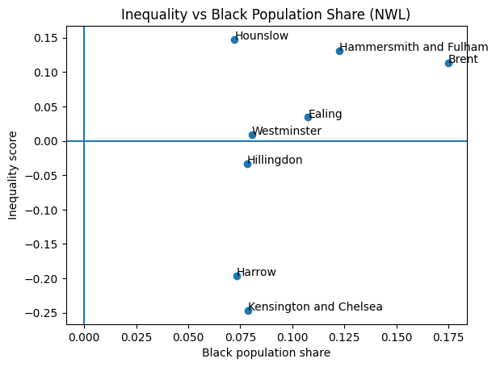
Health inequality vs Black Population share
Notes:
### Key insight: Inequality vs Black population share (NWL)
#### TOP-RIGHT (high inequality + higher Black population share) - CORE PROJECT INSIGHT
- Brent
- Hammersmith and Fulham
These boroughs combine higher overall inequality with higher exposure of Black communities → priority areas for equity-focused work.
This aligns directly with:
- targeting VCSE interventions
- prioritising community engagement
- focusing ICB partnership discussions
#### UPPER-MID (high inequality, moderate Black population):
- Hounslow
High structural inequality but lower relative Black population share. Suggests broader deprivation drivers rather than ethnicity concentration alone.
#### MIDDLE (near average inequality):
- Ealing
- Westminster
Mixed picture:
- Ealing → moderate Black population + moderate inequality
- Westminster → structural determinants high but outcomes lower
→ potential hidden or emerging risks.
#### LOWER (lower inequality):
- Hillingdon
- Harrow
- Kensington and Chelsea
Lower overall inequality, even where Black population share is moderate.
Important for identifying:
- protective factors
- service/system differences
--------------------------------------------------
#### CRITICAL NUANCE
- High inequality does NOT automatically equal ethnicity-driven inequality
- But where both co-occur, risk of unequal impact is higher
This part of the project (including plot) indicates where to investigate deeper, not final causality
We now have the first equity-targeting lens, not just “which borough is worse” but: where inequality and population exposure intersect

Slide 10
Preventive care
Weak prevention linked to higher inequality
Early intervention critical
Variation across boroughs

Slide 11
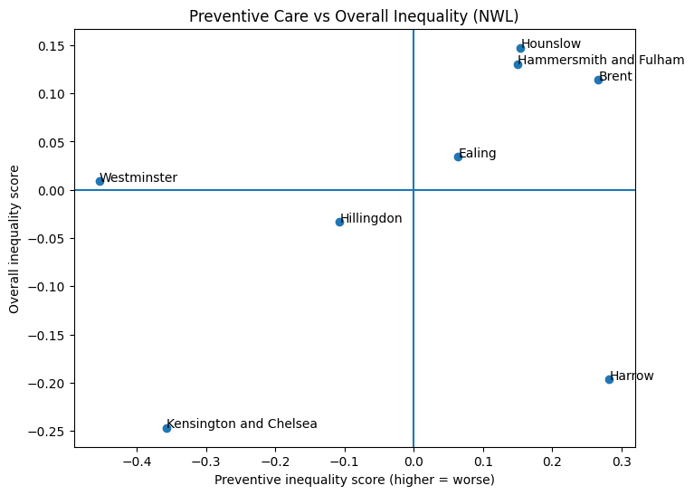
Preventive care vs Overall inequality
Notes:
### Preventive care vs inequality — interpretation
1. High preventive inequality + high overall inequality
(top-right quadrant)
- Brent
- Hounslow
- Hammersmith and Fulham
→ Interpretation:
- Preventive care is relatively weak
- Inequality is already high
→ This is the strongest signal of:
missed early intervention + downstream burden
→ Brent stands out further due to:
highest Black population share
→ Implication:
priority for:
- targeted outreach
- screening uptake
- VCSE-led engagement
--------------------------------------------------
2. High preventive inequality + low overall inequality
(top-left quadrant)
- Harrow
→ Interpretation:
- Preventive signals are worsening
- But outcomes have not yet deteriorated
→ This is an EARLY WARNING signal
→ Implication:
- opportunity to intervene before inequality becomes entrenched
- critical borough for proactive strategy
--------------------------------------------------
3. Low preventive inequality + low overall inequality
(bottom-left quadrant)
- Kensington and Chelsea
→ Interpretation:
- Strong preventive position
- Lower overall inequality
→ Suggests:
- prevention systems functioning relatively well
--------------------------------------------------
4. Low preventive inequality + mixed overall inequality
(bottom-left / centre)
- Westminster
→ Interpretation:
- Strong preventive signals
- But overall inequality ~ neutral
→ Suggests:
- prevention exists
- but may not fully translate into outcomes
OR
- inequality driven by factors outside prevention
--------------------------------------------------
5. Transition / mixed boroughs
- Ealing:
- Slightly positive preventive inequality
- Slightly positive overall inequality
→ Mild pressure across both domains
- Hillingdon:
- Negative preventive inequality (stronger prevention)
- Slightly negative overall inequality
→ Balanced profile

Slide 12
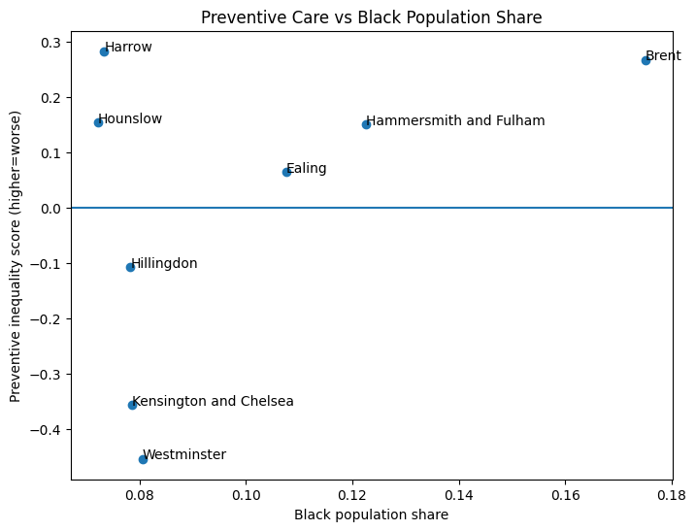
Preventive Care vs Black Population Share
Notes:
### Preventive Care vs Black population share
- Brent:
High Black population share + high preventive inequality
→ strongest equity concern
- Hammersmith and Fulham:
Moderate share + weak prevention
→ service access / targeting issue
- Hounslow:
Lower share but high preventive inequality
→ broader structural issue
- Harrow:
Lower share + rising preventive inequality
→ emerging risk, not yet ethnicity-concentrated
### Core insight
Inequality in NWL is not only about outcomes — it is strongly linked to variation in preventive care.
Different borough patterns:
- Established inequality + weak prevention → Brent, Hounslow
- Outcome-driven inequality → Hammersmith & Fulham
- Emerging prevention failure → Harrow
- Strong prevention → Kensington & Chelsea, Westminster
--------------------------------------------------
### Strategic implications
- Brent:
highest priority intersection:
inequality + prevention gap + ethnicity exposure
- Hounslow:
structural + prevention gap
- Hammersmith and Fulham:
service pathway / access issue
- Harrow:
early intervention opportunity
- Westminster / Kensington and Chelsea:
benchmark / comparator boroughs
This layer moves the analysis from: "where inequality exists" to: "where inequality could have been prevented earlier"

Slide 13
Trends over time
Some high-burden boroughs improving
Harrow emerging risk
Inequality shifting, not disappearing

Slide 14
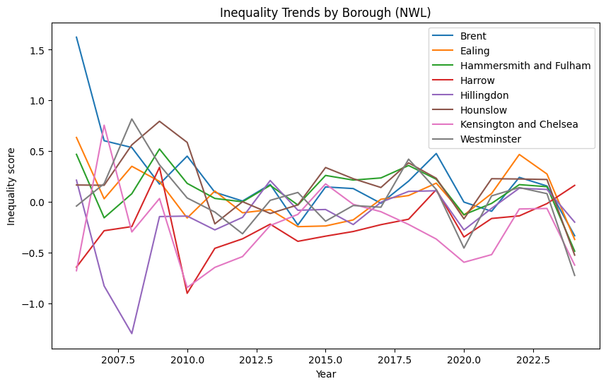
Inequality trends by Borough
Notes:
Key message
Inequality across NW London is not static. Most borough have improved over time, however, Harrow demonstrates worsening result.
**While several high-burden boroughs show improvement, new areas of inequality are emerging, highlighting the need for both sustained intervention and proactive monitoring.**
Different borough types require different responses:
A. High-burden improving (Brent, H&F)
→ Sustain and scale effective interventions
B. Structural inequality (Hounslow)
→ Focus on:
- housing
- employment
- prevention
- VCSE engagement
C. Emerging risk (Harrow)
→ Early intervention:
- monitoring
- targeted outreach
- community engagement
D. Stable / balanced (Ealing, Hillingdon)
→ Maintain performance, monitor volatility

Slide 15
Borough prioritisation
Brent: equity + prevention
Hounslow: structural prevention
H&F: access and outcomes
Ealing: focus on prevention
Harrow: early intervention & monitoring
Westminster: service responsiveness
K&C, Hillingdon: maintain & monitor

Slide 16
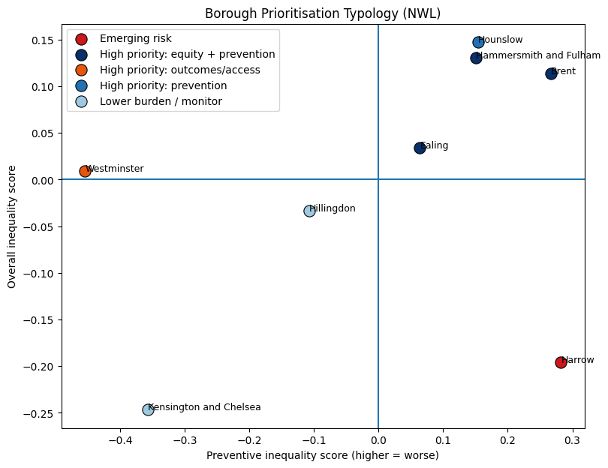
Borough typology ranking

Slide 17
Borough Prioritisation Summary
Borough | Typology | Recommended Action | Inequality | Prevention | Black Pop. | Trend
Harrow | Emerging risk | Early intervention and monitoring | -0.20 | 0.28 | 0.07 | ↑ 0.81
Hammersmith & Fulham | High priority: equity + prevention | Targeted outreach, VCSE partnership | 0.13 | 0.15 | 0.12 | ↓ -0.95
Brent | High priority: equity + prevention | Targeted outreach, VCSE partnership | 0.11 | 0.27 | 0.18 | ↓ -1.96
Ealing | High priority: equity + prevention | Targeted outreach, VCSE partnership | 0.03 | 0.06 | 0.11 | ↓ -1.01
Westminster | High priority: outcomes/access | Improve access and pathways | 0.01 | -0.45 | 0.08 | ↓ -0.68
Hounslow | High priority: prevention | Strengthen early intervention | 0.15 | 0.15 | 0.07 | ↓ -0.69
Hillingdon | Lower burden / monitor | Maintain performance | -0.03 | -0.11 | 0.08 | ↓ -0.41
Kensington & Chelsea | Lower burden / monitor | Maintain performance | -0.25 | -0.36 | 0.08 | ↑ 0.06

Slide 18
What this means for action
Strengthen prevention systems
Improve access and pathways
Monitor emerging risks
Targeted outreach via VCSE

