Slide 1
North West London Health Inequalities
Full analysis and borough prioritisation

Slide 2
Purpose of the analysis
Where inequality is highest and what drives it:
Where inequalities are most pronounced
Gaps in access, outcomes, or service experience
Support 3ST shape priorities, partnership work with the ICB
Align with ongoing programmes such as community engagement, prevention, and targeted outreach
Geography
NW London overall, with borough level insights or neighbourhoods.
Any notable differences between boroughs
Priority domains
Health outcomes (e.g., long term conditions, mental health, maternity, cancer, CVD)
Access to and experience of health services
Preventive care (e.g., screening, vaccination uptake)
Wider determinants that directly influence health (housing, employment, income, social isolation)

Slide 3
Headline
Health inequalities vary significantly across NWL
Different boroughs show different drivers
Prevention and access are key levers
Targeted intervention required

Slide 4
Where inequality is highest
Hounslow, Hammersmith & Fulham, Brent
Moderate: Ealing, Westminster
Lower: Hillingdon, Harrow, Kensington & Chelsea

Slide 5
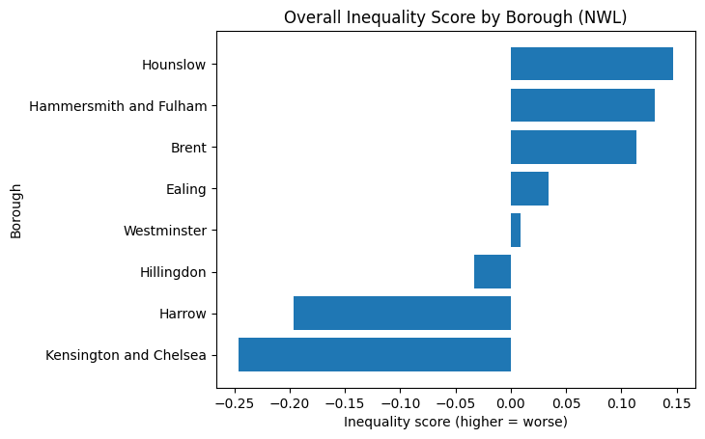
Health inequality score by Borough

Slide 6
What drives inequality
Prevention gaps
Access and service pathways
Structural determinants
Population exposure

Slide 7
LIST OF OUTCOMES
These are indicators reflecting health status or disease burden:
% reporting a long term MSK problem who also report depression or anxiety
% reporting a long-term mental health problem
% reporting cancer in the last 5 years
% reporting depression or anxiety
1. HLE male
2. HLE female
3. Low Birth Weight
7. Suicide rate
8. Mortality caused by PM2.5
Estimated prevalence of diagnosed and undiagnosed type 2 diabetes
Estimated diabetes diagnosis rate
Asthma: QOF prevalence
COPD: QOF prevalence
Cancer incidence: lung cancer
Diabetes: QOF prevalence
Epilepsy: QOF prevalence
Hospital admissions for diabetes (under 19 years)
Hospital admissions for epilepsy (under 19 years)
Chronic obstructive pulmonary disease (COPD): emergency hospital admissions
Emergency admissions for lower respiratory tract infections (0 to 4 years)

Slide 8
LIST OF DETERMINENTS
These reflect conditions, risks, behaviours, or system factors influencing health:
% with caring responsibility
4. School readiness FSM
5. Excess weight age 10-11
6. Excess weight age 04-05
9. Employment gap LongtermCond.
11. HIV late diagnosis
14. Smoking prevalence
Abdominal Aortic Aneurysm Screening Coverage
Access rate to specialist perinatal mental health services
Acute hepatitis B incidence rate/100,000
Admission episodes for alcohol-related cardiovascular disease (Broad)
Admission episodes for alcohol-related conditions (Broad)
Admission episodes for alcohol-related conditions (Narrow) (40 to 64 years)
Admission episodes for alcohol-related conditions (Narrow) (65 years and over)
Admission episodes for alcohol-related unintentional injuries (Narrow)
Admission episodes for alcoholic liver disease (Broad)
Alcohol-related conditions: admission episodes (all primary and secondary diagnoses)
Chlamydia detection rate per 100,000 aged 15 to 24 years
Chlamydia proportion of females aged 15 to 24 years screened

Slide 9
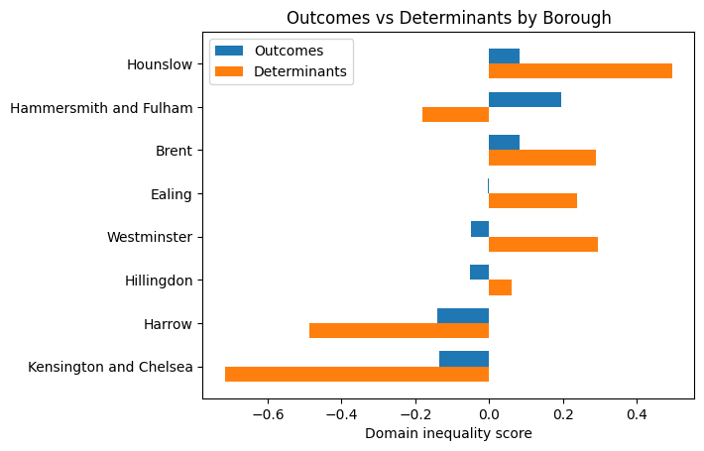
Health outcomes vs. structural determinents
Notes:
### The above results already answer part of our core project questions:
Are there differences across boroughs, and can we start to explain why?
1. Two distinct inequality patterns:
#### Determinant-driven inequality - structural conditions (housing, employment, environment) are worse:
- Hounslow
- Brent
- Ealing
- Westminster
This is important for:
- prevention
- VCSE upstream interventions
#### Outcome-driven inequality - suggests service-related factors (access, experience, outcome), population complexity, or unmet need
- Hammersmith and Fulham
This is important for:
- access
- service experience
- targeted care
#### Relatively lower inequality - comparatively better position (but still requires subgroup analysis)
- Kensington and Chelsea
- Harrow
2. Key insight for the project:
- Hounslow - structural disadvantage - requires prevention focus
- Brent - structural + emerging outcomes - high priority
- H&F - outcome pressure - service access/delivery
- Westminster - hidden structural risk
- Ealing - moderate structural pressure

Slide 10
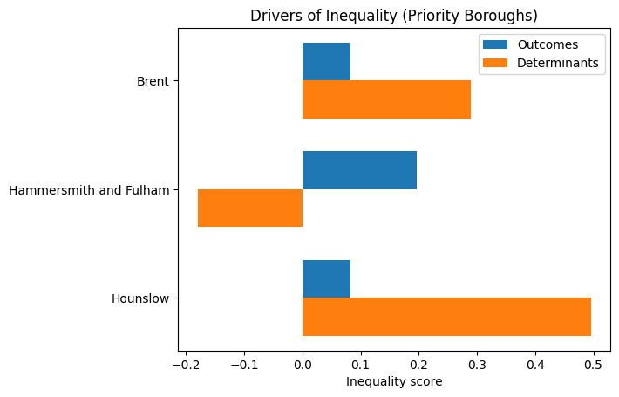
Drivers of inequality: top priority boroughs
Notes:
### A note:
The distinction between outcomes and determinants is based on dataset source (Fingertips vs GLA) and should be interpreted as a pragmatic analytical grouping rather than a strict causal classification.
### Priority borough deep-dive — drivers of inequality
1. Hounslow → Strong determinant-driven inequality
- Determinant score is substantially higher than outcomes
- Top drivers include:
- HIV late diagnosis
- Lower healthy life expectancy (male & female)
- School readiness (FSM)
- Interpretation:
Structural and social conditions are the dominant drivers
- Implication:
Focus on prevention, early intervention, and wider determinants (housing, education, income)
--------------------------------------------------
2. Brent → Mixed but determinant-leaning inequality
- Determinants clearly higher than outcomes
- Top drivers:
- Type 2 diabetes prevalence
- Low birth weight
- Childhood excess weight
- HIV late diagnosis
- Interpretation:
Strong overlap between:
- metabolic health risks
- maternal/child health
- Combined with highest Black population share → critical equity focus area
- Implication:
Integrated approach:
- prevention (diet, obesity, maternal health)
- targeted outreach for Black communities
- VCSE role likely significant
--------------------------------------------------
3. Hammersmith and Fulham → Outcome-driven inequality
- Outcomes high, determinants below average
- Top drivers:
- Lung cancer incidence
- COPD emergency admissions
- Mental health problems
- Screening-related indicators
- Interpretation:
Inequality likely driven by:
- service access
- unmet need
- late diagnosis patterns
- Implication:
Focus on:
- access to care
- early diagnosis
- service experience
- targeted clinical interventions
--------------------------------------------------
CROSS-BOROUGH INSIGHT
Different inequality mechanisms are operating:
- Hounslow → structural inequality
- Brent → structural + health risk accumulation
- H&F → service / outcome inequality
This directly supports:
→ No single intervention model
→ Need for borough-specific strategies
--------------------------------------------------

Slide 11
Ethnicity insight
Brent: highest Black population share
Strongest overlap with inequality
Key focus for targeted intervention

Slide 12
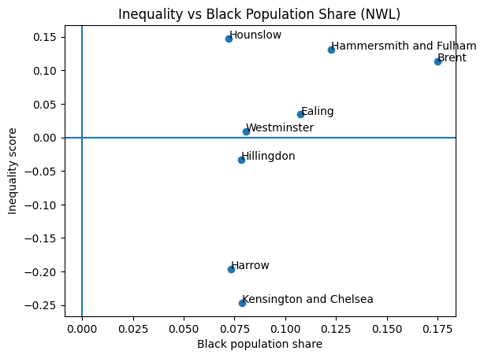
Health inequality vs Black Population share
Notes:
### Key insight: Inequality vs Black population share (NWL)
#### TOP-RIGHT (high inequality + higher Black population share) - CORE PROJECT INSIGHT
- Brent
- Hammersmith and Fulham
These boroughs combine higher overall inequality with higher exposure of Black communities → priority areas for equity-focused work.
This aligns directly with:
- targeting VCSE interventions
- prioritising community engagement
- focusing ICB partnership discussions
#### UPPER-MID (high inequality, moderate Black population):
- Hounslow
High structural inequality but lower relative Black population share. Suggests broader deprivation drivers rather than ethnicity concentration alone.
#### MIDDLE (near average inequality):
- Ealing
- Westminster
Mixed picture:
- Ealing → moderate Black population + moderate inequality
- Westminster → structural determinants high but outcomes lower
→ potential hidden or emerging risks.
#### LOWER (lower inequality):
- Hillingdon
- Harrow
- Kensington and Chelsea
Lower overall inequality, even where Black population share is moderate.
Important for identifying:
- protective factors
- service/system differences
--------------------------------------------------
#### CRITICAL NUANCE
- High inequality does NOT automatically equal ethnicity-driven inequality
- But where both co-occur, risk of unequal impact is higher
This part of the project (including plot) indicates where to investigate deeper, not final causality
We now have the first equity-targeting lens, not just “which borough is worse” but: where inequality and population exposure intersect

Slide 13
Preventive care
Weak prevention linked to higher inequality
Early intervention critical
Variation across boroughs

Slide 14
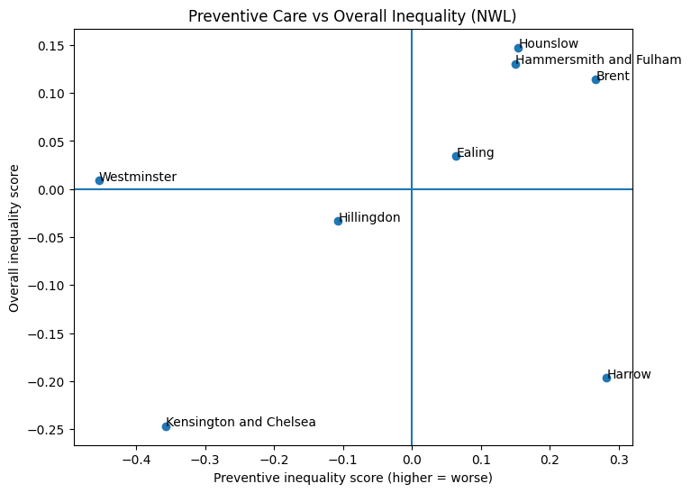
Preventive care vs Overall inequality
Notes:
### Preventive care vs inequality — interpretation
1. High preventive inequality + high overall inequality
(top-right quadrant)
- Brent
- Hounslow
- Hammersmith and Fulham
→ Interpretation:
- Preventive care is relatively weak
- Inequality is already high
→ This is the strongest signal of:
missed early intervention + downstream burden
→ Brent stands out further due to:
highest Black population share
→ Implication:
priority for:
- targeted outreach
- screening uptake
- VCSE-led engagement
--------------------------------------------------
2. High preventive inequality + low overall inequality
(top-left quadrant)
- Harrow
→ Interpretation:
- Preventive signals are worsening
- But outcomes have not yet deteriorated
→ This is an EARLY WARNING signal
→ Implication:
- opportunity to intervene before inequality becomes entrenched
- critical borough for proactive strategy
--------------------------------------------------
3. Low preventive inequality + low overall inequality
(bottom-left quadrant)
- Kensington and Chelsea
→ Interpretation:
- Strong preventive position
- Lower overall inequality
→ Suggests:
- prevention systems functioning relatively well
--------------------------------------------------
4. Low preventive inequality + mixed overall inequality
(bottom-left / centre)
- Westminster
→ Interpretation:
- Strong preventive signals
- But overall inequality ~ neutral
→ Suggests:
- prevention exists
- but may not fully translate into outcomes
OR
- inequality driven by factors outside prevention
--------------------------------------------------
5. Transition / mixed boroughs
- Ealing:
- Slightly positive preventive inequality
- Slightly positive overall inequality
→ Mild pressure across both domains
- Hillingdon:
- Negative preventive inequality (stronger prevention)
- Slightly negative overall inequality
→ Balanced profile

Slide 15
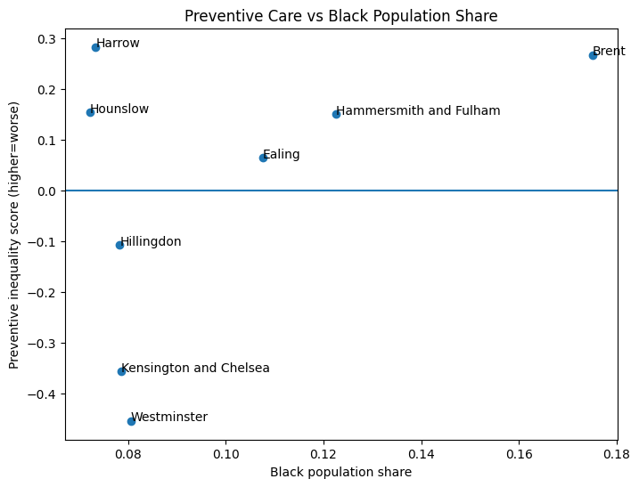
Preventive Care vs Black Population Share
Notes:
### Preventive Care vs Black population share
- Brent:
High Black population share + high preventive inequality
→ strongest equity concern
- Hammersmith and Fulham:
Moderate share + weak prevention
→ service access / targeting issue
- Hounslow:
Lower share but high preventive inequality
→ broader structural issue
- Harrow:
Lower share + rising preventive inequality
→ emerging risk, not yet ethnicity-concentrated
### Core insight
Inequality in NWL is not only about outcomes — it is strongly linked to variation in preventive care.
Different borough patterns:
- Established inequality + weak prevention → Brent, Hounslow
- Outcome-driven inequality → Hammersmith & Fulham
- Emerging prevention failure → Harrow
- Strong prevention → Kensington & Chelsea, Westminster
--------------------------------------------------
### Strategic implications
- Brent:
highest priority intersection:
inequality + prevention gap + ethnicity exposure
- Hounslow:
structural + prevention gap
- Hammersmith and Fulham:
service pathway / access issue
- Harrow:
early intervention opportunity
- Westminster / Kensington and Chelsea:
benchmark / comparator boroughs
This layer moves the analysis from: "where inequality exists" to: "where inequality could have been prevented earlier"

Slide 16
Trends over time
Some high-burden boroughs improving
Harrow emerging risk
Inequality shifting, not disappearing

Slide 17
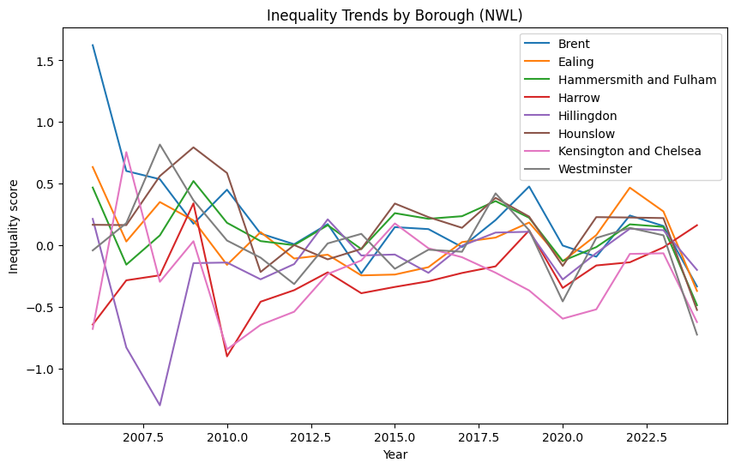
Inequality trends by Borough
Notes:
Key message
Inequality across NW London is not static. Most borough have improved over time, however, Harrow demonstrates worsening result.
**While several high-burden boroughs show improvement, new areas of inequality are emerging, highlighting the need for both sustained intervention and proactive monitoring.**
Different borough types require different responses:
A. High-burden improving (Brent, H&F)
→ Sustain and scale effective interventions
B. Structural inequality (Hounslow)
→ Focus on:
- housing
- employment
- prevention
- VCSE engagement
C. Emerging risk (Harrow)
→ Early intervention:
- monitoring
- targeted outreach
- community engagement
D. Stable / balanced (Ealing, Hillingdon)
→ Maintain performance, monitor volatility

Slide 18
Borough prioritisation
Brent: equity + prevention
Hounslow: structural prevention
H&F: access and outcomes
Ealing: focus on prevention
Harrow: early intervention & monitoring
Westminster: service responsiveness
K&C, Hillingdon: maintain & monitor

Slide 19
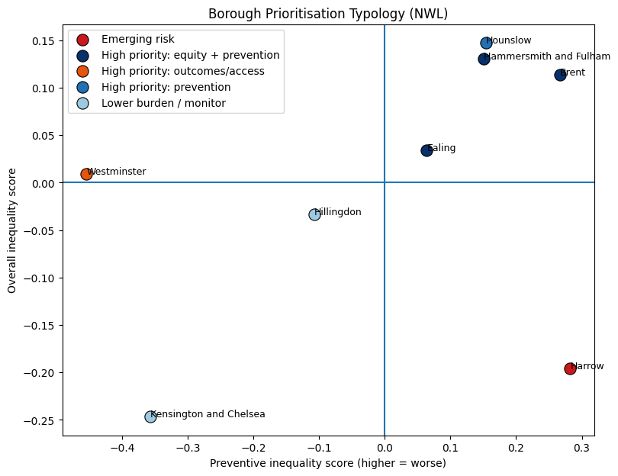
Borough typology ranking

Slide 20
Borough Prioritisation Summary
Borough | Typology | Recommended Action | Inequality | Prevention | Black Pop. | Trend
Harrow | Emerging risk | Early intervention and monitoring | -0.20 | 0.28 | 0.07 | ↑ 0.81
Hammersmith & Fulham | High priority: equity + prevention | Targeted outreach, VCSE partnership | 0.13 | 0.15 | 0.12 | ↓ -0.95
Brent | High priority: equity + prevention | Targeted outreach, VCSE partnership | 0.11 | 0.27 | 0.18 | ↓ -1.96
Ealing | High priority: equity + prevention | Targeted outreach, VCSE partnership | 0.03 | 0.06 | 0.11 | ↓ -1.01
Westminster | High priority: outcomes/access | Improve access and pathways | 0.01 | -0.45 | 0.08 | ↓ -0.68
Hounslow | High priority: prevention | Strengthen early intervention | 0.15 | 0.15 | 0.07 | ↓ -0.69
Hillingdon | Lower burden / monitor | Maintain performance | -0.03 | -0.11 | 0.08 | ↓ -0.41
Kensington & Chelsea | Lower burden / monitor | Maintain performance | -0.25 | -0.36 | 0.08 | ↑ 0.06

Slide 21
What this means for action
Strengthen prevention systems
Improve access and pathways
Monitor emerging risks
Targeted outreach via VCSE

Slide 22
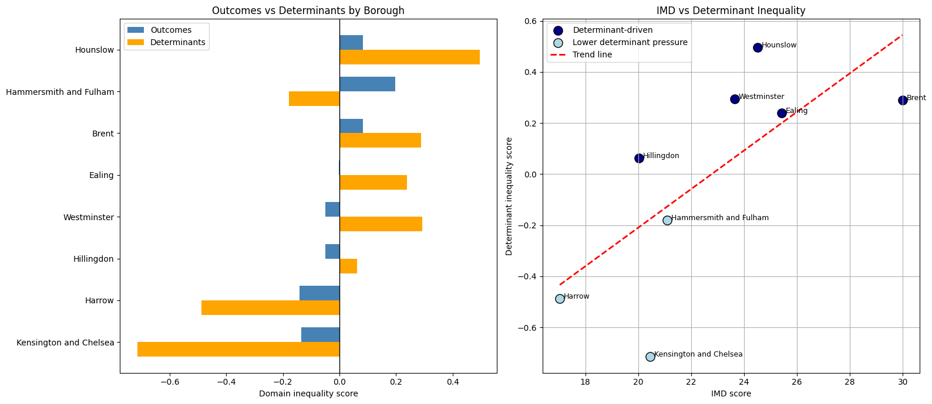
Structural Drivers of Determinant-Based Health Inequality
Determinant-based inequality across NW London is strongly aligned with structural deprivation patterns.
Notes:
Key Findings
- Boroughs with higher deprivation consistently show higher determinant (that are risk conditions, like alcoholism, smoking prevalence, obesity, unemployment due to long-term health condition etc) inequality.
- A strong positive relationship exists between IMD and determinant inequality (r = 0.71).
- Structural deprivation appears to influence risk conditions before translating into disease burden.
- Brent, Hounslow, Ealing and Westminster form the highest structural pressure cluster.

Slide 23
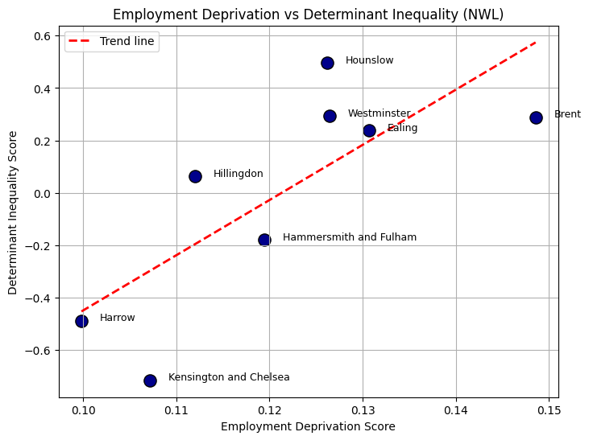
Employment Deprivation Emerges as the Strongest Structural Driver
Labour market disadvantage appears to be the primary driver of determinant-based inequality across NW London.
Notes:
Key Findings
Employment deprivation shows the strongest correlation with determinant inequality (r = 0.76).
Boroughs with higher labour market disadvantage experience elevated health risk conditions.
The relationship is visually stronger and more consistent than the overall IMD relationship.
Hounslow and Brent demonstrate the highest determinant pressure, followed by Westminster and Ealing

Slide 24
Income, Education, Housing deprivation and determinant-led inequality
Key Findings
Income and education both show strong positive relationships with determinant inequality.
Income acts as a reinforcing socioeconomic driver.
Education appears to influence inequality over a longer-term horizon.
Housing barriers showed moderate association

Slide 25
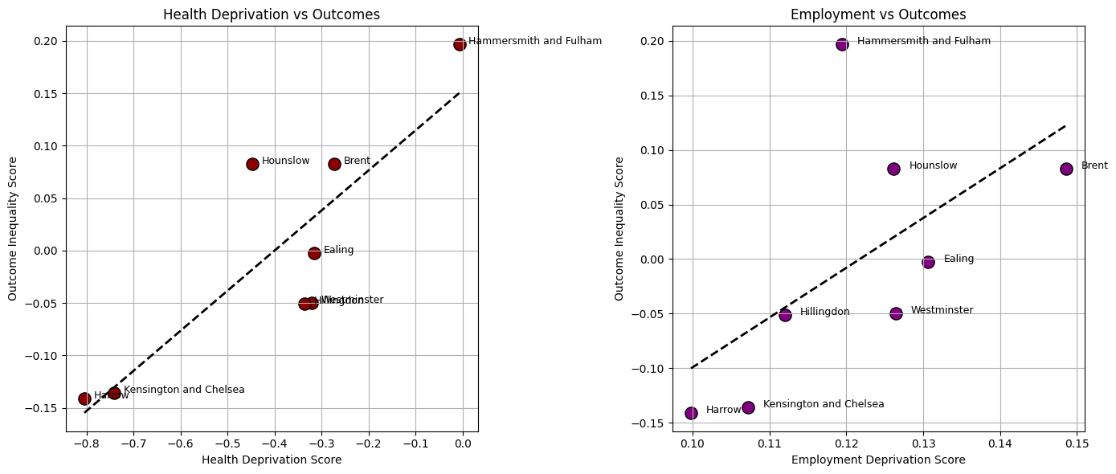
Structural Factors Influence Determinants/Risk Conditions Before Outcomes
Key Findings
Health deprivation aligns strongly with outcome inequality (r = 0.85).
Employment deprivation shows a moderate relationship with outcome inequality (r = 0.60).
Structural drivers influence determinant inequality more strongly than direct disease burden.
Findings support a pathway from structural disadvantage → risk conditions → health outcomes.

Slide 26
Key Structural Drivers Identified Across NW London
Structural Driver | Determinant Correlation | Outcome Correlation | Interpretation
Employment | 0.76 | 0.60 | Primary upstream driver
Education | 0.69 | 0.21 | Long-term structural factor
Income | 0.68 | 0.41 | Supporting socioeconomic driver
Housing barriers | 0.66 | 0.28 | Secondary structural factor
Health deprivation | 0.56 | 0.85 | Strongly aligned with outcomes
Notes:
Structural inequality in NW London appears to be driven primarily by labour market disadvantage, reinforced by income and education factors, with impacts emerging first through determinant-based inequality before translating into disease burden.

Slide 27
Reducing long-term health inequality requires earlier intervention at the structural and determinant level, before inequalities translate into higher disease burden.
Upstream Prevention Priorities
Employment support initiatives
Financial resilience programmes
Skills and education pathways
Housing and access support
Determinant-Focused Intervention Priorities
Smoking/alcoholism reduction
Obesity prevention
Mental health support
Earlier preventive engagement
Targeted community outreach

Slide 28
NEXT…

Slide 29
Strengthening the Evidence Base (Data Gaps)
To move from indicative patterns to direct, actionable evidence, the following data are critical:
• Local health outcomes by ethnicity (borough or below)
(e.g. maternity outcomes, long-term conditions, mental health)
• Access and experience by ethnicity
(e.g. GP access, waiting times, patient experience)
• Preventive care uptake by ethnicity
(e.g. screening, vaccinations, antenatal booking)

Slide 30
Additional high-value data
Ethnicity × deprivation (IMD linkage)
→ to understand structural inequality intersections
Secondary care utilisation by ethnicity
→ to link access, pathways, and outcomes
VCSE service mapping
→ to align inequalities with existing interventions
Neighbourhood-level data (MSOA/LSOA)
→ to identify hidden pockets of inequality
Time trends by ethnicity (local)
→ to assess whether inequalities are widening or improving

