Slide 1
Notes on literature for neuromorphic graphene device project

Slide 2
2020

Slide 3
Ultrafast machine vision with 2D material neural network image sensors https://doi.org/10.1038/s41586-020-2038-x
One of main papers!
From nature views – nice motivation part. Also – material – tungsten diselenide
Imaging under dim light would be difficult for the device described by the authors. A redesign would be needed to improve light absorption in the thin semiconductor and to increase the range of light intensities that can be detected.

Slide 4
2022

Slide 5
Gate-tunable quantum pathways of high harmonic generation in graphene - 10.1038/s41467-022-34337-y

Slide 6
2024

Slide 7
Programmable nonlinear optical neuromorphic computing with bare 2D material MoS2 https://doi.org/10.1038/s41467-024-54776-z
Questions:
Main points
They don’t like of integrated photonics with 2D materials
computing mechanism of transition from two-photon absorption to synergistic excited states absorption
Good refs. 1-13 about nonlinear optical response, especially 8-13 high harmonic gen.
Optical neuromorph comp. refs 16-21
spatial light modulators36 and meta-lenses37 have been demonstrated with purely patterned 2D materials
Schematic of optical ANN. The ΔT is a function of control power and control time delay. The control power in each cell is the input signal, and the control time delay is encoded into weight. The cell thicknesses are identical
A custom training dataset consisted of 3 × 3 patterns for letters H, U, S, and T, encoded by PCtl for each pixel
(Data noise) To evaluate the noise robustness, the Gaussian noise with a mean value of zero and standard deviation of 0.2 mW is included in the training dataset.
single layer ANN to classify
free-space optical neuromorphic computing concept
Supplementary Table 1 | Consumption in different systems
Set of good references

Slide 8
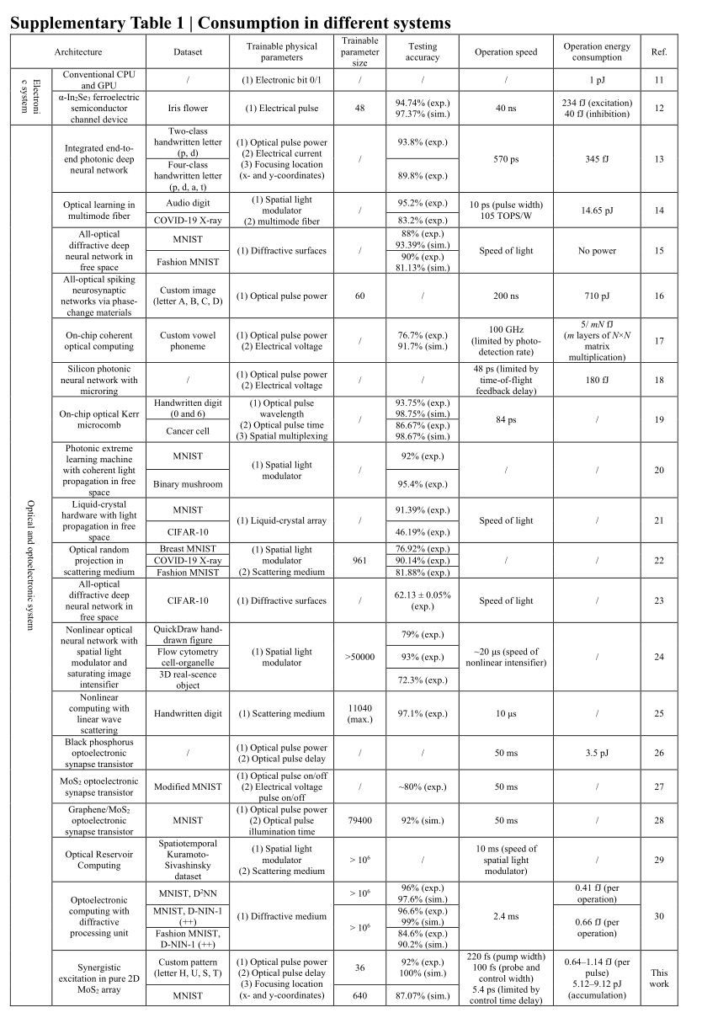
The same paper – table of energies

Slide 10
Notes for our purposes

Slide 11
Main comparison
Our quantum geometric features are really new (at least now)

