Slide 1


GDP of Germany
Course: Data Alalytics
Presenter: Olesia Medvid

Slide 2
- how GDP has been changed for the last 10 years in Germany - how GDP depends on Exports and Consumption expenditure (in Germany) - compare GDP of Germany with GDP average of EU countries - compare GDP per capita of Germany with another EU countries and average of EU members
GDP

Slide 3
DATA
- GDP (current US$)
- Exports of goods and services (BoP, current US$)
- Final consumption expenditure (current US$)
- GDP per capita (current US$)
Source: The World Bank Data <https://data.worldbank.org/>

Slide 4

ANALYSIS
- Data Selection
- Data Manipulation
- Data Merging
- Data Reshaping
- Data Cleaning
- Machine Learning
- Statistical method
- Visualisation

Slide 5
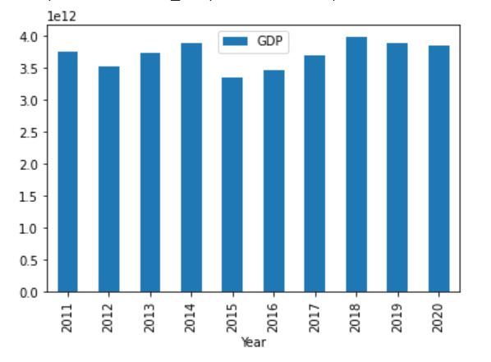
GDP in Germany(2011-2020)

Slide 6
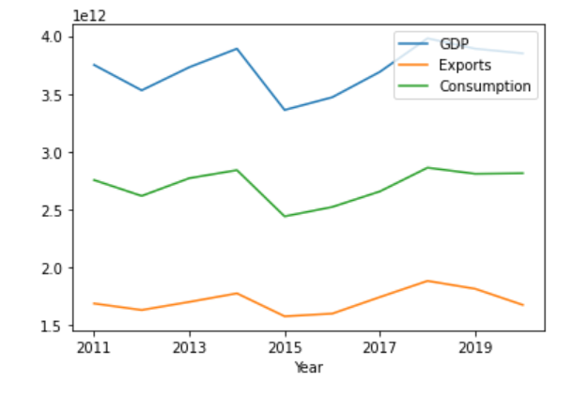
GDP, Export and Final consumption expenditure

Slide 7
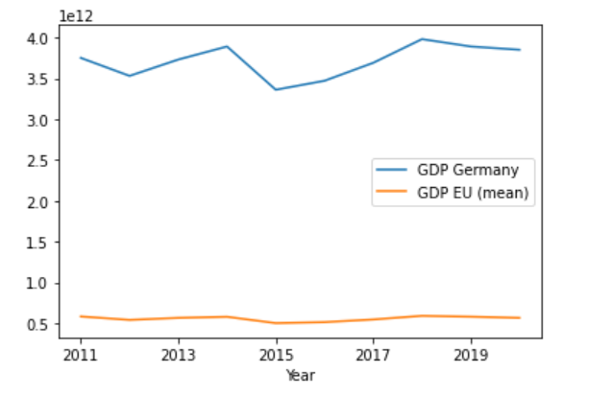
GDP of Germany and average of EU

Slide 8
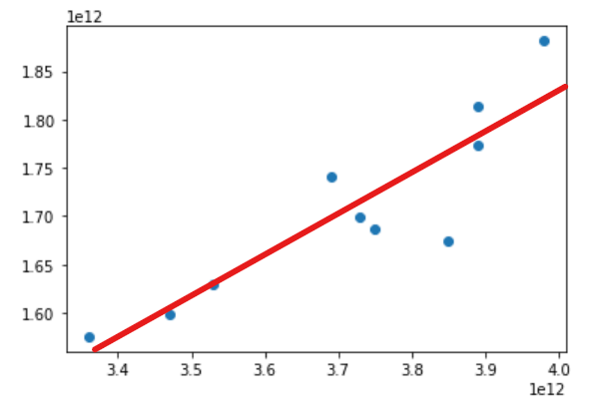
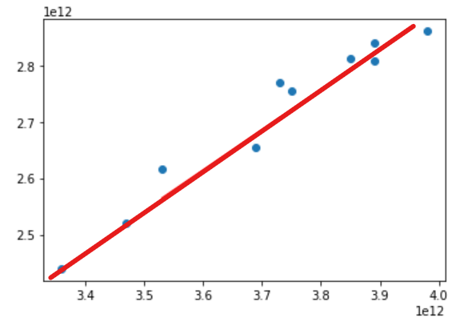
GDP and Exports Regression GDP and Consumption

Slide 9
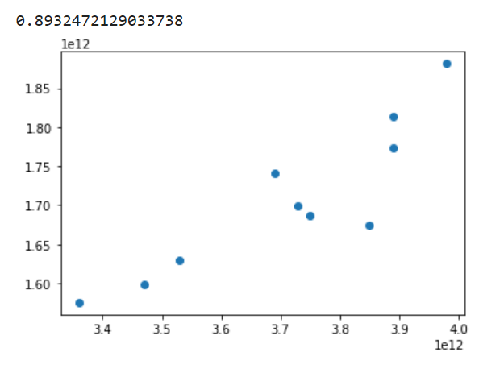
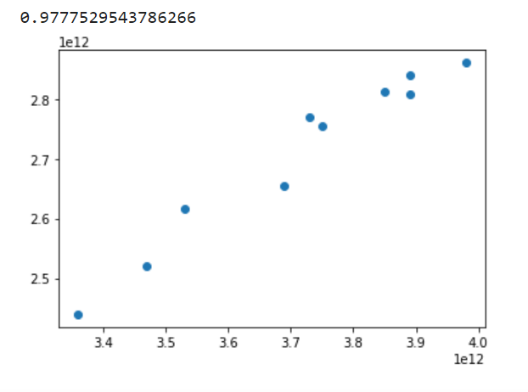
GDP and Exports Correlation GDP and Consumption

Slide 10
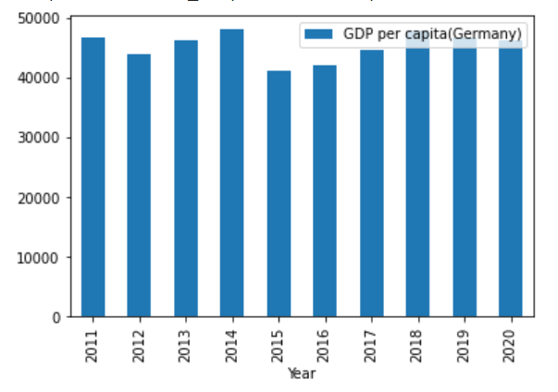
GDP per capita (Germany)

Slide 11
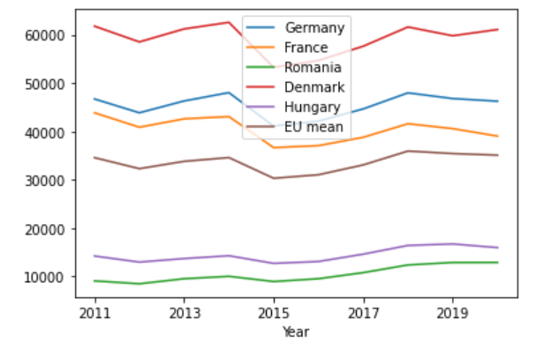
GDP per capita

Slide 12


Д Я К У Ю
Olesia Medvid
Data Analytics

