Slide 1
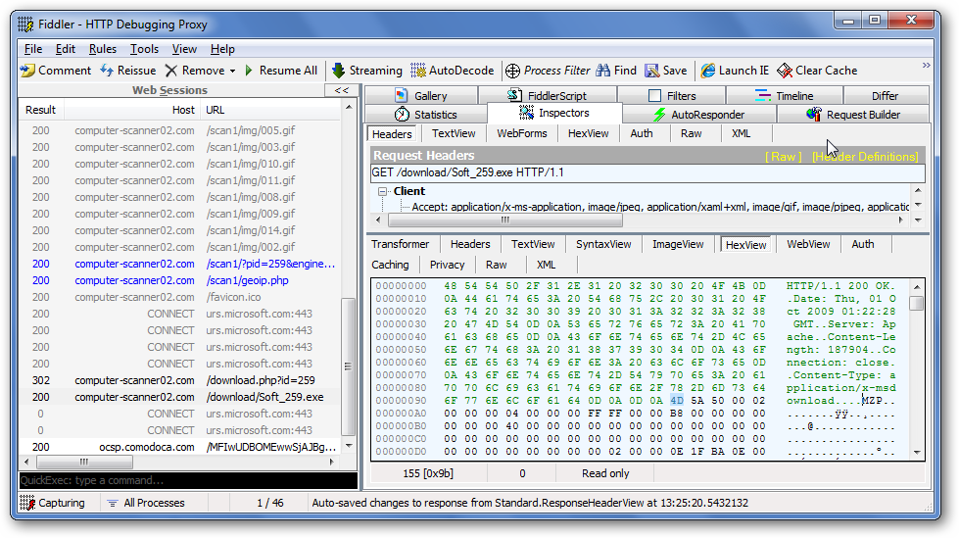
Fiddler
Notes:
Microsoft's Fiddler application, a free download, provides the ability to log and inspect all HTTP traffic between your computer and the Internet. It also allows one to set breakpoints and "fiddle" with incoming or outgoing data, thus making it possible to alter Referrer, UserAgent, and other HTTP headers to defeat defensive techniques employed by malicious websites. This session will provide an overview of Fiddler and demonstrate how it can be used in real world scenarios.

Slide 2
Introducing Fiddler
HTTP/HTTPS Debugger
Runs as a proxy server on the local machine or on a remote server
Written in C# (.NET Framework v2.0)
Freely available from

Slide 3
How does Fiddler work?

Slide 4
Debugging non-Windows clients
PC
Mac
Fiddler
Internet
Linux
PocketPC
Notes:
You can use Fiddler to monitor traffic from any device that supports a HTTP proxy.

Slide 5
Who uses Fiddler?
Microsoft engineers
Support teams
Lots of external web developers (10K+ downloads per week)
Security researchers

Slide 6
What can Fiddler do?
HTTP/HTTPS traffic monitoring and analysis
Request and response modification
Timing and network manipulation

Slide 7
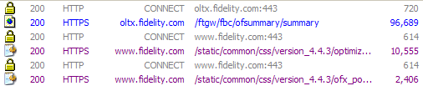
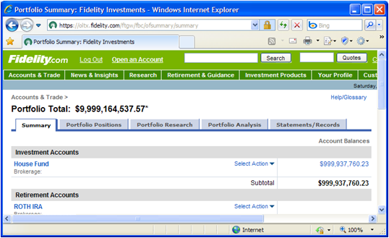
HTTPS Traffic Decryption

Slide 8
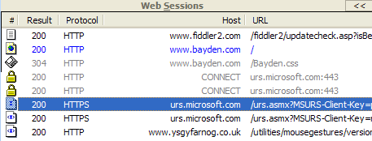
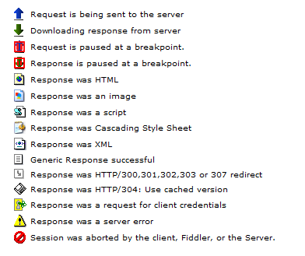
Fiddler UI: Session List
Icons show status of request/response
Lists all traffic
URLs, size, and key headers
Icons show status of request/response

Slide 9
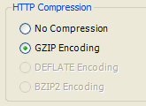
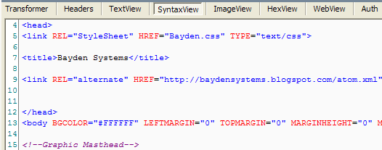
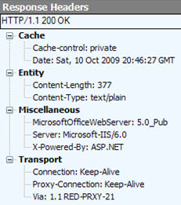
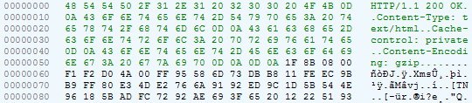
Fiddler UI: Inspectors
Inspectors allow you to visualize requests and responses in meaningful ways.

Slide 10
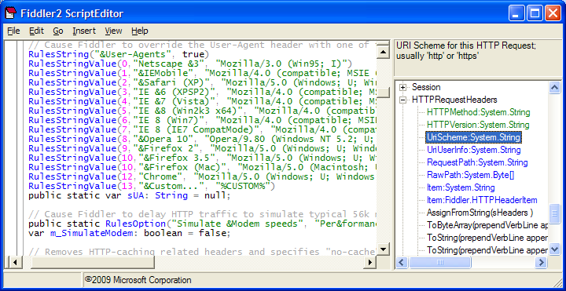
FiddlerScript Rules
Rules are where Fiddler gets really fun!
Use JavaScript to manipulate request or response headers or entity body.

Slide 11
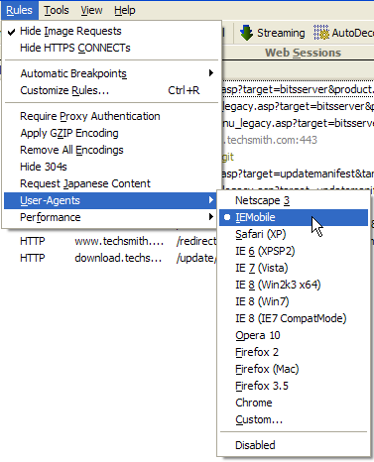
Extending Fiddler UI
FiddlerScript and extensions can add new menu items or tabs.

Slide 12
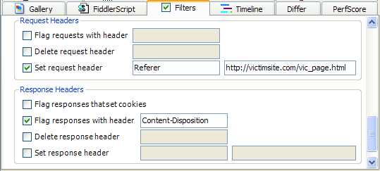
Using Simple Filters
Flag, modify or remove headers from all requests and responses.

Slide 13
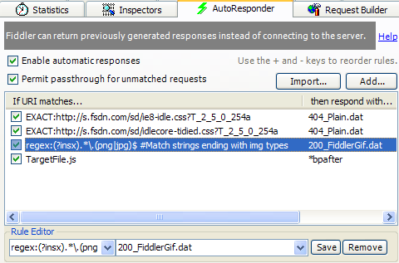
AutoResponder
Replay previously captured or generated traffic.

Slide 14
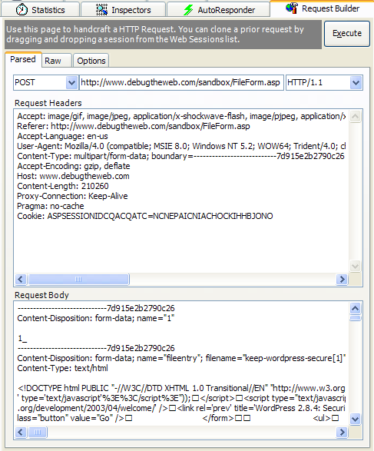
Request Builder
Create hand-built HTTP requests, or modify and reissue a request previously captured.

Slide 15
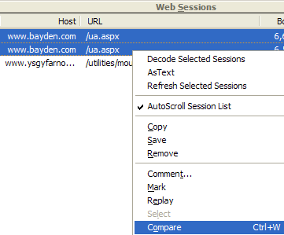
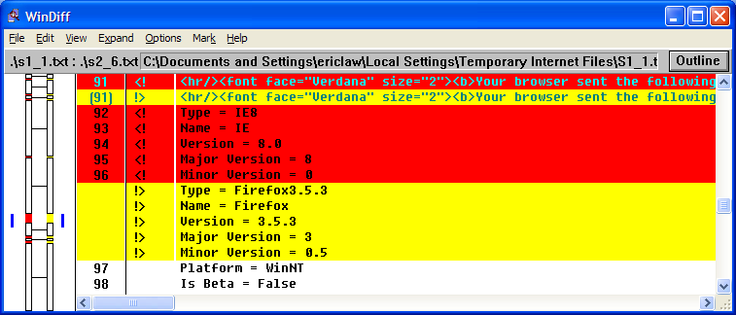
Traffic Comparison
Use WinDiff to compare HTTP requests and responses.

Slide 16
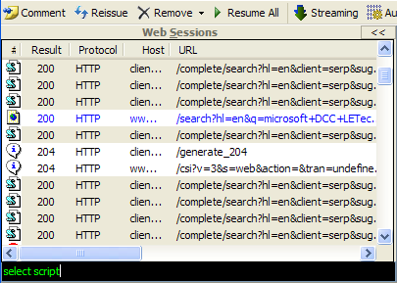
QuickExec
QuickExec allows you to issue textual commands directly…

Slide 17
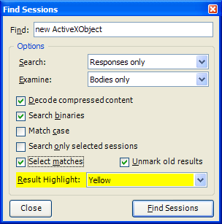
Search Traffic
Search for strings in all captured traffic.

Slide 18
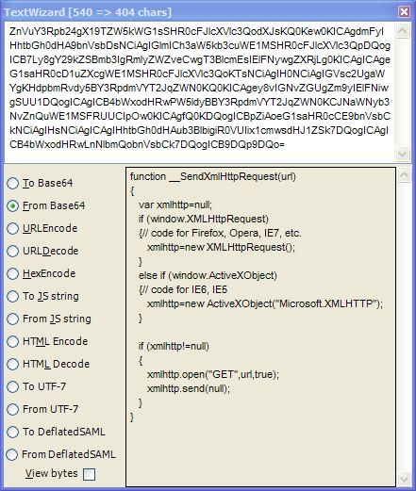
Text Encoding / Decoding
Convert text between popular web encodings.

Slide 19
SAZ Files
“Session Archive ZIP” files store raw traffic.
SAZ files are compressed and may be password protected.
SAZ files can be reopened by Fiddler or standard ZIP utilities.
FiddlerCap allows capture of SAZ files by non-technical, often remote, users.

Slide 20
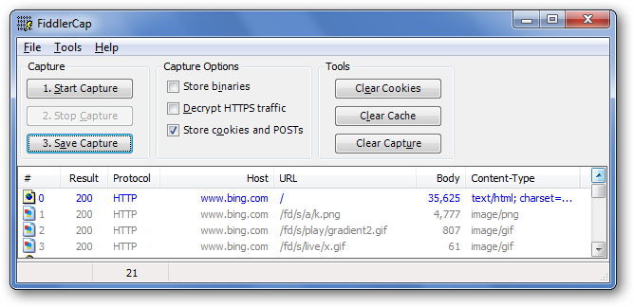
FiddlerCap
Use FiddlerCap for remote collection of evidence.

Slide 21
Fiddler application with extensions
Your application hosting FiddlerCore
Fiddler 2
YourApp.exe
Inspector2
ExecAction.exe
Inspector2
IFiddlerExtension
IFiddlerExtension
Fiddler ScriptEngine
Your FiddlerScript
FiddlerCore
FiddlerCore
Xceed*.dll
Makecert.exe
Xceed*.dll
Makecert.exe

