Slide 1

Analysis SDLC Model
Olga_Rymarchuk

Slide 2
Types of SDLC models
Waterfall model
Iterative model
Spiral model
V-model

Slide 3
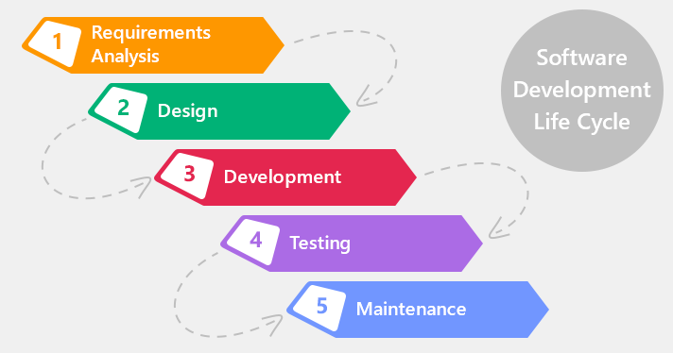
Despite the differences, all models contain the following general phases of the life cycle:
collection and analysis of software requirements;
architecture design;
detailed design;
implementation;
testing and integration;
accompaniment;
removal from service

Slide 4
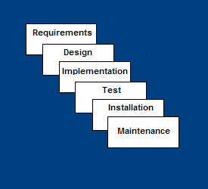
Waterfall Model

Slide 5


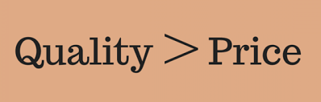
Waterfall Strengths
Easy to understand, easy to use
Provides structure to inexperienced staff
Sets requirements stability
Works well when quality is more important than cost or schedule

Slide 6
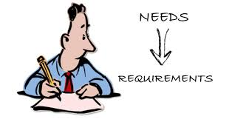
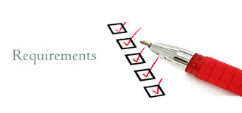
Waterfall Deficiencies
All requirements must be known upfront
Deliverables created for each phase are considered frozen – inhibits flexibility
Does not reflect problem-solving nature of software development – iterations of phases
Little opportunity for customer to preview the system (until it may be too late)

Slide 7
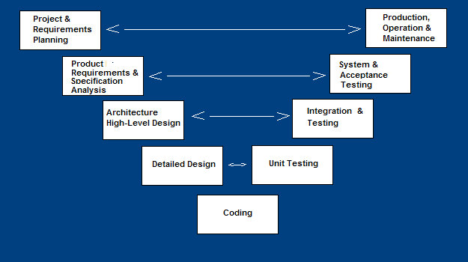
V-Shaped SDLC Model

Slide 8
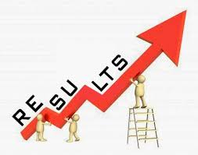
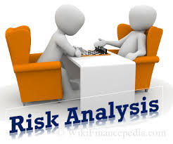
V-Shaped Strengths
• Emphasize planning for verification and validation of the product in early stages of product development
• Each deliverable must be testable
• Project management can track progress by milestones
• Easy to use
V-Shaped Weaknesses
• Does not easily handle concurrent events
• Does not handle iterations or phases
• Does not easily handle dynamic changes in requirements
• Does not contain risk analysis activities

Slide 9
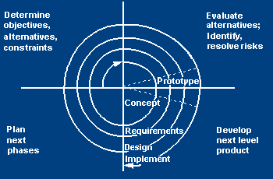
Spiral SDLC Model

Slide 10
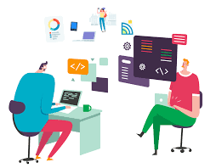
Spiral Model Strength and Weaknesses
Strengths
– Introduces risk management
– Prototyping controls costs
– Evolutionary development
– Release builds for beta testing
Weaknesses
– Lack of risk management experience
– Lack of milestones
– Management is dubious of spiral process – Change in Management

Slide 11
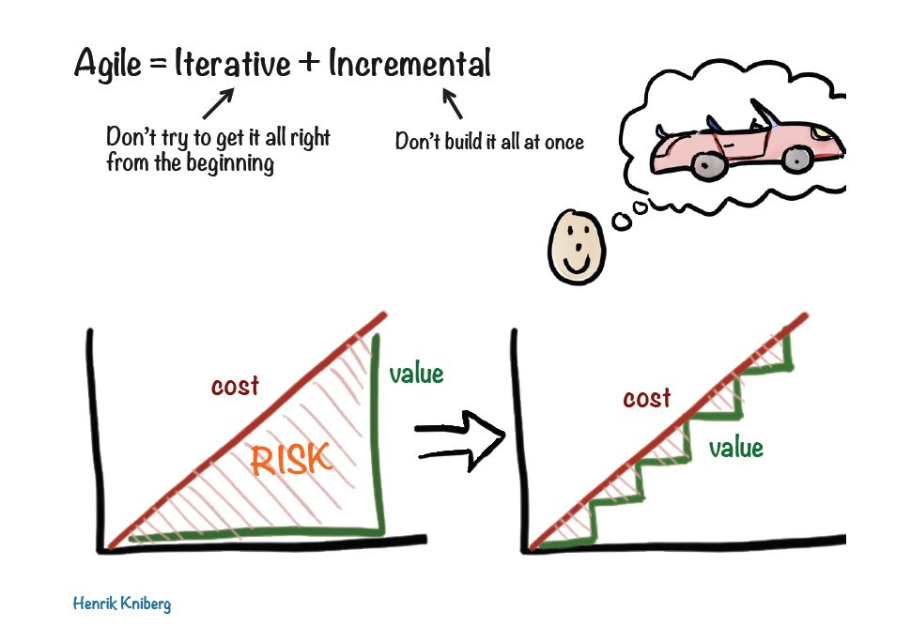
Agile SDLC Model

Slide 12
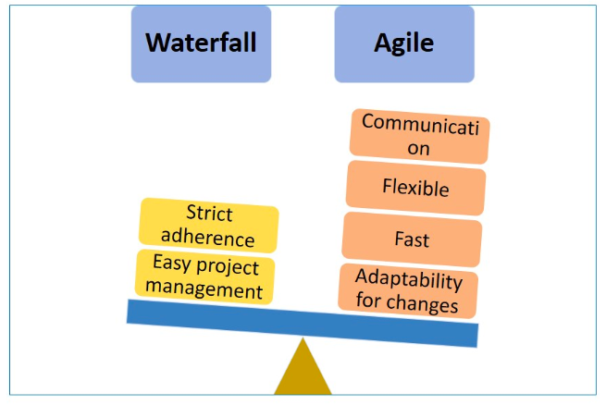
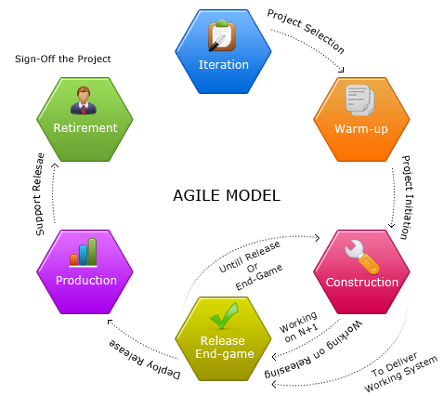
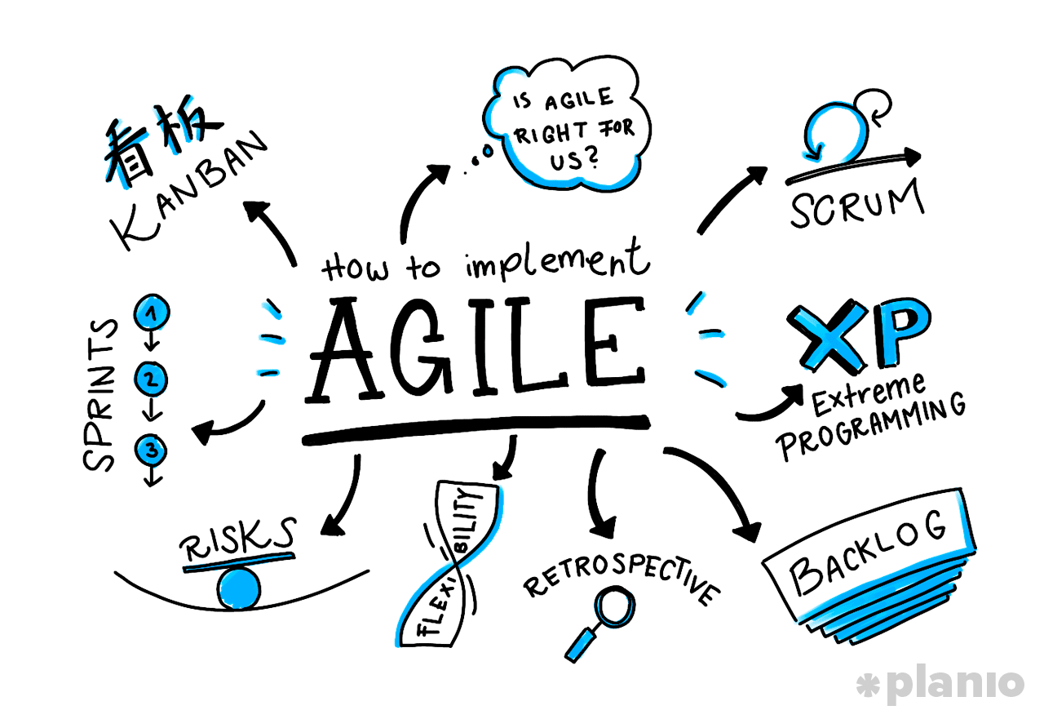
Agile SDLC Model

Slide 13
Cascade model | Iterative model | Spiral model | V-model
It is characterized that the development stages go one after another Stable requirements Allows you to quickly create a system without additional overhead for the organization of the development process | Requirements may change as development proceeds. It has a large overhead on the organization of the process than The project consists of iterations. But the cost of correcting the error depending on the duration of the project is not so high. | Serious risks Spiral -> revolution -> iteration (planning, risk analysis, development, customer evaluation) -> the project continues or not At the risk analysis stage, prototypes are created that allow the risk to be resolved at an early stage. | Fixed requirements, cost and time The difference is that the stages of analysis and design are related to the testing stage. It is not desirable that requirements change during development.

