Slide 1
Software Development using C# 5 lesson
Olga Bikova
olga.bikova@inbox.lv
23.09.2019

Slide 2
Agenda
Introduction to databases
SQL basics
ADO.NET
Entity Framework

Slide 3
Databases

Slide 4

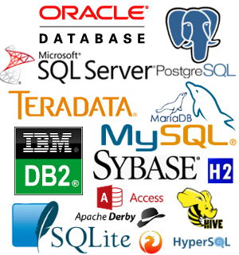
Databases

Slide 5
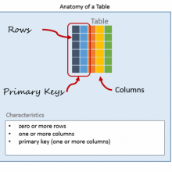
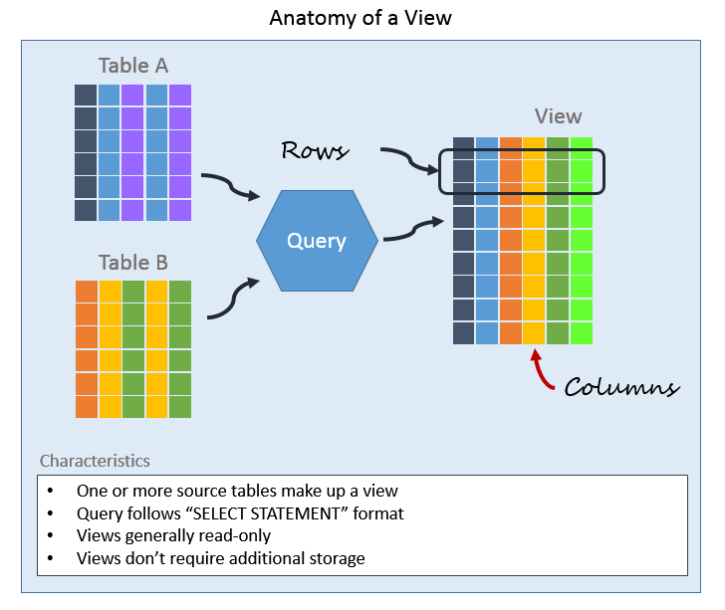
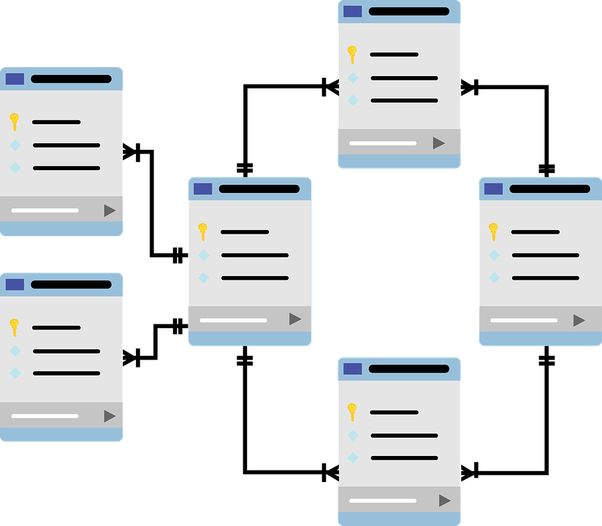
Databases
A database is an organized collection of data
Database represents collection of schemas, tables, queries, reports, view and other components

Slide 6
Databases types
Hierarchical databases.
Network databases.
Relational databases.
Object-oriented databases
Relation DB: Data is organized into one or more tables (or «relation») of columns and rows. Each row has its own unique key.

Slide 7
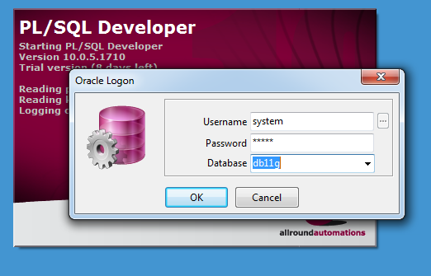

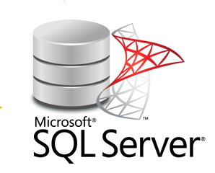


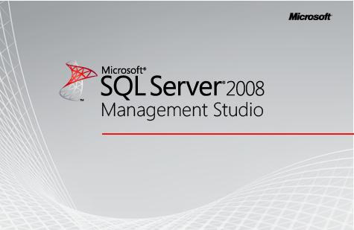
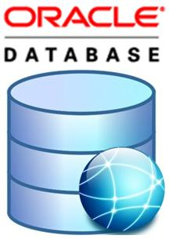
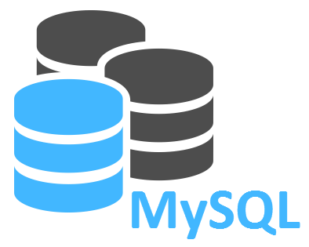

Database Management Systems
DBMS is a software system that uses a standard method and running queries with some of them designed for the oversight and proper control of databases.

Slide 8
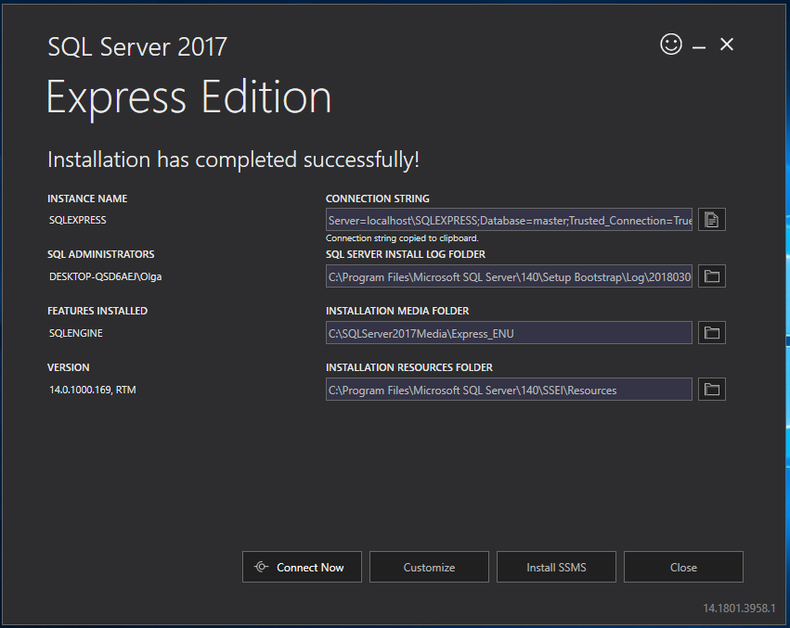

Slide 9
Connection String
Server=myServerAddress;
Database=myDataBase;
User Id=myUsername;
Password=myPassword;
Trusted_Connection=true/false;
Integrated Security=true/false;
and so on...

Slide 10
SQL

Slide 11
SQL - Structured Query Language
Used in programming and designed for managing data held in a relational database management system
The SQL language is subdivided into several language elements, including: clauses, expressions, predicates, queries, statements
SQL is designed for a specific purpose: to query data contained in a relational database.

Slide 12
SQL most important commands
SELECT - extracts data from a database
UPDATE - updates data in a database
DELETE - deletes data from a database
INSERT INTO - inserts new data into a database
CREATE DATABASE - creates a new database
ALTER DATABASE - modifies a database
CREATE TABLE - creates a new table
ALTER TABLE - modifies a table
DROP TABLE - deletes a table
CREATE INDEX - creates an index (search key)
DROP INDEX - deletes an index

Slide 13
ADO.NET

Slide 14
ADO.NET - ActiveX Data Object
Set of classes that expose data access services for .NET Framework apps
Provides a rich set of components for creating distributed, data-sharing applications
Supports a variety of development needs, including the creation of front-end database clients and middle-tier business objects used by applications, tools, languages, or Internet browsers

Slide 15
ADO.NET Components
.NET Framework Data Providers - components that have been explicitly designed for data manipulation and fast, forward-only, read-only access to data.
Connection - provides connectivity to a data source
Command - enables access to database commands to return data, modify data, run stored procedures, and send or retrieve parameter information
DataReader - provides a high-performance stream of data from the data source
DataAdapter - provides the bridge between the DataSet object and the data source

Slide 16
ADO.NET Components
DataSet
Is explicitly designed for data access independent of any data source
Can be used with multiple and differing data sources, used with XML data, or used to manage data local to the application
Contains a collection of one or more DataTable objects consisting of rows and columns of data, and also primary key, foreign key, constraint, and relation information about the data in the DataTable objects

Slide 17
Connect To DB within C# code
using System.Data.SqlClient;
SqlConnection Class
SqlCommand Class
SqlConnection.Open Method ()
SqlCommand. ExecuteNonQuery Method ()

Slide 18
Entity Framework

Slide 19
Entity Framework
The ADO.NET Entity Framework (EF) is designed to enable developers to create data access applications by programming against a conceptual application model instead of programming directly against a relational storage schema.
With the Entity Framework, developers can work at a higher level of abstraction when they deal with data, and can create and maintain data-oriented applications with less code than in traditional applications.

Slide 20
Entity Framework
EF provides three approaches to interact with databases:
Database First – EF creates the set of classes which represent concrete database model
Model First – developer should create database model, which will be used by EF to create real database
Code First – developer creates data models, which are used by EF to generate real database

