Slide 1
Software Development using C# 1 lesson
Olga Jepifanova
olga.bikova@inbox.lv
09.09.2019

Slide 2
Agenda
Compilation process
C# Syntax – main principles

Slide 3
Code compilation

Slide 4
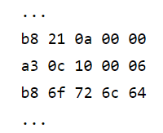
Long time ago...
Code was written by developers in machine codes (language that processor understands)

Slide 5
High level of abstraction
To avoid the complexity of writing machine codes clever people started to invent abstractions and put programs on the higher level.
Modern programming languages underneath take care of memory management, different processors, graphic cards, monitors operating systems and many other things that we as high level programmers don’t even think about.

Slide 6
Nowadays
Modern software developers usually work on a high level of abstraction.
Huge percentage of programmers doesn’t know how the computer work nowadays and don’t care about plenty of low-level things

Slide 7
Compiler
Compiler - transforms computer code written in one programming language (the source language) into another programming language (the target language).
Compiler is needed to convert C# code into something that processor of your computer understands
The processor doesn't know C#, it understands only machine codes.

Slide 8
Compiler - csc.exe
C# language compiler is csc.exe
csc.exe path:
C:\Windows\Microsoft.NET\Framework64\v4.0.30319>

Slide 9
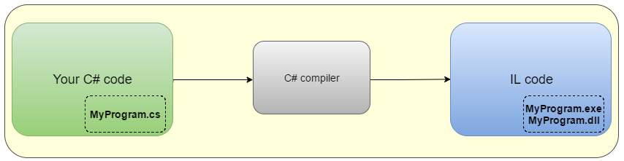
Compilation steps - 1
C# compiler takes your code as an input and produces an output — your program in IL(intermediate language) code saved in *.exe or *.dll files.

Slide 10
Compilation steps - 2
Common language runtime (CLR) is a program running on your computer that manages the execution of IL code
CRL just knows how to deal with IL and how to execute programs that are written in IL code.
CLR uses JIT (Just in time) compiler to compile IL code into machine codes
JIT compiles IL code at the moment when the user tries to use it

Slide 11
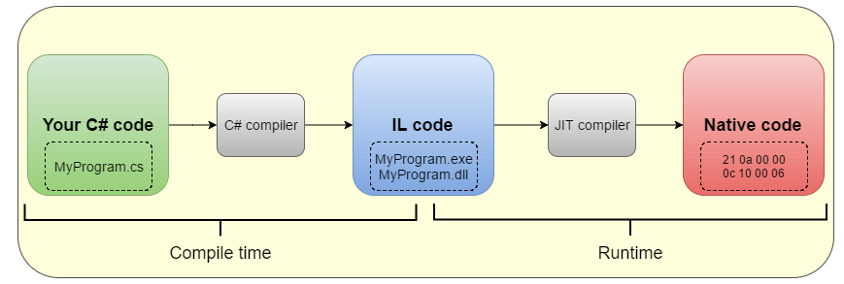
Compilation steps - 2

Slide 12
Comand-line compilation
Compilation could happen
using cmd (command line)
using Developer Command Prompt for VS 2017
Base comand
csc.exe /t:exe <file_name>.cs

Slide 13
C# syntax

Slide 14
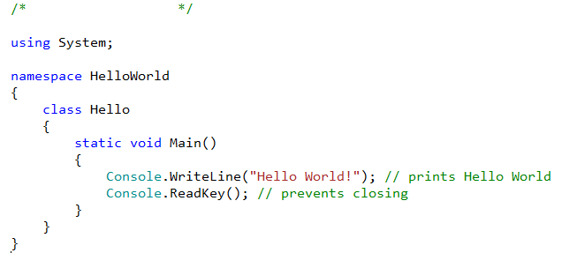
C# syntax
Consists of symbols, expressions, operators and keywords
Contains variables, functions, classes and identifiers
Notes:
Smotetj prezentaciju s intuita

Slide 15
Reserved Keywords
abstract | as | base | bool | break
catch | char | checked | class | const
default | delegate | do | double | else
explicit | extern | false | finally | fixed
foreach | goto | if | implicit | in
interface | internal | is | lock | long
null | object | operator | out | out (generic modifier)
private | protected | public | readonly | ref
sealed | short | sizeof | stackalloc | static
switch | this | throw | true | try
ulong | unchecked | unsafe | ushort | using
volatile | while

Slide 16
Contextual Keywords
add | alias | ascending | descending
dynamic | from | get | global
group | into | join | let
orderby | partial (type) | partial (method) | remove
select | set
Notes:
A contextual keyword is used to provide a specific meaning in the code, but it is not a reserved word in C#.

Slide 17
Operators and separators
{ } [ ] ( ) . , : ; + - * / % & | ^ ! ~ =
< > ? ++ -- && || << >> == != <= >=
+= -= *= /= %= &= |= ^= <<= >>= ->
Notes:
Знак операции — это один или более символов, определяющих действие над операндами. Внутри знака операции пробелы не допускаются. Например, в выражении a += b знак += является знаком операции, а a и b — операндами. Символы, составляющие знак операций, могут быть специальными, например, +, &&, | и <, и буквенными, такими как as или new.
Операции делятся на унарные, бинарные и тернарную по количеству участвующих в них операндов (один, два и три операнда соответственно). Один и тот же знак может интерпретироваться по-разному в зависимости от контекста.
Разделители используются для разделения или, наоборот, группирования элементов. Примеры разделителей: скобки, точка, запятая. Ниже перечислены все знаки операций и разделители, использующиеся в C#:
https://docs.microsoft.com/en-us/dotnet/opbuildpdf/csharp/language-reference/operators/toc.pdf?branch=live

Slide 18
Data types – value type
Directly contain data
Simple types: int, long, byte, char, float, double, decimal, bool, etc...
Enum types: User-defined types of the form enum E {...}
Struct types: User-defined types of the form struct S {...}
Nullable value type: Extensions of all other value types with a null value
Notes:
Ther eis also pointer type https://www.tutorialspoint.com/csharp/csharp_data_types.htm

Slide 19
Data types – reference type
Do not contain the actual data stored in a variable, but they contain a reference to the variables
Class types:
object, unicode string, User-defined types of the form class C {...}
Interface types: User-defined types of the form interface I {...}
Array types: Single- and multi-dimensional, for example, int[] and int[,]
Delegate value type: User-defined types of the form delegate int D {...}
Notes:
Ther eis also pointer type https://www.tutorialspoint.com/csharp/csharp_data_types.htm

Slide 20
Type conversion
Implicit conversions:
No special syntax is required because the conversion is type safe and no data will be lost
Explicit conversions (casts):
required when information might be lost in the conversion, or when the conversion might not succeed for other reasons
User-defined conversions:
performed by special methods
Conversions with helper classes:
convert between non-compatible types

Slide 21
Variables
Represent storage locations;
Has a type that determines what values can be.
Syntax for variable definition
<data_type> <variable_list>;
Syntax for variable initialization
variable_name = value;
<data_type> <variable_list> = value;

Slide 22
Variables
Non-nullable / Nullable - a (null) value of that exact type
Object - a (null) reference to an object of any reference type, or a reference to a boxed value of any value type
Class type - a (null) reference to an instance of that class type, or a reference to an instance of a class derived from that class type
Interface type - a (null) reference to an instance of a class type that implements that interface type
Array type - a (null) reference to an instance of that array type, or a reference to an instance of a compatible array type
Delegate type - a (null) reference to an instance of a compatible delegate type

Slide 23
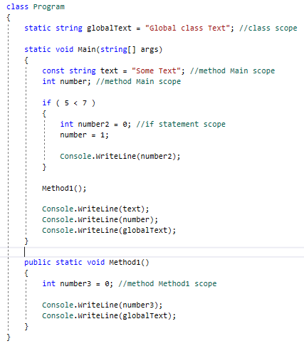
Variables Scope
The scope of a variable, sometimes referred to as accessibility of a variable, refers to where the variable can be read from and/or written to, and the variable's lifetime, or how long it stays in memory.

Slide 24
Constants
Refer to fixed values that the program may not alter during its execution.
Can be of any of the basic data types.
Treated just like regular variables.
Syntax for constant definition:
const <data_type> <constant_name> = value;

Slide 25
Constants
Integer: a decimal, or hexadecimal constant
Floating-point: has an integer part, a decimal point, a fractional part, and an exponent part (examples: 3.14159, 314159E-5F)
Character: enclosed in single quotes ('x' )
String: are enclosed in double quotes "" or with @""
Bool: true or false

Slide 26
Expressions
Constructed from operands and operators.
Operators of an expression indicate which operations to apply to the operands
Expression example:
x + (y * z)

Slide 27
Statements
Declaration statements:
used to declare local variables and constants
Expressions statements
used to evaluate expressions (=, ++, <<, await)
Selection statements
used to select one of a number of possible statements for execution based on the value of some expression (if, switch)
Iteration statements:
used to execute repeatedly an embedded statement (while, do, for, foreach)
Jump statements
used to transfer control (break, continue, throw, return)

Slide 28
Notations

Slide 29
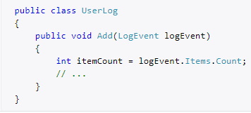
C# Notations – DO
use PascalCasing for class names and method names.
use camelCasing for method arguments and local variables.
Consistent with the Microsoft's .NET Framework and easy to read.
Notes:
Smotetj prezentaciju s intuita

Slide 30
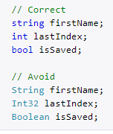
C# Notations – DO
use predefined type names instead of system type names like Int16, Single, UInt64, etc.
Consistent with the Microsoft's .NET Framework and easy to read.
Notes:
Smotetj prezentaciju s intuita

Slide 31
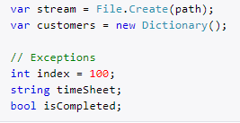
C# Notations – DO
use implicit type var for local variable declarations. Exception: primitive types (int, string, double, etc) use predefined names.
Removes clutter, particularly with complex generic types. Type is easily detected with Visual Studio tooltips.

Slide 32
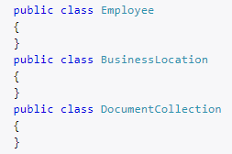
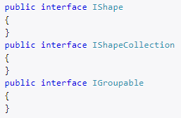
C# Notations – DO
use noun or noun phrases to name a class
prefix interfaces with the letter I. Interface names are noun (phrases) or adjectives.
Consistent with the Microsoft's .NET Framework and easy to read.
Notes:
Smotetj prezentaciju s intuita

Slide 33
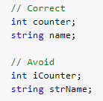
C# Notations – DO NOT
use Hungarian notation or any other type identification in identifiers
Consistent with the Microsoft's .NET Framework and Visual Studio IDE makes determining types very easy (via tooltips). In general you want to avoid type indicators in any identifier.
Notes:
Smotetj prezentaciju s intuita

Slide 34
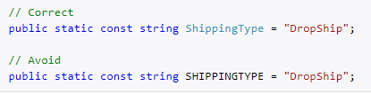
C# Notations – DO NOT
use Screaming Caps for constants or readonly variables
Caps grap too much attention..
Notes:
Smotetj prezentaciju s intuita

Slide 35

Thank you
…
if(anyQuestions)
{
AskPresenter();
}
else
{
//LoveCats();
AttendNextLesson();
}
…

