Slide 1
Software Development using C# 7 lesson
Olga Jepifanova
olga.bikova@inbox.lv
30.09.2019

Slide 2
Agenda
HTML
DOM
JavaScript

Slide 3
HTML

Slide 4
HTML - HyperText Markup Language
Most widely used language to write Web Pages
Hypertext refers to the way in which Web pages (HTML documents) are linked together
HTML is being widely used to format web pages with the help of different tags available in HTML language.

Slide 5
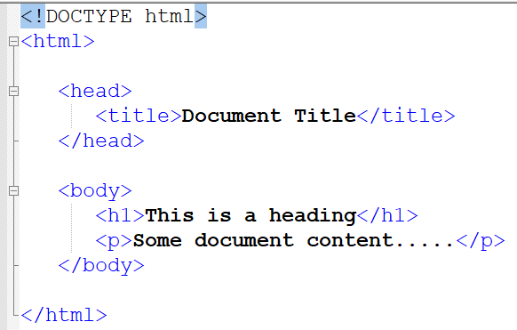
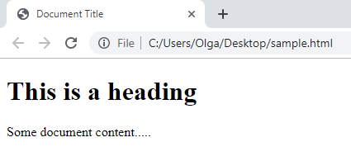
Basic HTML Document

Slide 6
The <!DOCTYPE> Declaration
The <!DOCTYPE> declaration tag is used by the web browser to understand the version of the HTML used in the document. Current version of HTML is 5 and it makes use of the following declaration <!DOCTYPE html>

Slide 7
HTML Tags
Tags are used to format the content.
Tags are enclosed within angle braces <Tag Name>
Most of the tags have their corresponding closing tags.
Some closing tags are optional, however. The tags are optional because it’s implied that a new tag would not be able to be started without closing it. These are the following:
html, head, body, p, dt, dd, li, option, thead, th, tbody, tr, td, tfoot, colgroup.
There are also tags that are forbidden to be closed:
img, input, br, hr, meta, etc.

Slide 8
HTML Tag vs. Element
An HTML element is defined by a starting tag. If the element contains other content, it ends with a closing tag.
For example, <p> is starting tag of a paragraph and </p> is closing tag of the same paragraph but <p>This is paragraph</p> is a paragraph element.
Nested element is kept within other element, like:
<h1>This is <i>italic</i> heading</h1>

Slide 9
HTML Attributes
An attribute is used to define the characteristics of an HTML element and is placed inside the element's opening tag.
All attributes are made up of two parts − a name and a value:
the name is the property you want to set.
the value is what you want the value of the property to be set and always put within quotations.

Slide 10
DOM – Document Object Model
The Document Object Model (DOM) is a programming interface for HTML and XML documents.
The DOM is an object-oriented representation of the web page, which can be modified with a scripting language such as JavaScript.
The modern DOM is built using multiple APIs that work together.

Slide 11
JavaScript
JavaScript is a dynamic computer programming language
JS is lightweight and most commonly used as a part of web pages
JS implementation allow client-side script to interact with the user and make dynamic pages

Slide 12
Advantages of JavaScript
Less server interaction − You can validate user input before sending the page off to the server. This saves server traffic, which means less load on your server.
Immediate feedback to the visitors − They don't have to wait for a page reload to see if they have forgotten to enter something.
Increased interactivity − You can create interfaces that react when the user hovers over them with a mouse or activates them via the keyboard.
Richer interfaces − You can use JavaScript to include such items as drag-and-drop components and sliders to give a Rich Interface to web page users.

Slide 13
Limitations of JavaScript
Client-side JavaScript does not allow the reading or writing of files. This has been kept for security reason.
JavaScript cannot be used for networking applications because there is no such support available.
JavaScript doesn't have any multi-threading or multiprocessor capabilities.

Slide 14

Thank you
…
if(anyQuestions)
{
AskPresenter();
}
else
{
//LoveCats();
AttendNextLesson();
}
…

