Slide 1
Software Development using C# 8 lesson
Olga Jepifanova
olga.bikova@inbox.lv
03.10.2019

Slide 2
Agenda
Web API

Slide 3
Web Applications

Slide 4
Web Application
A web application is a computer program that utilizes web browsers and web technology to perform tasks over the Internet.
Since Internet is a cost-effective communication channel, millions of business can use it to exchange information with their target market and make fast and secure transactions.
Such kind of effective engagement is possible when business necessary data is captured, stored, processed and presented in proper way to the user.

Slide 5
Web Application
Web applications use a combination of:
server-side scripts (code) to handle the storage and retrieval of the information
client-side scripts (JavaScript and HTML) to present information to users.
This allows users to interact with the others using online forms, content management systems, shopping carts and more.
Web applications allow users to create documents, share information, collaborate on projects, and work on common documents regardless of location or device.

Slide 6
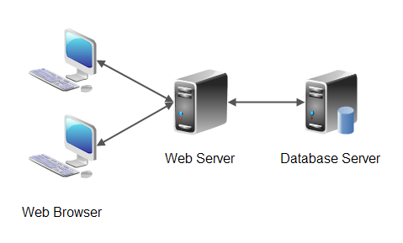
Web Application

Slide 7
ASP.NET
ASP.NET is a .NET Framework technology for creating web apps
ASP.NET offers different frameworks for creating web applications:
Web Forms
ASP.NET MVC
ASP.NET Web Pages

Slide 8
ASP.NET
Web Forms - you can build dynamic websites using a familiar drag-and-drop, event-driven model.
MVC - gives you a powerful, patterns-based way to build dynamic websites that enables a clean separation of concerns and that gives you full control over markup for enjoyable, agile development.
Web Pages and the Razor syntax provide a fast, approachable, and lightweight way to combine server code with HTML to create dynamic web content.

Slide 9
ASP.NET
All mentioned frameworks are:
based on .NET
share core functionality of .NET and of ASP.NET
share the same facilities for managing requests, handling sessions
offer a login security model based around membership
are not entirely independent, and choosing one does not preclude using another.

Slide 10
Web APIs
ASP.NET Web API is a framework that makes it easy to build HTTP services that reach a broad range of clients, including browsers and mobile devices. ASP.NET Web API is an ideal platform for building RESTful applications on the .NET Framework.
Web API 1.0 was introduced with .NET Framework 4.5
Web API 2.0 was introduced with .NET Framework 4.5.1 and MVC 5

Slide 11
REST
REST (Representation State Transfer) - it is an architectural pattern which is based on HTTP and uses HTTP requests, responses, verbs and status codes to communicate
The fact that REST services use HTTP means they can be consumed by almost any ‘online’ device or application
Web API in .NET is the way to write REST APIs services in .NET

Slide 12
REST Concept
Client-Server – different responsibilities
Stateless – no state information is kept
Cacheable – client can cache response data
Layered System – client doesnt know is request sent directly to the server or through proxy.
Uniform Interface – unified interface for client and server communication

Slide 13
HTTP key implementation
REST uses addressable resources to define the structure of the API. These are the URLs you use to get to pages on the web
Request verbs describe what to do with the resource
Request Headers are additional instructions that are sent with the request
Usually data is sent within request body
Response Body – This is the main body of the response.
Response Status codes – These codes are issues with the response and give the client details on the status of the request.

Slide 14
REST verbs
Use GET requests to retrieve resource representation / information only
Use POST to create new subordinate resources
Use PUT primarily to update existing resource
Use DELETE to delete resources
Use PATCH requests to make partial update on a resource.

Slide 15
Summary of HTTP Methods for RESTful APIs
HTTP METHOD | CRUD | ENTIRE COLLECTION (E.G. /USERS) | SPECIFIC ITEM (E.G. /USERS/123)
POST | Create | 201 (Created), ‘Location’ header with link to /users/{id} containing new ID. | Avoid using POST on single resource
GET | Read | 200 (OK), list of users. Use pagination, sorting and filtering to navigate big lists. | 200 (OK), single user. 404 (Not Found), if ID not found or invalid.
PUT | Update/Replace | 404 (Not Found), unless you want to update every resource in the entire collection of resource. | 200 (OK) or 204 (No Content). Use 404 (Not Found), if ID not found or invalid.
PATCH | Partial Update/Modify | 404 (Not Found), unless you want to modify the collection itself. | 200 (OK) or 204 (No Content). Use 404 (Not Found), if ID not found or invalid.
DELETE | Delete | 404 (Not Found), unless you want to delete the whole collection — use with caution. | 200 (OK). 404 (Not Found), if ID not found or invalid.

Slide 16

Thank you
…
if(anyQuestions)
{
AskPresenter();
}
else
{
//LoveCats();
AttendNextLesson();
}
…

