Slide 1
Software Development using C# 2 lesson
Olga Jepifanova
olga.bikova@inbox.lv
12.09.2019

Slide 2
Agenda
IF Decision statement
Boolean logic
Switch
Arrays / Lists / Collections
For / For-each iteration statements
While iteration statements
Enumerators
String Class
Regex
Working with DateTime

Slide 3
Decision Making

Slide 4
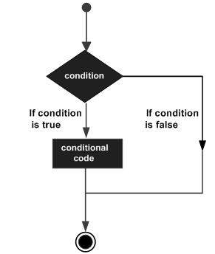
IF condition
if (...)
{
//do something
}
else
{
//do something else
}

Slide 5
IF condition
if statement - consists of a boolean expression followed by one or more statements
if...else statement - if statement can be followed by an optional else statement, which executes when the boolean expression is false
if...else if.. else statement - if statement can be followed by an optional else if statement, which check another case in given scope
nested if statement - one if or else if statement can be used inside another if or else if statement(s)

Slide 6
The ? : Operator (ternary operation)
Is used to replace if ... else statement
General syntax:
Expression1 ? Expression2 : Expression3;
Same as:
if (Expression1 == true)
{
Expression2;
}
else
{
Expression3;
}

Slide 7
Boolean logic

Slide 8
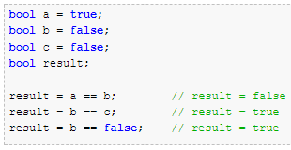
Boolean logic operators - Equivalence
The operator symbol is a double-equals signs
==
Compares the two operands and returns a Boolean value

Slide 9
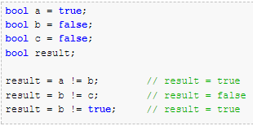
Boolean logic operators - Inequality
The operator symbol is an exclamation mark and an equals signs !=
Compares two operands and returns true if the two values are different

Slide 10
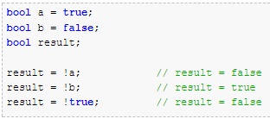
Boolean logic operators - NOT
The operator symbol is an exclamation mark
!
Inverts the value of a Boolean value

Slide 11
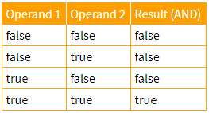
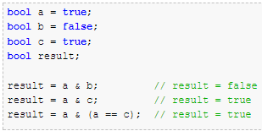
Boolean logic operators - AND
The operator symbol is ampersand character
& (&&)
Returns true if both of the operands are true

Slide 12
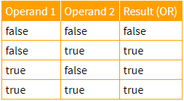
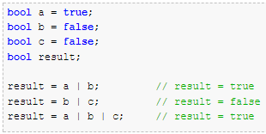
Boolean logic operators - OR
The operator symbol is ampersand character
| (||)
Returns true if either of the operands are true

Slide 13
Bitwise operators
Bit contain either 0(false) or 1(true)
And (&) exp & exp
Exclusive OR (^) exp ^ exp
Inclusive OR (|) exp | exp
Bitwise operators compares each bit of the first operand to the corresponding bit of the second operand
5 & 4
0101 & 0100

Slide 14
Switch

Slide 15
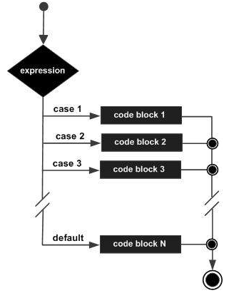
Switch condition
switch (expression)
{
case constant-expression1 :
statement(s);
break;
case constant-expression 2 :
statement(s);
break;
default :
statement(s);
}

Slide 16
Switch
The expression used in a switch statement must have an integral or enumerated type
There can be any number of case statements within a switch
The constant-expression for a case must be the same data type as the variable in the switch, and it must be a constant or a literal
When the variable being switched on is equal to a case, the statements following that case will execute until a break statement is reached.

Slide 17
Switch
When a break statement is reached, the switch terminates
Not every case needs to contain a break. If no break appears, the flow of control will fall through to subsequent cases until a break is reached
A switch statement can have an optional default case, which must appear at the end of the switch. The default case can be used for performing a task when none of the cases is true. No break is needed in the default case.

Slide 18
Arrays / Lists / Collections

Slide 19
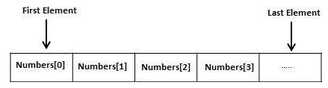
Arrays
Stores a fixed-size sequential collection of elements of the same type
A specific element in an array is accessed by an index

Slide 20
Arrays
Declaration syntax:
datatype [] arrayName;
Initialization syntax:
double[] variableName = new double[10];
specify the type of elements in the array
specifies the name of the array
specifies the rank (size) of the array

Slide 21
Arrays - examples
string[] arr1 = new string[] { "one", "two", "three" };
string[] arr2 = { "one", "two", "three" };
var arr3 = new string[] { "one", "two", "three" };
int[] array = { -5, -6, -7 };
int[] array = new int[2];
array[0] = 10;
array[1] = 3021;

Slide 22
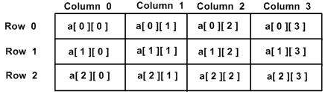
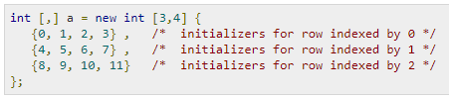
Multidimensional Arrays

Slide 23
Collections
Hold many values or objects in a specific series
There are two types of collections available in C#:
non-generic collections
ArrayList; SortedList; Stack; Queue
generic collections
List<T>; Dictionary<TKey,TValue>; SortedList<TKey,TValue>
Every collection class implements the IEnumerable interface so values from the collection can be accessed using a foreach loop.

Slide 24
ArrayList
ArrayList stores objects of any type like an array.
There is no need to specify the size of the ArrayList like with an array as it grows automatically.
Initialize ArrayList:
ArrayList <name> = new ArrayList();

Slide 25
List
Represents a strongly typed list of objects that can be accessed by index.
Provides methods to search, sort and manipulate lists.
List initialization:
List<int> intList = new List<int>();

Slide 26
List Methods
Add(T item) - Adds an element at the end of a List<T>.
AddRange(IEnumerable<T> collection) - Adds elements of the specified collection at the end of a List<T>.
Insert(int index, T item) - Inserts an element at the specified index in a List<T>.
Remove(T item) - Removes the first occurence of the specified element.
RemoveAt(int index) - Removes the element at the specified index.
Clear() - Removes all the elements from a List<T>

Slide 27
Dictionary
Dictionary in C# is same as English dictionary. English dictionary is a collection of words and their definitions, often listed alphabetically in one or more specific languages. In the same way, the Dictionary in C# is a collection of Keys and Values, where key is like word and value is like definition.
Dictionary initialization:
Dictionary<int, string> dict = new Dictionary<int, string>();

Slide 28
For / Foreach / While

Slide 29
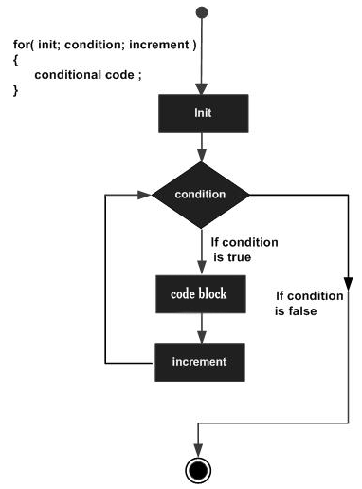
for Loop
A for loop is a repetition control structure that allows you to efficiently write a loop that needs to execute a specific number of times.

Slide 30
for Loop
Syntax:
for ( init; condition; increment ) {
statement(s);
}
The init step is executed first, and only once. This step allows you to declare and initialize any loop control variables.
The condition is evaluated. If it is true, the body of the loop is executed. If it is false, the body of the loop does not execute and flow of control jumps to the next statement just after the for loop
Increment statement allows you to update any loop control variables.

Slide 31
foreach Loop
The foreach statement iterates through a collection that implements the IEnumerable interface.
In contract to for statement, the foreach statement does't use the indexes.
Example:
var names = new List<string>() { "John", "Tom", "Peter" };
foreach (string name in names)
{
Console.WriteLine(name);
}

Slide 32
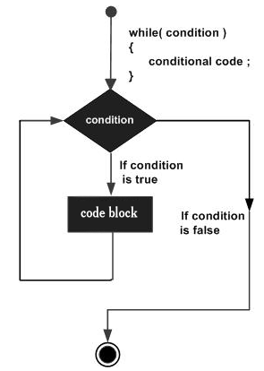
while loop
A while loop statement in C# repeatedly executes a target statement as long as a given condition is true.

Slide 33
Nested while loop
int i = 0;
while (i < 2) {
Console.WriteLine("Value of i: {0}", i);
int j = 1;
i++;
while (j < 2)
{
Console.WriteLine("Value of j: {0}", j);
j++;
}
}

Slide 34
do while Loop
The do-while loop is the same as a 'while' loop except that the block of code will be executed at least once, because it first executes the block of code and then it checks the condition.
Syntax:
do
{
//execute code block
} while(boolean expression);

Slide 35
Enums

Slide 36
Enumeration
An enumeration is a set of named integer constants
An enumerated type is declared using the enum keyword
Enumeration contains its own values and cannot inherit or cannot pass inheritance
Declaration syntax:
enum <enum_name> {
enumeration list
};

Slide 37
Enumeration
Each of the symbols in the enumeration list stands for an integer value.
By default, the value of the first enumeration symbol is 0
Example:
enum Days { Sun, Mon, tue, Wed, thu, Fri, Sat };
Enum can have predefined type. Default type is int
enum Seasons : byte { Winter, Spring, Summer, Autumn };

Slide 38
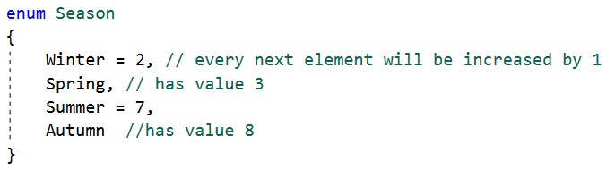
Enumeration
It is possible to specify value for enum members

Slide 39
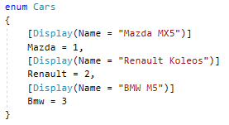
Enumeration
It is possible to get Enum specified text value using Display attribute and helper class
using System.ComponentModel.DataAnnotations;

Slide 40
Enum methods
Enum.Parse(Type enumType, string value)
Enum.Parse(Type, string, boolean)
Converts the string representation of the name or numeric value of one or more enumerated constants to an equivalent enumerated object
Enum.GetValues(Type enumType)
Retrieves an array of the values of the constants in a specified enumeration

Slide 41
Enum methods
Enum.GetName(Type enumType, object value)
Retrieves the name of the constant in the specified enumeration that has the specified value.
Enum.GetNames(Type enumType)
Retrieves an array of the names of the constants in a specified enumeration.

Slide 42
System.String class

Slide 43
Strings
Strings represents array of characters
More common practice is to use the string keyword to declare a string variable
The string keyword is an alias for the System.String class
System.String class contains all methods needed for work with text data

Slide 44
Creating a String object
By assigning a string literal to a String variable
By using a String class constructor
By using the string concatenation operator (+)
By retrieving a property or calling a method that returns a string
By calling a formatting method to convert a value or an object to its string representation

Slide 45
Properties of the String class
String class has two main properties:
Chars - Gets the Char object at a specified position in the current String object.
Length - Gets the number of characters in the current String object.

Slide 46
Main String methods
Method | Description
Compare | compares two string values, taking into account current culture
CompareOrdinal | compares two string values despite user regional settings
Contains | checks if string contains another string
Concat | combines strings
CopyTo | copy string part or whole string into another string
EndsWith | checks if string ending equals to substring

Slide 47
Main String methods
Method | Description
Format | string formatting
IndexOf | reports the zero-based index of the first occurrence of the specified string in this instance.
Insert | returns a new string in which a specified string is inserted at a specified index position in this instance.
Join | concatenates all the elements of a string array, using the specified separator between each element
LastIndexOf | reports the zero-based index position of the last occurrence of a specified Unicode character within this instance

Slide 48
Main String methods
Method | Description
Replace | returns a new string in which all occurrences of a specified string in the current instance are replaced with another specified string
Split | returns a string array that contains the substrings in this instance that are delimited by elements of a specified string or Unicode character array
Substring | retrieves a substring from this instance. The substring starts at a specified character position and has a specified length
ToLower ToUpper | returns a copy of this string converted to lowercase/uppercase
Trim | returns a new string in which all leading and trailing occurrences of a set of specified characters from the current String object are removed

Slide 49
String.Format
Converts the value of objects to strings based on the formats specified and inserts them into another string.
Exists lot of different standart and custom formats for:
Numeric values
Date and Time values
TimeSpan values
Enumeration values

Slide 50
CultureInfo
string.Format(IFormatProvider provider, string format, params object[] args)
string.Format(new System.Globalization.CultureInfo("en-GB"), "{0:C}", amount)
CultureInfo.Invariant - Gets the CultureInfo object that is culture-independent
An object that supplies culture-specific formatting information

Slide 51
StringBuilder class

Slide 52
StringBuilder
Represents a mutable string of characters.
Use StringBuilder if there is unknown number of changes to a string can be performed during application run
Has two main properties: Length and Capacity
Length provides info about current length of string value
Capacity provides info about reserved length in memory

Slide 53
StringBuilder methods
Method | Description
Append | Appends the substring to string
Insert | Inserts the substring into string at a specified character position.
Remove | Removes the specified range of characters from string
Replace | Replaces all occurrences of a specified character or substring in string with another specified character or substring
AppendFormat | Appends the substring returned by processing a composite format string, which contains zero or more format items to string

Slide 54
String vs. StringBuilder
Use String when:
There is small amount of operation performed on string value
There is small amount of concat operations performed on string
There is need to perform IndexOf or StartsWith operations
Use StringBuilder when:
There is unknown amount of operation performed on string value

Slide 55
Regex

Slide 56
Regular expressions
A regular expression is a pattern that could be matched against an input text.
The .Net framework provides a regular expression engine that allows such matching.
Regex Class provides all necessary functionality to work with regular expressions

Slide 57
Regex methods
bool IsMatch(string input)
Indicates whether the regular expression specified in the Regex constructor finds a match in a specified input string.
bool IsMatch(string input, int startat)
Indicates whether the regular expression specified in the Regex constructor finds a match in the specified input string, beginning at the specified starting position in the string.
bool IsMatch(string input, string pattern)
Indicates whether the specified regular expression finds a match in the specified input string.

Slide 58
Regex methods
MatchCollection Matches(string input)
Searches the specified input string for all occurrences of a regular expression.
string Replace(string input, string replacement)
In a specified input string, replaces all strings that match a regular expression pattern with a specified replacement string.
string[] Split(string input)
Splits an input string into an array of substrings at the positions defined by a regular expression pattern specified in the Regex constructor.

Slide 59
Regex options
Method | Description
Compiled | Specifies that the regular expression is compiled to an assembly. This yields faster execution but increases startup time.
CultureInvariant | Specifies that cultural differences in language is ignored
IgnoreCase | Specifies case-insensitive matching
IgnorePatternWhitespace | Eliminates unescaped white space from the pattern and enables comments marked with #
Multiline | Changes the meaning of ^ and $ so they match at the beginning and end, respectively, of any line, and not just the beginning and end of the entire string
RightToLeft | Specifies that the search will be from right to left instead of from left to right.
Singleline | Changes the meaning of the dot (.) so it matches every character

Slide 60
Regex help
http://regexstorm.net/tester
https://regexr.com/
https://regex101.com/

Slide 61
DateTime

Slide 62
DateTime struct
Represents an instant in time, typically expressed as a date and time of day
Start date is 01.01.0001 00:00:00 (MinValue)
End date is 31.12.9999 23:59:59 (MaxValue)
Define specific date
new DateTime(123456781234567121);
new DateTime(2018, 2, 18);
new DateTime(2018, 7, 20, 18, 30, 25);

Slide 63
DateTime Operations
Method | Description
Add | Adds the value of the specified TimeSpan to date
AddDays | Adds the specified number of days to date
AddHours | Adds the specified number of hours to date
AddMinutes | Adds the specified number of minutes to date
AddMonths | Adds the specified number of month to date
AddYears | Adds the specified number of years to date
Substract | Subtracts the specified time or duration from date

Slide 64

Thank you
…
if(anyQuestions)
{
AskPresenter();
}
else
{
//LoveCats();
AttendNextLesson();
}
…

