Slide 1
Software Development using C# 3 lesson
Olga Jepifanova
olga.bikova@inbox.lv
16.09.2019

Slide 2
Agenda
.Net Framework overview
Classes and objects
Encapsulation
Abstraction
Polymorphism
Inheritance

Slide 3
.Net Framework overview

Slide 4
.Net Framework
The .NET Framework is a development platform for building different types of apps or services such as:
Console
Windows Forms / Windows Presentation Foundation (WPF)
Web Applications
Web Services
Windows Services
Services-oriented applications using Windows Communications Foundation (WCF)

Slide 5
.Net Framework
.Net Framework consists of:
The common language runtime (CLR) - runs the code and provides services that make the development process easier
Class Library - includes a broad range of functionality and support for many industry standards.

Slide 6
Base Class Libraries
.Net Framework has an expansive standard set of class libraries
Libraries provide implementations for many general and app-specific types, algorithms and utility functionality.
Base Class Library (BCL) APIs are expected with any .NET implementation, both because developers will want them and because popular libraries will need them to run.
The BCL provides the most foundational types and utility functionality and are the base of all other .NET class libraries.

Slide 7
Class Libraries
The .Net Framework Class Library (FCL) includes a huge collection of reusable classes , interfaces, and value types that expedite and optimize the development process and provide access to system functionality.
FCL provides the consistent base types that are used across all .NET enabled languages.
FCL organized in a hierarchical tree structure and it is divided into Namespaces (root is System).
The Classes are accessed by namespaces, which reside within Assemblies.

Slide 8
Class Libraries
FCL is the key component of .NET framework. It provides core functionalities of .NET architecture, which include:
Base data types
Object type
Implementation of data structures
Garbage collection
Security, data access and database connectivity
Network communications
Support for implementing rich client GUI for both Windows and Web-based applications

Slide 9
Classes and objects

Slide 10
Class and Object
A class is a data structure that combines state (fields) and actions (methods and other function members) in a single unit.
A class provides a definition for dynamically created instances of the class, also known as objects.
Classes support inheritance and polymorphism

Slide 11
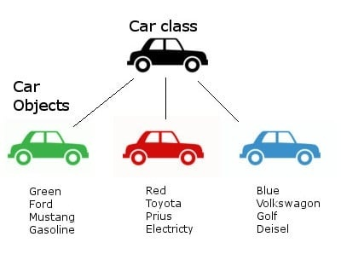
Class and Object

Slide 12
Class and Object
New classes are created using class declarations
Class declaration consists of header and body
Instances of classes are created using the new operator, which allocates memory for a new instance, invokes a constructor to initialize the instance, and returns a reference to the instance
The memory occupied by an object is automatically reclaimed when the object is no longer reachable

Slide 13
Class members
The members of a class are either static members or instance members.
Static members belong to classes, and instance members belong to objects (instances of classes)
Members are: properties, fields, constants, methods, events, operators, constructors, types and etc.

Slide 14
Class properties
A property is a member that provides a flexible mechanism to read, write, or compute the value of a private field
Properties can be used as if they are public data members
Properties enable a class to expose a public way of getting and setting values, while hiding implementation

Slide 15
Class properties
Properties have accessors - get and set
get - is used to return the property value.
set - is used to assign a new value.
The value keyword is used to define the value being assigned by the set accessor.
Properties can be:
Read-write (have both get and set)
Read-only (have only get)
Write-only (have only set)

Slide 16
Class methods
A method is a code block that contains a series of statements
Methods are declared in a class or struct by specifying:
the access level such as public or private,
optional modifiers such as abstract or sealed,
the return value,
the name of the method,
any method parameters

Slide 17
Methods parameters and arguments
Parameters are temporary variable names within functions
The argument can be thought of as the value that is assigned to that temporary variable
Within the function, parameters act as placeholders for the argument it is passed
When calling code calls the method, it provides concrete values called arguments for each parameter

Slide 18
Class constructors
Whenever a class or struct is created, its constructor is called
A class or struct may have multiple constructors that take different arguments
Constructors give possibility to set default values or limit instantiation
A constructor that takes no parameters is called a default constructor

Slide 19
Encapsulation

Slide 20
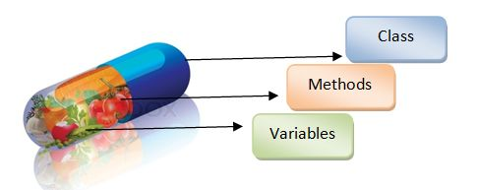
Encapsulation

Slide 21
Encapsulation
Encapsulation is defined 'as the process of enclosing one or more items within a physical or logical package’.
Prevents access to implementation details
Enables a programmer to implement the desired level of abstraction
Implemented by using access specifiers
An access specifier defines the scope and visibility of a class member

Slide 22
Encapsulation - specifiers
Public - allows a class to expose its member variables and member functions to other functions and objects. Any public member can be accessed from outside the class.
Private - allows a class to hide its member variables and member functions from other functions and objects. Only functions of the same class can access its private members.
Protected - allows a child class to access the member variables and member functions of its base class.
Internal - allows a class to expose its member variables and member functions to other functions and objects in the current assembly
Protected internal - allows a class to hide its member variables and member functions from other class objects and functions, except a child class within the same application.

Slide 23
Inheritance

Slide 24
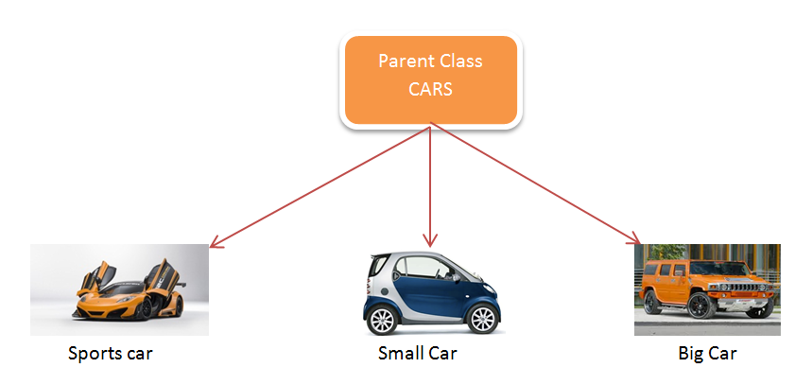
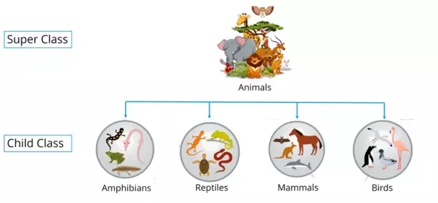
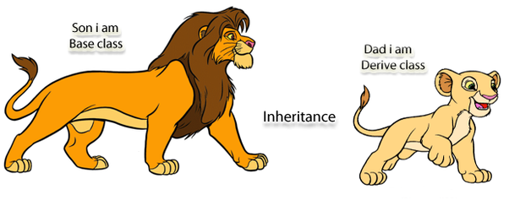
Inheritance

Slide 25
Inheritance
Inheritance allows us to define a class in terms of another class, which makes it easier to create and maintain an application.
With inheritance it is possible to reuse the code functionality and speeds up implementation time.
Inheritance implements base and derived classes
The idea of inheritance implements the IS-A relationship
It is not possible to inherit from sealed class

Slide 26
Base and derived classes
Class can be derived from many classes and inherit data or functions from multiple base classes or interfaces
Syntax example:
<acess-specifier> class <base_class> {
...
}
class <derived_class> : <base_class> {
...
}

Slide 27
Polymorphism

Slide 28
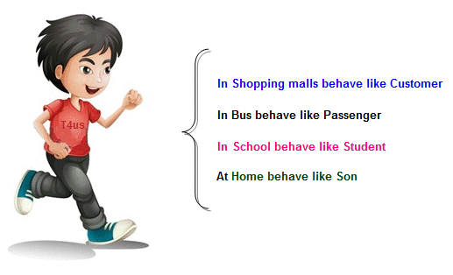
Polymorphism

Slide 29
Polymorphism
The word polymorphism means having many forms
Polymorphism is often expressed as 'one interface, multiple functions’
Polymorphism can be:
Static – methods and operator overloading at compile-time
Dynamic – methods overriding at run-time

Slide 30
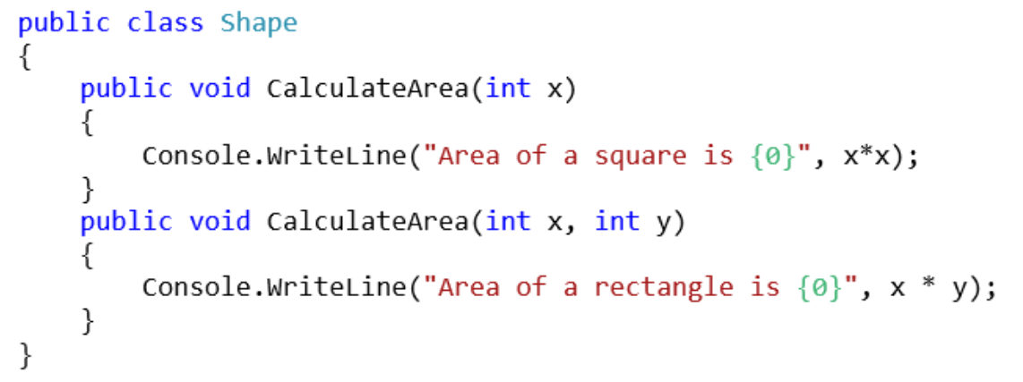
Static Polymorphism
Which method is to be called is decided at compile-time only.
Method with a same method name can be used many times in the same class, but with different parameters
Few methods with the same name, signature and parameters cannot exist within one class

Slide 31
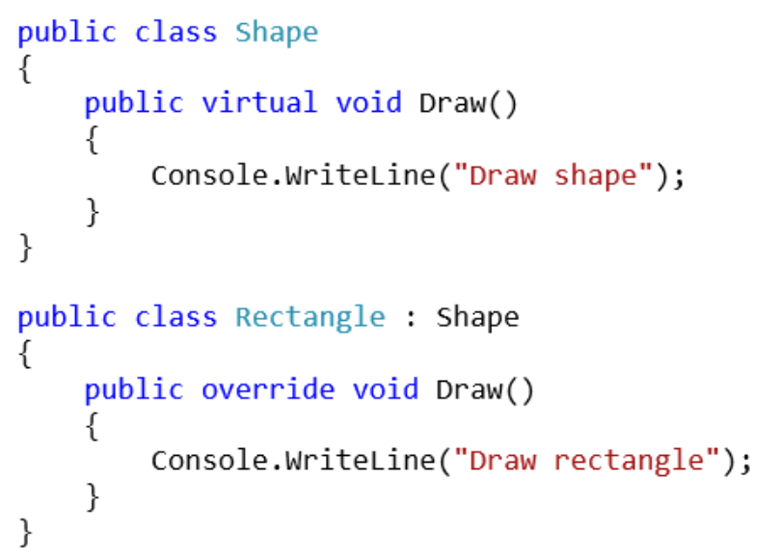
Dynamic Polymorphism
Dynamic polymorphism is also known as method overriding
Method overriding means having two or more methods with the same name, same signature but with different implementation
Only virtual methods can be overrided

Slide 32
Abstraction

Slide 33




Abstraction

Slide 34
Abstraction
The word abstract means a concept or an idea not associated with any specific instance
OOP concept has same meaning of abstraction by making classes not associated with any specific instance
The abstraction is done when we need to only inherit from a certain class, but not need to instantiate objects of that class

Slide 35
Abstraction
An Abstract Base class can not be instantiated; it means the object of that class can not be created.
Class having abstract keyword and having, abstract keyword with some of its methods (not all) is known as an Abstract Base Class.
The method of abstract class that has no implementation is known as "operation". It can be defined as abstract void method ();
An abstract class holds the methods but the actual implementation of those methods is made in derived class.

Slide 36

Thank you
…
if(anyQuestions)
{
AskPresenter();
}
else
{
//LoveCats();
AttendNextLesson();
}
…

