Slide 1

Network Messenger
Network Messenger
CIT243_H1
Aliaksei Petrusevich
Olga Gavrylchenko
Sean Bamforth

Slide 2
I. Project Objective
Apply the major concepts of computer science
Implement the knowledge of Java programming language
Gain experience in developing applications for Android OS
Teamwork and GitHub
Learn new concepts

Slide 3
II. Team Members
Aliaksei Petrusevich
Olga Gavrylchenko
Sean Bamforth

Slide 4
III. Definition of Terms
Broadcast Intents
Web Service
Simple Mail Transfer Protocol
Hypertext Transfer Protocol

Slide 5
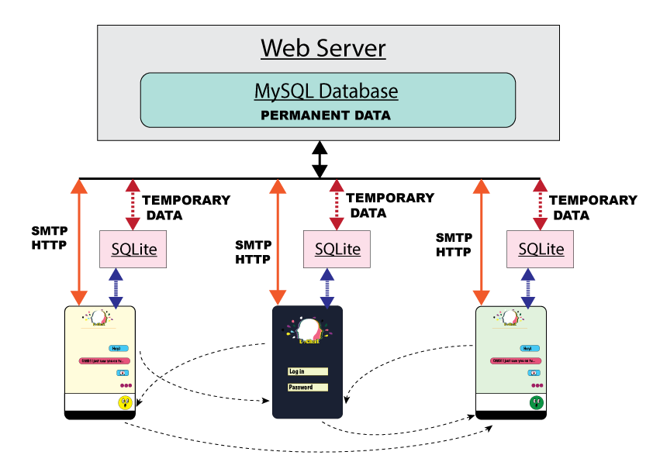
IV. Architecture Picture

Slide 6
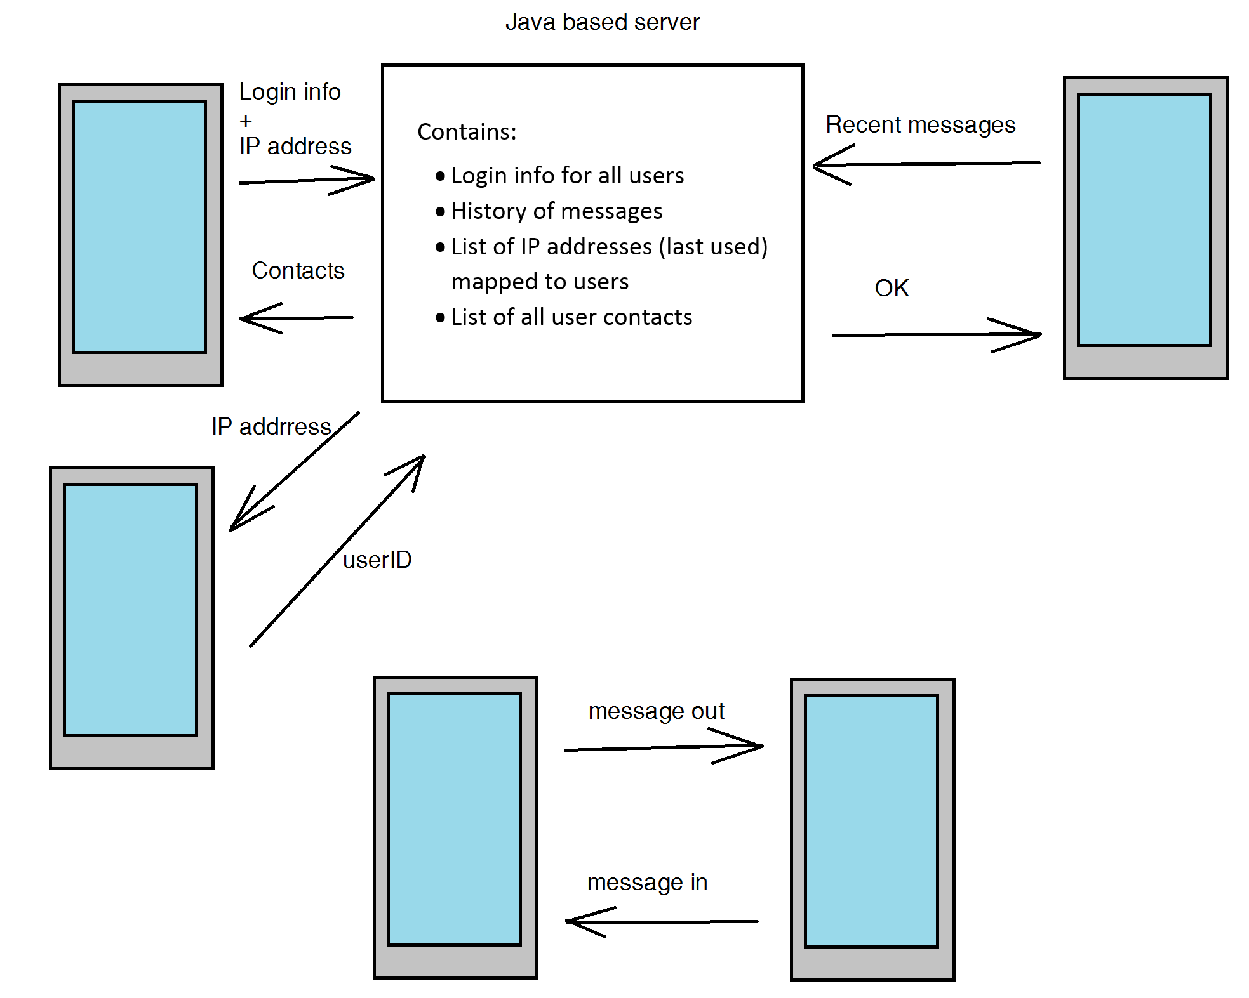

Slide 7
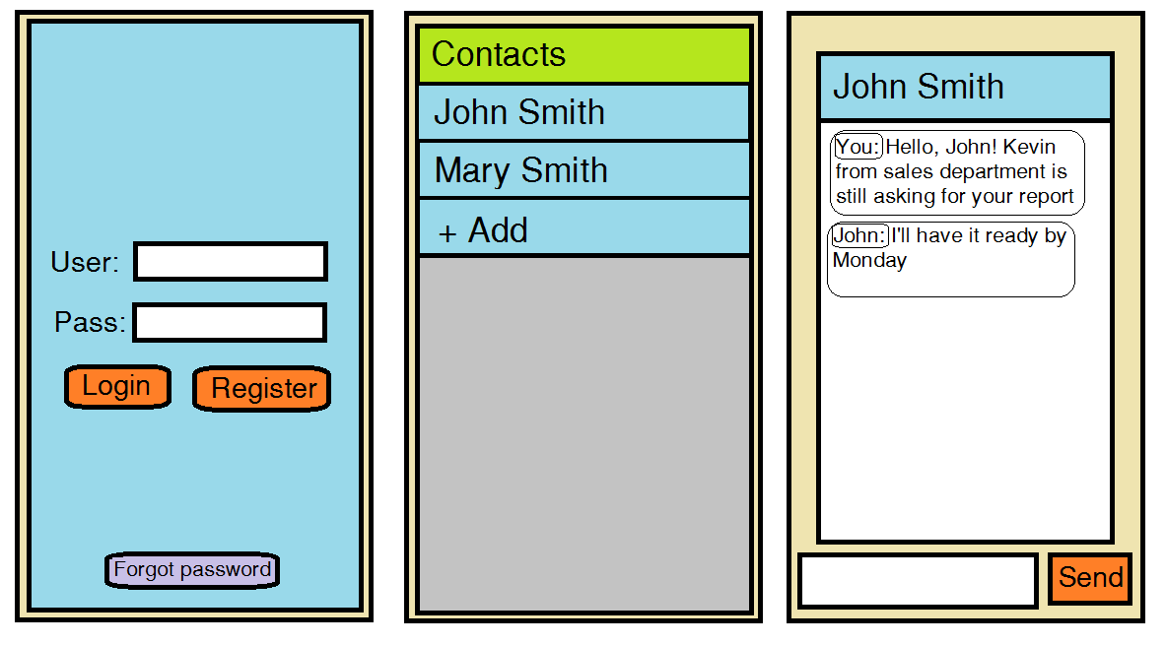
V. Layouts

Slide 8
VI. Code Example
<In progress>

Slide 9
VII. Project Demo
<In progress>

Slide 10
VIII. Summary
<In progress>

Slide 11
References
<In progress>

Slide 12

Thank You!

