Slide 1

Network Messenger
CIT243 Android Programming
Aliaksei Petrusevich Olga Gavrylchenko Sean Bamforth
ETA: April 26, 2018

Slide 2
I. Project Objective
Apply the major concepts of computer science
Implement the knowledge of Java programming language
Gain experience in developing applications for Android OS
Teamwork and GitHub
Learn new concepts

Slide 3
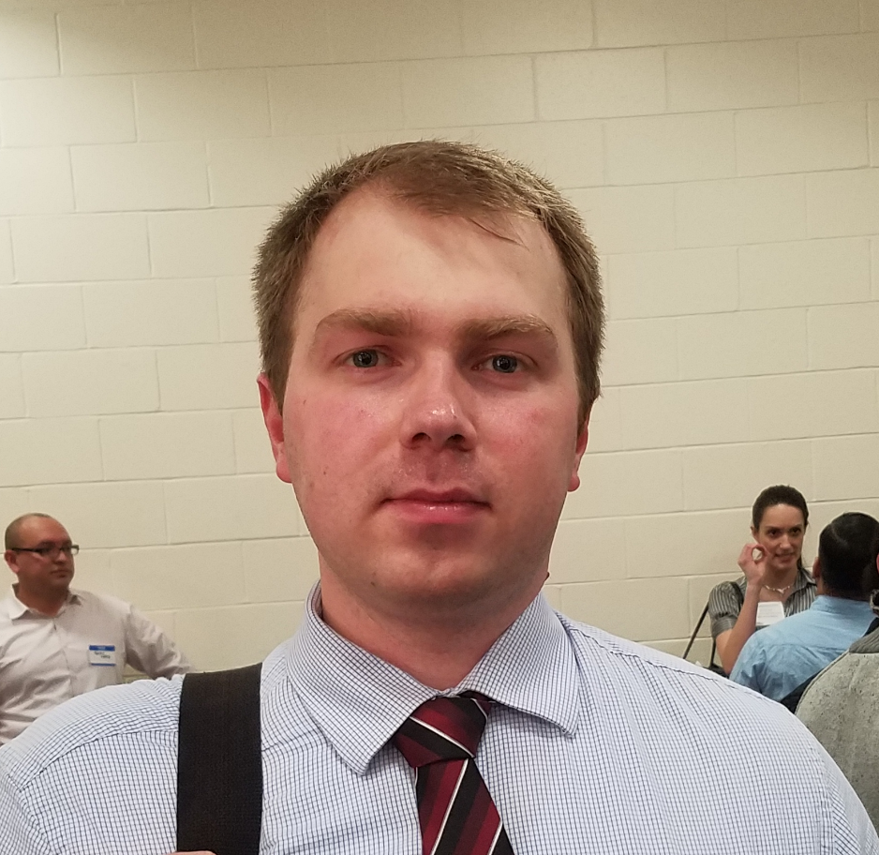
II. Team Members
Aliaksei Petrusevich
Olga Gavrylchenko
Sean Bamforth

Slide 4
III. Definition of Terms
<In progress>

Slide 5
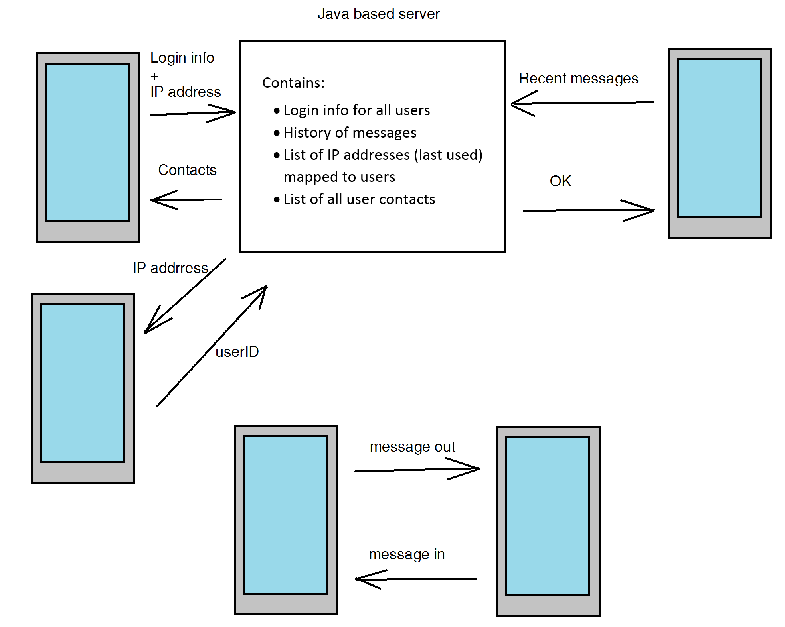
IV. Architecture Picture

Slide 6
VI. Code Example
<In progress>

Slide 7
VII. Project Demo
<In progress>

Slide 8
VIII. Summary
The first steps are made, and the project is in progress. Expected completion – first quart of April to mid April.

Slide 9
References
<In progress>

Slide 10

Thank You!

