Slide 1


Outlier detection using autoencoders
Olga Lyudchik
Non Member state summer student
Dr. Jean-Roch Vlimant (EP-UCM)
Dr. Maurizio Pierini (EP-CMG-PS)

Slide 2
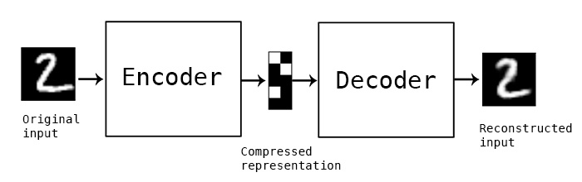
What are autoencoders?
Compression and decompression functions are:
Data-specific
Lossy
Learned automatically from data examples
To build an autoencoder, you need three things:
Encoding function
Decoding function
Loss function
2

Slide 3
What are autoencoders good for?
Data denoising
2. Dimensionality reduction for data visualization
3. Outliers?
3

Slide 4
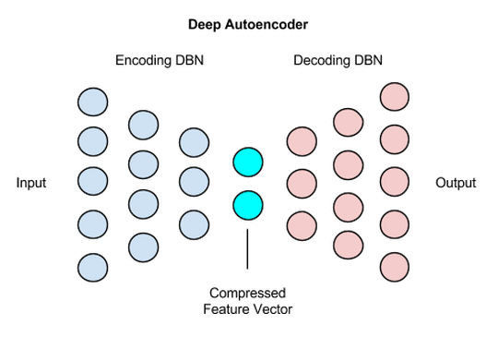
Deep autoencoder
4

Slide 5
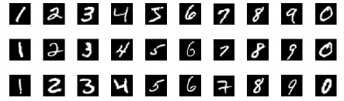

MNIST database
Training set: 60,000 digits ranging from 0 to 9
Testing set: 10,000 another digits
Each digit is normalized and centered in a gray-level image with size 28×28.
MNIST $≈$ collection of 784-dimensional vectors.
5

Slide 6
Networks topologies being used
39 models: Model [number of hidden dense layers_latent dimension]
Model [1_2] | Model [2_2] | Model [3_2] | Model [4_2] | Model [5_2]
Model [1_4] | Model [2_4] | Model [3_4] | Model [4_4] | Model [5_4]
Model [1_6] | Model [2_6] | Model [3_6] | Model [4_6] | Model [5_6]
Model [1_8] | Model [2_8] | Model [3_8] | Model [4_8] | Model [5_8]
Model [1_16] | Model [2_16] | Model [3_16] | Model [4_16] | Model [5_16]
Model [1_32] | Model [2_32] | Model [3_32] | - | Model [5_32]
Model [1_64] | Model [2_64] | Model [3_64] | Model [4_64] | Model [5_64]
Model [1_128] | Model [2_128] | Model [3_128] | Model [4_128] | Model [5_128]
1) ‘Mse’ loss function and ‘adadelta’ optimizer.
2) Relu activation function for the output layer with latent dimension.
3) Sigmoid as an activation function for the last output layer with 784 neurons .
6

Slide 7
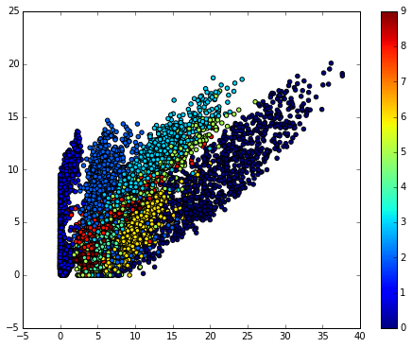
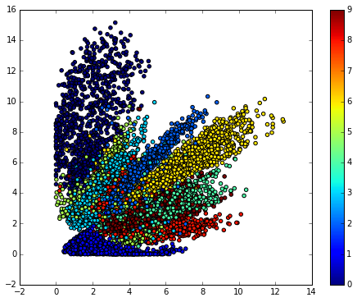
Data Visualization
Training set: 53,735
Outlier: 7
Using earlyStopping
Testing set: 8,972
Model with 1 hidden layer
Model with 5 hidden layers
7

Slide 8
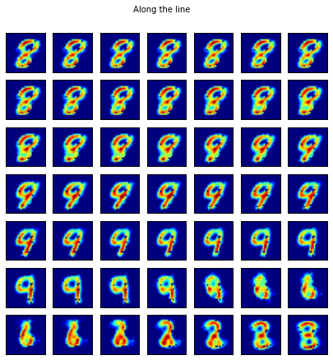
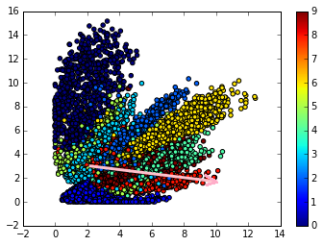
Visualisation of digits’ transformation along the line
8

Slide 9
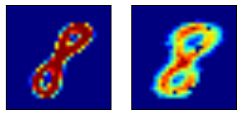

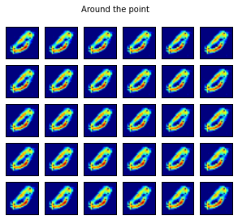
Visualisation of digits’ transformation around a point
R = 0.2
9

Slide 10
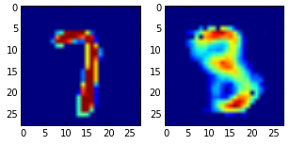
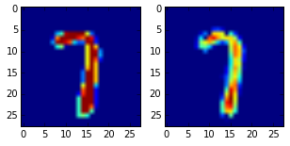
Reconstruction of outlier
maximum MD: 0.944811
minimum MD: 0.344363
Model with 2 hidden layers
and 2 latent dimensions
Model with 3 hidden layers
and 64 latent dimensions
10

Slide 11
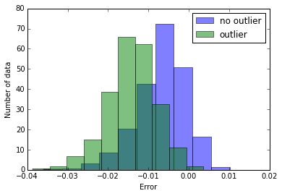
Performance evaluation
Mean difference between the prediction of the model and its original input for normal and outlier data
Model with 5 hidden layers and 32 latent dimensions
11

Slide 12
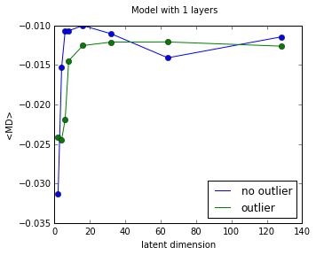
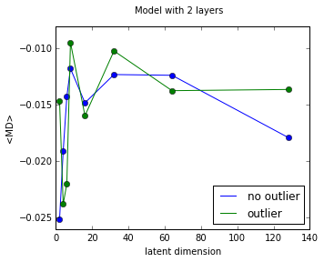
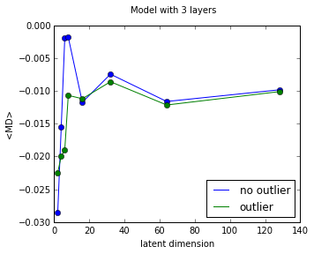
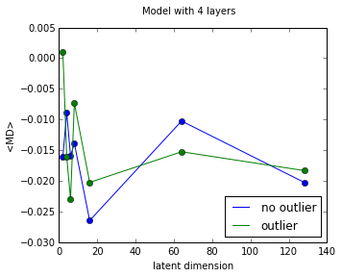
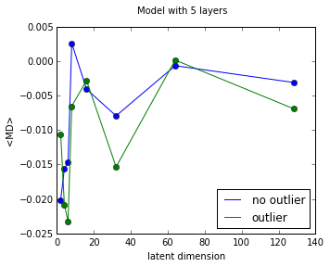
Performance evaluation
12

Slide 13
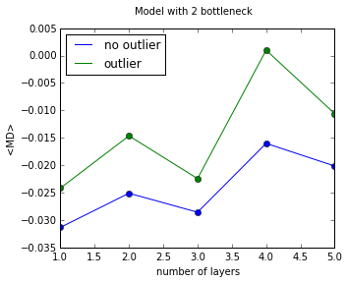
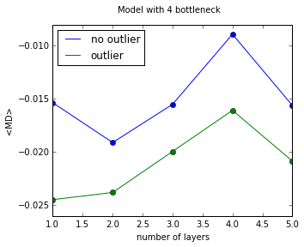
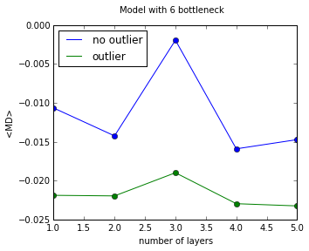
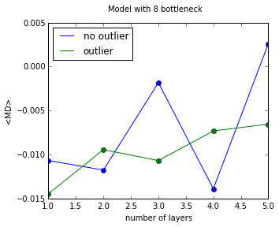
Performance evaluation
13

Slide 14
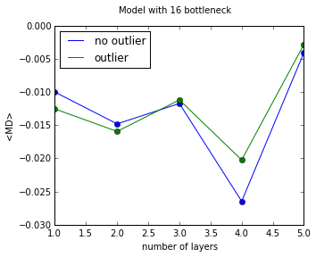
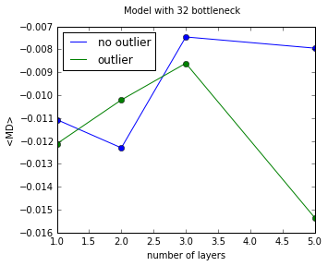
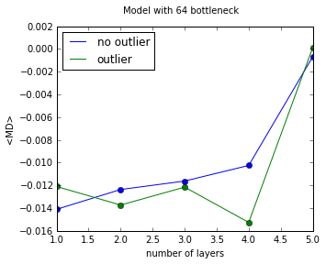
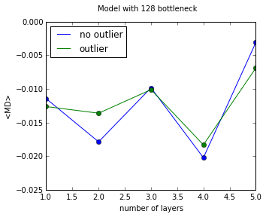
Performance evaluation
14

Slide 15
Thank you for attention!

