Slide 1
Autoencoders
Olga Lyudchik
Non-member sate summer student
Supervisor: Dr. Jean-Roch Valery VLIMANT
(EP-UCM)

Slide 2
The topic:
Define a search for top quarks in 1l+jets events, based on unsupervised ML algorithms. Without teaching the algorithm what a top quark is and what it looks like, test the possibility of highlighting the existence of the top quark by clustering similar events into classes, that could then be compared to the known background. The top signal should emerge as an unassociated event category.

Slide 3
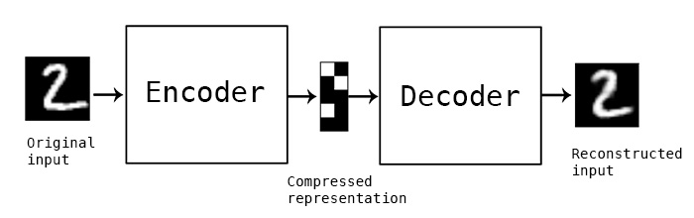
What are autoencoders?
"Autoencoding" is a data compression algorithm where the compression and decompression functions are
1) Data-specific
2) Lossy
3) Learned automatically from data examples

Slide 4

What are autoencoders good for?
Data denoising
2. Dimensionality reduction for data visualization
Using an autoencoder to compress data into a low-dimensional space (e.g. 64 dimensional)
Use t-SNE or PCA for mapping the compressed data to a 2D plane.
3. Outliers?

Slide 5
Anomaly Detection using autoencoders
Inliers are located in dense areas while outliers are not. The dense areas can be estimated by statistical methods, neighbor-based methods, and reconstruction-based methods.
For example, the methods in compute PCA projections on data, and those having large projection variances are determined as outliers.
Assumption:

Slide 6
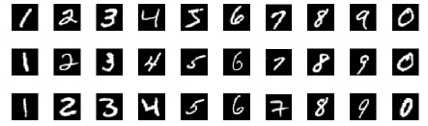
MNIST dataset
1) 60,000 digits ranging from 0 to 9 for training the digit recognition system
2) 10,000 another digits as test data
Each digit is normalized and centeredin a gray-level image with size 28×28, or with 784 pixel in total as the features.
Examples of MNIST data set:

Slide 7
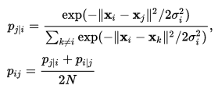


t-Distributed Stochastic Neighbor Embedding
models each high-dimensional object by a two- or three-dimensional point in such a way that similar objects are modeled by nearby points and dissimilar objects are modeled by distant points.
For set of N high-dimentional objects x₁, …, x_{N}, computes probabilities p_{ij} that are proportional to the similarity of objects x_{i} and x_{j},:
2) Aims to learn a d-dimentional map y₁, …, y_{N} (with y_{i} є R^{d}) that reflects the similarities p_{ij} as well as possible. 3) Measures similarities q_{ij} between two points in the map y_{i} and y_{j} using a very similar approach:
4) The locations of the points y_{i} in the map are determined by minimizing the Kullback–Leibler divergence of the distribution Q from the distribution P that is:

Slide 8
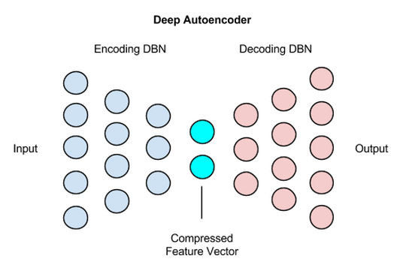
Deep autoencoders
784 (input) 256 128 64
64 128 256 784 (output)

Slide 9
Thank you for attention!

