Slide 1
FLEXDASHBOARD
Olga Sholderer

Slide 2
Hi, my name is Olga.
I studied politics and public administration with a research twist in Russia/Denmark/Hungary and the Netherlands ( ← ♥)
I’ve got my work experience in non-profits (United Nations, Council of Europe, NGOs working on human rights, democracy and peace building). Currently working in a non-profit enhancing quality of business education worldwide!
Beach volleyball, food, traveling, surfing and food.

Slide 3
Flexdashboard: what is it?
Cool and easy way to create a dashboard without paying non-sense money for the software
In essence:
uses R Markdown
htmlwidgets; base, lattice, and grid graphics; tabular data; gauges and value boxes; and text annotations
row and column-based layouts
storyboard and shiny

Slide 4
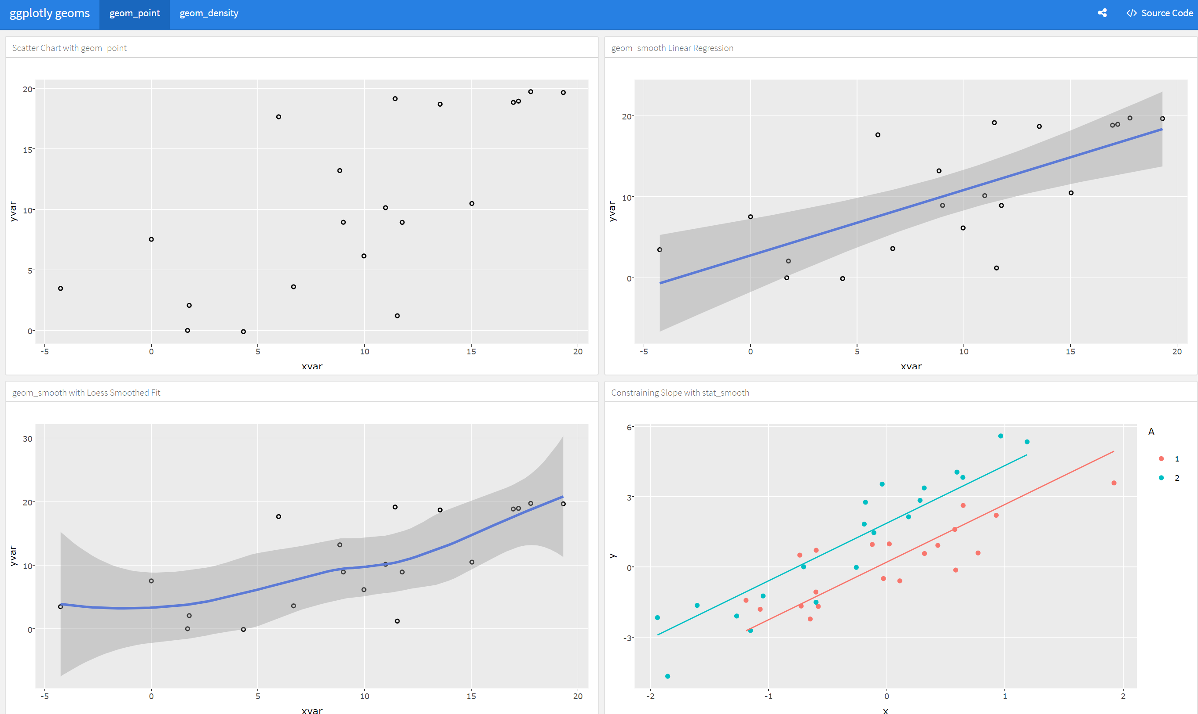
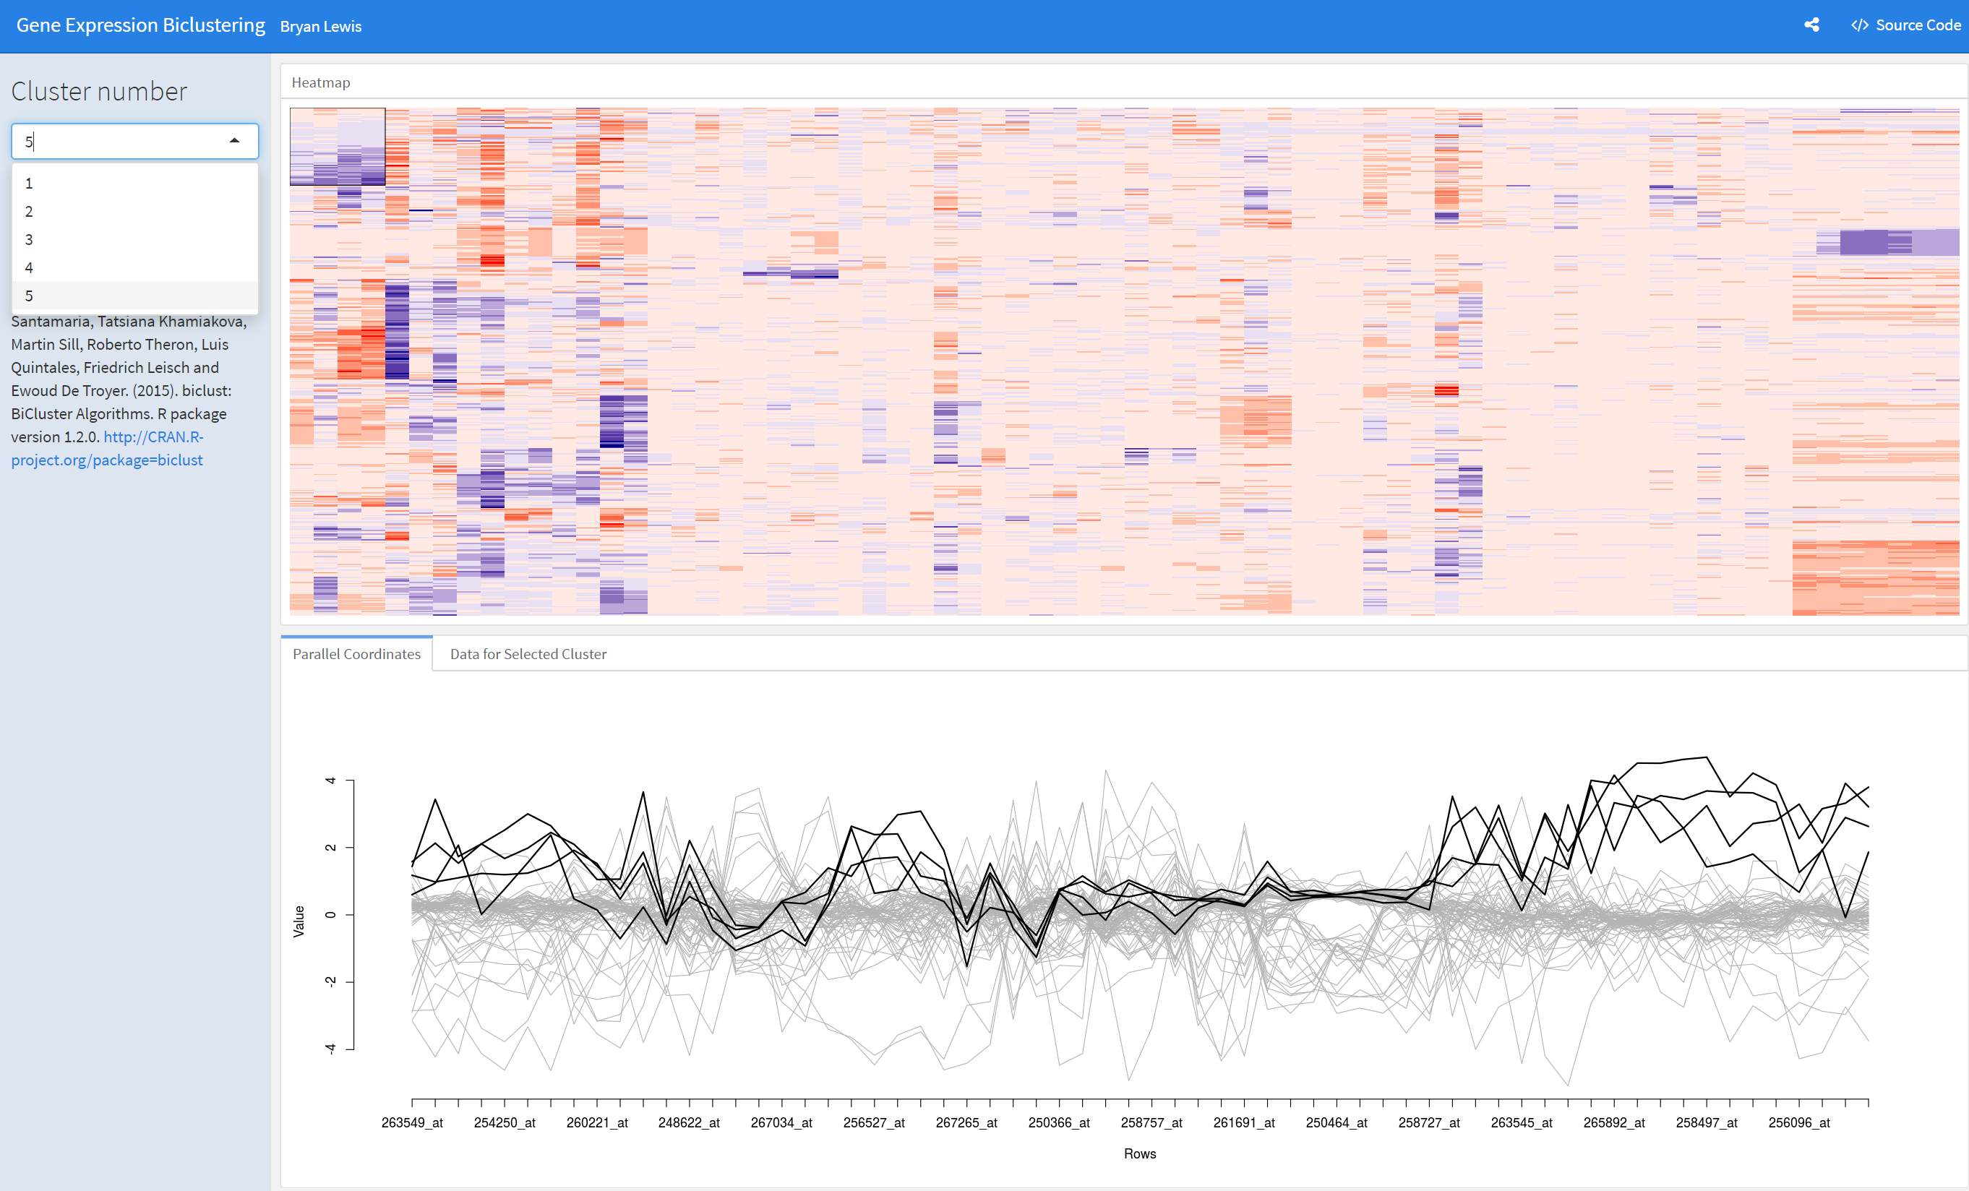
Some examples:

Slide 5
R Markdown
Outputs high-quality, reproducible documents:
HTML-files,
PDF documents,
Presentations,
… and yes, dashboards!
Yaml header + structure
Check out R Markdown cheat sheet

Slide 6
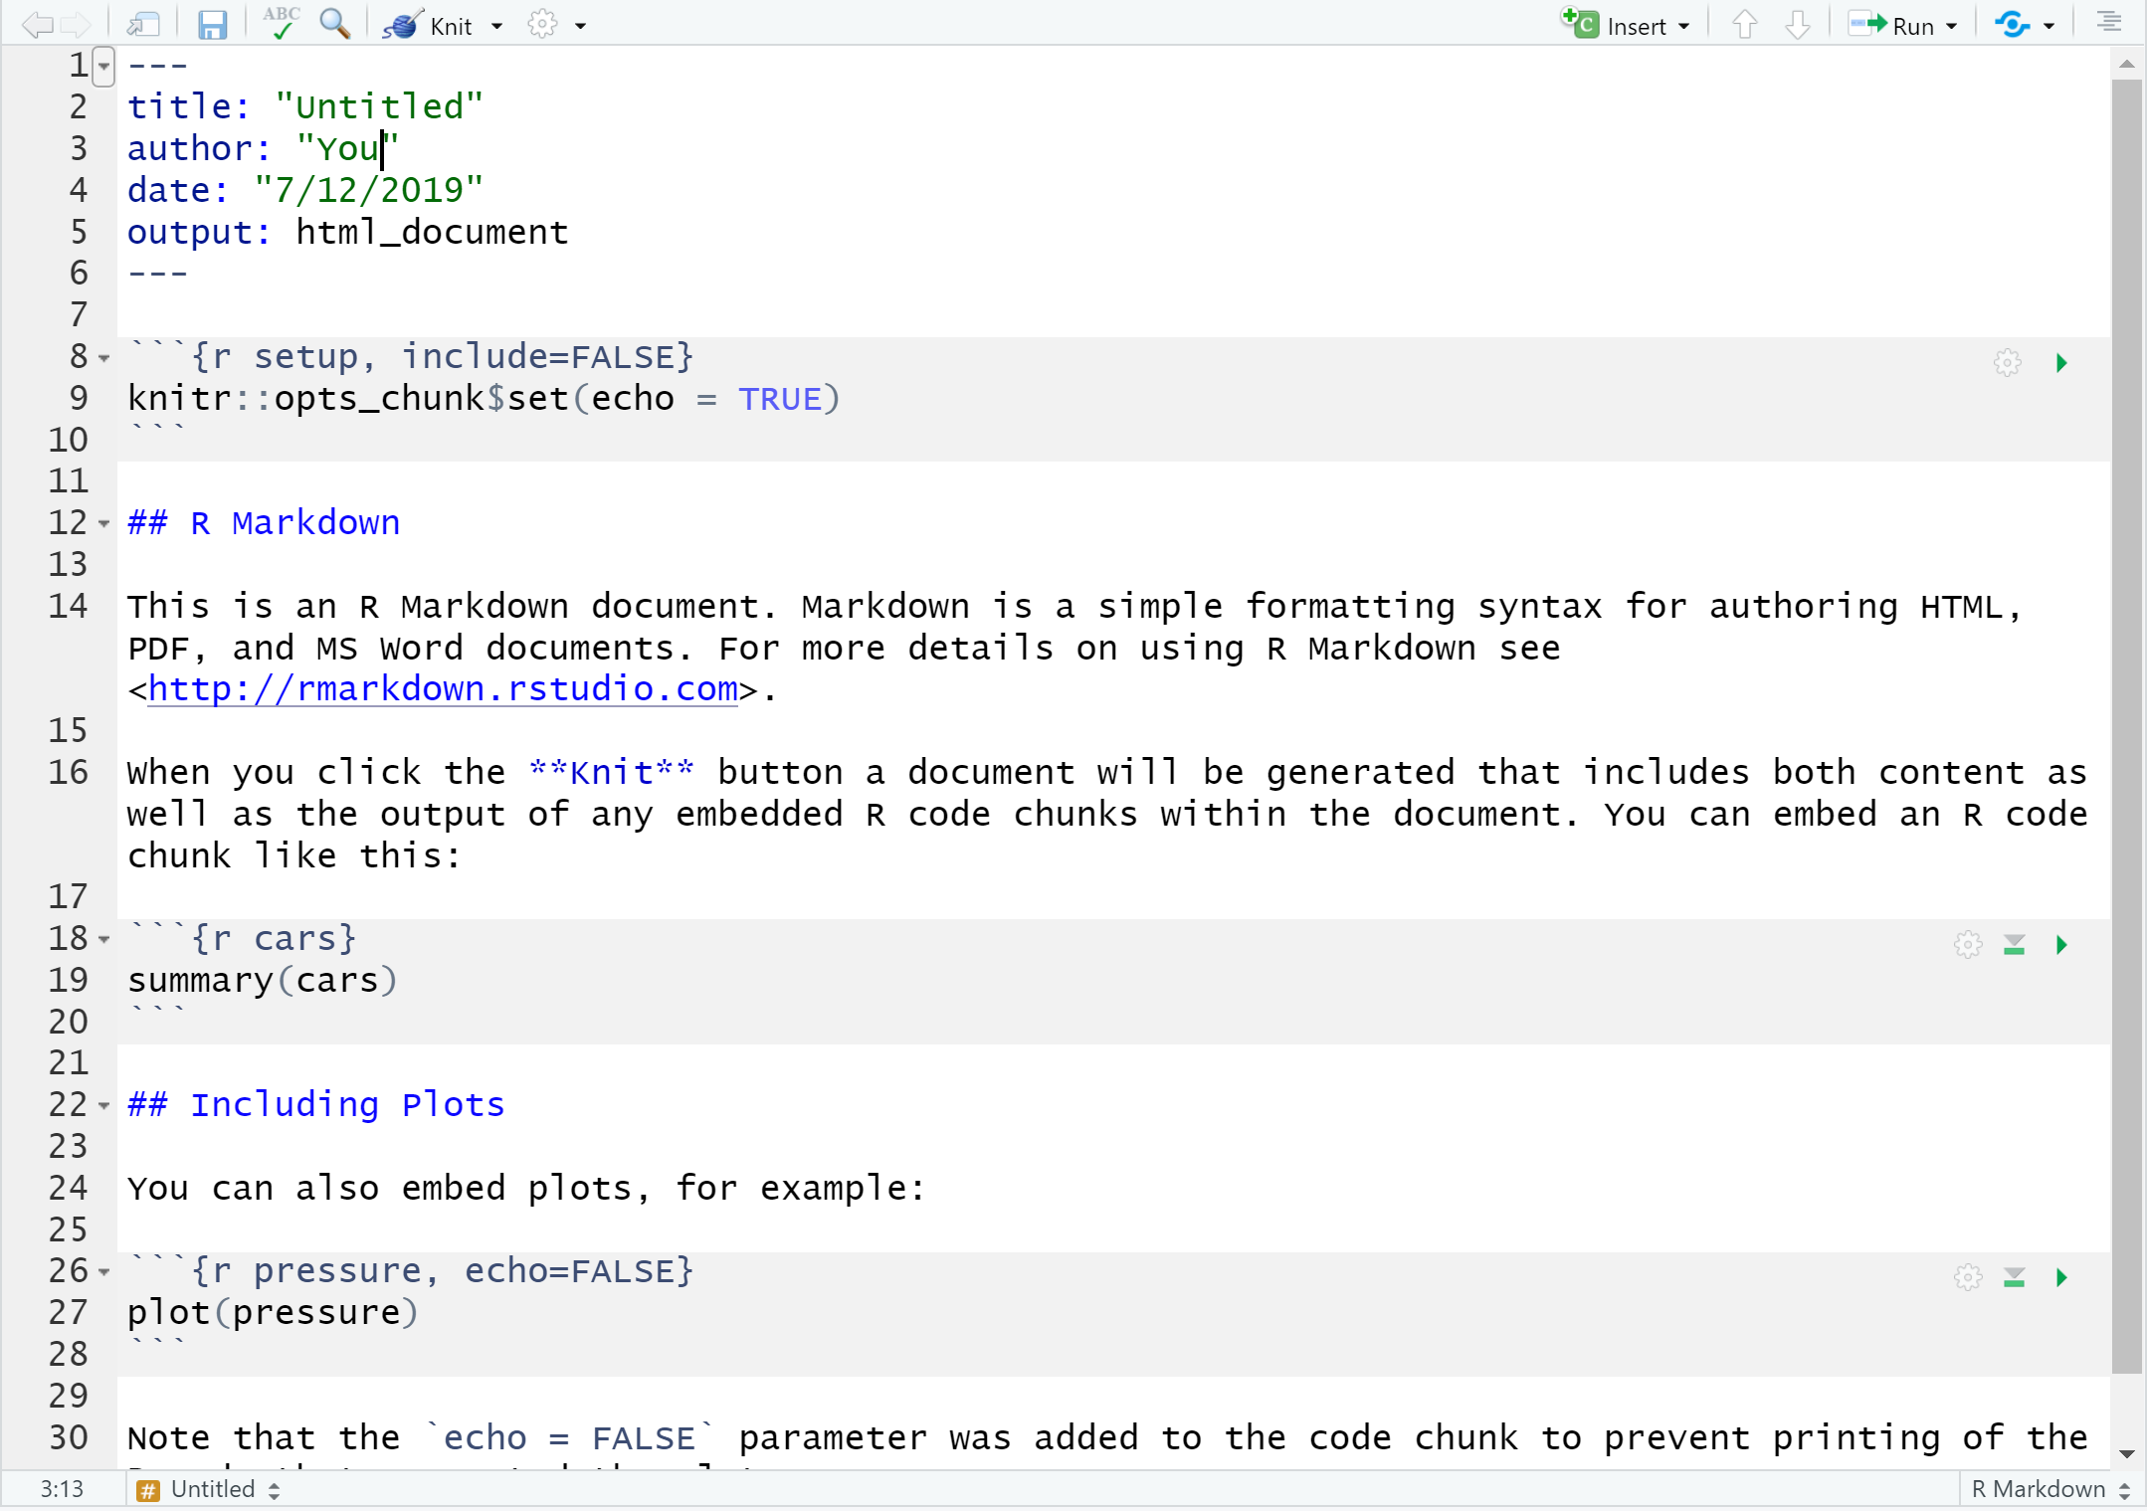
YAML header
Code chunk

Slide 7
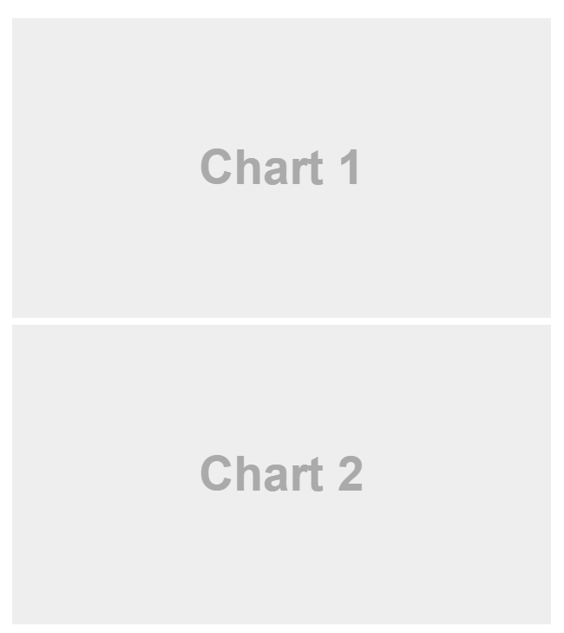
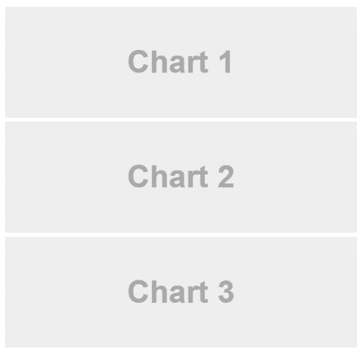
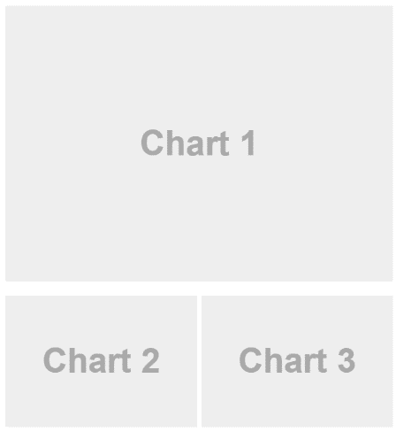
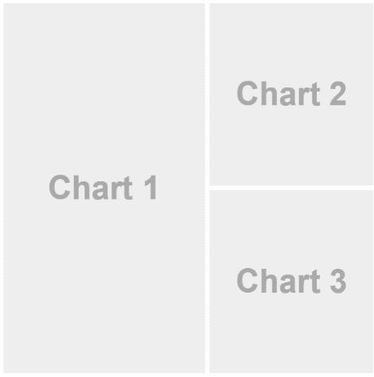
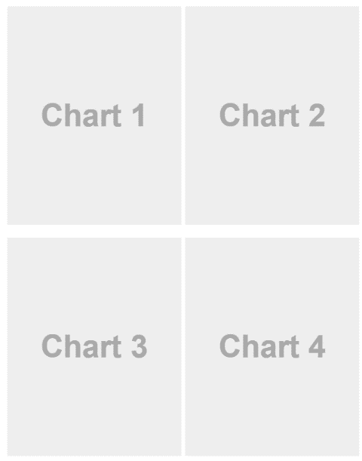
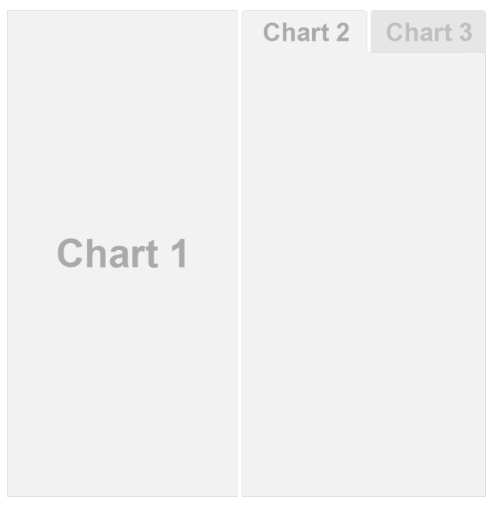
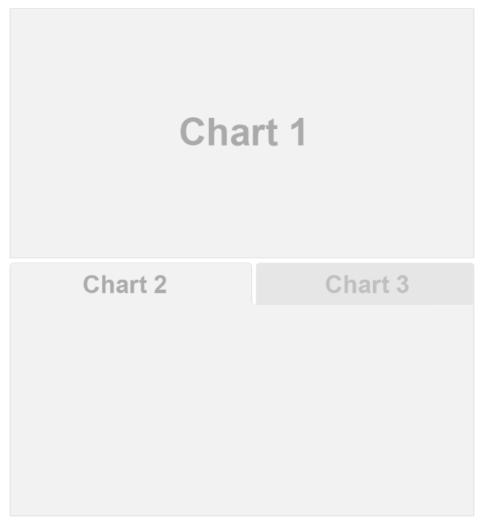
Exercise #1 : Add title and chart names to any of the layouts and knit them
Chart Stack (Fill)
Chart Stack (Scrolling)
Focal Chart (Top)
Focal Chart (Left)
Chart Grid (2x2)
Tabset Column
Tabset Row

Slide 8
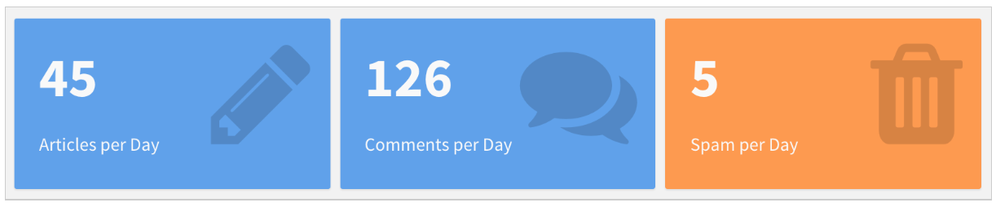
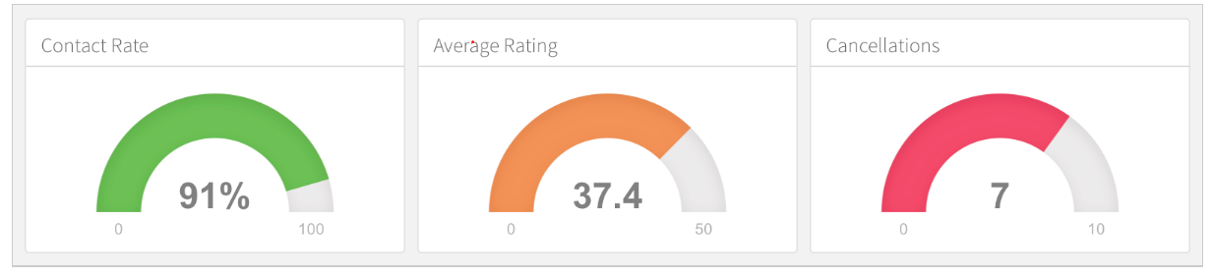
Cool additions
Value boxes: ```{r} valueBox(articles, icon = "fa-pencil")```
Gauges: ```{r} gauge(rate, min = 0, max = 100, symbol = '%', gaugeSectors( success = c(80, 100), warning = c(40, 79), danger = c(0, 39)))```
Icons from: https://fontawesome.com/

Slide 9
Exercise # 2: Create a dashboard with value boxes, table and interactive graph
Use ggplotly() for turning your ggplots into interactive graphs
Use DT::datatable(rownames=FALSE) for making searchable tables
For valueBoxes, make sure to add a color (e.g. http://www.stat.columbia.edu/~tzheng/files/Rcolor.pdf) and an icon (format: “fa-[name of the icon]” from https://fontawesome.com/icons?d=gallery

Slide 10
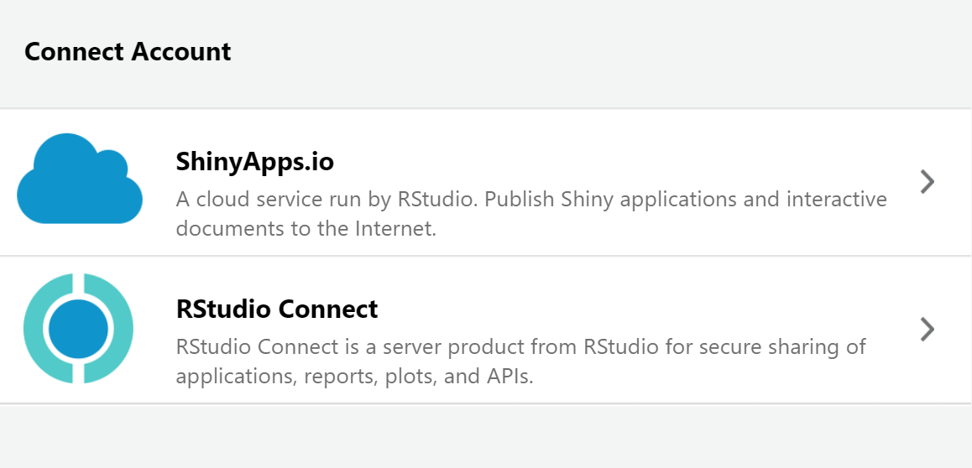
Great for communicating your point clearly
Storyboards – bring attention to specific datapoints
Shiny components
Publish your dashboard

Slide 11
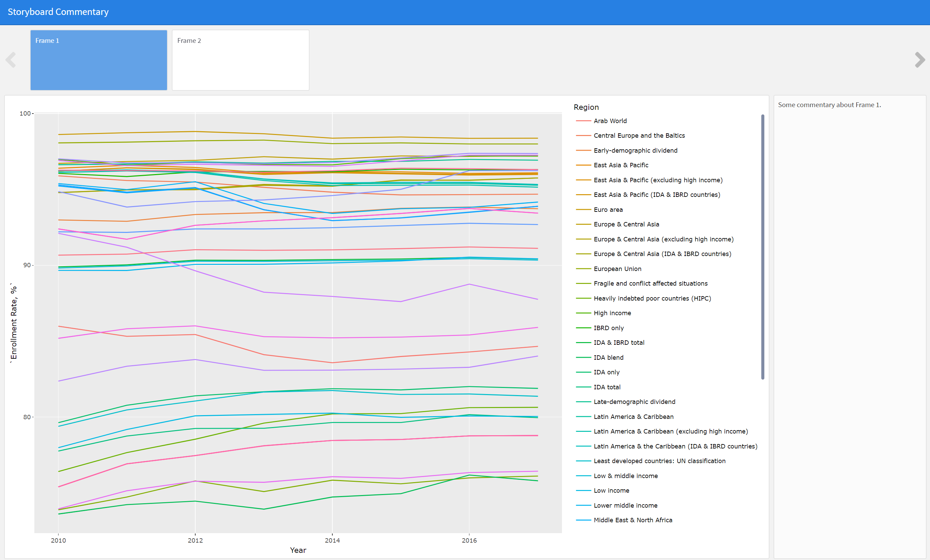
Final Exercise
Let’s make a storyboard with the visuals we have already created!
Open Exercise#3.Rmd, add names of charts and commentary. Run and see how it looks like!

Slide 12

What we have not covered at the workshop but exciting continuation…
Automate your dashboard
Add your logo and other cool appearances with CSS styles
Make it mobile friendly
LEARN MORE HERE: https://rmarkdown.rstudio.com/flexdashboard
More about visualizations: Storytelling with Data: A Data Visualization Guide for Business Professionals by Cole Nussbaumer Knaflic
Follow me on Twitter: @@sholderer

