Slide 1
R for Beginners: Learn How to Automate Your Reporting
Olga Sholderer
Senior Consultant, Deloitte Netherlands

Slide 2
Agenda
Housekeeping
Basics of R: intro and demo
RMarkdown: what is it and how can it help with reporting
Demo

Slide 3
Housekeeping
Housekeeping
Intro to R
RMarkdown
Demo
1 Access RStudio Cloud
https://rstudio.cloud/spaces/70290/join?access_code=IaaM%2FFet3%2BZkNtTnIQ6xT5gWHW2dtVlisGx8Zhkd
Login with Google or GitHub account
Join Space > Projects > WomenTech
Make permanent copy of the project
2 Additional Exercises
Practice after the session using materials on RStudioCloud
3 Download Session Materials
Materials available on https://github.com/OlgaShldrr/
Access session materials: https://bit.ly/3cWcIsV

Slide 4
Basics of R
Housekeeping
Intro to R
RMarkdown
Demo
select
keeps only the variables you mention
filter
find rows/cases where conditions are true
group_by
takes an existing table and converts it into a grouped table where operations are performed "by group".
summarise
is typically used on grouped data created by group_by(). The output will have one row for each group.
Access session materials: https://bit.ly/3cWcIsV

Slide 5
Additional resources on R
Housekeeping
Intro to R
RMarkdown
Demo
https://rstudio.com/resources/cheatsheets/ - tonnes of cheetsheets on many topics
www.stackoverflow.com – your number one source on troubleshooting errors
https://rstudio.cloud/learn/primers - learn more of the basics
Access session materials: https://bit.ly/3cWcIsV

Slide 6
R Markdown
Housekeeping
Intro to R
RMarkdown
Demo
Outputs high-quality, reproducible documents:
HTML-files
PDF documents
Presentations
Dashboards
Check out R Markdown cheat sheet
Access session materials: https://bit.ly/3cWcIsV

Slide 7
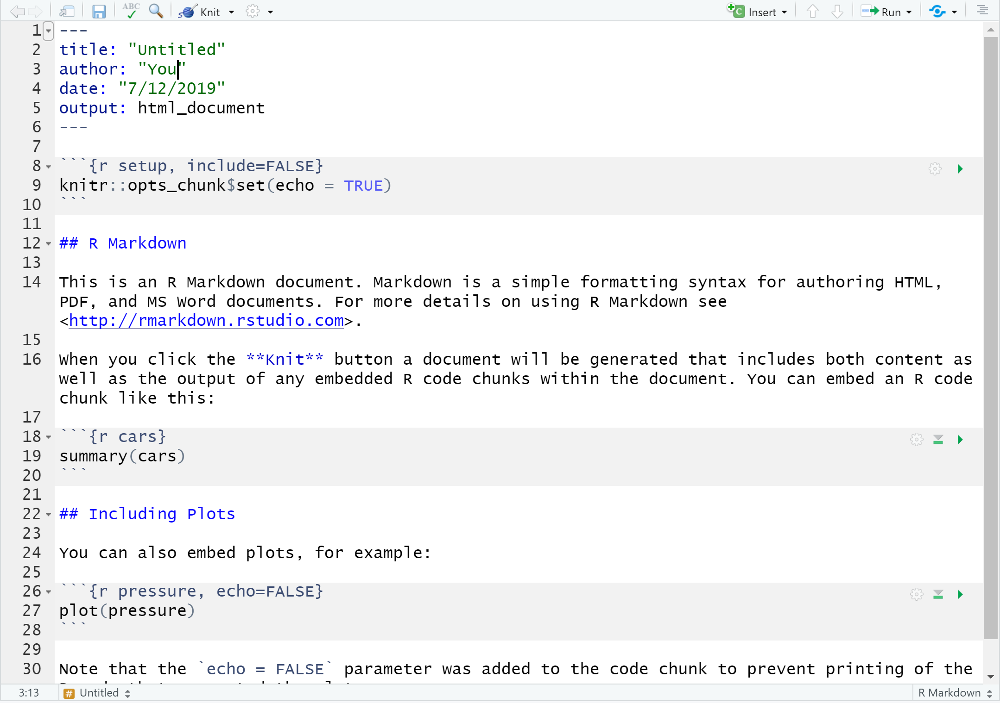
Housekeeping
Intro to R
RMarkdown
Demo
YAML header
Code chunk
Access session materials: https://bit.ly/3cWcIsV

Slide 8
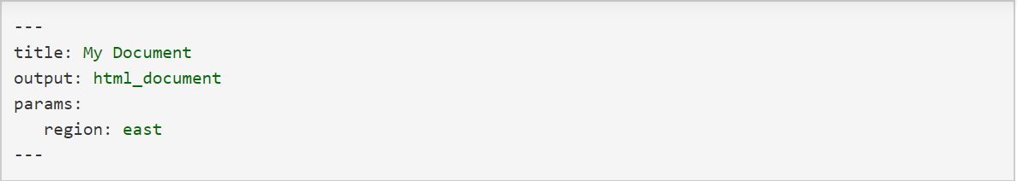
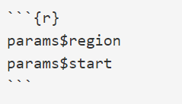
Parameterized Reports in R
Housekeeping
Intro to R
RMarkdown
Demo
Access session materials: https://bit.ly/3cWcIsV

Slide 9
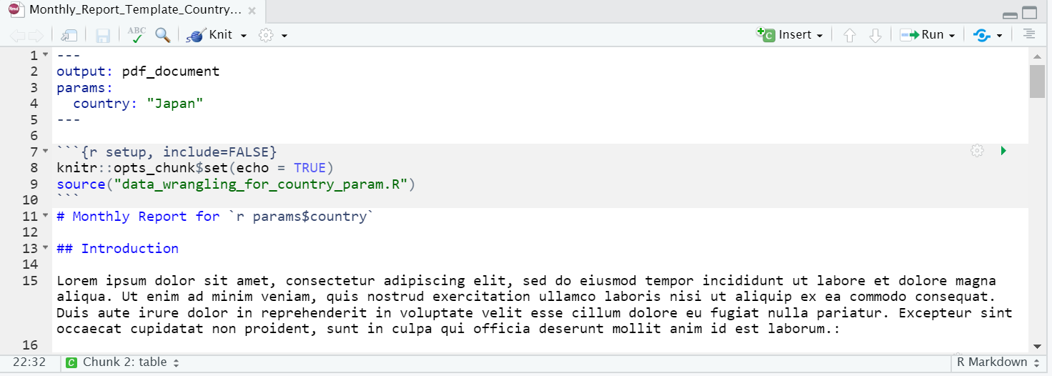

Use Parameters in Filters
Housekeeping
Intro to R
RMarkdown
Demo
Access session materials: https://bit.ly/3cWcIsV

Slide 10
Layout
Housekeeping
Intro to R
RMarkdown
Demo
CSS options for HTML: change fonts, colors
Include logos
Access session materials: https://bit.ly/3cWcIsV

Slide 11



Thank you!
@sholderer
Olga Sholderer
Access all the materials on https://github.com/OlgaShldrr/
Access session materials: https://bit.ly/3cWcIsV

