Slide 1
Mini Project
Shark Attacks
Diego Fornero
Olga Galanina
Lucila Gonzalez
17/02/2026
Data Analytics
IRONHACK

Slide 2
Project Overview
Describe the dataset
Source & Size: Indicate where the dataset originates from and its size in terms of rows and columns.
Number of columns 7070
Number of rows 23
Key Columns
Country: Contains the country details which might indicate countries or regions.
Date: Provides timing information, essential for temporal analysis.
Activity: Describes the actions being undertaken by individuals at the time of the attack.
Fatal (Y/N): Binary indicator of whether the attack was fatal, assisting in classifying attacks by severity.
Initial Observations:
  Comments on missing values, noticeable data anomalies, or interesting patterns during the initial dataset exploration.
  Mention any pre-existing categorizations or notable fields like seasonal adjustments or regional breaks.
Notes:
Briefly describe the original dataset and the hypothesis you've formulated.
Check the month with + shark attack.
Check the country in the month with + shark attack.
Correlate the country with the moth, is it in summer?

Slide 3
Project Overview
Hypothesis 1: According to the regular news, there are many shark attacks in Australia.
Hypothesis 2: There are more shark attacks during the summer in Australia, with a higher number Fatal cases.
Research Objectives:
Analyze shark attack frequency by country df["Country"].value_counts()
Focus mostly on Australia df_aus = df[df["Country"] == "Australia"]
Examine seasonality (month) df["Date_clean"] = pd.to_datetime(df["Date"], errors="coerce")
Investigate relationship between activity and fatal outcomes df["Fatal_clean"] = df["Fatal"].str.strip().str.upper()
Evaluate whether surfing is associated with higher attack frequency surf_cases = df_aus[df_aus["Activity_clean"].str.contains("surf", na=False)]
Media reports often highlight Australia as:
A hotspot for shark attacks
A country with high surfing activity
A region with dangerous shark species and igh number of fatal accidents
Analytical Approach:
Filter dataset for Australia df_aus = df[df["Country"] == "Australia"]
Compare total cases with other countries df["Country"].value_counts().head(10)
Analyze distribution of cases over the course of the year df["Year"] = df["Date_clean"].dt.year
Notes:
Explain the structure and process of your data cleaning and analysis.
Highlight any unique data cleaning techniques or methods you've employed. →
date: convert it timestamp format in a new clean date column, creating new column with months.
uppercase, dictionary and creating new column with correct data.
Check the month with + shark attack.
Check the country in the month with + shark attack.
Correlate the country with the moth, is it in summer?

Slide 4
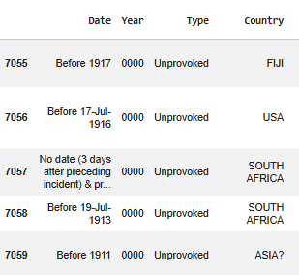
2. Data Wrangling and Cleaning
Date
Challenge
The date column contains multiple inconsistent formats (only year or suffixes, ex.: 1st, 2nd, 3rd, 5th).
Solution
Use regex method to remove the suffix and keep only the number.
Convert all date values to a standardized datetime format.
Country
Challenge
Correct countries with multiple naming variations and exclude the territories that are not countries.
Solution
Create a dictionary with usable values to standardize country names and apply it to each value in the column using the .map() method.
Create a new column called New_country, containing only unique values.
Sample of initial data
Notes:
Discuss the significant data cleaning challenges you encountered (missing data, duplicates, formatting issues, etc.).
Explain how you resolved these challenges.
+screenshots from database

Slide 5
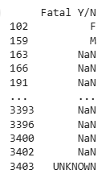
2. Data Wrangling and Cleaning
Sample of initial data
Fatal Y/N
Challenge
The Fatal Y/N column contained multiple inconsistent values that were not suitable for analysis, ex.: 'N', 'Y', 'F', 'M', 'NAN', 'NQ', 'UNKNOWN', '2017', 'Y X 2'.
Solution
Create a dictionary with usable values and apply it to each value in the column using the .map() method.
Create a new column Fatal_clean containing only three categories:
Yes
No
Unknown
Notes:
Discuss the significant data cleaning challenges you encountered (missing data, duplicates, formatting issues, etc.).
Explain how you resolved these challenges.
+screenshots from database

Slide 6
3. Exploratory Data Analysis
Available Data set:
Country
Fatality outcome
Month
Activity
Tasks:
Identify the countries with the highest percentage of shark attacks.
Identify the countries with the highest number of fatal shark attack cases.
Calculate the percentage of total and fatal incidents by country.
(Optional) Identify the activities most frequently associated with fatal incidents.
Structuring data and key methods:
Created new columns, “Country_new” and “Fatal_new”, containing cleaned data.
Used the .isin() pandas method to filter rows with values “Y” or “No”, and .notna() to keep only valid (non-null) data in the Fatal column.
Used .groupby() and .agg() to group the data by country and summarize fatal cases.
Used .agg() to calculate multiple summary metrics, for example counting how many rows exist per country in Fatal_new.
Used .sort_values() to sort the percentages of attack cases in descending order.
Notes:
Discuss the exploratory data analysis methods you used.
Share insights and interesting patterns you found.
Structure the data to make it suitable for analysis (e.g., create new fields, group data, create pivot tables).
Use aggregation and filtering techniques to refine the dataset and start testing your hypotheses.
Research Team Key Tasks & Topics:
Read the self-guided material on Exploratory Data Analysis (EDA), focusing on using statistical measures and visualization (histograms, box plots, scatter plots, etc.).
Explore how EDA techniques validate hypotheses and reveal insights.
Share findings with the Dev Team and apply appropriate EDA methods and visualization tools.

Slide 7
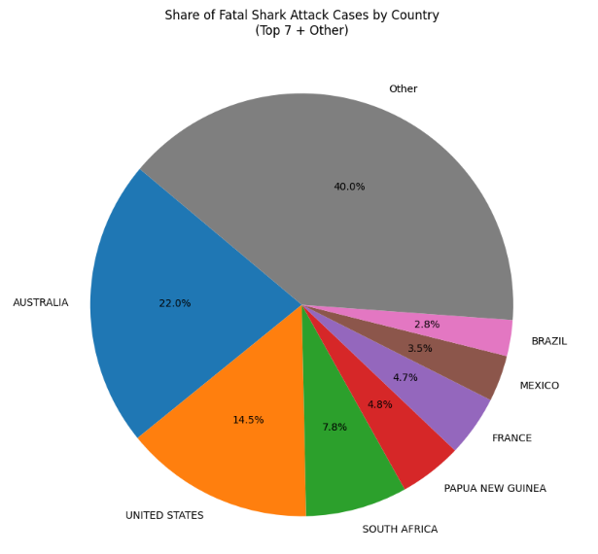
3. Exploratory Data Analysis
The top 7 countries account for 60% of the fatal cases in the database.
Countries outside the top 7 each represent less than 2% of the total fatal cases.
Australia accounts for 22% of the fatal cases in the database, making it the country with the highest number of fatal cases.
Notes:
Discuss the exploratory data analysis methods you used.
Share insights and interesting patterns you found.

Slide 8
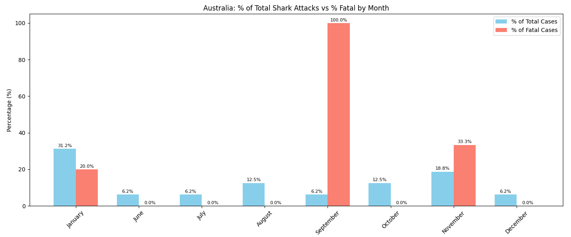
3. Exploratory Data Analysis
There is no data on shark attacks between February and May, suggesting that sharks may be less active during these months or the data is missing.
Approximately 30% of shark attacks occur in January, with 20% of them being fatal, which aligns with the fact that summer in Australia spans from December to February.
Notes:
Discuss the exploratory data analysis methods you used.
Share insights and interesting patterns you found.

Slide 9
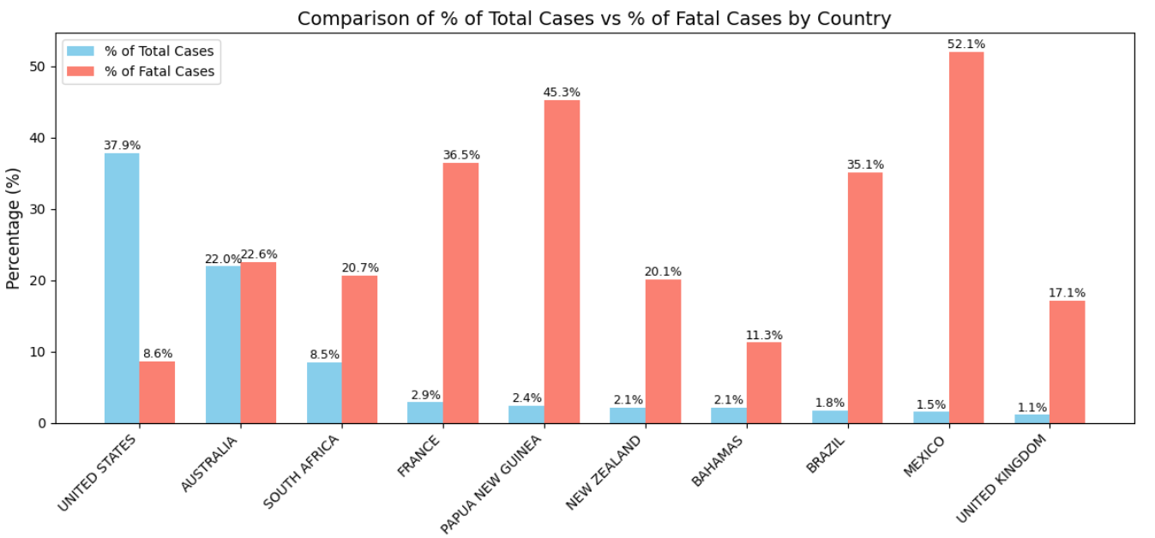
3. Exploratory Data Analysis
The percentage of fatal cases is higher in countries with a lower number of shark attacks.
For example, in Papua New Guinea and Mexico, more than 45% of shark attacks result in fatalities.
% of Total Cases = Total_Cases_by_contry/ Total_Cases * 100
% of Fatal Cases = Fatal_Cases_by_country / Total_Cases_by_country * 100
Notes:
Discuss the exploratory data analysis methods you used.
Share insights and interesting patterns you found.

Slide 10
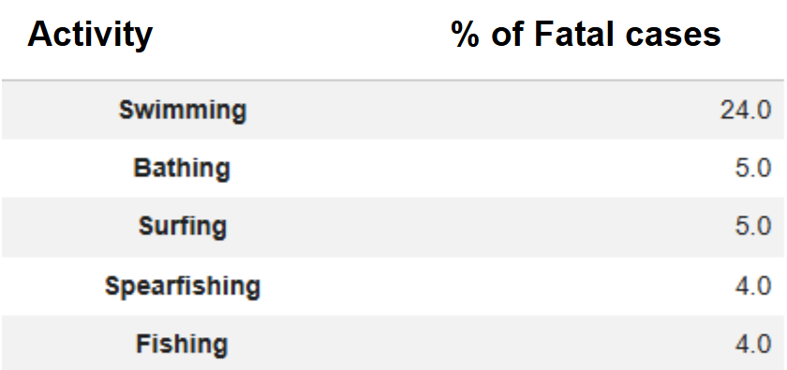
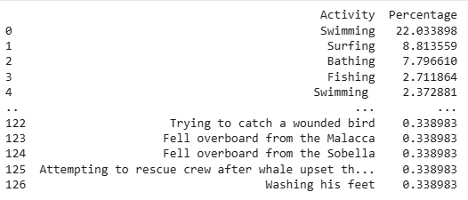
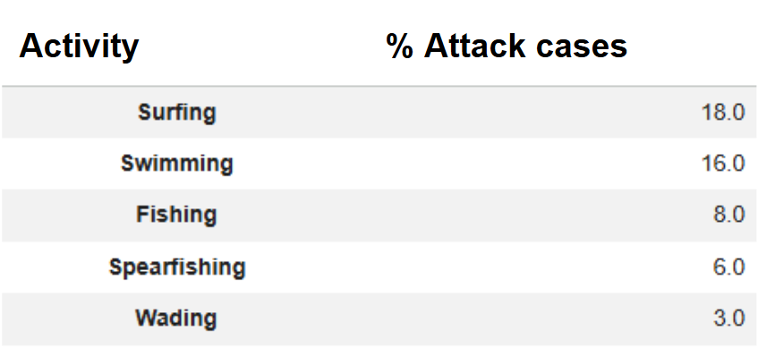
3. Exploratory Data Analysis
Top activities provoked fatal cases
Top activities provoked fatal cases in AUS
Top activities provoked attacks
Swimming and surfing are the most frequent activities associated with shark attacks and resulting in fatal incidents across all countries.
They are also the leading activities associated with fatal incidents caused by shark attacks in Australia.
Notes:
Discuss the exploratory data analysis methods you used.
Share insights and interesting patterns you found.

Slide 11
4. Major Obstacle
Agreed on the hypothesis and defined the scope of the project:
Obstacle: At the beginning, we aimed to analyze a larger dataset with more columns to find correlations between shark species, the number of attacks, and the age of victims in the top countries. However, the scope was too large and complicated to manage.
Solution: We limited the scope of the project to the country level (Australia) and focused on the number of attacks and fatal cases by month, and we formulated two hypotheses to be tested.
What we learned:
We needed a visual representation of our findings through graphs, so we revisited the prework to explore the usage of the matplotlib.pyplot library.
To obtain cleaned date strings with numbers only and no ordinal suffixes for further processing (e.g., converting to datetime), we applied the regex method and referred to the extra lesson on this topic in the student portal.
Notes:
Discuss the biggest obstacle or mistake you encountered during this project.
Share what you learned from it and how it influenced your project

Slide 12
4. Major Obstacle - Zoom on data cleaning
Date Formatting
The Date column contains many different formats, making standardization challenging.
Dates need to be cleaned and converted to a consistent datetime format.
After cleaning, we observed that only 46 out of 7,024 rows contain valid Month information.
Country Data Issues
Misspelled country names (e.g., “Columbia” → “Colombia”).
Territories that are not countries (e.g., “Virgin Islands”, “New Caledonia”, “Samoa”).
Regions or islands incorrectly listed as countries (e.g., “Coral Sea”, “Atlantic Ocean”).
Correct countries with multiple naming variations (e.g., “USA”, “U.S.A.”, “Usa” → “United States”).
Fatal Y/N
More than three possible options are present in the column.
The data was cleaned and normalized to retain only three categories: “Y”, “N”, and “UNKNOWN”.
Notes:
Discuss the biggest obstacle or mistake you encountered during this project.
Share what you learned from it and how it influenced your project

Slide 13


5. Conclusion and Insights
Hypothesis 1: According to the regular news, there are many shark attacks in Australia.
The United States, Australia and South Africa are the top three countries with the highest number of fatal shark attack incidents.
Australia accounts for 22% of fatal shark attacks, making it the country with the highest number of fatal cases.
Hypothesis 2: There are more shark attacks during the summer in Australia, with a higher number Fatal cases.
31% of shark attacks occurred in January in Australia, which is approximately 63% higher than in November, the month with the second-highest number of attacks.
Australia accounts for 20% of fatal cases that occurred in January, which is the summer season in the country.
Notes:
Discuss whether your initial hypothesis was supported or refuted.
Share any surprising insights or findings.
Discuss potential implications of your findings.

Slide 14
5. Conclusion and Insights
Surprising fact:
France was identified as the 5th country with the highest numberof shark attacks. When we are thinking about France we are not really considering Corsica and the Overseas French territories like Reunion Island.
Overall implications:
Shark attacks show clear temporal (seasonal) and geographical patterns.
Risk increases during periods of high human-water interaction.
Prevention strategies should be:
Season-specific
Location-specific
Activity-focused (e.g., swimming, surfing)
Notes:
Discuss whether your initial hypothesis was supported or refuted.
Share any surprising insights or findings.
Discuss potential implications of your findings.

Slide 15
Thank you for your attention!
Diego Fronero
Olga Galanina
Lucila Gonzalez

Slide 16
Comments from the Notebook
Comments :
Date: change the data type from float
Year: change from float to int
Type: OK
Country: 1 - Check the empty cells ; 2 - Check uppercase or lowercase ; 3 - Clean duplicates
State: 1 - Check the empty cells ; 2 - Check uppercase or lowercase
Location: 1 - Check the empty cells ; 2 - Check uppercase or lowercase
Activity: 1 - Check the empty cells ; 2 - Check uppercase or lowercase
Name: clean names as well
Sex: 10 different uniques (clean)
Age: 1 - Check the empty cells ; 2 - Clean exclamation marks
Injury: ? check the emty cells
Fatal Y/N: clean other options except Yes/No/Unknown
Time:change the datatime from object >> to other datatype
Species: 1 - check the wrighting with spaces or without, uppercases etc.
Source:
Check the empty cells
Check uppercase or lowercase
Clean duplicates
Conclusion: should be summarized & formalized and clean; manage the errors cused by "?" or other marks
Source:
Check the empty cells
Check uppercase or lowercase
Clean duplicates
Conclusion: should be summarized & formalized and clean; manage the errors cused by "?" or other marks

