Slide 1
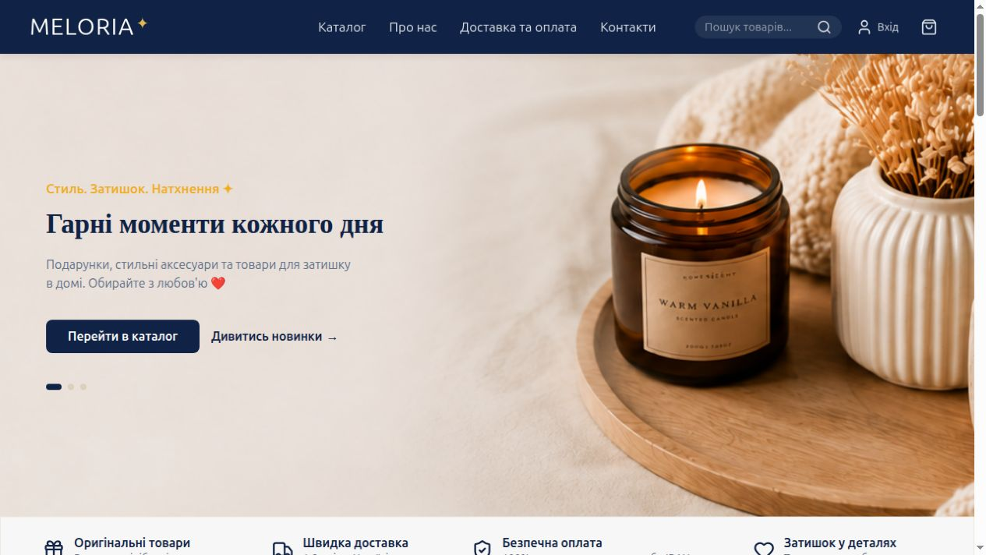
MELORIA
01 / 07 1:00
Title & Problem Statement
Meloria Shop
Ukrainian home products
and gifts
Who is it for?
Shoppers in Ukraine looking for
thoughtful gifts and home accessories.
Olha Khodakivska
A clear path from product discovery
to placing an order.
meloria.pp.ua
GitHub repository
Notes:
Meloria is my first personal online shop. I want to test a small business in Ukraine and support Ukrainian manufacturers. The current catalogue presents Presentwill products. Large marketplaces such as Amazon and Temu inspired the shopping concept, but my current scope is a small shop with a focused catalogue. The customer needs an easy way to find a gift, review it and place an order.
Sources: Owner-provided project purpose; README.md.
Project: https://github.com/OlhaKhodakivska/meloria-shop
Screenshots: https://www.meloria.pp.ua/, captured 16 October 2026. Structure and timing: user-provided IHK slide plan. Visual direction: user-provided Pinterest reference, adapted to Meloria colours.

Slide 2
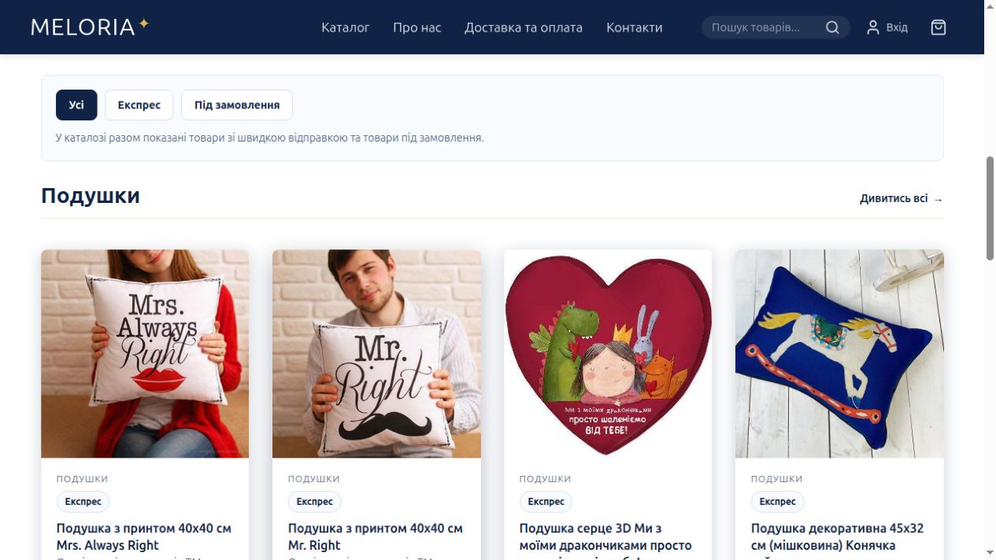
MELORIA
02 / 07 1:00
Core Objectives & Scope
Implemented
Search and product filters
Cart with quantity updates
Validated checkout
Supabase order storage
Telegram order notifications
Design decisions
Ukrainian interface for local shoppers
Responsive layout and clear product cards
Warm colours for gifts and home products
Current limits: one language, JSON catalogue, manual bank transfer
meloria.pp.ua
GitHub repository
Notes:
The shop covers the main customer journey. Customers can search, filter, add products to the shared cart and complete a validated order form. The server saves the order before it attempts a Telegram notification. The warm visual style suits gifts and home products. Scope limits are intentional: the interface is Ukrainian, the catalogue comes from a JSON file and payment uses manual transfer rather than an integrated payment gateway.
Sources: src/pages/Home.tsx; src/pages/Checkout/Checkout.tsx; api/orders.ts; README.md.
Project: https://github.com/OlhaKhodakivska/meloria-shop
Screenshots: https://www.meloria.pp.ua/, captured 16 October 2026. Structure and timing: user-provided IHK slide plan. Visual direction: user-provided Pinterest reference, adapted to Meloria colours.

Slide 3
MELORIA
03 / 07 2:00
Technical Architecture
Components & state
Data flow
Header
App
products.json
Catalogue
Home
Checkout
Checkout
/api/orders
Supabase
CartDrawer
Telegram
Footer
The API notifies Telegram after saving the order.
Home renders ProductCard components.
src/components reusable interface
src/pages application pages
src/context shared cart state
api server order handler
Cart Context shares cart data
localStorage keeps it after refresh
React + TypeScript CSS Modules Clerk authentication Vercel hosting
meloria.pp.ua
GitHub repository
Notes:
React and TypeScript implement the interface, with CSS Modules for styling. Vercel hosts both the frontend and the serverless order API. App contains the main layout and routed pages. Home renders product cards. Local hooks manage forms and filters. Cart Context shares cart state with the cart drawer and checkout, and localStorage preserves it after refresh. The catalogue loads products.json. Checkout sends a request to /api/orders. The API validates it and saves the order in Supabase using a private server key. After saving, the API attempts a Telegram notification. Supabase itself does not send that message. Clerk provides authentication.
Sources: src/App.tsx; src/pages/Home.tsx; src/context/CartContext.tsx; api/orders.ts; vercel.json.
Project: https://github.com/OlhaKhodakivska/meloria-shop
Screenshots: https://www.meloria.pp.ua/, captured 16 October 2026. Structure and timing: user-provided IHK slide plan. Visual direction: user-provided Pinterest reference, adapted to Meloria colours.

Slide 4
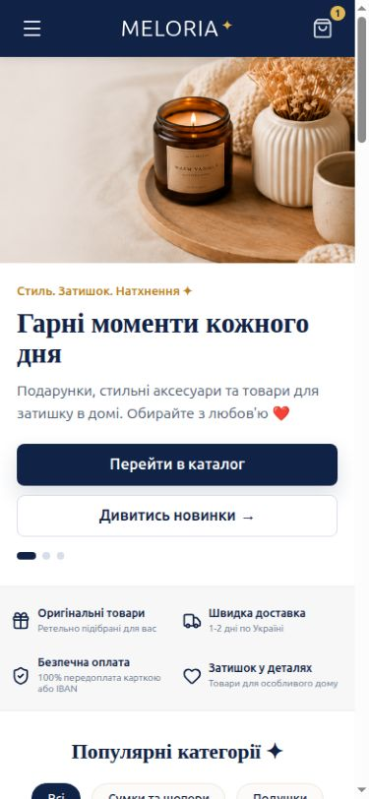
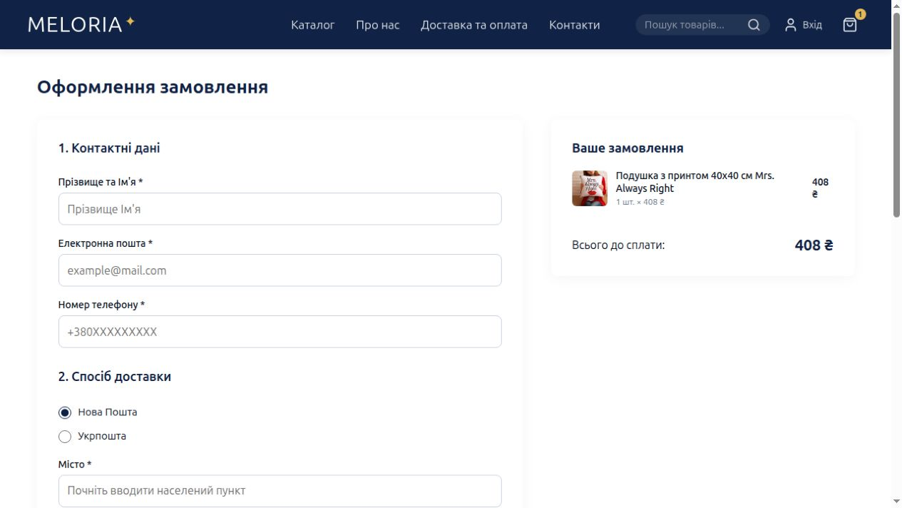
MELORIA
04 / 07 3:00
Live Application Demo
Main customer journey
01
Find a product
Use search or filters
02
Update the cart
Add an item and change quantity
03
Open checkout
Show validation without submitting
04
Check mobile layout
Show navigation and product browsing
Desktop checkout
Open the live shop
Backup: local catalogue and cart demo
Mobile
meloria.pp.ua
GitHub repository
Notes:
Three-minute browser demo: 0:00–0:40 search or filter a product, 0:40–1:20 add it to the cart and update quantity, 1:20–2:20 open checkout and demonstrate invalid or missing fields, 2:20–3:00 show the mobile layout. Prepare the browser tab before presenting. Use synthetic data in any form demonstration. Do not submit a real order during this demo. Keep a local development build ready for catalogue and cart, plus these screenshots as a visual fallback. The default local Vite server does not provide the production order API, so do not promise a successful offline order.
Sources: docs/qa/final-verification-2026-10-15.txt; src/pages/Checkout/Checkout.tsx.
Project: https://github.com/OlhaKhodakivska/meloria-shop
Screenshots: https://www.meloria.pp.ua/, captured 16 October 2026. Structure and timing: user-provided IHK slide plan. Visual direction: user-provided Pinterest reference, adapted to Meloria colours.

Slide 5
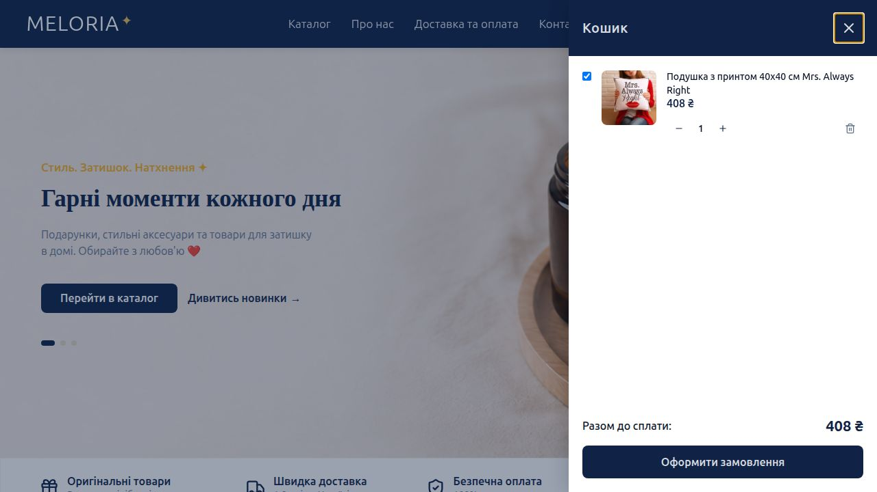
MELORIA
05 / 07 1:30
Technical Challenge & Solution
Checkout failed on the old address
The same shop worked on Vercel,
but failed on GitHub Pages.
Diagnosis
Compare both addresses.
Confirm the saved order and notification.
Identify the missing server API.
Solution
Redirect old links to the Vercel site.
Result: customers reach the working checkout
I confirmed the order and Telegram message
meloria.pp.ua
GitHub repository
Notes:
The owner observed that checkout failed on the legacy GitHub Pages address. On the Vercel domain, the order appeared in Supabase and the Telegram notification arrived. We compared the deployment setups with AI assistance. GitHub Pages serves static files and cannot run our server order handler. Vercel supports the handler. The fix changed the legacy Pages deployment into a redirect, preserving the destination route. The owner published and verified it. The screenshot shows the real cart interface, not a captured error screen.
Sources: scripts/build-github-redirect.js; docs/qa/final-verification-2026-10-15.txt; owner-provided confirmation.
Project: https://github.com/OlhaKhodakivska/meloria-shop
Screenshots: https://www.meloria.pp.ua/, captured 16 October 2026. Structure and timing: user-provided IHK slide plan. Visual direction: user-provided Pinterest reference, adapted to Meloria colours.

Slide 6
MELORIA
06 / 07 0:45
QA, Accessibility & Ethics
Accessibility
73
Native buttons, labels and visible focus
Keyboard navigation improvements
automated tests passed
Recorded verification: 15 Oct 2026
Data privacy & AI
Synthetic data for tests and demos
Private server credentials and order access
AI assistance disclosed. I review the changes
Quality checks
Production build, lint and TypeScript
Loading, empty and error states
Mobile and desktop browser checks
No Lighthouse score recorded
Full contrast and screen reader audits remain
View QA report
meloria.pp.ua
GitHub repository
Notes:
The latest recorded verification on 15 October reports 73 passing automated tests, lint, application and API TypeScript checks and a production build. Browser checks covered desktop and mobile layouts and simulated-service loading, empty, error and checkout flows. The owner separately confirmed a production order. Accessibility work includes semantic controls, labels, focus indicators and keyboard improvements. No Lighthouse score or complete accessibility conformance audit is available. Tests and demonstrations should use synthetic data. Private Supabase credentials stay on the server and public order access was closed. I used AI for review and debugging, and I am responsible for understanding and reviewing changes.
Sources: docs/qa/final-verification-2026-10-15.txt; scripts/secure-order-access.sql.
Project: https://github.com/OlhaKhodakivska/meloria-shop
Screenshots: https://www.meloria.pp.ua/, captured 16 October 2026. Structure and timing: user-provided IHK slide plan. Visual direction: user-provided Pinterest reference, adapted to Meloria colours.

Slide 7
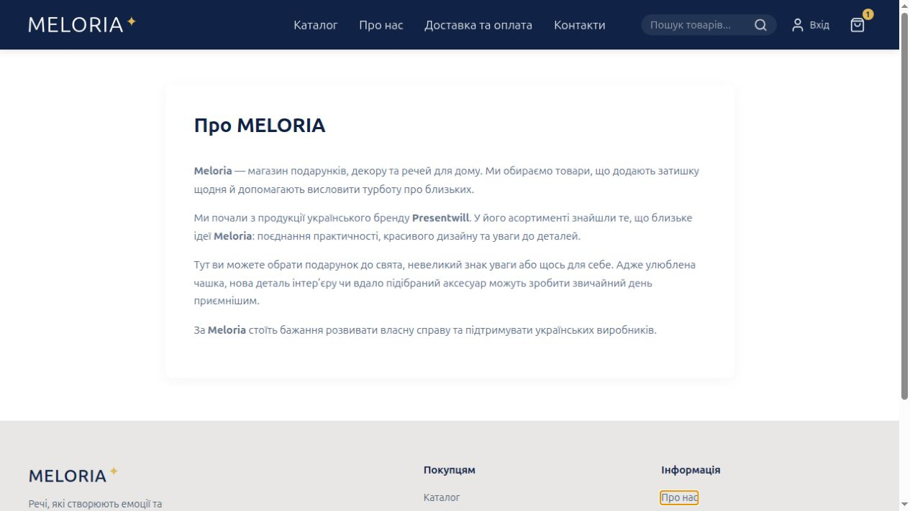
MELORIA
07 / 07 0:45
Reflection & Future Outlook
What I learned
Shared state needs clear ownership.
Hosting affects backend functionality.
Small changes are easier to verify.
Future business development
More Ukrainian manufacturers
German localization
Online payments
A paginated catalogue API
Thank you
Explore Meloria Shop
meloria.pp.ua
GitHub repository
Notes:
I learned to keep shared state ownership clear, verify deployment assumptions and make small, testable changes. My next business steps may include more Ukrainian manufacturers, German localization and an online payment gateway. A paginated catalogue API would reduce the large initial data download. These are future plans rather than current features. I want to develop the business gradually and support Ukrainian manufacturers. Thank you.
Sources: README.md; docs/qa/final-verification-2026-10-15.txt; owner-provided roadmap.
Project: https://github.com/OlhaKhodakivska/meloria-shop
Screenshots: https://www.meloria.pp.ua/, captured 16 October 2026. Structure and timing: user-provided IHK slide plan. Visual direction: user-provided Pinterest reference, adapted to Meloria colours.

