Slide 1
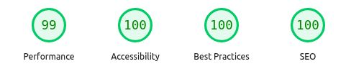
MELORIA
06 / 07
QA, Accessibility & Ethics
Accessibility
82
Clear labels, visible focus and improved contrast
Keyboard navigation improvements
automated tests passed
Data privacy & AI
Synthetic data for tests and demos
Private server credentials and order access
Quality checks
AI assistance disclosed. I review the changes
Production build, lint and TypeScript
PageSpeed Insights: Desktop
Loading, empty and error states
Cart and order validation tests
Automated results. Manual accessibility checks remain.
View PageSpeed report
meloria.pp.ua
GitHub repository
Notes:
To help customers shop with confidence, I tested the cart, order details and error messages.
I also improved text contrast and reduced page movement while the shop loads.
In this desktop check, Google PageSpeed Insights gave Meloria 99 for performance and 100 in the other three categories.
These results are encouraging, and I will continue testing accessibility manually.
Customer order details stay separate from the public catalogue.
I used AI assistance and reviewed the changes myself.
These checks give me a foundation for Meloria's next steps.
Source: https://pagespeed.web.dev/analysis/https-www-meloria-pp-ua/gil615rffp?form_factor=desktop
Report captured 23 October 2026, 12:31 GMT+2. Desktop scores only. Mobile performance in the same report is 73. Results vary by run and device. Accessibility 100 is an automated score, not a complete manual audit.
82 tests passed in the last local test run. Original visual reference: user-supplied Meloria_Shop_IHK_Presentation.pdf, page 6.

