Slide 1
Diglot-Weave learning using proverbs
T Parlan, O Holder, R Bell, N Karpova

Slide 2
Donders Education Hackathon 2016
Goal & target audience
Implementing an application for learning a new language by association with and knowledge of a mother language

Slide 3
Donders Education Hackathon 2016
Your solution
Prototype of a language-learning application which uses Diglot-Weave technique applied to proverbs in your native language.

Slide 4
Donders Education Hackathon 2016
Added value for schools
Combine learning new language, proverbs, idioms and reading literature
Pleasant and easy way of learning new language

Slide 5
Donders Education Hackathon 2016
Cognitive neuroscience inspiration
Craik and Tulving (1975) “Depth of Processing and retention of words in episodic memory”
Understand the semantics of the word and sentence – more likely to remember
You should understand the semantics of the sentence to recognize it as a proverb
Relational rehearsal superior to maintenance rehearsal
Proverbs could create associations
Repetition

Slide 6
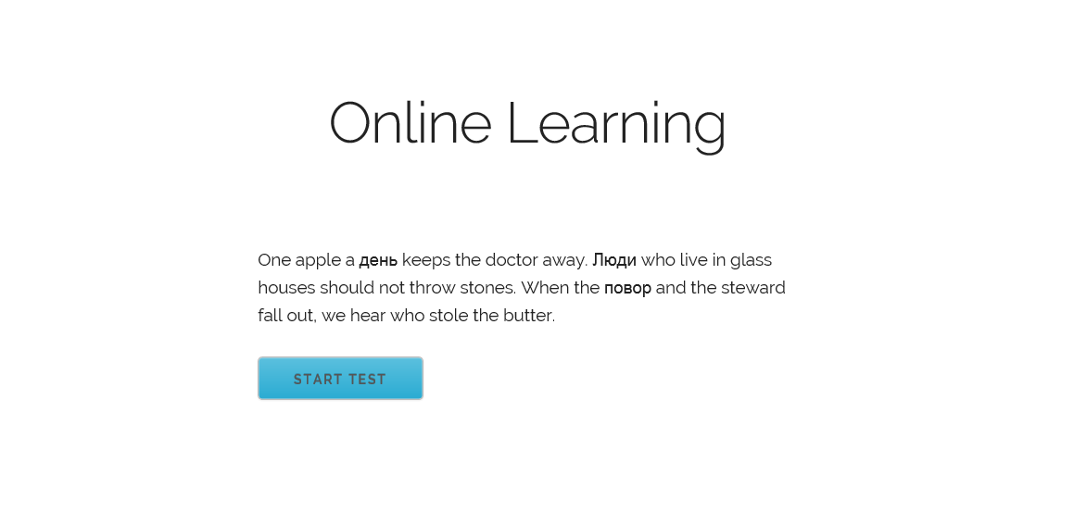
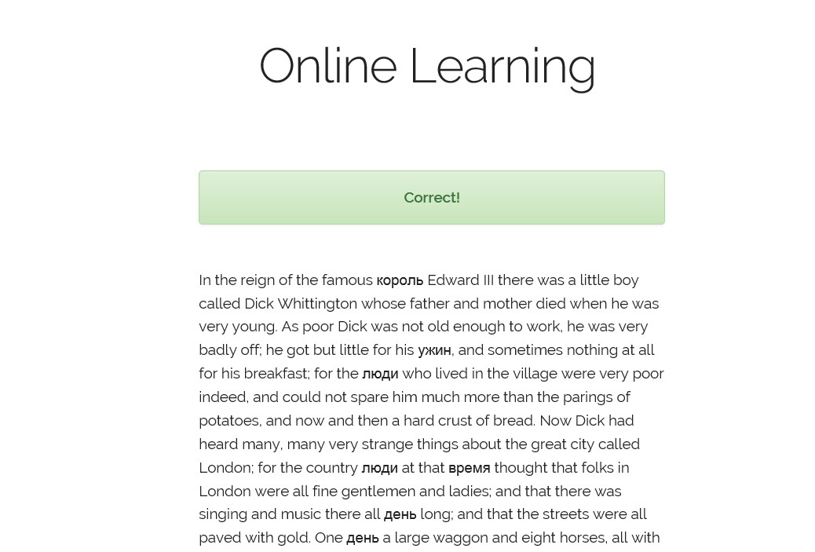
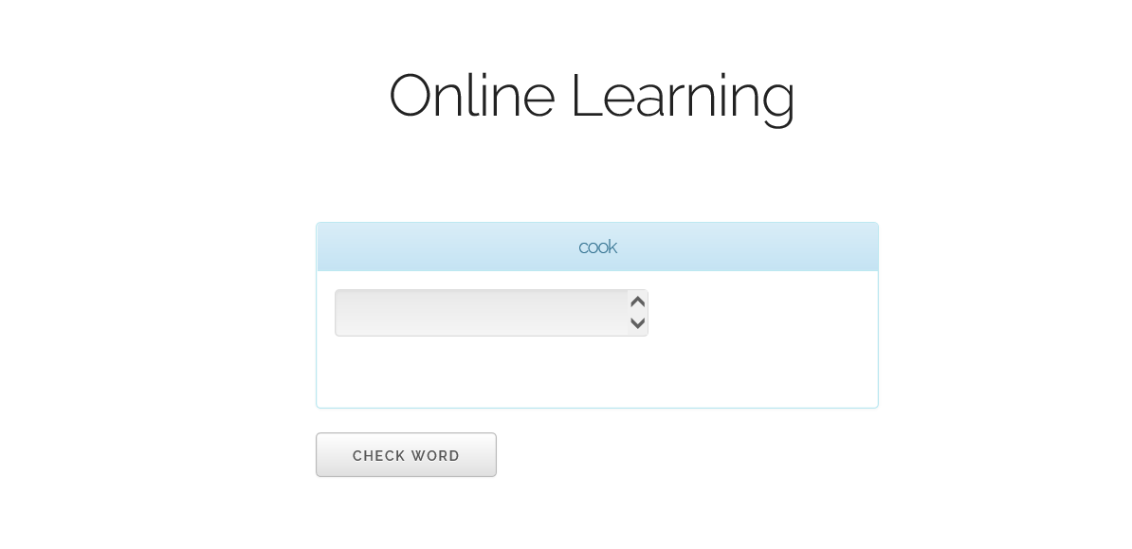
Donders Education Hackathon 2016
The implementation: results of 24 hours blood, sweat & tears
1.
3.
2.

Slide 7
Donders Education Hackathon 2016
Take home message

