Slide 1
Ansible Meetup - 2018
Matthew Prickett - Cloud SE
James – Nice Guy!
V1.4

Slide 2
Agenda
Intro
Ansible Roles
Ansible Galaxy
Demo
Q & A

Slide 3
Ansible Roles
(Introduction)

Slide 4
Why Ansible Roles?
Performance
Management
Troubleshooting

Slide 5
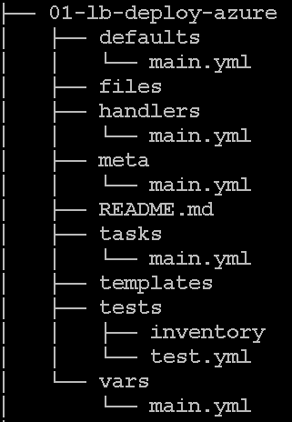
Directory Structure
ansible-galaxy init f5-sys-ready
Additional folders
/templates - j2 files
/library – Custom Modules

Slide 6
/tasks/main.yml
- name: LB Deploy Azure
azure_rm_deployment:
state: present
subscription_id: "{{ subscription_id }}"
resource_group_name: "{{ resource_group_name }}"
password: "{{ password }}"
ad_user: "{{ ad_user }}"
client_id: "{{ client_id }}"
tenant: "{{ tenant }}"

Slide 7
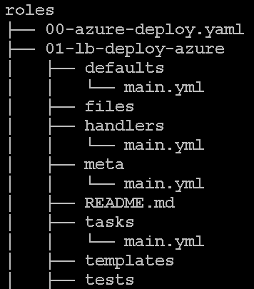
Master Playbook
00-aazure-deploy.yaml
---
- hosts: localhost
connection: local
gather_facts: no
roles:
- 01-lb-deploy-azure
- 02-lb-facts
- 03-lb-sys-ready
- 04-lb-license
- 05-lb-sys-ready
- 06-lb-waf-config

Slide 8
Task Order – Pre Tasks
---
- hosts: localhost
connection: local
gather_facts: no
pre_tasks:
- name: Start of Role Execution
raw: date > /root/ansible/mylogs/startofrole.log
roles:
- 01-lb-deploy-azure
- 02-lb-facts

Slide 9
Task Order – Post Tasks
- 03-lb-sys-ready
- 04-lb-license
- 05-lb-sys-ready
- 06-lb-waf-config
post_tasks:
- name: End of Role Execution
raw: date > /root/ansible/mylogs/endofrole.log

Slide 10
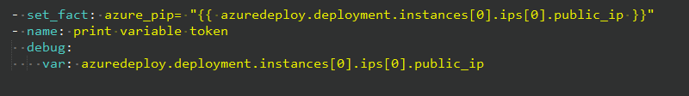
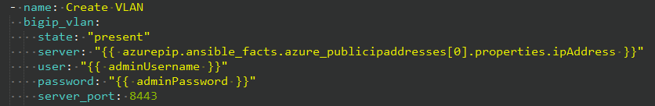
Facts…
Can be used across roles…

Slide 11
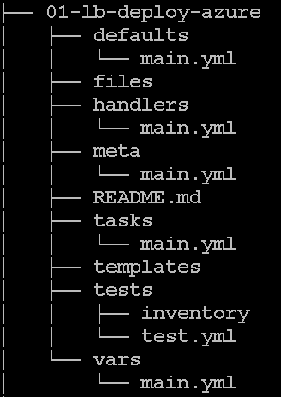
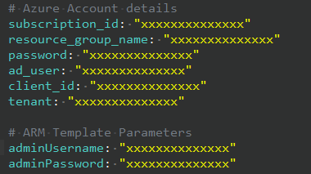
Variables…
CLi
--extra-vars="@/root/ansible/azure/azure_inventory.yaml" -vvv
main.yaml

Slide 12
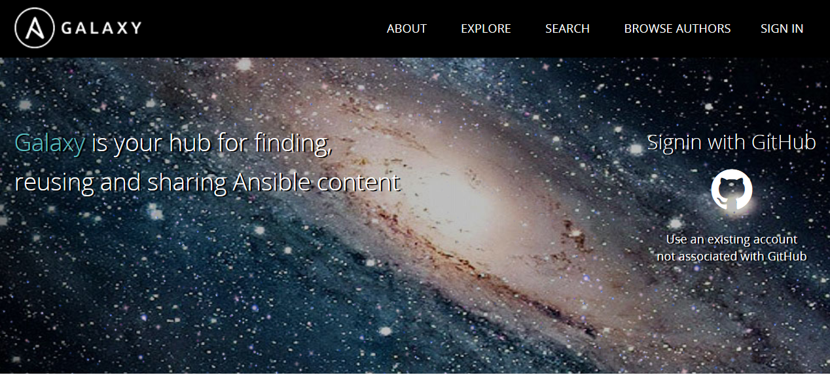
https://galaxy.ansible.com/

Slide 13
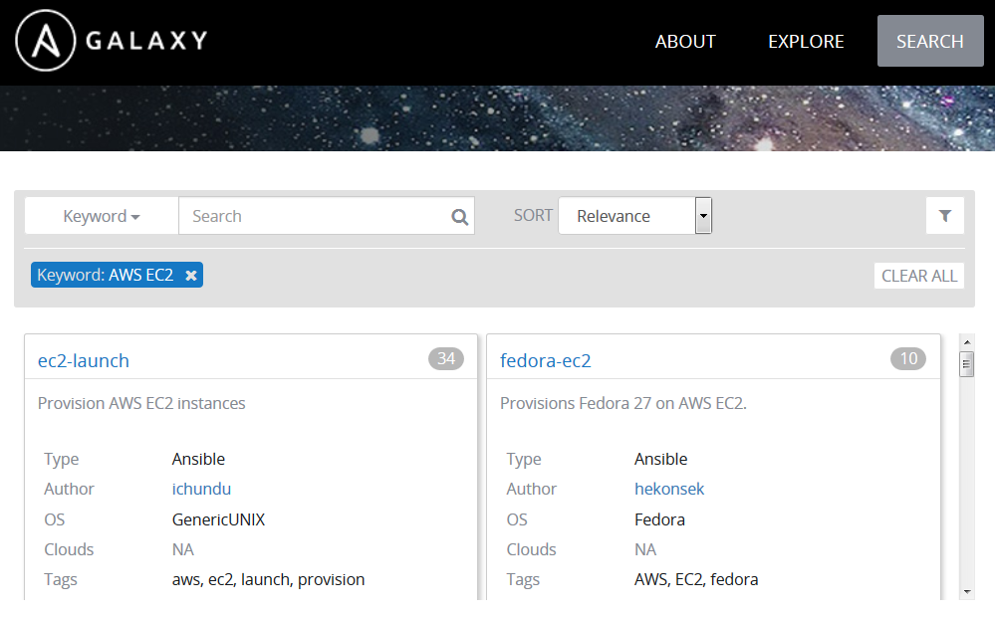
Ansible Galaxy - Search

Slide 14
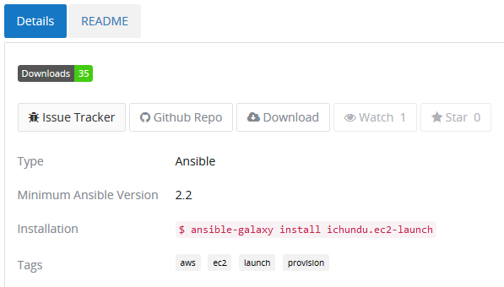
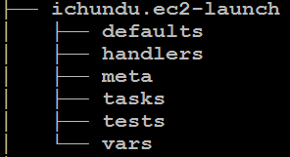
Ansible Galaxy - Installation
# ansible-galaxy install ichundu.ec2-launch

Slide 15
What do we use Roles for in Prod?
Install and configuration
Microservices for our portal
Operational plays

Slide 16
Why roles?
Lets us organise composable parts
Functional blocks can be plugged together
Well designed roles and variables give independence
apache/ngnix for example

Slide 17
Q & A

