Slide 1
Solo Project: EFT Class builder
Oliver Parrack

Slide 2
My application
Class creator for EFT ( escape from tarvok )
Be able to create builds from a set amount of items.
Be able to view this builds.

Slide 3
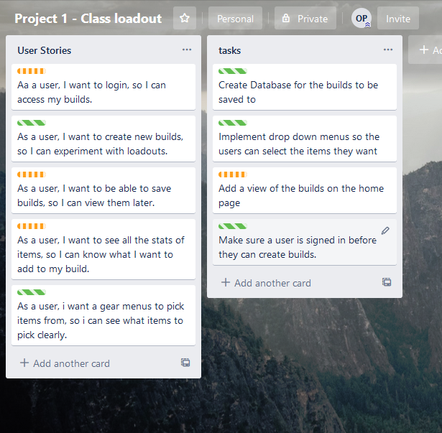
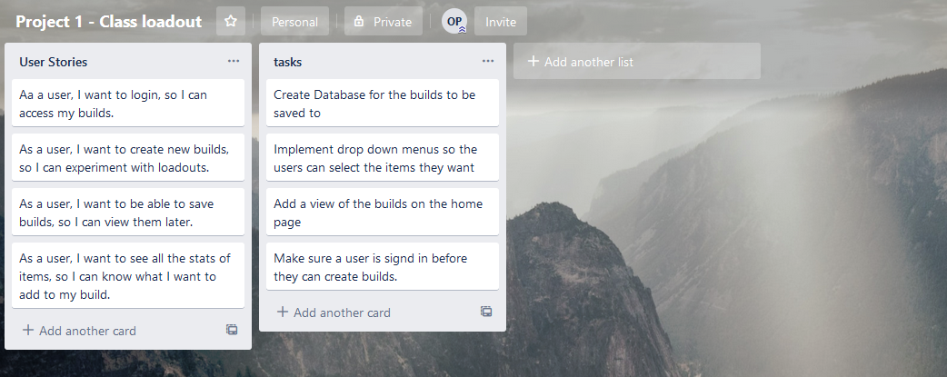
Planning

Slide 4
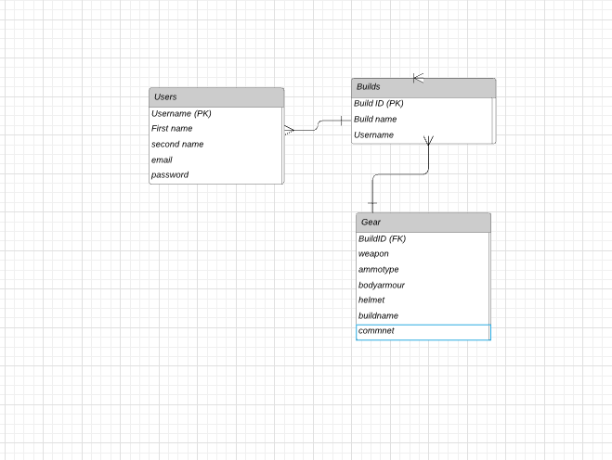
First Draft

Slide 5
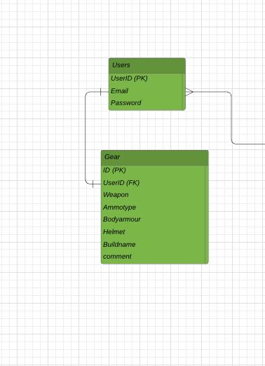
ERD

Slide 6
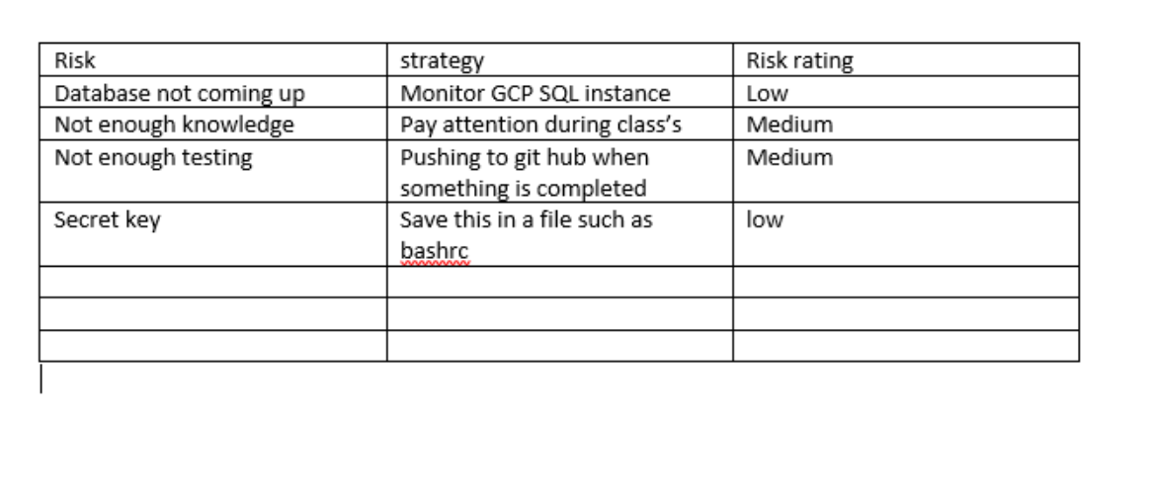
RISKS!

Slide 7
Version control GIT
https://github.com/OliQa/Project-final

Slide 8
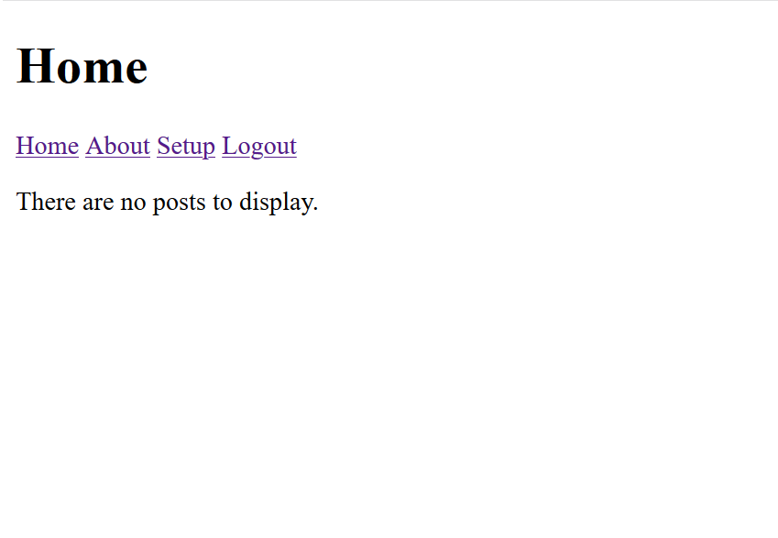
What doesn’t work
Viewing
Jenkins

Slide 9
Improvements
More social functionary
Adding more items
Adding pictures

Slide 10
My application
http://34.89.53.11:5000/home

