Slide 1
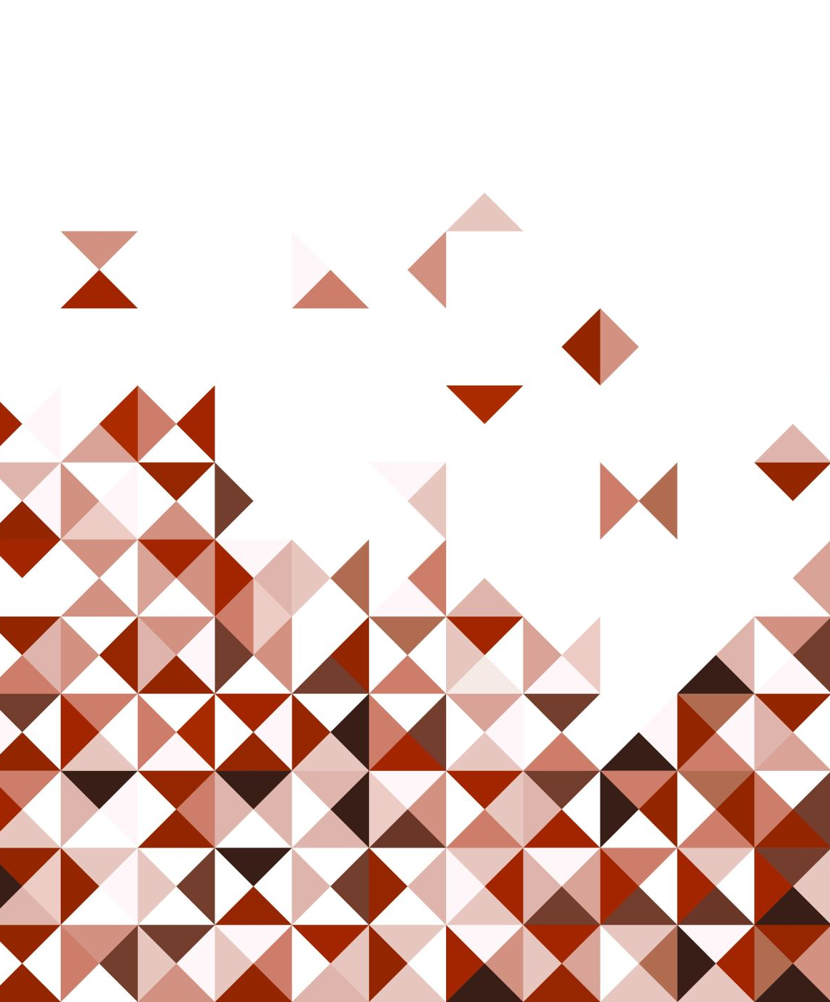
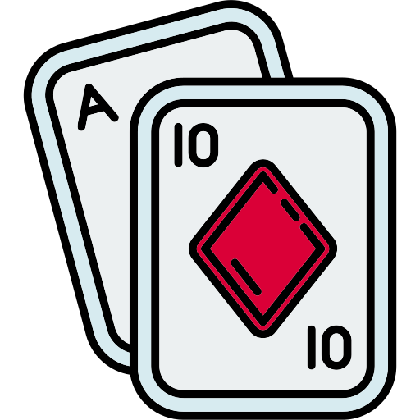
QDutch
A reimagined card game by
Francis Blais, Vincent Girouard, Olivier Romain and Marius Trudeau

Slide 2
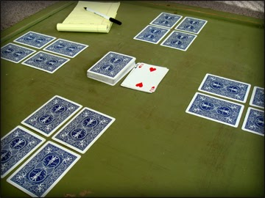
Dutch: The Original Game
4 Player game where each player gets 4 cards and can look at 2 of them
The goal is to have the less number of points in your hand
Each player takes a turn and draw a card. He can change it with one of its cards.
When a player feels like he has the less points, he can call « Dutch » to end the game!

Slide 3
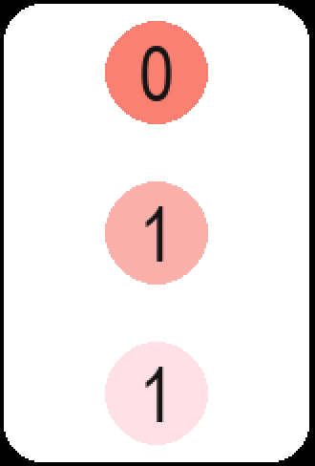
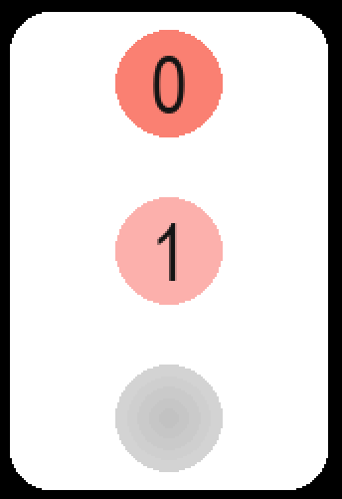
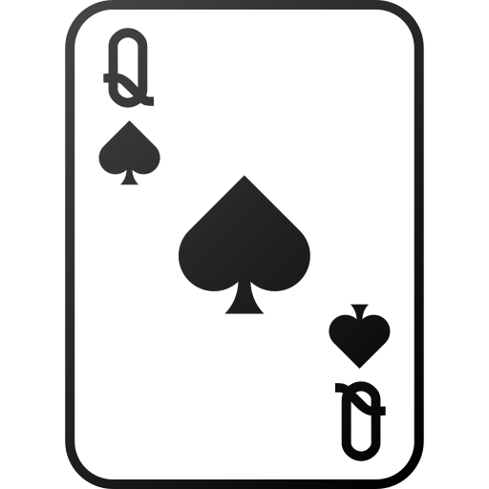

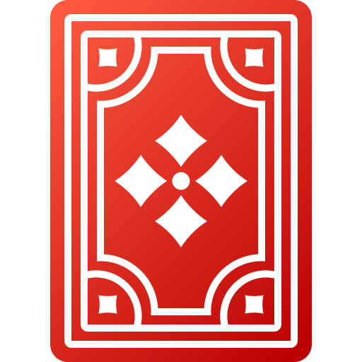
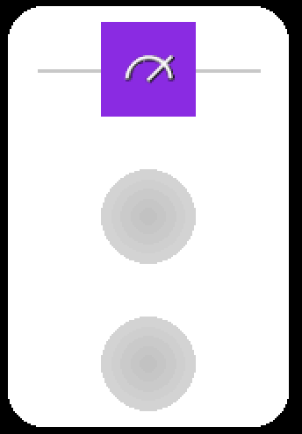
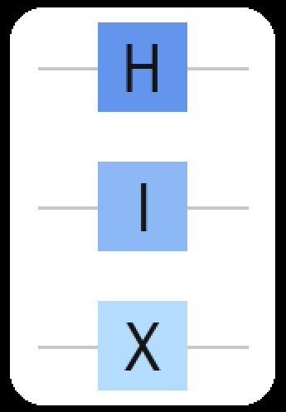
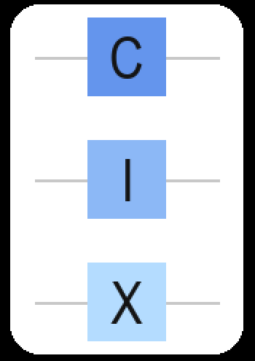
The original and new mechanics
Original game
Quantum implementation
1st Mechanic
Each cards have a value from 0 to 13
Each cards are now quantum states in binary (Ex : 3 -> |0⟩x|1⟩x|1⟩)
2nd Mechanic
Special cards allows for special classical actions (Jack or Queen)
Special cards are now operators (superposition and intrications) or measurements

Slide 4
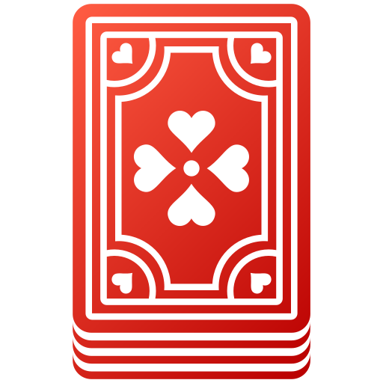
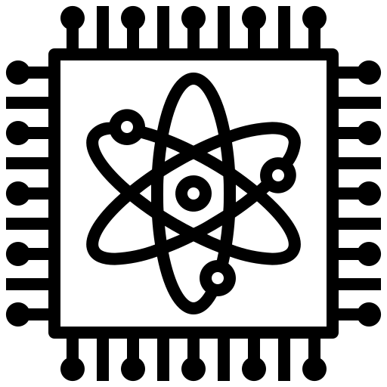
Classical mechanichs and winning conditions
Classical mechanics
Winning condition
Deck draw is classical. You draw a normal cards which corresponds either to a state, operator or measurements
Players and cards are treated classicaly between eachother. You cannot intricate two different cards
When the game ends after a player called Dutch, every state is measured. Points are calculated based on the measured states
Winning order:
The player with the less points.
The player which called Dutch.
The player with the lowest value card.
The players share the victory
3 pts

Slide 5
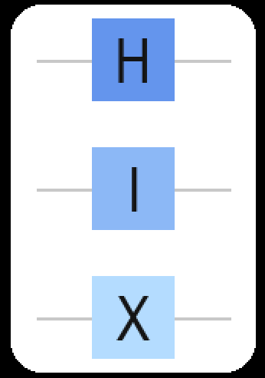

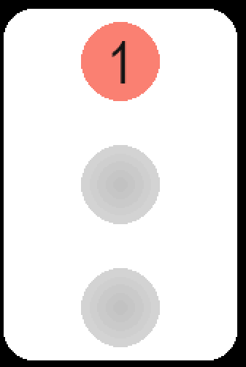
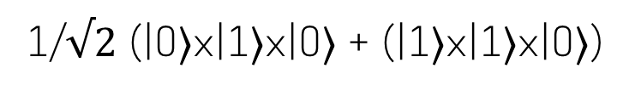
Example
Player 1 starts with a card in the state |0⟩x|1⟩x|1⟩ (3)
Player 1 draws an operator card with a NOT and a Hadamard and applies it to its 3 card
Player 2 now draws a measurement card and applies it to Player 1 state!
1/$√2$ (|0⟩x|1⟩x|0⟩ + (|1⟩x|1⟩x|0⟩)
Unlucky! Player 1 now has 1 at his first position!

