Slide 1
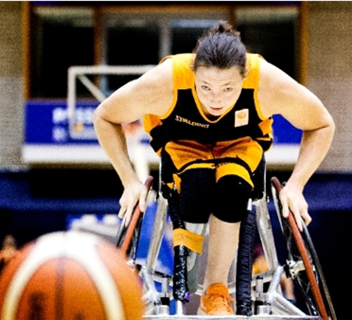
WHEELS

Slide 2
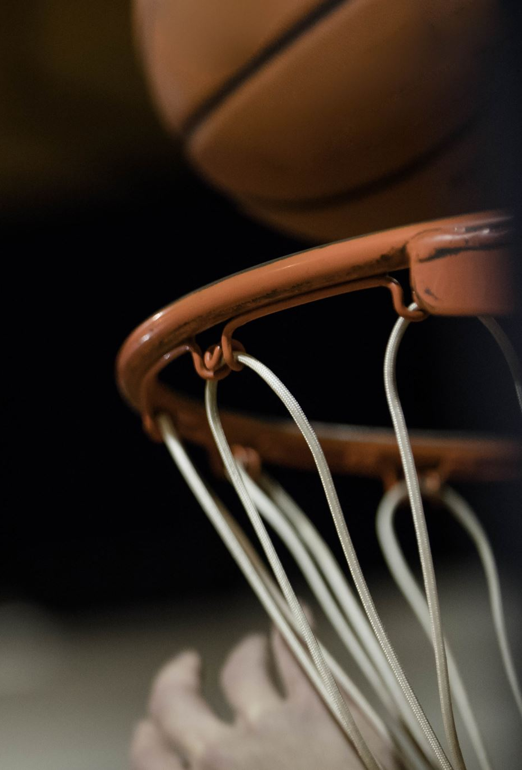
Research Question
How can we identify different patterns in IMU data of wheelchair basketball players and use these patterns in order to classify specific wheelchair basketball movements

Slide 3
Two Teams
Understand Raw Data
Martijn Kok
Sjoerd Rietveld
Daan Gielen
Discover Small Sprints
Collin van Adrichem
Jake van der Valk
Alejandro Oliver
Tasks
Research pattern recognition methods
Plot the data
Notes:
We know we have to focus on unsupervised learning techniques, due to the dataset being unlabeled

Slide 4
Understand Raw Data
Tasks
Look into the raw data
Find patterns for multiple actions (fast defence, fast Breaking, sprinting and game stops)
Problems
Research pattern recognition methods
Plot the data
Tasks
Research pattern recognition methods
Plot the data
Notes:
We know we have to focus on unsupervised learning techniques, due to the dataset being unlabeled

Slide 5
Discover Small Sprints
Tasks
Research pattern recognition methods
Plot the data
Problems
Problems in the dataset didn´t let us focus on the pattern recognition methods
Tasks
Research pattern recognition methods
Plot the data
Notes:
We know we have to focus on unsupervised learning techniques, due to the dataset being unlabeled

Slide 6
Future Actions
Understand
Completely understand the data
Classify
Completely classify the Data
Find
Find technique which bests adapt to our problem

