Slide 1
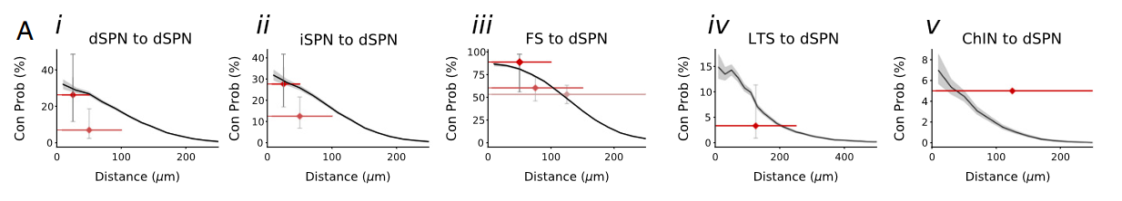
50-μm distance (A, i–iii) in ref. 81
I couldn’t find FS
?
8/9 (88,9 %)
5/19 (26,3 %)
13/27 (27,7 %)
48/90 (53,3 %)
2/60 (3,3 %)
3/43 (7 %)
10/80 (12,5 %)
Actually only to MSNs
250-μm distance (A, v) in ref. 80
100-μm distance (A, i–iii) in ref. 43
250-μm distance (A, iii and iv) in ref. 112
„pairs within 50-μm distance (A, i–iii) in ref. 81, 100-μm distance (A, i–iii) in ref. 43, 250-μm distance (A, iii and iv) in ref. 112, and 250-μm distance (A, v) in ref. 80.“

Slide 2
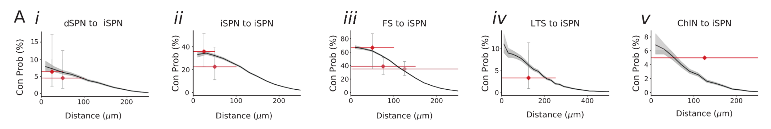
50 μm distance (Ai,ii,iii) in Taverna et al. (30)
?
14/39 (35,9 %)
6/9 (66,7 %)
3/47 (6,4 %)
7/31 (22,6 %)
22/77 (35,1 %)
2/60 (3,3 %)
3/66 (4,5 %)
Actually only to MSNs
100 μm distance (Ai,ii,iii) in Planert et al. (20)
250 μm distance (Aiii,iv) in Gittis et al. (45)
250 μm distance (Av) in Janickova et al. (46)
„Experimental measurements were made for neuron pairs within 50 μm distance (Ai,ii,iii) in Taverna et al. (30), 100 μm distance (Ai,ii,iii) in Planert et al. (20) 250 μm distance (Aiii,iv) in Gittis et al. (45) and 250 μm distance (Av) in Janickova et al. (46)“

Slide 3
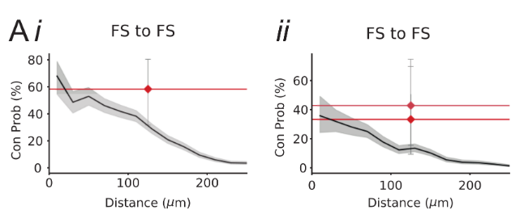
7/12 (58,3 %)
3/7 (42,9 %)
2/6 (33,3 %)
synapses (45)
gap junctions (47, 48)
„experimental data for i) synapses (45) and for ii) gap junctions (47, 48)“

